Slide 1
Anti-infective Activity of Selected Trifluoromethyl-substituted N-Arylcinnamamides
Hana Michnova^{1*}, Tomas Strharsky¹, Sarka Pospisilova¹, Jiri Kos¹, Alois Cizek², Josef Jampilek¹
¹ Regional Centre of Advanced Technologies and Materials, Faculty of Science, Palacky University, Slechtitelu 27, 78371 Olomouc, Czech Republic
² Department of Infectious Diseases and Microbiology, Faculty of Veterinary Medicine, University of Veterinary and Pharmaceutical Sciences, Palackeho 1946/1, 61242 Brno, Czech Republic
* Corresponding author: michnova.hana@gmail.com

Slide 2
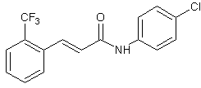
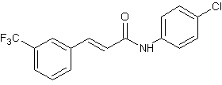
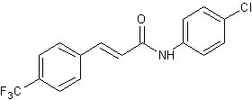
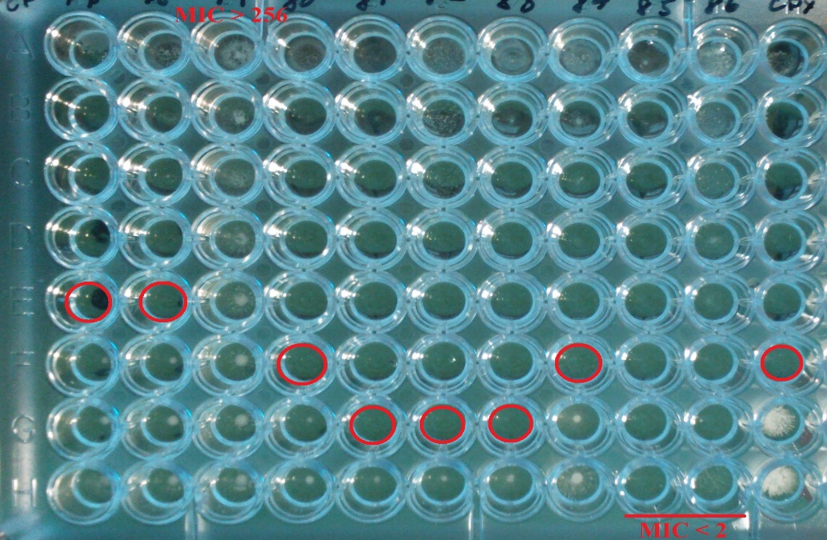
Anti-infective Activity of Selected Trifluoromethyl-substituted N-Arylcinnamamides
Graphical Abstract
Compound 2
Compound 1
Compound 3

Slide 3
Abstract:
The adaptation of microorganisms to antibiotics is common in all strains. This development of antibiotic resistance is significantly accelerated by the excessive use of antibiotics. One way to fight this severe problem is the research and development of new potentially antimicrobial agents.
Three series of newly synthesized trifluoromethyl-substituted N-arylcinnamamides were tested for their anti-infective activity. These series differ in the position of the trifluoromethyl substituent on the phenyl core of the cinnamic acid. All compounds were tested against Staphylococcus aureus and its methicillin-resistant forms, Enterococcus faecalis, and Mycobacterium smegmatis. The activity was determined by the microdilution method for the assessment of minimum inhibitory concentration. For this contribution, one chlorine-substituted compound at position 4 of the anilide ring from each group was selected for activity comparison. The influence of the position of trifluoromethyl is discussed.
Keywords: anti-infective activity; N-arylcinnamamides; Staphylococcus aureus; MRSA; Enterococcus faecalis; Mycobacterium smegmatis

Slide 4
Introduction
Cinnamic acids derivatives are frequently investigated and developed due to their broad spectrum of biological activity.
Three new series of trifluoromethyl-substituted N-arylcinnamamides with different positions of the trifluoromethyl substituent on the phenyl core of cinnamic acid were prepared.
The anti-infective activity of these structures was tested against reference strain Staphylococcus aureus ATCC 29213, three MRSA isolates, reference strain Enterococcus faecalis ATCC 29212 and fast growing strain of mycobacteria Mycobacterium smegmatis ATCC 700084.
Antimicrobial effect was assessed by determination of minimum inhibitory concentrations (MICs).
Microdilution method on a microtiter plate was used for simultaneous testing of multiple substances in multiple concentrations. Ciprofloxacin was used as the reference antibiotic.
MIC was determined visually as the lowest concentration with no visible bacterial growth.

Slide 5
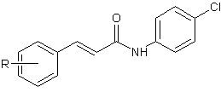
Results
Table 1: Minimum inhibitory concentration (MIC) in µg/mL and µM; S. aureus – Staphylococcus aureus, MW – molecular weight, CIP - ciprofloxacin
Comp. | MW | R | S. aureus ATCC 29213 |  | MRSA 63718 |  | MRSA SA 630 |  | MRSA SA 3202
 |  |  | MIC
 |  |  | µg/mL | µM | µg/mL | µM | µg/mL | µM | µg/mL | µM
1 | 325.71 | 2-CF₃ | 256 | 786 | 256 | 786 | 256 | 786 | 256 | 786
2 | 325.71 | 3-CF₃ | 8 | 24.6 | 4 | 12.3 | 2 | 6.1 | >256 | >786
3 | 325.71 | 4-CF₃ | >256 | >786 | >256 | >786 | >256 | >786 | > 56 | >786
CIP | 331.35 | – | 0.25 | 0.75 | 8 | 24 | 128 | 386 | 16 | 48

Slide 6
Results
Table 2: Minimum inhibitory concentration (MIC) in µg/mL and µM; S. aureus – Staphylococcus aureus ATCC 29213, E. faecalis – Enterococcus faecalis ATCC 29212, M. smegmatis – Mycobacterium smegmatis ATCC 700084, MW – molecular weight, CIP - ciprofloxacin
Comp. | MW | R | E. faecalis |  | M. smegmatis
 |  |  | MIC
 |  |  | µg/mL | µM | µg/mL | µM
1 | 325.71 | 2-CF₃ | 256 | 786 | 64 | 197
2 | 325.71 | 3-CF₃ | > 256 | > 786 | 8 | 24.6
3 | 325.71 | 4-CF₃ | > 256 | > 786 | > 256 | > 786
CIP | 331.35 | – | 0.5 | 1.5 | 0.125 | 0.38

Slide 7
Discussion
(2E)-N-(4-Chlorophenyl)-3-[3-(trifluoromethyl)phenyl]prop-2-enamide (2) showed the highest activity against S. aureus and MRSA isolates. Only isolate MRSA SA 3202 was not sensitive to any structure. In this case, the meta-position carries the antistaphylococcal effect. The changes to the ortho-position and para-position lead to a significant reduction or total loss of activity.
None of the tested structures was active against E. faecalis.
In the case of antimycobacterial activity, the relationship between the activity and the position of substitution is very similar to that of staphylococci. Compound 2 with the trifluoromethyl moiety on the phenyl core of the cinnamic acid in meta-position demonstrated the highest activity against M. smegmatis. The change to the ortho-position leads to a decrease of activity, and the change to the para-position causes total loss.

Slide 8
Conclusions
Trifluoromethyl-substituted N-arylcinnamamides bring interesting anti-infective activity, especially against S. aureus, including MRSA, and M. smegmatis.
(2E)-N-(4-Chlorophenyl)-3-[3-(trifluoromethyl)phenyl]prop-2-enamide was the most active compound.
When comparing the position of the trifluoromethyl substituent on the phenyl core of the cinnamic acid, the antistaphylococcal and antimycobacterial activities increase in the order: para < ortho < meta.

Slide 9
Acknowledgments
This study was supported by Palacky University Olomouc (IGA_PrF_2020_023).

