Slide 1
In vitro evaluation and in vivo efficacy of nitroimidazole-sulfanyl ethyl derivatives against Leismania (V.) braziliensis and Leishmania (L.) mexicana
Miguel A. Rodríguez¹, Zuleima Blanco¹, Henry Oviedo², Noris M. Rodríguez^{2*} and Jaime E. Charris^{1*}
¹ Organic Synthesis Laboratory, Faculty of Pharmacy, Central University of Venezuela, 47206, Los Chaguaramos 1041-A, Caracas, Venezuel; ² Institute of Biomedicine, Faculty of Medicine, Central University of Venezuela, 4043, Caracas 1010-A, Venezuela.
*Corresponding author.: jaime.charris@ucv.ve. nmrodric@gmail.com

Slide 2
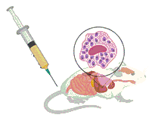
In vitro evaluation and in vivo efficacy of nitroimidazole-sulfanyl ethyl derivatives against Leismania (V.) braziliensis and Leishmania (L.) mexicana
Graphical Abstract
Mice infected with
Leishmania species:
Reduced toxicity
Less size of lesions
Longer survival time
Metronidazole:
Drug Repositioning
Optimization against Leishmania spp.
L. (V) braziliensis DL50 21 ug/mL
L. (L) mexicana DL50 18 ug/mL

Slide 3
Abstract:
The aim of this study was the synthesis of several small molecules of the type nitroimidazole-sulfanyl, and the evaluation of the biological properties against the main species that cause cutaneus leishmaniasis in Venezuela. Final compounds (4-7) were generated through simple nucleophilic substitution of 1-(2- chloroethyl)-2-methyl-5-nitroimidazole 3 with 2-mercaptoethanol, 1-methyl-2-mercaptoethanol and 2-thiolacetic acid derivative. Compound 8 was synthesized via a coupling reaction between 7 and an amino acid. The inhibitory concentrations (IC₅₀) of (1-8) against Leismania (V.) braziliensis and (L.) mexicana in promastigotes and macrophages were determined by in vitro activity assays. For the in vivo evaluation of the more active compounds 7 and 8. Balb/c mice were infected with promastigotes of the two species and divided into four groups of ten (10) animals, and a control group. Two ways were used to the treatment intramuscular and intralesional. The parasitological diagnosis was determinate by PCR. Considering the defined parameters, compounds 7 and 8 showed in vitro and in vivo activity against L. (V.) braziliensis and L. (L.) mexicana. These compounds may represent an alternative treatment for this two species, which are the most important, from the epidemiological point of view, to produce cutaneous leishmaniasis in Venezuela.
Keywords: L. braziliensis; L. mexicana; nitroimidazole; synthesis

Slide 4
Introduction
Leishmaniasis is a neglected tropical disease (NTD) caused by protozoa of the genus Leishmania.
The disease is endemic in 98 countries with an overall prevalence of 12 million cases and an annual mortality rate of more 59.000 deaths.
Over 20 Leishmania species known to be infective to humans are transmitted by the bite of infected female phlebotomine sandflies.
Three main types of leishmaniasis: visceral (VL), cutaneous (CL), and mucocutaneous (MCL).
It is estimated that approximately 0.7 to 1.2 million of new CL cases occur each year. ¹

Slide 5
Introduction
The recommended first-line therapies: include pentavalent antimony compounds, such as sodium stibogluconate® and meglutamine antimoniate®. Disadvantages, such as toxicity, high costs.²⁻⁴
Sodium
Stibogluconate
Meglutamine
Antimoniate

Slide 6
Introduction
The second-line treatments include pentamidine and amphotericin B, but their use is limited because of toxicity and cost.²⁻⁴
Pentamidine
Amphotericin B

Slide 7
Introduction
Recently, the oral administration of miltefosine has been used for the treatment of VL in some countries, but despite its great efficacy, miltefosine is not free either from toxicity as it shows teratogenic potential.²⁻⁴
Miltefosine

Slide 8
Introduction
Several compounds that show leishmanicidal activity are currently in different stages of development. Among them, a few classes of compounds, such as the sitamaquine,⁵ the imiquimod,⁶ the posaconazole,⁷ as well as some natural product derivatives, such as licochalcone A.⁸

Slide 9
Introduction
In addition, the drawbacks associated with the currently available treatments have led to the development of new strategies aiming at leishmaniasis control. In this context, special attention has been given nitroheteroaromatic scaffolds. In particular, nitrocontaining imidazol like, metronidazole or fexnidazole and its sulfonic metabolite now in clinical trial were shown to have effective antileishmanial efficacy.^{9,10}

Slide 10
Introduction
The catecholic and pyrogallolic benzoate derivatives 9a and 9b were synthesized by our group, the biological results revealed that these two compounds constitute promising candidates in the search for improved therapies against L. (V.) braziliensis and L. (L.) mexicana.¹¹

Slide 11
Results and discussion. Chemistry
Conditions: a) SOCl2 (5Eq), CH2Cl2, rt, 6h; b) H2O, Et3N until pH 8.5, rt; c) 2-mercapto-1-propanol (1.2Eq), K2CO3 (3Eq), ACN, reflux, 6h; d) 2-mercaptoethanol (1.2Eq), K2CO3 (3Eq), ACN, reflux, 6h.

Slide 12
Results and discussion
Chemistry
Conditions:; e) methyl thioglycolate (1.2Eq), K2CO3 (3Eq), ACN, reflux, 4h; f) LiOH (1Eq), THF:MeOH:H2O (3:3:1), 0°C, 30 min; g) (S)-Methyl 2-amino-4-methylpentanoate hydrochloride (1.2Eq), EDC (1.2Eq), DMAP (0.2Eq), DCM, 0°C, 12h.

Slide 13
Results and discussion. Biological
The synthesized compounds were evaluated for their antileishmanial activity against in vitro forms of L. (V.) braziliensis and L. (L.) mexicana (promastigotes) strains. In order to calculate the LC₅₀ two reported methods were used.¹¹
Female Balb/c mice inoculated in the foot pad with promastigotes of L.(L.)mexicana or L.(V.)braziliensis were treated with compound 7 and 8.¹²
The evolution of the lesion size in animals infected after of the treatment was determined as a function of time.
The PCR methodology was used for parasitologic diagnosis.
Female Balb/c mice, weigth 18-22 g, were maintained on a commercial pellet diet at libitum and under conditions approved by Ethics Committee of the Institute of Biomedicine, Faculty of Medicine, Central University of Venezuela. Glucantime was used as control.

Slide 14
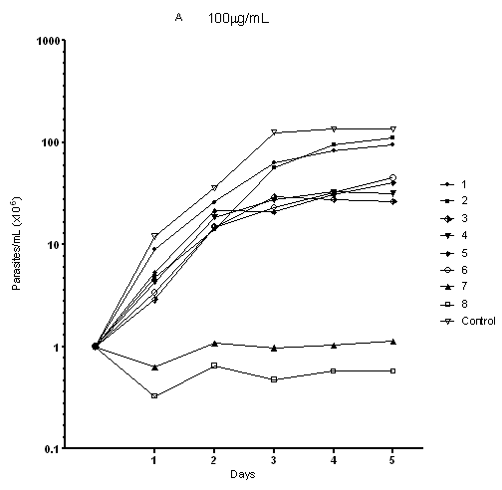
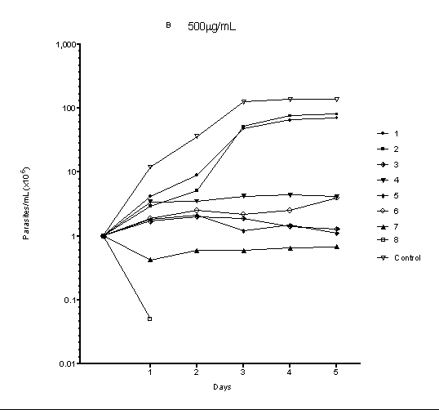
Results and discussion. Biological
Fig 1.- Promastigotes of L.(L.)mexicana treated whit compounds 3,4,7,and 8. A (100µg/mL) B (500µg/mL). Parasites were counted every day during 5 days.

Slide 15
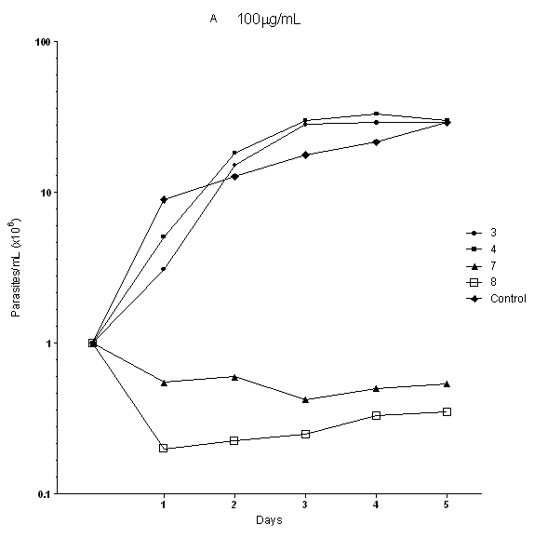
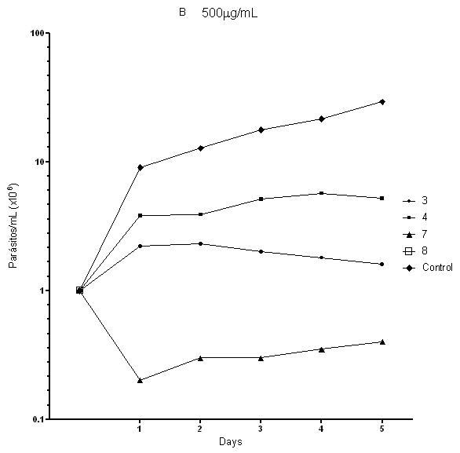
Results and discussion. Biological
Fig 2.- Promastigotes of L.(V.)braziliensis treated whit compounds 3,4,7,and 8. A (100µg/mL) B (500µg/mL). Parasites were counted every day during 5 days.

Slide 16
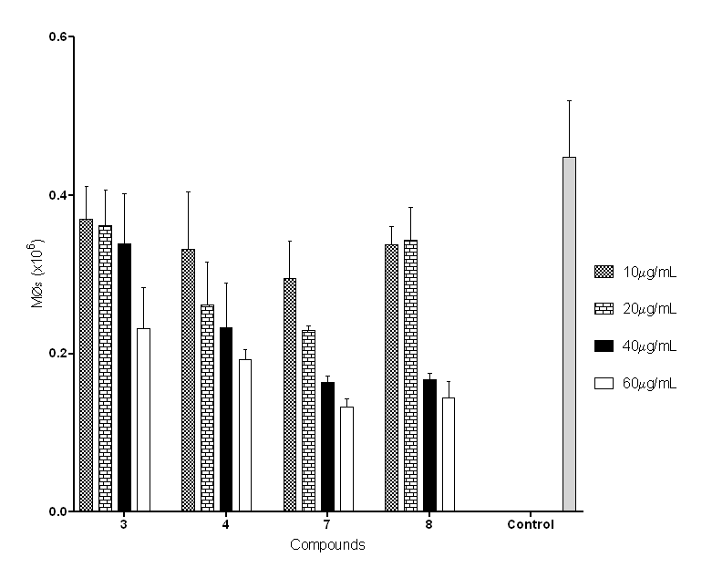
Results and discussion. Biological
Fig 3.- Macrophages J774-G8 treated with differents concentrations of compounds 3,4,7 and 8.

Slide 17
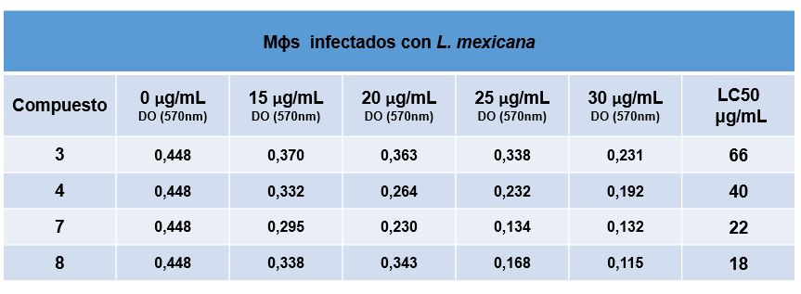
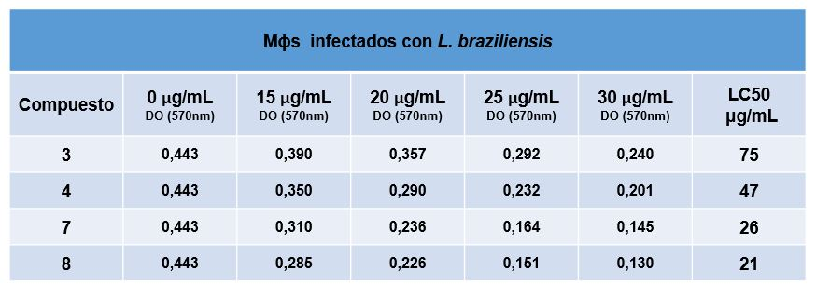
Results and discussion. Biological
MØs infected L.(L.)mexicana
A
MØs infected L.(V.)braziliensis
B
Fig 4.- Macrophages infected with L.(L.)mexicana (A) and L.(V.)braziliensis (B) and treated with differents concentrations of the compounds. LD₅₀ was calculated.

Slide 18
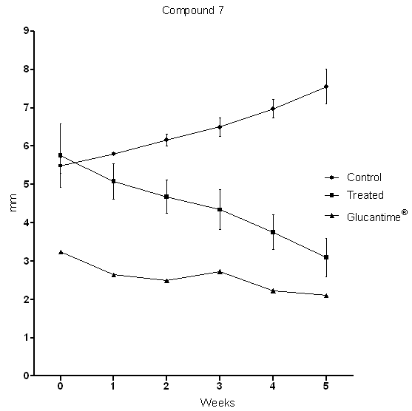
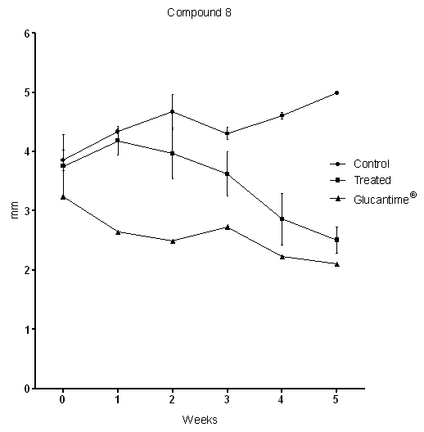
Results and discussion. Biological
A
B
Fig 5.- Balb/c mice inoculated in the foot pad iwith promastigotes of L.(L.)mexicana and treated with compound 7 (Fig. A) and 8 (Fig. B). Size of the lesion was measured every week during five weeks.

Slide 19
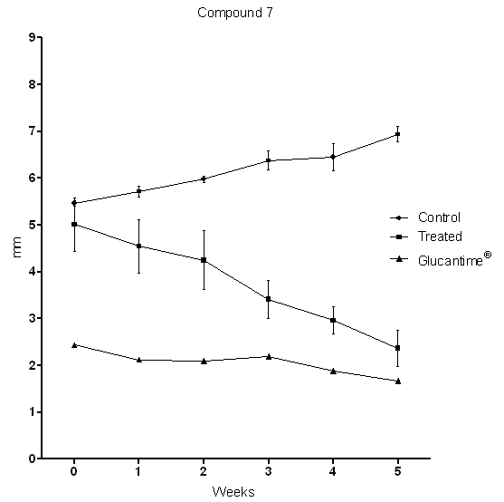
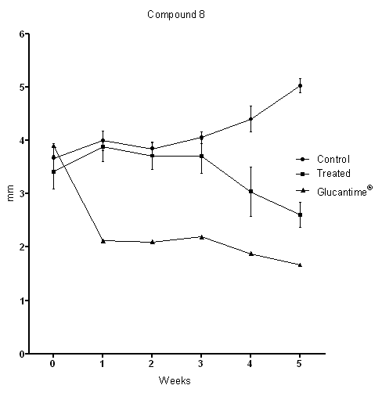
Results and discussion
A
B
Fig 6.- Balb/c mice inoculated in the foot pad with promastigotes of L.(V.)braziliensis and treated with compound 7 (Fig. A) and 8 (Fig. B). Size of the lesion was measured every week during five weeks.

Slide 20
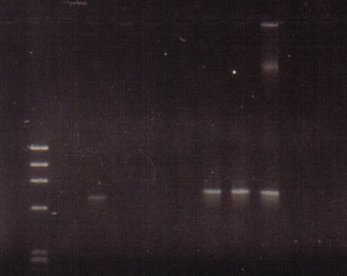
Results and discussion
M 1 2 3 4 5 6 7 8 9 10
Fig 7.- Pasitological diagnosis using PCR and samples obteined from the food pad of the treated mice. Lanes 2,7,and 8 resulted positives for L.(V.) braziliensis and 1,3,4,5 and 6 were negatives with no parasites. Lane 9.- positive control; lane 10 negative control.. M.- Molecular weight marker.

Slide 21
Conclusions
New metronidazole derivatives endowed with a sulfanyl dridge were designed, synthesized and screened for their activities against the main species that cause cutaneus leishmaniasis in Venezuela.
The biological results revealed that these two compounds 7 and 8, showed better activity than metronidazole and the activity was substituent dependent.
These findings provide us lead and encourage us to continue the efforts towards the optimization of the efficacy profile of this structural moiety for treatment of cutaneus leishmaniasis.
The combination of these two compounds with other leishmanicidal drugs may lead to dose reduction and an enhancement in their efficacy.

Slide 22
Acknowledgments
We thank the Instituto de Investigaciones Farmacéuticas (IIF), Instituto de Biomedicina and Consejo de Desarrollo Científico y Humanístico de la Universidad Central de Venezuela (CDCH-UCV) (grants IIF.01-2014, PG. 09-8819-2013/2) for financial support.

Slide 23
References
https://www.who.int/en/news-room/factsheets/detail/leishmaniasis. (2019 Accessed 07-15-2020).
K. Singh, G. Garg, V. Ali, Curr. Drug Metab. 2016, 17, 897.
J. Sangshetti, F. Kalam, A. Kulkarni, A. Rohidas, R. Patilc, RSC Adv., 2015, 5, 32376.
R. Dietze, S. Carvalho, L. Valli, J. Berman, T. Brewer, W. Milhous, J. Sanchez, B. Schuster, M. Grogl, Am. J. Trop. Med. Hyg. 2001, 65, 685.
L. Zhai, M. Chen, J. Blom, T. Theander, S. Christensen, A. Kharazmi, J. Antimicrob. Chemother. 1999, 43, 793.
T. Stefanello, M. Panice, T. Ueda-Nakamura, M. Sarragiotto, R. Auzély-Velty, C. Nakamura, Antimicrob. Agents Chemother. 2014, 58, 7112.
I. Singh, S. Jain, A. Kaur, S. Singh, R. Kumar, P. Garg, S. Sharma, S. Arora, Eur. J. Med. Chem. 2010, 45, 3439.
A. Tiwari, S. Kumar, R. Shivahare, P. Kant, S. Gupta, S. Suryawanshi, Bioorg. Med. Chem. Lett. 2015, 25, 410.
V. Somaratne, R. Ranawaka, H. Jayaruwan, D. Wipuladasa, S. de Silva, J. Dermatol. Treat. 2019, 30, 87.
E. de Morais-Texaira, A. Rabello, M. Gontijo, J. Antimicrob Chemoth. 2019, 74, 2318.
M. Rodríguez, J. Gutiérrez, J. Domínguez, P. Peixoto, A. Fernández, N. Rodríguez, D. Deffieux, L. Rojas, S. Quideau, L. Pouységu, J. Charris, Arch. Pharm. Chem. Life Sci. 2020, 353, e2000002.
S. Brito, O. Crescente, A. Fernandez, A. Coronado, N. Rodríguez, Biomedica 2006, 26, 180.

