Slide 1
SPECTRAL STUDIES OF THE COMPLEX OF ADENOSINE AND AMP WITH ALCOHOL SUGARS
Yevhenii Stepanenko¹*, Roman Nikolaev¹, Zenovii Tkachuk¹
¹ Institute of Molecular Biology and Genetics of NASU, 150, Ac. Zabolotnogo St., Kyiv, Ukraine, 03680;
* Corresponding author: stepanenkojack@gmail.com

Slide 2
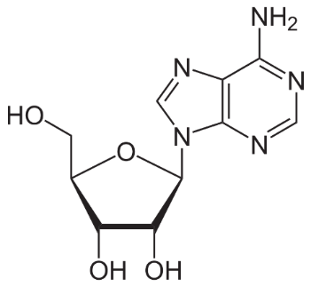
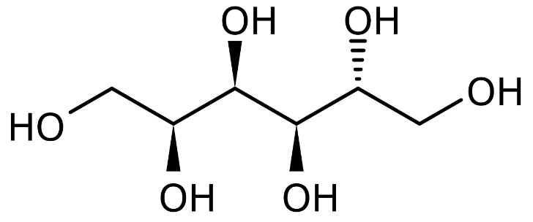
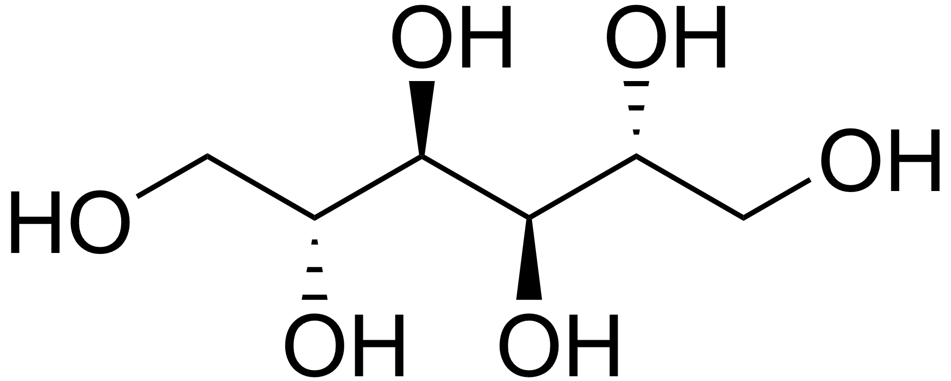
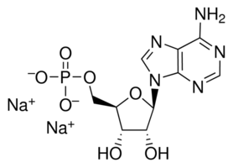
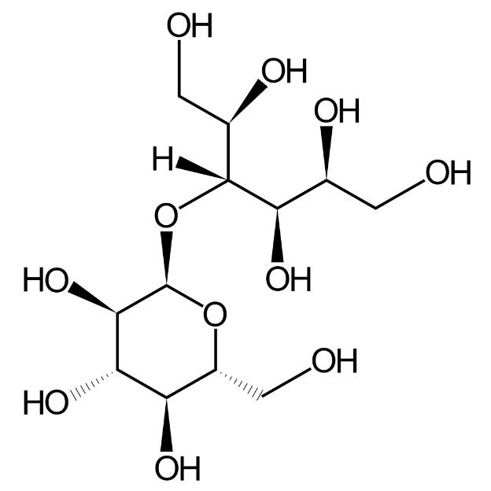
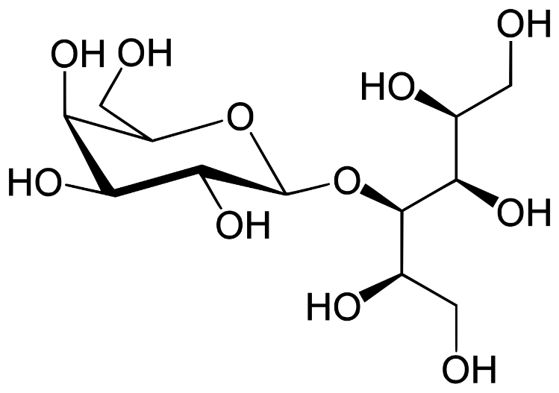
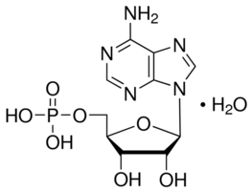
Structure of the studied molecules
Components of ORN
Alcohol sugars
Adenosine
D-Mannit
Sorbitol
Adenosine 5′-monophosphate disodium salt (AMPNa)
Lactitol
Maltitol
Adenosine 5′-monophosphate monohydrate (AMP)
2

Slide 3
Abstract:
Our previous studies have shown the possibility of the formation of complexes of oligoribonucleotides (ORNs) with alcoholic sugar (D-mannitol (D-M)).
A mixture of the acid form of ORNs and D-mannitol in a weight ratio of 3 to 1 has antiviral activity. ORNs consists of sequences of ribonucleotides of monophosphates. Therefore, we decided to investigate whether ORNs components form complexes with D-M. Adenosine is the major contributor to the ORNs emission spectra. Consequently, we have started studies on adenosine.
In the course of our work, the spectral characteristics of aqueous solutions of the sodium salt of adenosine, AMP and the sodium salt of AMP and their mixtures with alcohol sugars (D-Mannitol, Sorbitol, Maltitol, and Lactitol) studied. We have measured absorption, fluorescence, and excitation spectra of room temperature.
Keywords: oligoribonucleotides; alcohol sugar; antiviral activity; spectral studies
3

Slide 4
Introduction
We previously investigated the antiviral activity of binary ORN-sugar mixtures.
It is known that ORN and D-mannitol alone do not show antiviral activity by inhibiting the neuraminidase activity of influenza virus. However, a mixture of the acid form of ORNs and D-mannitol in a weight ratio of 1 to 1 showed low antiviral activity, as shown in table 1. Slightly higher antiviral activity detected for the same mixture in a ratio of 1 to 2. The explicit antiviral activity offers a mix of ORN and D-mannitol in a weight ratio of 3 to 1. Moreover, the salt form of ORNs and D-mannitol in a weight ratio of 3 to 1 has immunomodulatory and has no antiviral activity. Replacement of D-mannitol by its sorbitol analogue in the ORNs-sugar mixture does not lead to antiviral activity.
Replacement of D-mannitol with its sorbitol analogue in the ORN-sugar
the mixture does not lead to antiviral activity. Therefore, we suggest that the peculiarities of the properties of D-mannitol could associate with the appearance of the mentioned antiviral effect only in the mix of the acid form of ORN + D-mannitol. A mixture of yeast ORN and Lactose shows immunomodulatory but has no antiviral activity.
We hypothesize that the sugars, their interactions with yeast ORN, and/or effects on it or its components may relate differences in biological activity.

Slide 5
EEM Spectra of aqueous solutions at room temperature
We added D-M to adenosine in a mass ratio adenosine/alcohol sugars = 75/25 % (≈ 9,76E-06/1.43E-05 M/ml)
Based EEM scale and intensity of color we can see an increase in the intensity of radiation in the same regions of fluorescence values at close to 1,000 CPS
A change in the fluorescence intensity indicates a redistribution of energy within the molecule.
5

Slide 6
Fluorescent components of EEM Spectra of Adenosine and Adenosine + D-M
Here we can distinguish two centers of fluorescence (λ_{EM}290nm and λ_{EM}340nm) and estimate the difference between them
A change in the shape of the fluorescence peak may indicate a change in the structure or formation of a complex.
6

Slide 7
Fluorescent Spectra Adenosine and Adenosine + D-M
The addition of D-M did not displace all the centers of fluorescence as a whole. Therefore, these changes are not associated with a change in solvent.
The effect on one fluorescence center indicates a change in the conformation of the molecule.
A change in the fluorescence intensity indicates a redistribution of energy within the molecule.
A change in the shape of the fluorescence peak may indicate a change in the structure or formation of a complex.
Δλ_{max}(λ_{EM}415nm)=+1,55 nm
Δ λ_{max}(λ_{EX}290nm)=-6,44nm
Δ λ_{max}(λ_{EX}340nm)= 0 nm
ΔAreaλ_{EM}415nm=+20,25%
ΔAreaλ_{EX}290nm=+17,49%
ΔAreaλ_{EX}340nm=+21,29%
7

Slide 8
Energy level diagram of Adenosine and Adenosine + D-M
Since the absorption and excitation spectra do not coincide, we selected the positions of the S₁ level from the absorption peak. Here we have only absorption.
We obtained the virtual level S*_{1,2} from the intersection of the excitation and emission spectra. This center is absent in the absorption spectra. But spectrally this level is.
Since there is an overlap of the absorption and excitation spectrum zones, we can show the presence of a no radiative transition from the S₁ level to the S*₁ level, and S*₂ to the S*₁.
When D-M is added to adenosine, we have a small decrease in energy, which may indicate a modification of the molecule into a structure with less energy. The distances between the levels within the structure have changed, so there is a change in the conformation of the molecule and its internal redistribution of energy.
8

Slide 9
Fluorescent Spectra of aqueous solutions Adenosine and Adenosine + Alcohol sugars
The spectral changes of different alcoholic sugars have a common appearance (shift of the maximum position and the shape of the emission peak).
But the increase or decrease in intensity is different for everyone.
9

Slide 10
Fluorescent Spectra of aqueous solutions of Adenosine and Adenosine + Alcohol sugars
The same alcohol sugar may increase emissions at one emission center and decrease at another (sorbitol) or not affect one of the centers at all (lactitol).
We hypothesize that different spectral effects of alcohol sugars on adenosine may have different biological activity, such as ORN.
10

Slide 11
EEM Spectra, and Fluorescent components of different forms of AMP before and after the addition of D-M
This slide compares the spectra of the same amount of acid and salt AMP before and after the addition of DM.
As can be seen, the two forms of AMP differ spectrally in intensity, but they have common centers of fluorescence.
Sugar has different effects on two forms of AMP.
11

Slide 12
Fluorescent components of EEM Spectra of aqueous solutions
From the absorption spectra, we can see that the two forms of AMP were taken in equal amounts.
But in terms of emission intensity relative to the Raman water scattering, the acid form of AMP has an 86.66% larger area under the curve, relative to the salt form of AMP.
This suggests that these two forms of the same substance have different physical properties and possibly biological.
12

Slide 13
Emission spectra of aqueous solutions at room temperature
Here are the fluorescence spectra of two centers of emission of acid and salt forms of AMP obtained on two different spectrofluorimeter (FluoroMax+ Spectrofluorometer by HORIBA Scientific, and FP-8200 Fluorescence Spectrometer by JASCO)
As we can see, these spectra are almost the same, the differences may be related to the operation of the devices themselves. This means that our results are reproduced independently of each other. And this means that the two forms of AMP still have different quantum yields.
13

Slide 14
Emission spectra of aqueous solutions at room temperature
mass ratio AMP/D-M = 75/25 % (≈ 7,51E-06/1.43E-05 M/ml)
This slide shows the spectral changes in the two forms of AMP with the addition of DM.
The increase in the emission intensity of the area under the curve is shown in the figures.
There is also a modification of the spectrum after the addition of alcohol sugar, which indicates the formation of a complex in both forms.
14

Slide 15
Emission spectra of aqueous solutions at room temperature
You can see the modification of the spectrum after the addition of alcohol sugar, which indicates the formation of a complex in both forms. But quantitatively we have different influences.
These results correlate with adenosine, so sugar affects the same areas of the molecule.
15

Slide 16
Fluorescent components of EEM Spectra of aqueous solutions
As the concentration of the acid form of AMP increases while maintaining the mass ratio AMP/Alcohol sugar = 75/25 % , the effect of alcohol sugars increases, and a new center of fluorescence is manifested.
The high concentration of acidic AMP correlates better with the results obtained for ORN.
16

Slide 17
Fluorescent Spectra of aqueous solutions AMP and AMP + D-M
The effect on one fluorescence center indicates a change in the conformation of the molecule.
A change in the fluorescence intensity indicates a redistribution of energy within the molecule.
A change in the shape of the fluorescence peak may indicate a change in the structure or formation of a complex.
Δλ_{max}(λ_{EX}350nm)=0 nm
Δλ_{max}(λ_{EX}420nm)=-4,43 nm
Δ λ_{max}(λ_{EM}290nm)=--28,13 nm
Δ λ_{max}(λ_{EM}345nm)=--15,63 nm
Δ λ_{max}(λ_{EM}445nm)= 0 nm
ΔAreaλ_{EX}350nm=+40,46%
ΔAreaλ_{EX}420nm=+75,94%
ΔAreaλ_{EM}290nm=+65,97%
ΔAreaλ_{EM}345nm=+74,96%
ΔAreaλ_{EM}445nm=+79,12%
17

Slide 18
Energy level diagram of AMP and AMP + D-M aqueous solutions at room temperature
When D-M is added to AMP, we have more pronounced changes in energy than in the case of adenosine. But the spectral changes in the case of AMP also have a more significant appearance than adenosine.
All these changes may indicate a change in conformation, modification of the molecule, or a complex.
Since the effect of D-M on AMP has similar effects as adenosine and, it may indicate that the sugar alcohol affects one and the same general part of the molecule.
18

Slide 19
Conclusions
• We have obtained the effect of alcohol sugars on the ORN component, so we can assume that the biophysical changes they cause derived from its ingredients.
• When alcohol sugar added, we have a change in energy, which may indicate a modification of the molecule into a structure, change in the conformation of the molecule, and its internal redistribution of power.
• Since the effect of D-M on AMP has similar products as adenosine and, it may indicate that the sugar alcohol affects the same general part of the molecule.
• Alcohol sugars have quantitatively different effects on the acid or salt form of the molecule.
• With increasing concentration of the substance, the effect of alcohol sugar rises significantly.
• The same alcohol sugar may increase emissions at one centre and decrease at another (Sorbitol), or not affect one of the centres at all (Lactitol).
• We assume that different spectral effects of alcohol sugars on adenosine can have various biological activities as the ORN.
19

