Slide 1
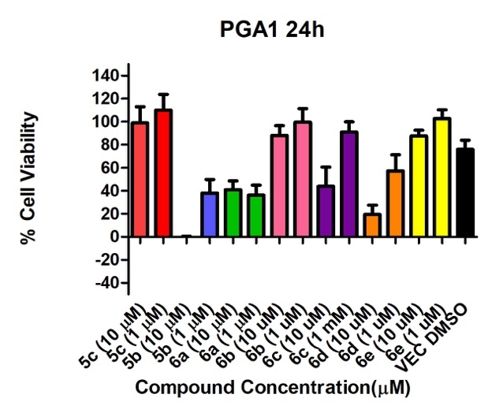
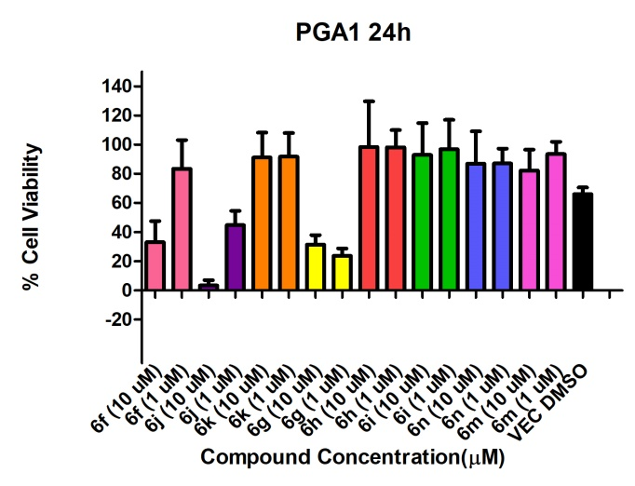
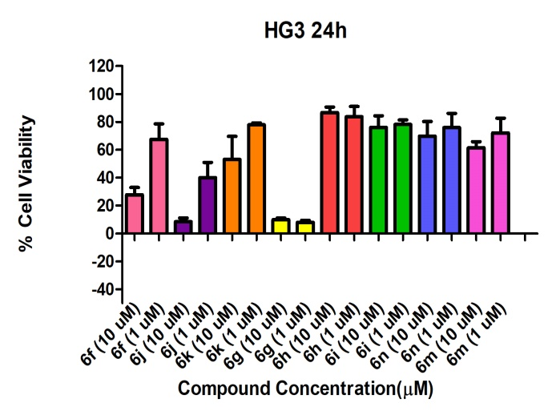
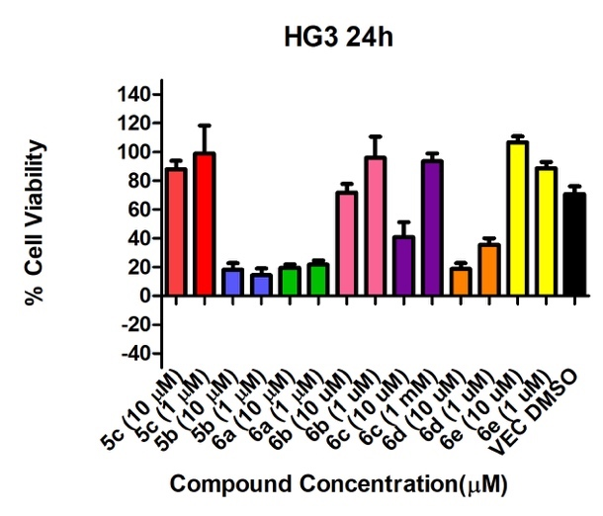
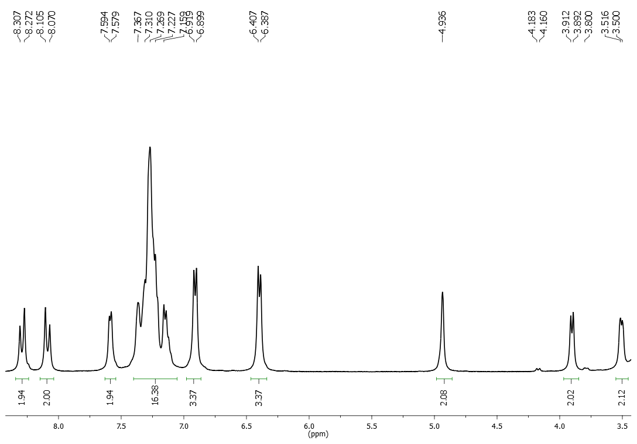
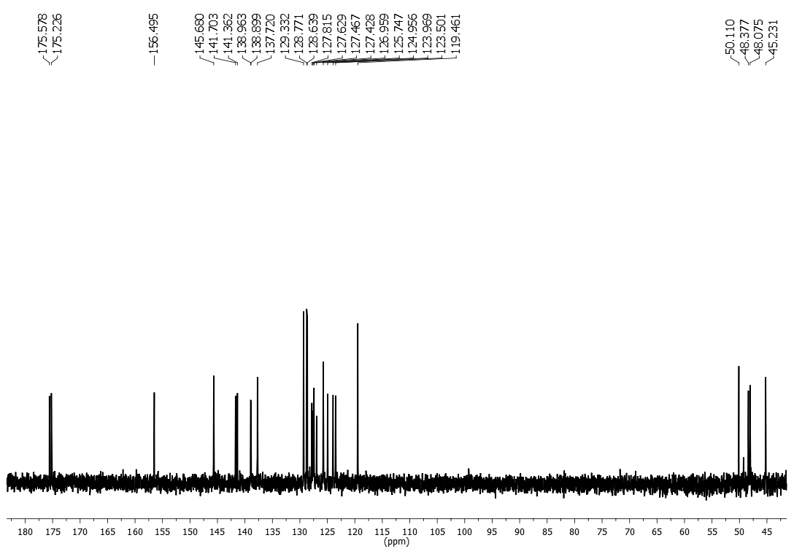
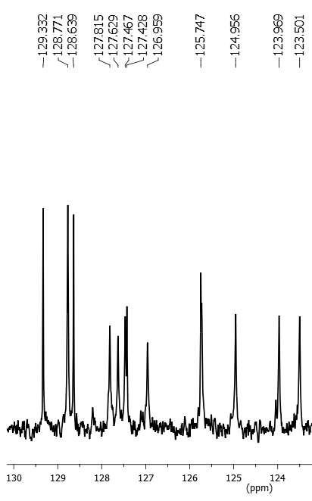
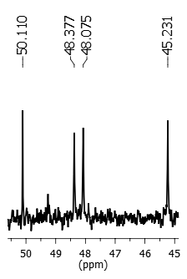
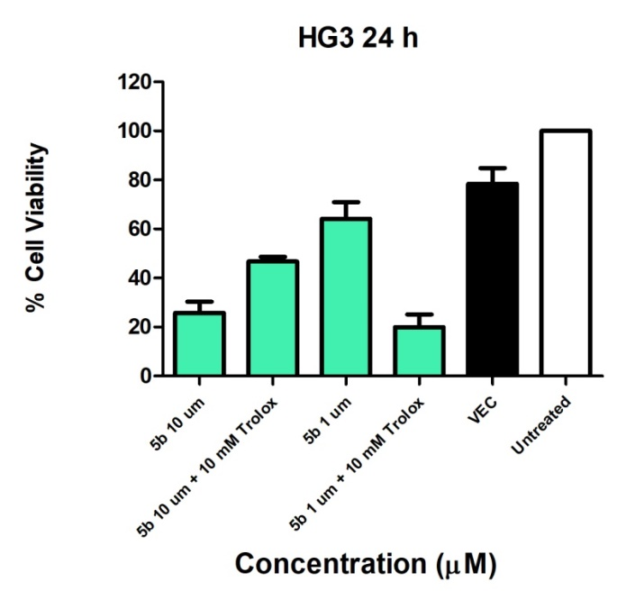
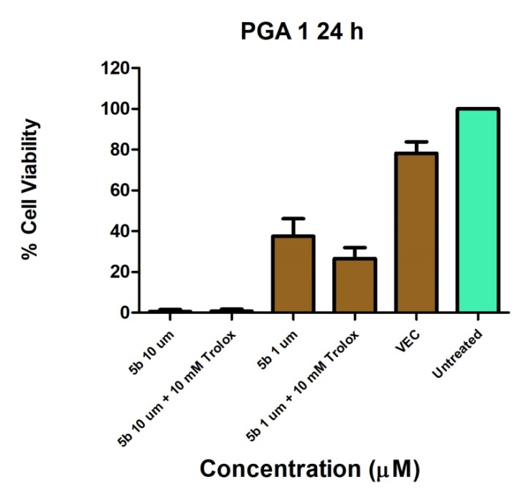
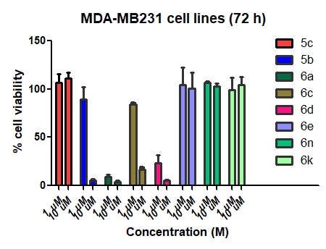
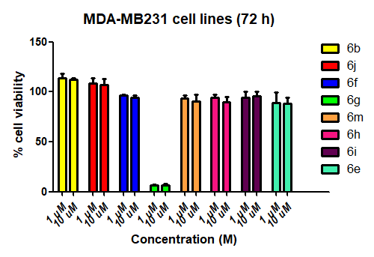
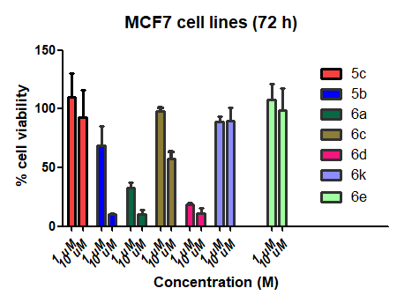
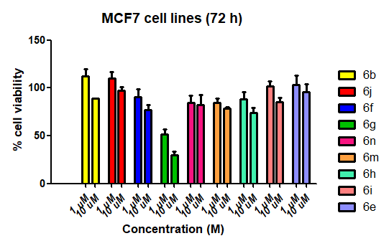
Synthesis and biological evaluation of new N-substituted 9-nitro-12,14-dioxo-9,10-dihydro-9,10-[3,4]epipyrroloanthracen-13-yl derivatives
Maria Vera^{1*}, James Mc Keown², Sara Noorani², Mary J. Meegan²
¹ Departamento de Química Orgánica, Facultad de Química, Universidad de Murcia, Campus de Espinardo, 30100 Murcia, España.
² School of Pharmacy and Pharmaceutical Sciences, Trinity College Dublin, Trinity Biomedical Sciences Institute (TBSI), 152-160 Pearse Street, Dublin 2, Ireland.
*maria.vera8@um.es
Cancer is a disease characterised by the uncontrolled growth and spread of abnormal cells, and it is the second leading cause of death globally. The vast majority of patients require chemotherapy in conjunction with surgery or radiological treatments in some steps of their treatment. CLL (Chronic Lymphocytic Leukaemia) is the most common leukaemia in developed countries globally, primarily affecting the elderly. CLL is classed as a clonal disorder of mature B-lymphocytes and its clinical patient prognoses being affected mainly by the mutational status of the Immunoglobulin G Heavy Chain Variable region (IGHV) (with mutated IGHV holding a better patient prognosis than the wild type variant). Our previous research has demonstrated antiproliferative activity for ethanoanthracene compounds in B-cell lymphomas. In this project we have developed a general procedure for the synthesis of N-substituted 9-nitro-12,14-dioxo-9,10-dihydro-9,10-[3,4]epipyrroloanthracen-13-yl derivatives to study their activity against chronic lymphocytic leukaemia cell lines (CLL) and breast cancer.
INTRODUCTION
SYNTHETIC ROUTE
A Diels-Alder reaction between 1 and the maleic anhydride afforded compounds 3 in good yield.
The synthesis of products 5 and 6 was carried out by reaction of compound 3 with different amines using acetic acid as solvent.
The structures of the products were confirmed by NMR, MS, IR spectroscopy
Yields were in the range 60-90%
Analytical purity of the products was confirmed by HPLC
PANEL OF COMPOUNDS SYNTHESISED
Code | X | R | Code | X | R
5a | -NO₂ |  | 6g | -NO₂
5b | -NO₂ |  | 6h | -CN
5c | -COCH₃ |  | 6i | -COCH₃
6a | -NO₂ |  | 6j | -NO₂ | -CH₂-CH₂-
6b | -CN |  | 6k | -CN | -CH₂-CH₂-
6c | -COCH₃ |  | 6l | -COCH₃ | -CH₂-CH₂-
6d | -NO₂ |  | 6m | -CN | -CH₂-(CH₂)₄-CH₂-
6e | -CN |  | 6n | -COCH₃ | -CH₂-(CH₂)₄-CH₂-
6f | -COCH₃
IN-VITRO ANTIPROLIFERATIVE ACTIVITY IN LEUKAEMIA CELL LINES
PGA1 cells
At 10 μM concentration compounds 5b, 6d, 6j and 6g are effective (less than 50% of cell viability) The compound 5b is the most active at this concentration, although at 1 μM compound 6g has the less cell viability (23.7 %).
HG3 cells
Compounds 5b, 6a, 6d, 6j and 6g show activity at 10 μM concentration with less than 20% viability. Among all compounds tested, the novel dimeric compound 6g (the dimer with the nitrovinyl moiety and the ether) is the most effective at 1 μM concentration with 7.9% cell viability.
NMR CHARACTERIZATION FOR 6g
TROLOX REACTIVE OXYGEN SPECIES TESTING IN PGA1 AND HG3 cells
STABILITY ASSAY BY HPLC FOR 5b
29b
Degradation product
a) ¹H-NMR spectrum of compound 6g (DMSO-d6, 400 MHz)
b) ¹³C-NMR spectrum of compound 6g (DMSO-d6, 100.61 MHz)
The stability of compound 5b was evaluated at different pH conditions that mimic stomach (pH 4), blood (pH7) and intestine (pH9) simulating in vivo assays. 5b is stable in acid conditions but not at pH >7
CONCLUSIONS
The effect of the active oxygen species in cell death induced by compound 5b shows that it is dependent on concentration. In both cell lines, the reduction in cell viability (44% in HG3 and 11% in PGA1) with concentration suggests that cell death is related to ROS flux at lower concentration (1 μM)
A new series of N-substituted 9-nitro-12,14-dioxo-9,10-dihydro-9,10-[3,4]epipyrroloanthracen-13-yl derivatives with maleimide N-substitution, were synthesised including novel dimers 6a-6n.
NMR, MS, IR spectroscopic identification of products
Compounds 5a-c, 6a-n have been subjected to biological evaluation.
Compound 6g is identified as the most potent and could be a good candidate for further apoptosis evaluation
IN-VITRO ANTIPROLIFERATIVE ACTIVITY IN BREAST CANCER CELL LINES
 | IC₅₀ Values (μM)
Compound | MCF-7 | MDA-MB-231
5b | 1.642 | 2.070
6a | 5.088 | 0.1713
6d | 1.742 | 1.841
6g | 9.440 | 0.001693
6g
REFERENCES
World Health Organization Cancer-Fact Sheet No. 297.
Whalen, K., Finkel, R. y PanaveliL, T.A. 2015. Lippincott illustrated reviews: pharmacology. 6th ed. Philadelphia: Wolters Kluwer..
The experiment was carried by using ALAMAR BLUE reagent, and the results show that compound 6g is the most active example, giving an IC₅₀ in the triple negative MDA-MB-231 cell line at nanomolar concentration.
AKNOWLEDGEMENTS
To Fundación Séneca de la Comunidad Autónoma de la Región de Murcia (Proyecto 19249/PI/14)

