Slide 1
Structural bases for rational design of new biomaterials based on metallodrug/β-lactoglobulin adducts
Domenico Loreto¹ , Giarita Ferraro², Nicole Balasco³, Ilaria Iacobucci^{3,4}, Maria Monti^{3,4} and Antonello Merlino^{1,}*
¹ Department of Chemical Science, Univeristy of Naples Federico II, Complesso Universitario di Monte Sant’Angelo, Via Cinthia, I-80126, Napoli, Italy;
² Department of Chemistry, University of Florence, Via della Lastruccia, 50019, Sesto Fiorentino, Firenze, Italy;
³ Institute of Biostructures and Bioimaging, CNR, Via Mezzocannone 16, 80134 Napoli, Italy;
⁴ CEINGE Advanced Biotechnologies, Via G. Salvatore 486, 80145 Naples, Italy
* Corresponding author: antonello.merlino@unina.it

Slide 2
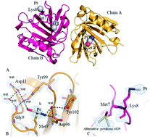
Structural bases for rational design of new biomaterials based on metallodrug/β-lactoglobulin adducts
Graphical Abstract

Slide 3
Abstract:
β-lactoglobulin is a whey carrier protein of 18.4 kDa. Due to its high solubility, safe status, biodegradable nature, gel forming ability, abundance, stability at acidic pH and stability against gastric pepsin, β-lactoglobulin can be considered as a good system for the preparation of micro- or nanoparticles for pharmaceutical industry. It has been demonstrated that β‐lactoglobulin–pectin nanoparticles are able to transfer cytotoxic Pt compounds to cancer cells. With the aim to unveil the molecular basis of the metallodrug recognition by β‐lactoglobulin, we are analyzing the interactions between this protein and several metallodrugs. The interaction between cisplatin (CDDP), the most used Pt-based anticancer agent, and β-lactoglobulin have been investigated both in solution and at solid state. UV-vis absorption spectroscopy and circular dichroism data indicate that the protein retains its conformation upon CDDP binding. X-ray crystallography analysis reveals that β-lactoglobulin interacts with CDDP through coordination of Pt fragments to the side chains of Met7, His146 and Lys8, with the number of binding sites increasing over time. ESI-MS data indicate that [Pt(NH₃)₂Cl⁺], [Pt(NH₃)₂OH²⁺] and [Pt(NH₃)₂²⁺] fragments interact with the protein. These results open the way for a rational design of new biomaterials based on metallodrug/β-lactoglobulin adduct nanoparticles.
Keywords: 3 to 5 keywords separated by semi colons

Slide 4
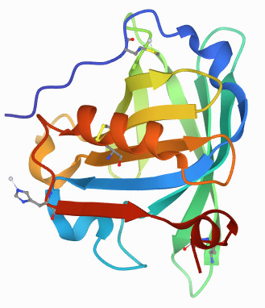
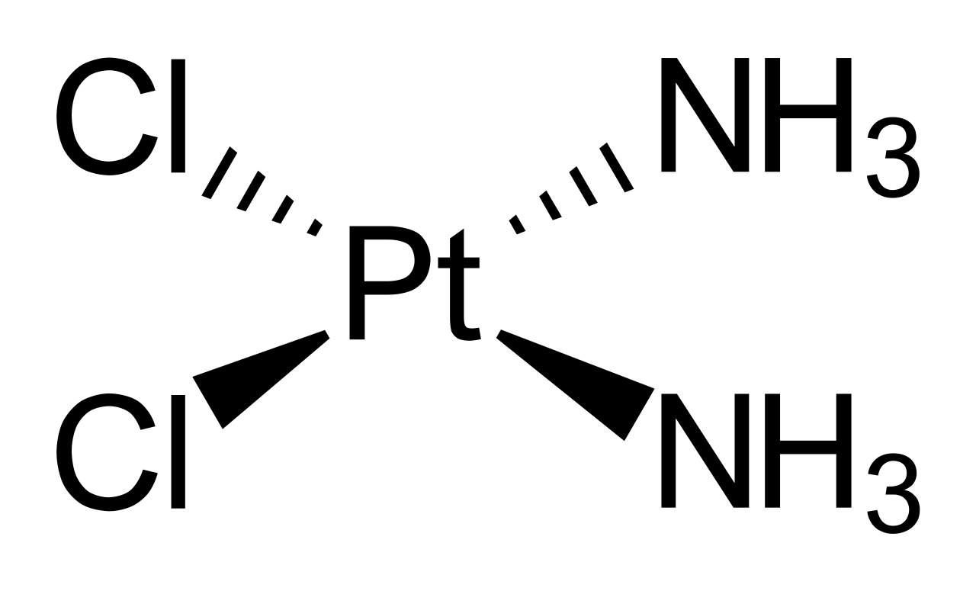
Introduction
β-lactoglobulin is the major whey protein in cow’s milk of 18.4 kDa (162 amino acids)
It is a globular protein composed by 8-stranded antiparallel β-barrel with a 3-turn α-helix on the outer surface.
Cisplatin: the most used Pt-based anticancer agent
The interactions between β-lactoglobulin and cisplatin have been investigated both in solution and at solid state
E. Dufour et al. Biochimica et Biophysica Acta, 1994, 1205(1), 105. Z. Teng et al. Food Chemistry, 2016, 204, 391. Z. Teng et al. Food Chemistry, 2014, 159, 333.
Z. Izadi et al. Chem Biol and Drug Design 2016, 88(2), 209. Z.H. Siddik, Oncogene 2003, 22, 7265. L. Kelland, Nature Reviews Cancer 2007, 7, 573. M.H. Green, J. Nat Cancer Inst. 1992, 84, 306.

Slide 5
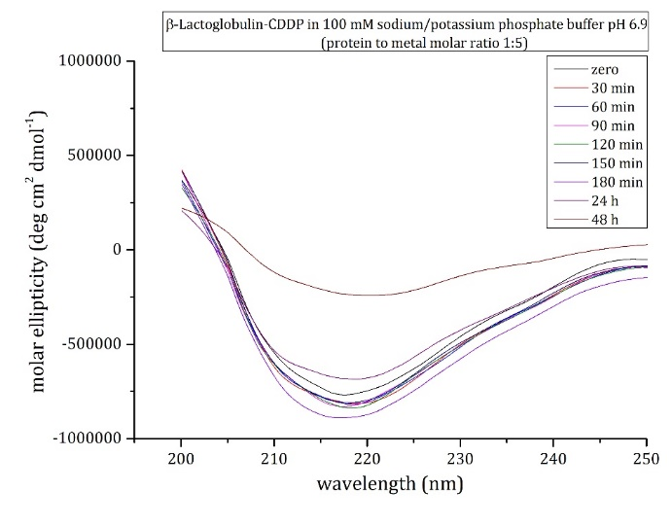
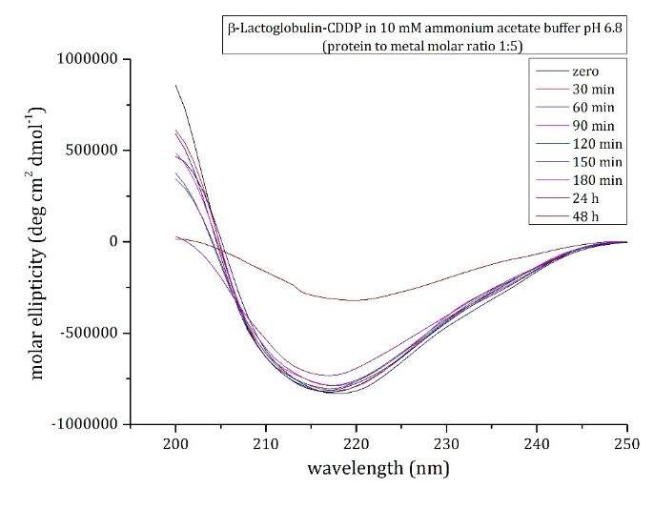
Results and discussion
In solution characterization of CDDP binding to β-lactoglobulin
Absorption intensity decreases in the first two hours
After two hours, an increase of absorption intensity occurs, due to CDDP binding
Despite a slight precipitation of the sample, β-lactoglobulin conserves its secondary structure in the presence of the metal compound

Slide 6
Results and discussion
Crystallographic studies
The structure of the CDDP/β-lactoglobulin adducts contain two molecules in the asymmetric unit
CDDP soaking for 18h
CDDP soaking for 72h

Slide 7
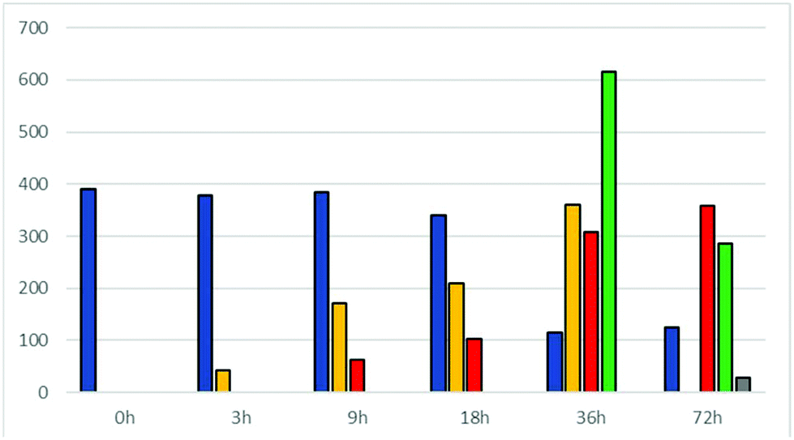
Results and discussion
Mass spectrometry analysis
Electrospray ionization mass spectra of the CDDP/β-lactoglobulin are collected as a function of time
Blue: Metal-free protein;
Yellow: [Pt(NH₃)₂Cl⁺] or [Pt(NH₃)₂OH₂⁺];
Red: Pt(NH₃)₂²⁺];
Green: Adduct with 2 CDDP fragments;
Grey: Adduct with 3 CDDP fragments.
Bar graph summarizes the results of mass spectrometry course experiments. Two forms of native protein are observed for A and B variants of the protein. After three hours the first Pt/β-lactoglobulin is formed. Longer reaction times (9h) give rise to another protein-metal fragment. Only after 36h the presence of two binding Pt sites is observed, while 72h are needed for observing adducts of the protein with three CDDP molecules

Slide 8
Conclusions
The first structural study on the interaction of β-lactoglobulin with an anticancer metallodrug is reported;
In solution data demonstrate that the protein binds CDDP without affect its overall conformation;
Crystallographic studies underline the presence of binding sites of CDDP close to the side chain of Met7, Lys8 and His146. β-lactoglobulin can form adducts with one Pt-containing fragment coordinating protein residues side chains;
ESI-MS analysis reveals the presence of [Pt(NH₃)Cl⁺], [Pt(NH₃)₂OH₂⁺] and [Pt(NH₃)₂²⁺] fragments bond to the protein;
The number of CDDP fragments embedded by protein increases with time;
Monodentate and bidentate mode of Pt binding to the protein are possible, the former preceding the latter in coordination of the protein;
Up to 3 CDDP molecules can bind the protein.
The interactions β-lactoglobulin with other metallodrugs is under investigation. Further efforts will be spent toward a rational design of new biomaterials based on metallodrug/β-lactoglobulin adduct nanoparticles.

Slide 9
Acknowledgments
I would like to thank the head of my research group, Prof Antonello Merlino and all the people who are involved in this progect, in particular:
Dr Giarita Ferraro;
Dr Nicole Balasco;
Prof Maria Monti;
PhD student Ilaria Iacobucci;

