Slide 1
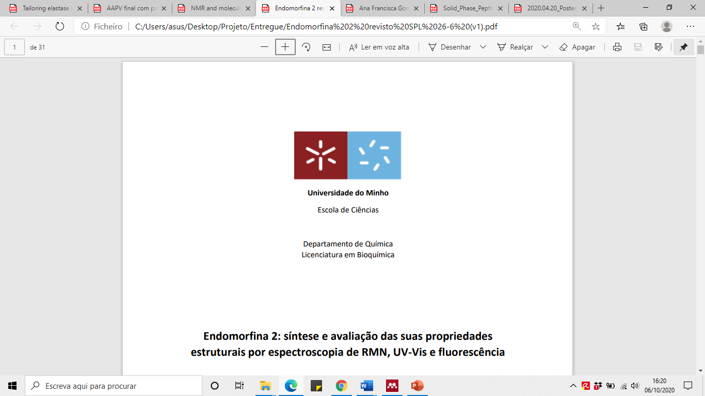

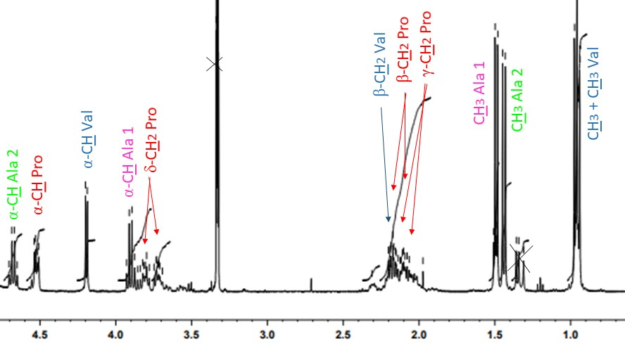
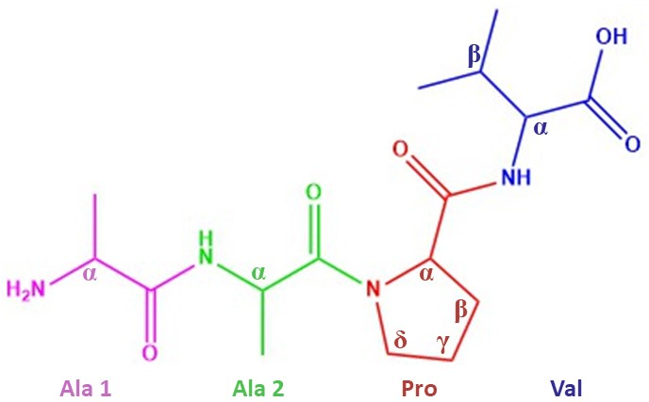
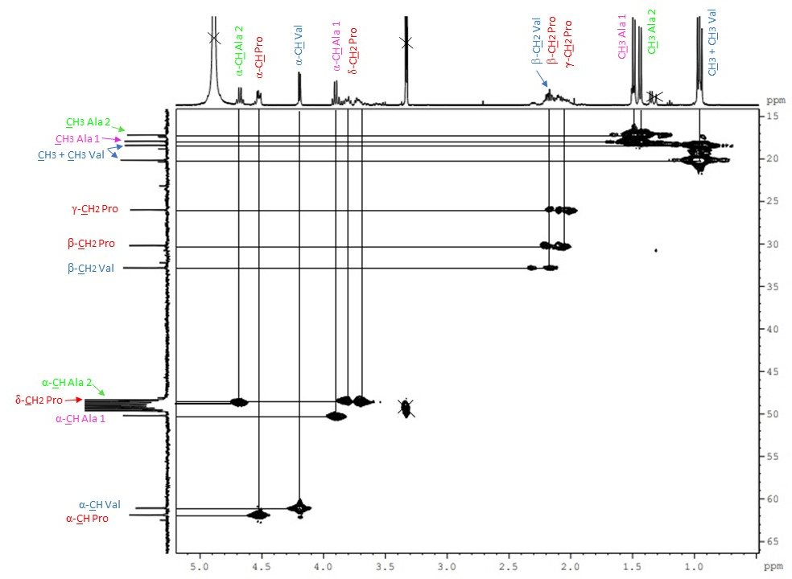
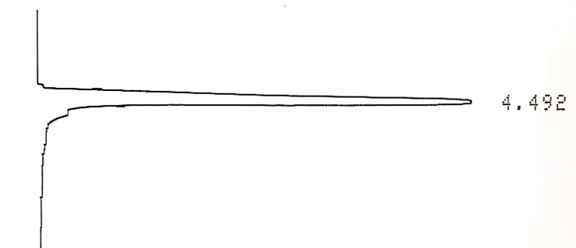
Exploring the antibacterial potential of human neutrophil elastase inhibitor Ala-Ala-Pro-Val synthesized using microwave-assisted solid phase
A. Francisca G. Silva¹, Helena P. Felgueiras², Susana P. G. Costa¹, Sílvia M. M. A. Pereira-Lima¹
¹Chemistry Research Centre (CQ), University of Minho, Portugal
²Centre for Textile Science and Technology (2C2T), University of Minho, Portugal
Introduction
2D-NMR
Chronic wounds are the result of alterations in physiologic processes related to tissue formation and elimination of damaged tissue. They are characterized by a prolonged inflammatory phase that does not progress through the normal phases of healing, which results in an exaggerated response of neutrophils. The neutrophils gather in the inflammatory sites and release human neutrophil elastase (HNE). At normal amounts, this enzyme is associated to the healing process. However, at uncontrolled amounts it is associated with the degradation of proteins of the extracellular matrix (such as elastin, fibrin, fibronectin) and important growth factors, which compromises the healing process. In these cases, the activity of endogenous inhibitors is not enough to control the HNE activity, so it becomes important the search for other HNE inhibitors.^{1,2} Here, we synthesize the peptide Ala-Ala-Pro-Val (AAPV), known for its ability to inhibit HNE activity, and test its antimicrobial potential.³
Figure 1- AAPV structure
Peptide synthesis
The peptide AAPV synthesized by microwave-assisted solid phase peptide synthesis (MW-SPPS). The microwave irradiation optimizes the amino acid coupling reactions and deprotections, drastically reduces the reaction time and increases the purity/yield of the final product.^{4,5}
A pre-loaded chlorotritylchloride solid support was used in a 9-fluorenylmethoxycarbonyl α-amino protection synthesis strategy. Coupling was achieved with N,N′-diisopropylcarbodiimide (DIC) and Ethyl cyanoglyoxylate-2-oxime (Oxyma). The peptide was obtained in a 58% yield.
Figure 4- NMR spectra of AAPV: a) ¹H b) HMQC (performed on deuterated methanol in a Brunker Avance III 400 spectrometer (400 Hz)
Antibacterial activity
Finally, its antibacterial potential was explored against Staphylococcus aureus, Staphylococcus epidermidis (Gram-positive), Escherichia coli and Pseudomonas aeruginosa (Gram-negative). These are some of the most common pathogens colonizing chronic wounds. The wound is a nutritious environment for microorganisms to proliferate, causing the wound infection, since these microorganisms are potentially pathogenic.⁶ To the authors knowledge this is the first report on the potential abilities of the peptide AAPV to fight microorganisms.
Table 1- AAPV Minimum Inhibitory Concentrations (MIC)
Figure 2- Schematic representation of the synthesis of AAPV peptide by MW-SPPS
 | AAPV MIC (mg/mL)
Escherichia coli | 2
Pseudomonas aeruginosa | 2
Staphylococcus aureus | 2
Staphylococcus epidermidis | 2
Incubation at 37ºC at 120 rpm, in Muller Hinton, protected from light for 24h. The MIC was 2 mg/mL for all the tested bacteria.
HPLC analysis
Once synthesized, the peptide was precipitated from ethyl ether and the purity accessed by HPLC. A Lichroscoper® RP-18 column was used and the peptide eluted with a mixture ACN/H₂O 1:4 with 0,1% TFA with a flow rate of 0,6 mL/min. Injection volume was 50 µL and UV absorbance detection at 214 nm was used. The AAPV peptide appeared in a single peak at 4,5 min without any appreciable impurities.
Conclusions
The AAPV synthesis, by means of MW-SPPS, proceeded as planed with the peptide obtained in a satisfactory yield of 58%. It was HPLC pure and the two-dimensional NMR data confirmed the structure of the peptide obtained. The results of the antibacterial activity test demonstrated that the peptide only has activity at 2mg/mL, which is too high for a cost-effective application.
Figure 3- HPLC analysis to synthesized AAPV
References
Cavaco-Paulo, A., et. Al., React. Funct. Polym. 2013, 73 (10), 1357–1365.
Cavaco-Paulo, A., et. Al., Eur. J. Pharmacol. 2011, 666 (1–3), 53–60.
Costa, S. P. G., et. Al., Amino Acids 2017, 49 (6), 1077–1088.
(4) Jensen, K. J., et. Al., Chem. Soc. Rev. 2012, 41 (5), 1826–1844.
(5) Beck-Sickinger, A. G., et. Al., Beilstein J. Org. Chem. 2014, 10, 1197–1212.
(6) Felgueiras, H. P., et. Al., Colloids Surfaces B Biointerfaces 2017, 156, 133–148.

