Slide 1

Ferritin-based anticancer metallodrug delivery: encapsulation of Arsenoplatin-1 within the ferritin nanocage
Giarita Ferraro^{1,}*, Alessandro Pratesi², Đenana Miodragović³, Paola Imbimbo⁴, Daria Maria Monti⁴, Thomas V. O’Halloran³, Luigi Messori¹ and Antonello Merlino⁴
¹ Department of Chemistry “Ugo Schiff”, University of Florence, Sesto Fiorentino, Florence, Italy;
² Department of Chemistry and Industrial Chemistry, University of Pisa, Pisa, Italy
³ Chemistry of Life Processes Institute, North-western University, Evanston, United States
⁴ Department of Chemical Sciences, University of Naples Federico II, Naples, Italy
* giarita.ferraro@unifi.it
  University of Florence
  Department of Chemistry “Ugo Schiff”

Slide 2
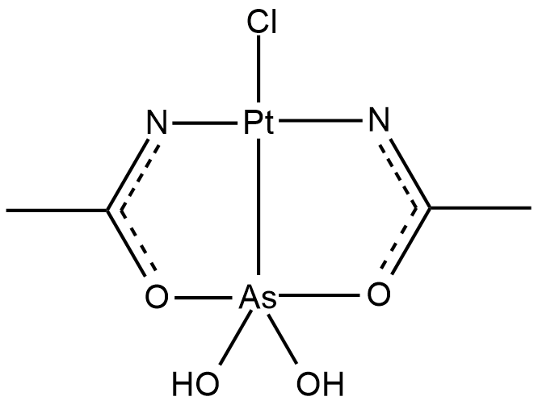
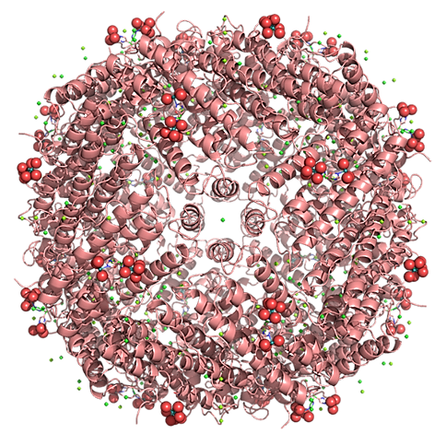
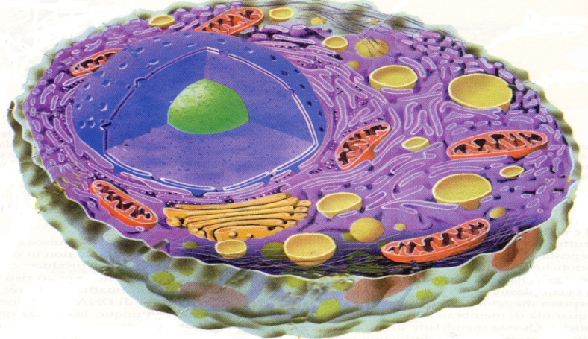

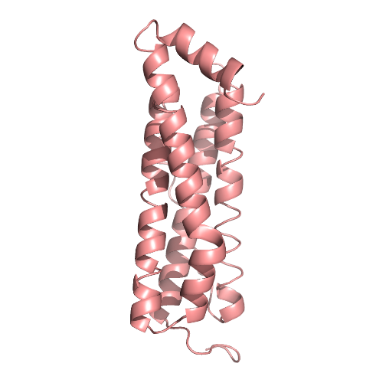


Ferritin-based anticancer metallodrug delivery: encapsulation of Arsenoplatin-1 within the ferritin nanocage
AP-1
cancer cells
normal cells

Slide 3
Abstract:
An ideal drug delivery system is characterized by high stability, biocompatibility and selective delivery of molecules to target cells. Molecules already present in the body, like proteins, are safer for the immune defence mechanism. Ferritins (Fts) are proteins that self-assemble into hollow cage-like structures, already used to encapsulate molecules for optical imaging, catalysis and photodynamic therapy. Here, Ft was chosen to encapsulate Arsenoplatin-1 (AP-1), the prototype of a novel class of metallodrugs containing a PtAs(OH)₂ core. AP-1-encapsulated Ft was prepared following the alkaline pH procedure: Ft cage is disassembled at basic pH and then reassembled in the presence of the drug by raising the pH at a neutral value. In this way, the metallodrug is trapped inside the Ft core. UV-Vis spectroscopy and ICP-OES measurements confirm the encapsulation and allow to evaluate the exact amount of AP-1 in the nanocage. The X-ray structure of AP-1-encapsulated Ft reveals that an AP-1 fragment without the chloride ligand binds the protein. The biological activity of AP-1-loaded Ft was tested on cancer cell lines and compared to that observed in normal ones. The results indicate that, even if reducing the overall drug toxicity, the presence of the cage improves AP-1 selectivity for cancer cells.
Keywords: drug delivery; biocompatible; protein; nanocarrier; metallodrug

Slide 4
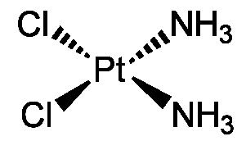
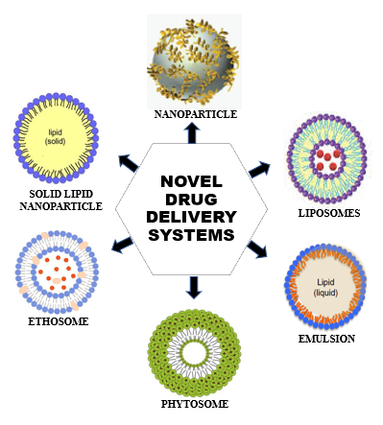


Cisplatin
Metal compounds have an important place in the clinical practice
They are used as drugs to treat several human diseases (carcinomas, lymphomas, infection control, anti-inflammatory, diabetes, and neurological disorders).
Several side effects: general toxicity and drug resistance
Rosenberg B. Nature (1965) 205, 698
alternative metal centers
change of oxidation state and coordination geometry
ligand modification
development of polynuclear systems
drug delivery/targeting protocols

Slide 5
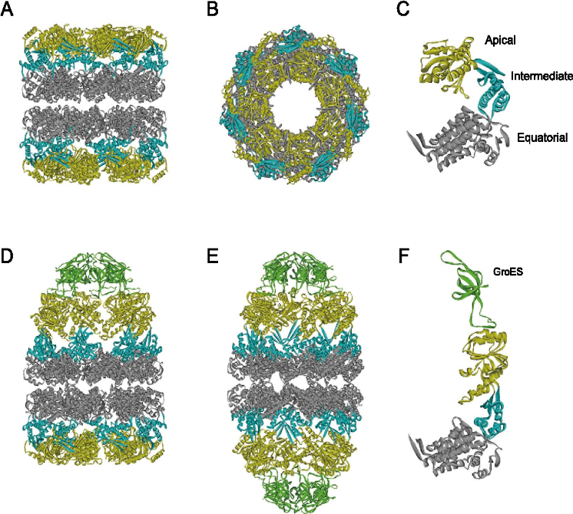
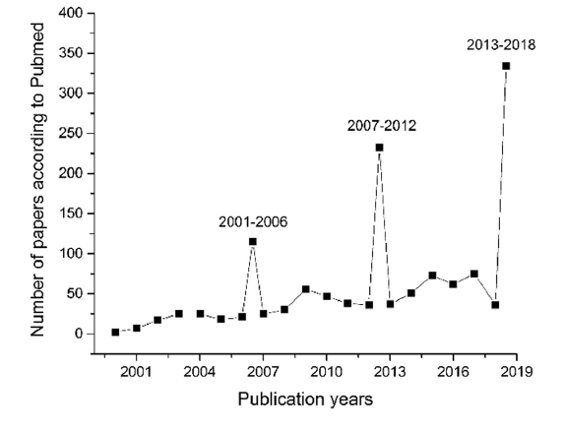
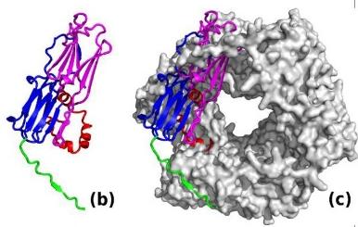
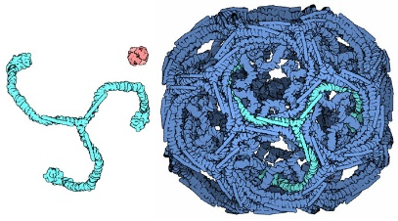
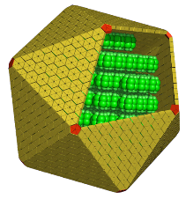
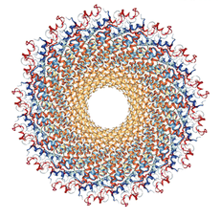
Proteins as delivery systems for anticancer drugs
chaperonines
heat shock proteins
clathrin
carboxysomes
mosaic viruses
A graph on the growing interest of researchers in the field of “proteins as delivery systems for anticancer drugs” from 2000 to 2018 (data from Pubmed).
Monti, D.M. et al. Nanomedicine: NBM (2019) 20, 101997

Slide 6
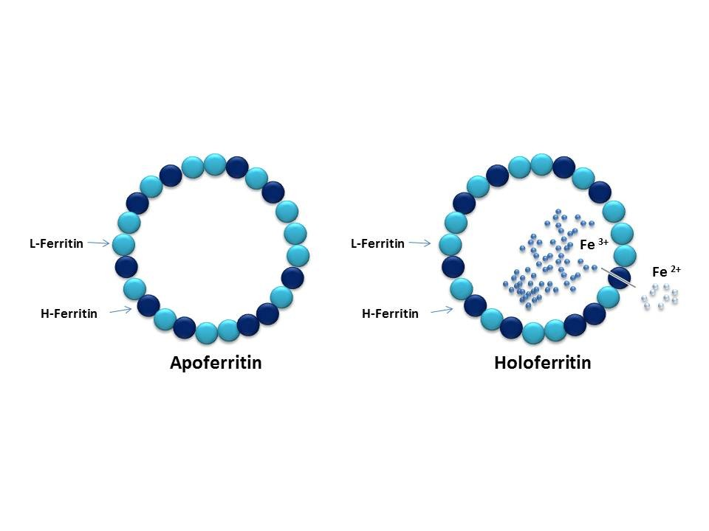
Ferritin: a protein nanocage for iron store and mineralization
Apo-Ferritin
Holo-Ferritin
•
•
•
•
•
•
Fe²⁺
•
•
•
•
•
•
•
•
•
•
•
•
•
•
•
•
•
•
•
•
Fe³⁺
L-chain
L-chain
H-chain
H-chain
24-mer cage with octahedral symmetry
outer diameter ~120 Å - inner diameter ~80 Å
2 type of chains: H-chain (heavy) + L-chain (light)
iron sequestration → detoxification and cellular reserve
Monti, D.M. et al. Nanomedicine: NBM (2019) 20, 101997

Slide 7
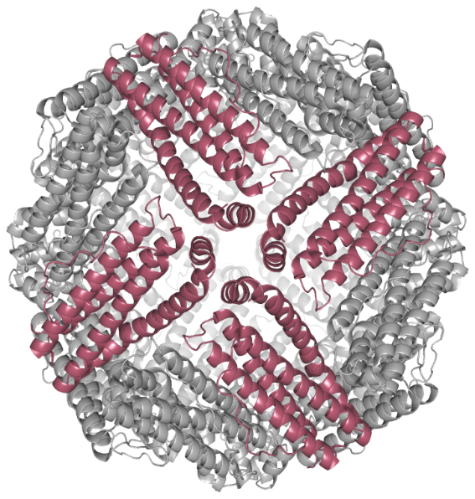
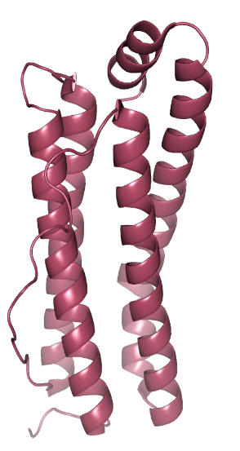

Why ferritin?
A B
biocompatible
Cartoon representation of the structure of the globular ferritin (A) and its monomeric form (B)
non-immunogenic
stable and soluble in the bloodstream
amenable to both genetic and chemical functionalization
could lead to longer circulation half-life and to better tumor accumulation rates
recognized by receptors over-expressed on cancer cells surface

Slide 8
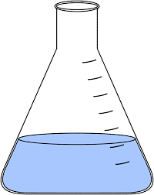
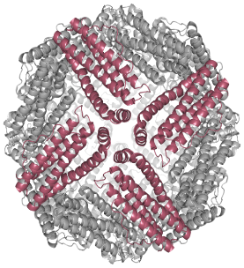
Encapsulation of Arsenoplatin-1 within the ferritin nanocage

Slide 9
Arsenoplatin-1 (AP-1)
Complexes containing a PtAs(OH)₂ core with a square planar Pt(II) and a five coordinate As(III) geometry
Stable in solution
With chemical bonding, ligand substitution chemistry and biological activities distinct from the parent compounds cisplatin and arsenic trioxide
With a promising activity in drug-resistant cancer cell lines
Miodragović Đ.U. et al. Angew Chem Int Ed Engl (2013) 52, 10749.

Slide 10
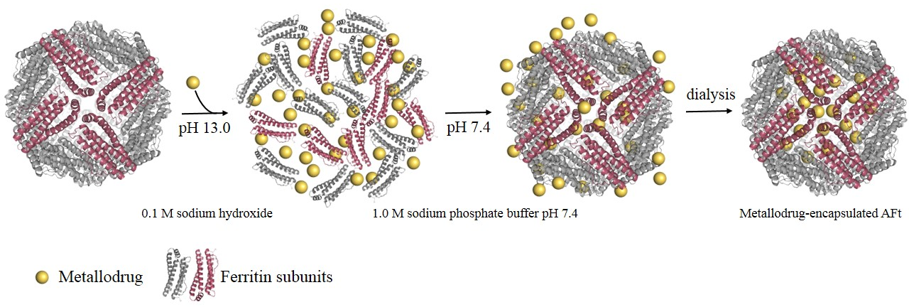
Alkaline pH encapsulation protocol
The ferritin cage is disassembled at alkaline pH (13.0) in the presence of 0.1 M NaOH
AP-1 is added to the ferritin solution and the reaction mixture is incubated for 1h at room temperature under stirring
After the incubation time, the pH is restored to 7.4 by adding 1.0 M sodium phosphate buffer
The AP-1-encapsulated ferritin is then extensively dialyzed and stored at 4°C
Pontillo, N. et al. Chem Commun (2016) 52, 4136

Slide 11
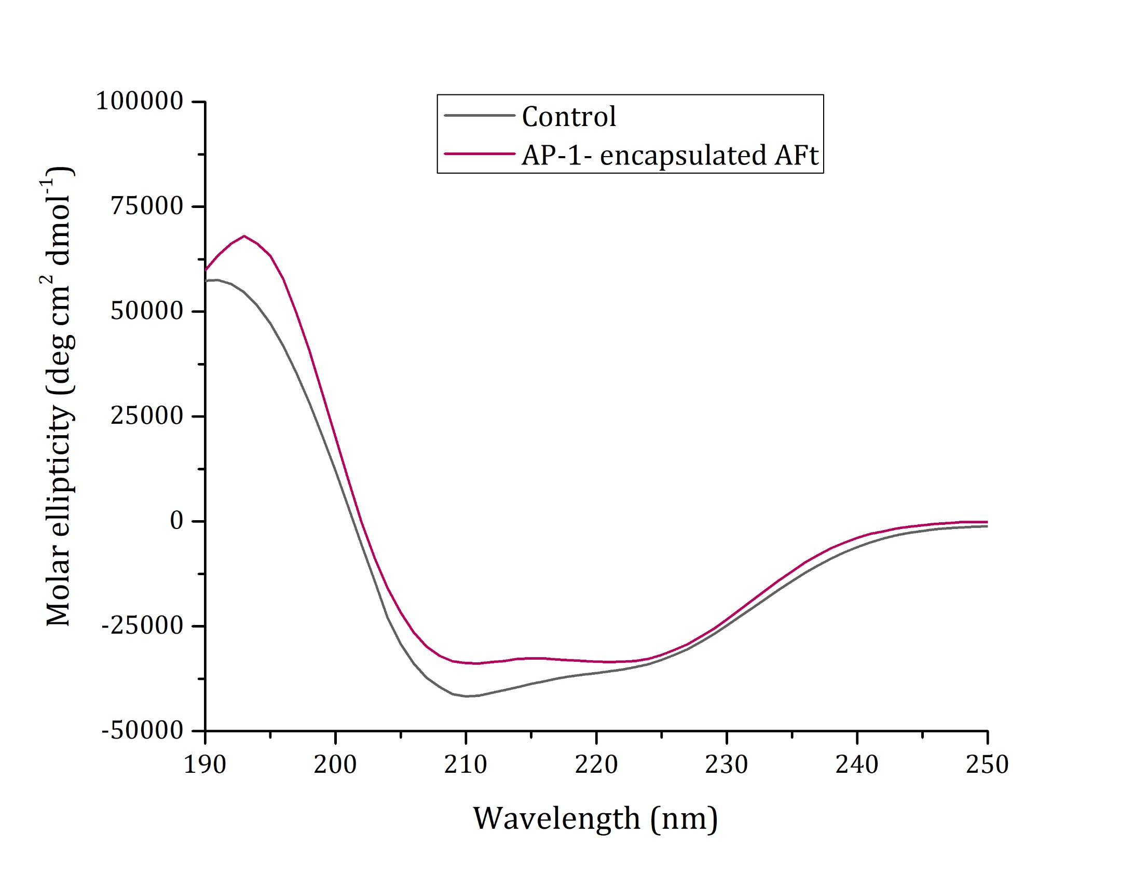
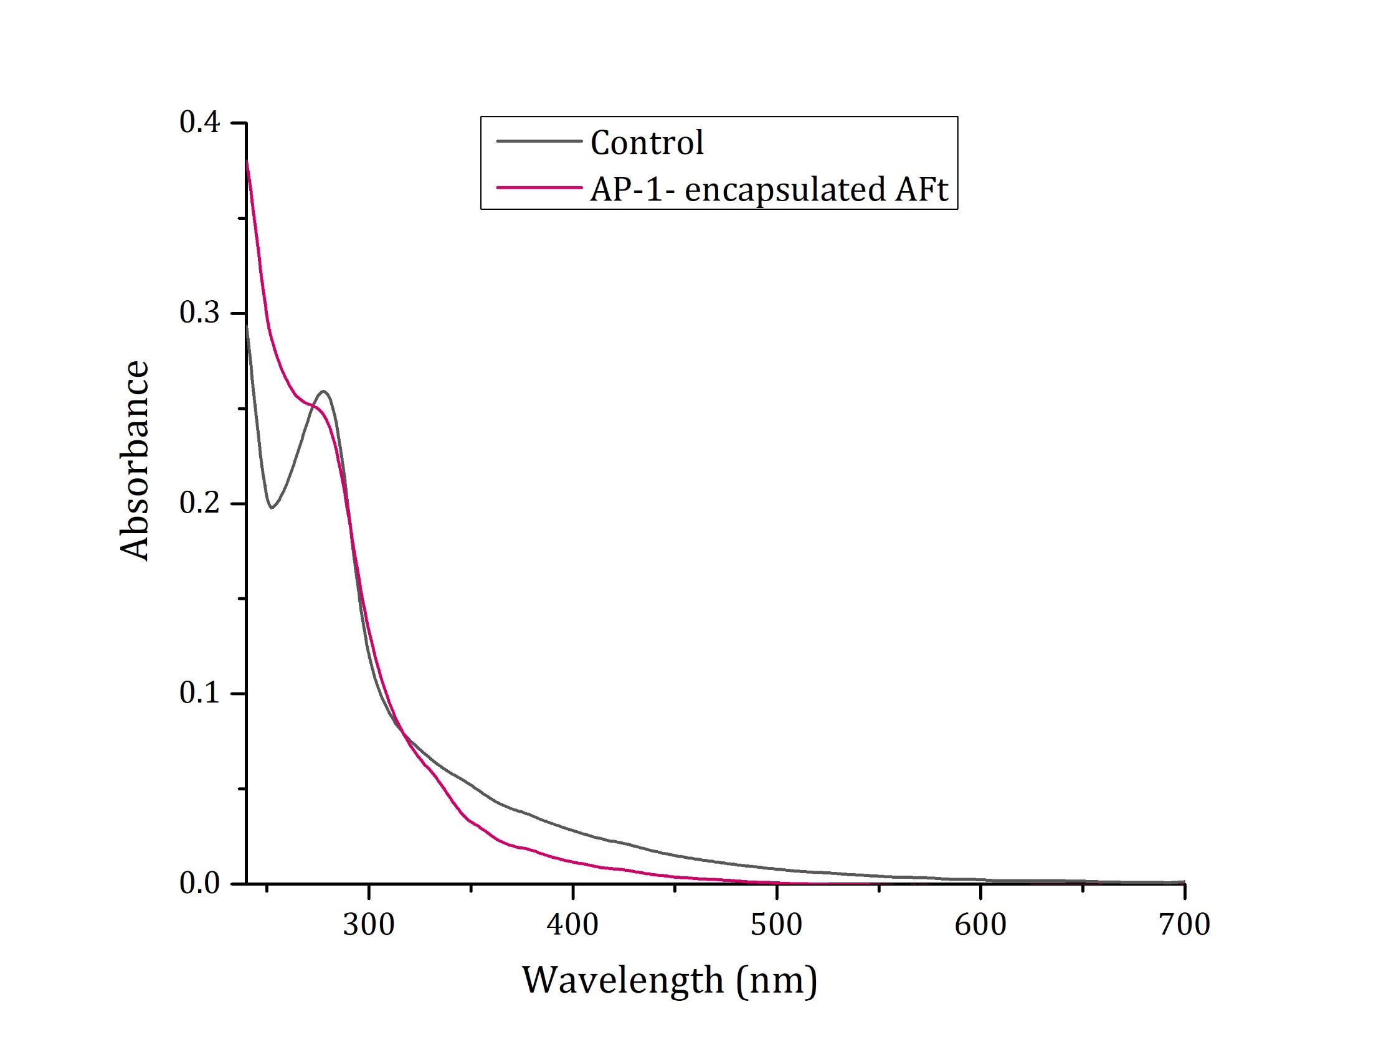
Far UV-CD spectroscopy
UV-Vis absorption spectroscopy
ICP- OES measurements
AP-1 molecules/cage | AP-1 molecules/single chain
600 – 700 | 25.0 – 29.2

Slide 12
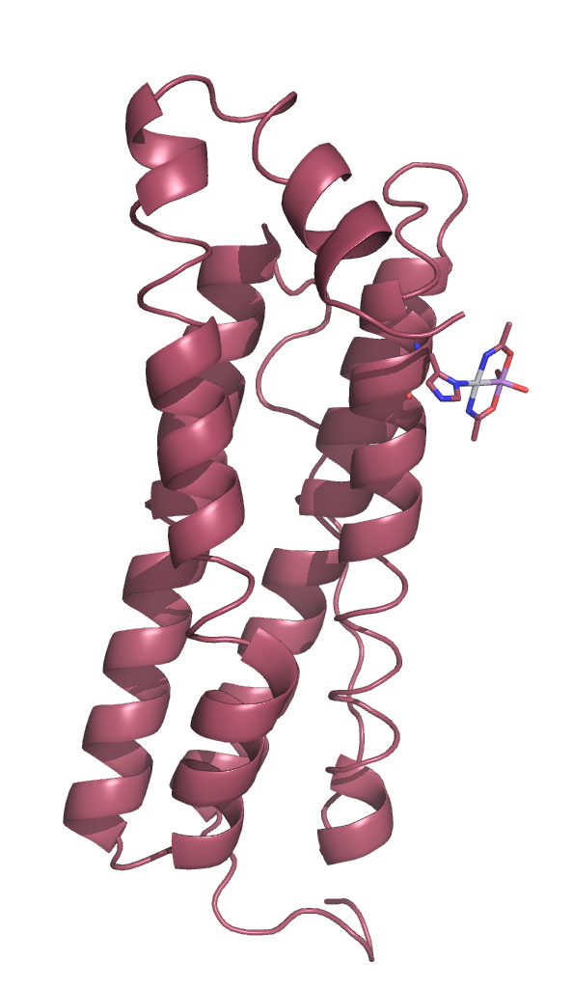
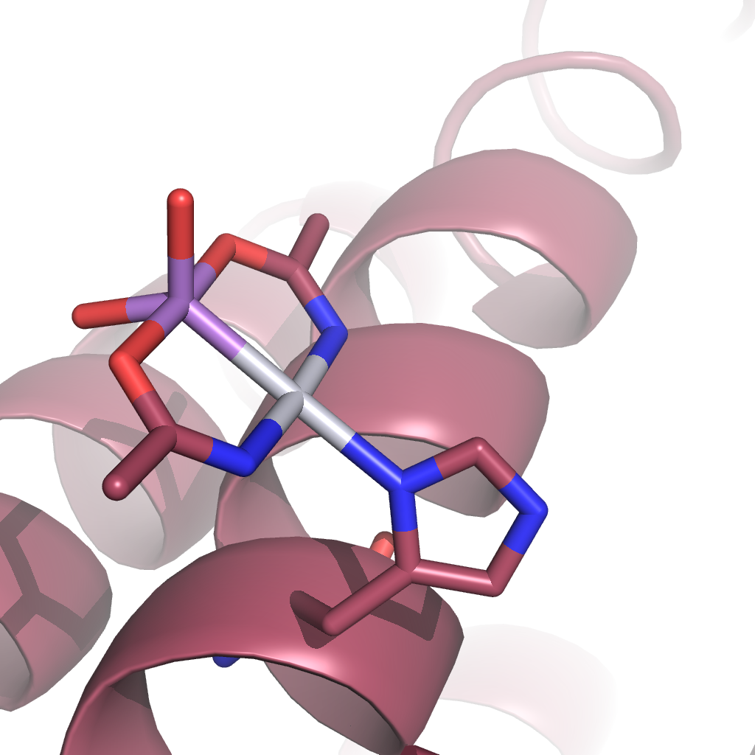
X-ray crystallography
A
B
C
As
Pt
His49
(A) Crystals of AP-1-encapsulated AFt.
(B) Cartoon representation of the structure of a single ferritin chain of AP-1-encapsulated AFt.
(C) Details of the AP-1 binding site.

Slide 13
Biological activity
IC₅₀ values obtained after 48 h of incubation with AP-1 and AP-1-encapsulated AFt
 | 48 h incubation
 | AP-1 (μM) | AFt-AP-1 (μM/AP-1)
HaCaT (human keratinocyte cells ) | 2.60 ± 0.26 | 10.91 ± 0.73
A431 (human epidermoid carcinoma) | 4.04 ± 0.92 | 4.66 ± 0.29
Balb/c 3T3 (immortalized murine fibroblast) | 3.60 ± 0.10 | 27.80 ± 0.14
Svt2 (immortalized murine fibroblast transformed with SV40 virus) | 3.87 ± 1.01 | 11.64 ± 0.29

Slide 14
Conclusions
A well-characterized hetero-bimetallic compound of potential medicinal interest, AP-1, has been selected and encapsulated within the ferritin nanocage.
The drug-loaded nanocarrier has been investigated:
From a biophysical point of view, analysing the conformation of the nanocomposite and solving the X-ray structure. These data have allowed highlighting the nature of the interactions of AP-1 with the nanocarrier.
From an analytical point of view, defining the exact amount of metal that is encapsulated in the nanocage, and the protein-metallodrug stoichiometry.
From a biological point of view, testing the cytotoxic effects of the nanocomposite, in comparison to the free drug, on cancer and non-cancer cell lines to assess the possible target-selectivity.

Slide 15
Conclusions
The AFt nanocage re-assembles in the presence of the drug and is able to trap the drug inside the cage.
The structure and the electrostatic potential of the outer surface of AFt are basically not affected by the presence of the drug. The AP-1-AFt nanocomposite retains the chemical-physical features of the native protein, even upon drug encapsulation, confirming that this system can be used as a suitable nanocarrier.
In the drug-loaded ferritin, the binding site is located on the inner surface of the cage. An AP-1 moiety binds the side chain of His49, but there is a significant amount of metal compound in the bulk. These molecules could be the active species, which are responsible for the activity of the nanocomposite.

Slide 16
Conclusions
Ligand-free ferritin is non-toxic either for normal or for cancer cell lines, confirming the biocompatibility of this nanocarrier.
The drug-loaded nanocarrier shows moderate selectivity, since it kills tumor cell lines at a lower concentration than that needed to kill normal cell lines.
The cytotoxicity of the drug-encapsulated AFt depends mainly on the intrinsic properties of the encapsulated compound, rather than on the structure of the ferritin obtained upon encapsulation.

Slide 17
Acknowledgements
University of Naples Federico II
Prof. Daria M. Monti
Dr. Paola Imbimbo
Prof. Antonello Merlino
→ Biological tests
XRD measurements and analysis
ESRF synchrotron
Northwestern University
Prof. Thomas V. O’Halloran
Dr. Denana Miodragovic
→ Synthesis of AP-1
University of Florence
Prof. Luigi Messori
University of Pisa
Dr. Alessandro Pratesi
→ ICP-OES measurements

