Slide 1





Vanillin derivatives as highly selective inhibitors of the cancer associated carbonic anhydrase isoforms IX and XII
Macarena S. Le Pors¹, Leonardo E. Riafrecha¹, and Pedro A. Colinas^{1,}*
¹ CEDECOR, (UNLP-CICBA), Departamento de Química, Facultad de Ciencias Exactas, Universidad Nacional de La Plata, 47 y 115 (1900), La Plata, Buenos Aires, Argentina.
* Corresponding author: pcolinas@quimica.unlp.edu.ar

Slide 2
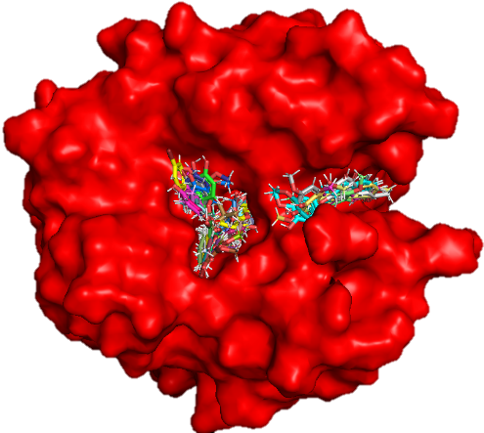
Vanillin derivatives as highly selective inhibitors of the cancer associated carbonic anhydrase isoforms IX and XII
hCA II

Slide 3
Abstract
Relationship between carbonic anhydrase (CA) and cancer has been known for more than 20 years but only recently two isozymes (IX and XII) overexpressed in solid tumor have been identified, cloned and sequenced. Membrane-bound hCA isozymes IX and XII are expressed at high levels and with a high prevalence in different tumor tissues, whose normal counterparts do not contain these proteins. Thus, specifically targeting the tumor associated isoforms hCA IX and XII over the main off target isoforms hCA I and II, which have a physiological relevance, using specific inhibitors is a promising strategy in the cancer therapy.
[6]-Paradol, a pungent phenolic compound present in certain Zingiberaceae plants (ginger, etc.), is known to have cytotoxicity activity against human leukemia cells. Also other ingredients of ginger like [6]-shogaol showed to inhibit non-small cell lung cancer cells. All these compounds contain the 4-hydroxy-3-methoxyphenyl moiety also found in vanillin. Recently our group showed that attachment of carbohydrate tails to phenoxy moiety leads to highly selective CA IX inhibitors. The aim of the present work is to study new C-glycoside incorporating the 4-hydroxy-3-methoxyphenyl moiety as selective inhibitor of tumor associated CA isoforms. We present the hCA (I, II, IX and XII) inhibition profile of the carbohydrate derivatives and also other ones prepared by aldol reaction of alkyl and aryl ketones. Docking analysis is discussed showing that the high selectivity could be explained in terms of a binding pocket out of the CA active site. Thus, discovery of these selective IX and XII inhibitors will be a promising step in the strategy for an effective cancer therapy.
Keywords: cancer; carbonic anhydrase; enzyme inhibition; vanillin.

Slide 4
Introduction
Cancer
Cancer is the second cause of death globally.
In the last years “targeted therapies” have emerged as an alternative to traditional treatments.
Two isozymes overexpressed in solid tumor have been identified, cloned and sequenced: CA IX and XII.
Both of these enzymes are associated with cancer progression, metastasis, and impaired therapeutic response.

Slide 5
Carbonic Anhydrase (CA)
Metalloenzymes family that contains Zn²⁺ in the active site.
There are five families: α-, β-, γ-, δ-, ε-CAs.
α-CAs present in mammals (16 isoforms). Some are intracellular (CA I and II) and others are transmembrane (CA IX and XII).
β-CAs present in bacteria and algae.
CAs catalyze a simple but important reaction:
CO₂ + H₂O HCO₃⁻ + H⁺
Reversible hydration of CO₂

Slide 6
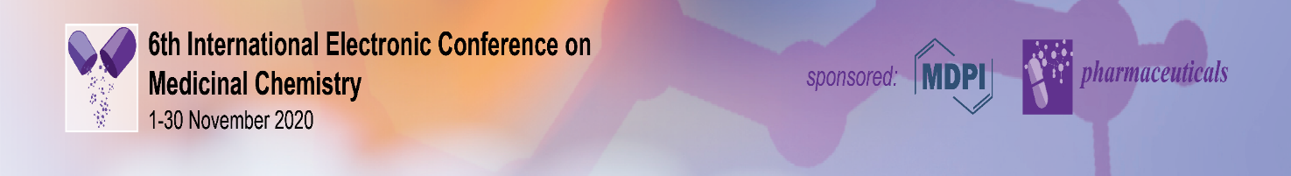
CA inhibitors
Design of specific inhibitors of CA IX and XII is considered to be a promising strategy in the cancer therapy.
Problem to solve!: target the tumor associated isoforms hCA IX and XII over the main off target isoforms hCA I and II, which have a physiological relevance.
Some CA pharmacophores are :
- Phenols: OH binds through hydrogen bonds with the water molecule/hydroxyl ion attached to Zn (II).
- Methoxyaryl: They bind within the enzymatic active site without interaction with the zinc ion and through different interactions with amino acid residues and water molecules.
We studied the attachment of carbohydrate and alkyl
and aryl chains to the vanillin moiety in order to design
selective CA inhibitors.
Phenol-hCA II adduct

Slide 7
Results and discussion
Preparation of vanillin derivatives

Slide 8
Vanillin derivatives and inhibitory activity

Slide 9
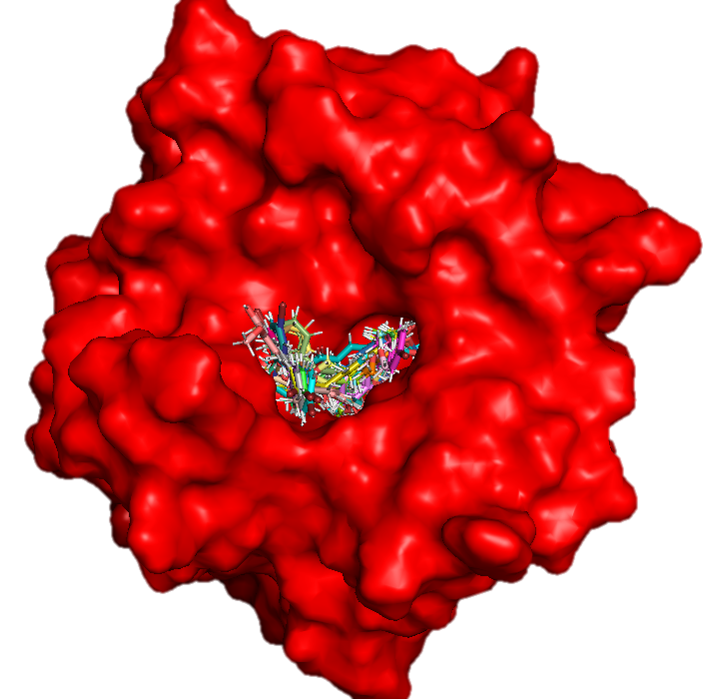
Docking snapshots
The frames show the arrangement of the lower energy poses of the vanillin derivatives inside of the hCAIX active site and some inside of binding pocket out of the hCA II active site.
hCA II
hCA IX

Slide 10
Conclusions
The compounds showed better activity profile against hCA IX and XII over I and II which is highly desirable when only the tumor-associated isoforms would be targeted.
Dehydroparadol 2 and 3 were the most effective and selective inhibitors to hCA IX and XII over I and II.
C-glycosides 6 and 7 were the most effective and selective inhibitors to hCA IX and XII over II.
The high selectivity could be explained in terms of a binding pocket out of the CA active site.

Slide 11
Acknowledgments
Dr. Claudiu Supuran (Universitá degli Studi di Firenze, Italy)
Dr. Martín Lavecchia (CEQUINOR, Universidad Nacional de La Plata,
Argentina)
Consejo de Investigaciones científicas y técnicas (CONICET)
Comisión de Investigaciones científicas de la Pcia. de Buenos Aires (CIC)
Universidad Nacional de La Plata

