Slide 1
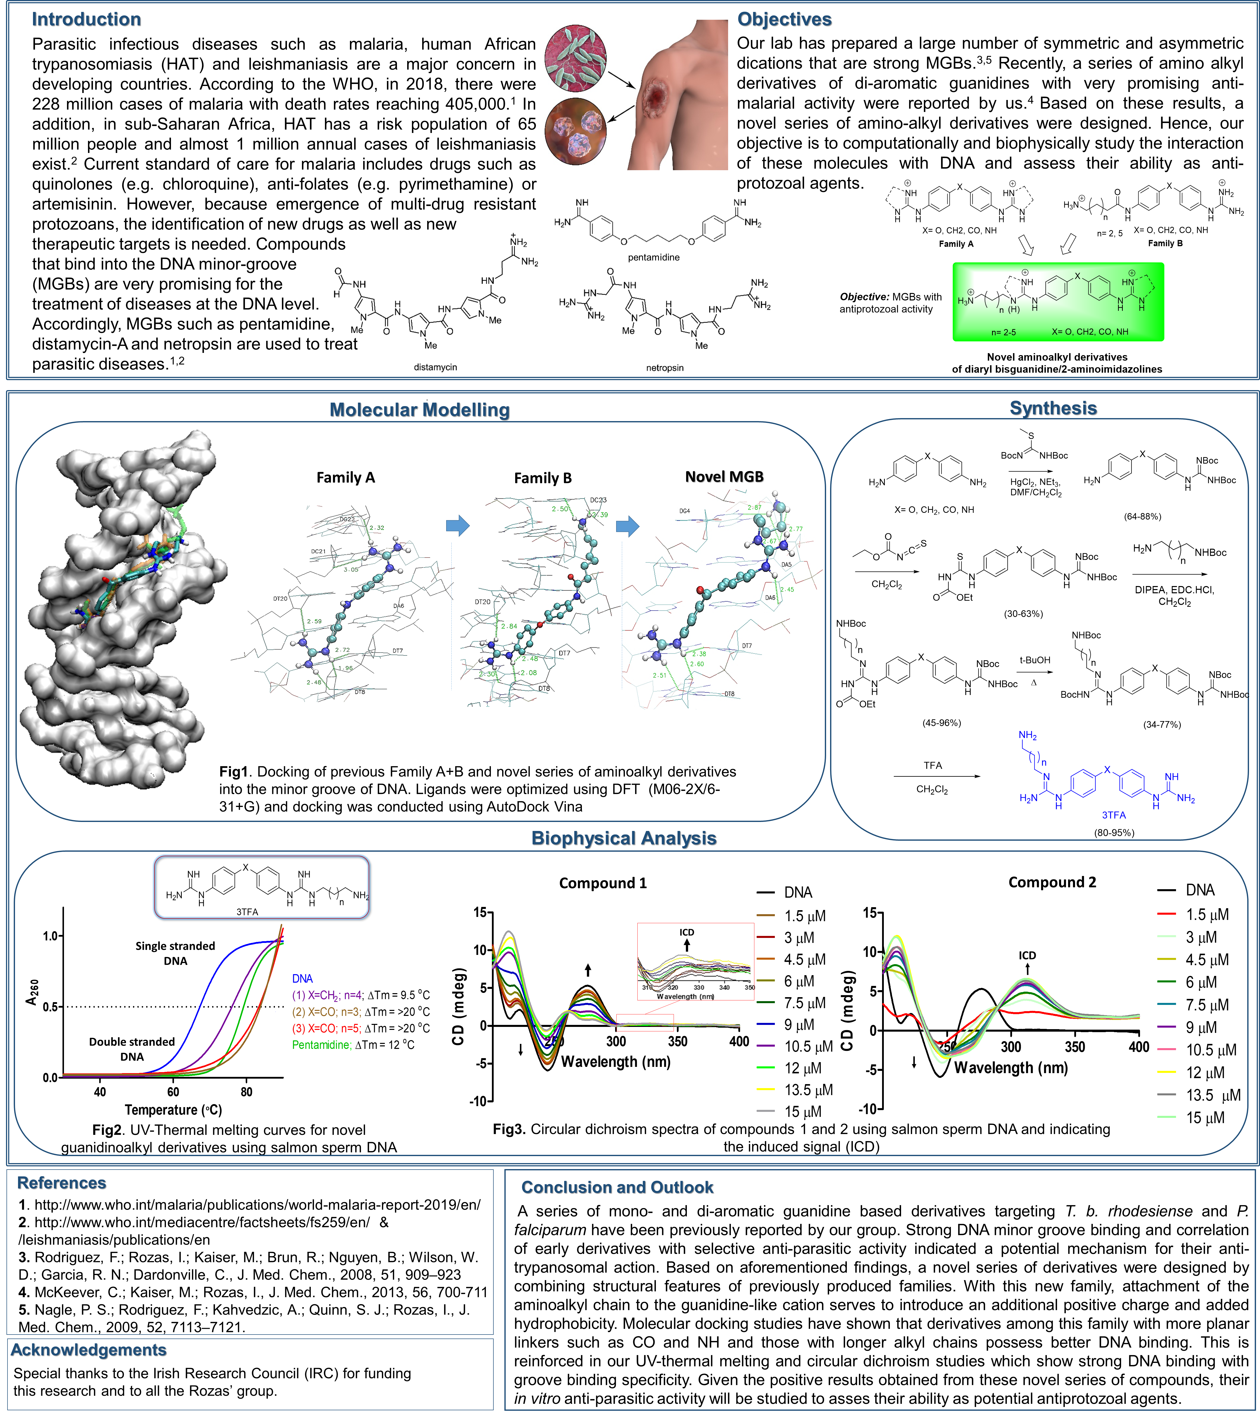
Derivatives of guanidine-based DNA minor groove binders as antiprotozoal agents
Adeyemi Rahman^{1*}, Isabel Rozas¹
¹School of Chemistry, TBSI, Trinity College Dublin, 152-160 Pearse St., Dublin 2
*Correspondence author: rahmanad@tcd.ie

