Slide 1
Pyrazolines from dehydrozingerone analogues: Cytotoxicity and morphological changes on HeLa cells
Jovana Muškinja^{1,2,}*, Jovan Luković³, Ivana Nikolić³, Marina Mitrović³ and Zoran Ratković ²
¹ Department of Science, Institute for Information Technologies, University of Kragujevac, Jovana Cvijića bb, 34000 Kragujevac, Serbia
² Department of Chemistry, Faculty of Science, University of Kragujevac, Radoja Domanovića 12, 34000 Kragujevac, Serbia
³Department of Biochemistry, Faculty of Medical Science, University of Kragujevac, Svetozara Markovića 69, 34000 Kragujevac, Serbia
* Corresponding author: jovana.muskinja@gmail.com

Slide 2
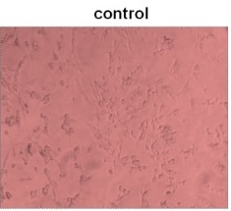
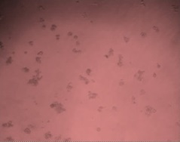
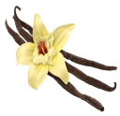
Pyrazolines from dehydrozingerone analogues: Cytotoxicity and morphological changes on HeLa cells
Hela cells

Slide 3
Abstract:
Ginger root is one of the most widely used natural product and is excellent source for many kinds of bioactive compounds. One of them is dehydrozingerone, also very attractive biological active compound. This compound served as a starting material in the synthesis of new derivatives. The synthesized products were used in reaction with formic acid and hydrazine hydrate in order to obtain N-formyl derivative of pyrazoline. All new compounds were identified and well characterized by IR, ¹H and ¹³C NMR spectroscopy and physical data. In vitro cytotoxic activity of pyrazolines against human cervical cancer (HeLa) was determined using MTT method. Tested concentrations of substances were 100, 150 and 200 µM. Morphology changes of treated cells were visualized and compared to untreated cells using microscopy.
Keywords: ginger; dehydrozingerone; pyrazoline; HeLa

Slide 4
Introduction
Many natural materials have served as healing agents in order to treat various diseases. One of the most well-known and used plant drugs, for this purpose, is the root of the ginger plant. Ginger has been used for a wide array of unrelated aliments that include arthritis, rheumatism, sprains, muscular aches, pains, sore throats, indigestion, hypertension, infectious diseases,…¹
Although the medicinal properties of ginger have been known for thousands of years, it is a very important fact that ginger root is also an excellent source of many types of active compounds. These compounds mostly have a broad spectrum of biological activities, such as antioxidant, anti-inflammatory, antimicrobial, anticancer, antidiabetic, anti-allergic,…²⁻⁸

Slide 5
In ginger root many bioactive compounds have been identified as phenolic compounds. The most famous of them are dehydrozingerone 1, zingerone 2, gingerol 3, shogaol 4, paradol 5 and their derivatives (Figure 1).
Figure 1. Structure of bioactive phenolic compounds in Ginger root

Slide 6
All these types of isolated compounds possess mutual property, they belong the vanilloid group of compounds, because they have a fragment of vanillin (also very significant natural product, Figure 2) in their structure.
Another very important fact is that two of them have conjugate enone system in their molecule and on this way they can be easily transformed into some usable heterocyclic derivatives, similar to corresponding chalcones ^{9,10} (Scheme 1).
Figure 2. Structure of vanillin fragment
Scheme 1. Synthesis of different heterocycles starting from chalcone
These properties made a good starting point for further synthesis. The aim of present study was to synthesize new heterocyclic products, starting from dehydrozingerone, and investigate their antitumor activity.

Slide 7
Results and discussion
Having in mind earlier described properties, we synthesized dehydrozingerone 2 in the large amount starting from vanillin 1. The next step was synthesis of new derivative of dehydrozingerone. It is known that the presence of different alkyl groups on chalcones, can lead to a remarkable increase in bioactivity^{11,12} and from this reason we wished to prepare series of dehydrozingerone O-alkyl derivatives. Alkylation of the phenolic group was achieved by standard procedure¹³⁻¹⁵ using an alkyl halides in order to obtain 4-(4-alkoxy-3-methoxyphenyl)-but-3-en-2-ones, 2b-f, Scheme 2.
Scheme 2. Synthesis of 4-(4-alkoxy-3-methoxyphenyl)-but-3-en-2-ones

Slide 8
In continuation of our interest in the synthesis of different heterocycles and starting from our previous results in dehydrozingerone derivatives transformation,¹⁶ we decided to prepare some similar pyrazolines, but with formyl group in their molecule. Therefore, we expected that some changes in the structure of the products would lead to changes in antitumor activity. From this reason, a small series of a new N-formyl pyrazolines, 5-(4-alkoxy-3-methoxyphenyl)-3-methyl-4,5-dihydro-1H-pyrazole-1-carbaldehyde, 3a-f (Scheme 3), were synthesized in reaction of dehydrozingerones with hydrazine in boiling formic acid.
Scheme 3. Synthesis of 5-(4-alkoxy-3-methoxyphenyl)-3-methyl-4,5-dihydro-1H-pyrazole-1-carbaldehydes

Slide 9
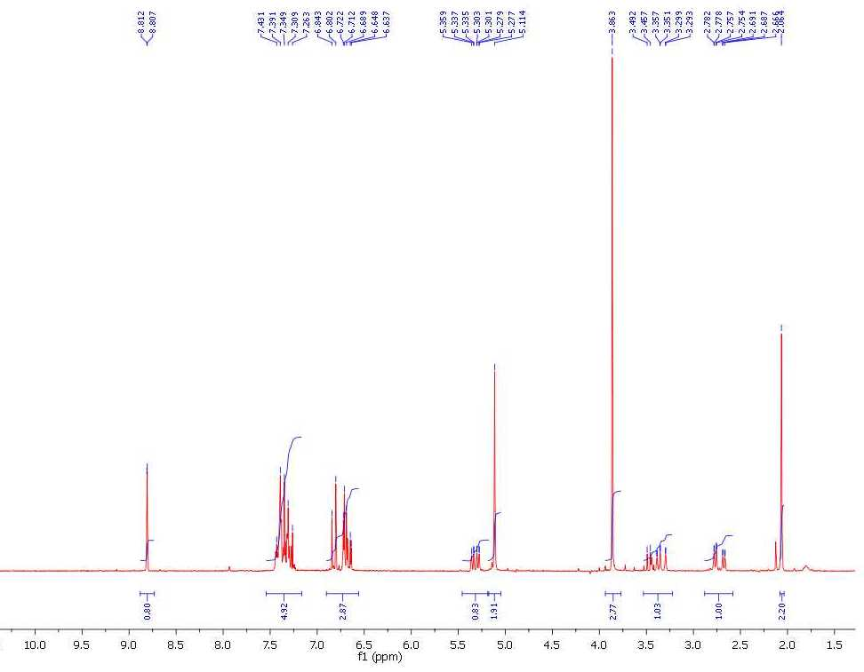
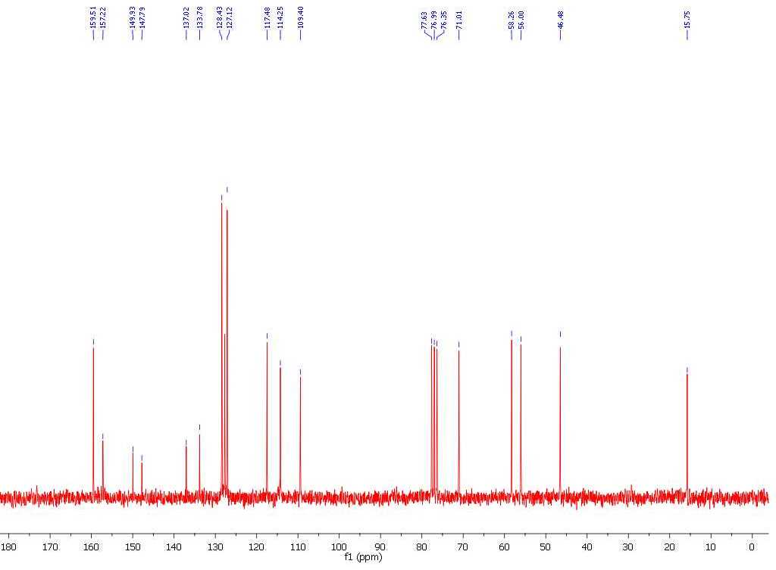
All new products were characterized by their spectral data (IR, ¹H NMR and ¹³C NMR). On Figures 3 and 4 are given NMR spectra of benzyl derivative of pyrazoline.
Figure 3. ¹H NMR spectrum of 5-(4-benzyloxy-3-methoxyphenyl)- -3-methyl-4,5-dihydro-1H-pyrazole-1-carbaldehyde
Figure 4. ¹³C NMR spectrum of 5-(4-benzyloxy-3-methoxyphenyl)- -3-methyl-4,5-dihydro-1H-pyrazole- 1-carbaldehyde

Slide 10
Cytotoxic effect of new pyrazolines had been tested on HeLa cells. Cells were seeded in a 96-well plate at 3x10³ cells/well. The cells were incubated at 37°C in 5% CO₂ atmosphere and absolute humidity for 48h with concentrations (100, 150 and 200 µM) in triplicate. Then, the cell culture media was removed, and 100μL of MTT solution (3-(4,5-dimethylthiazol-2-yl)-2,5-diphenyltetrazolium bromide, 0.5 mg/mL) was added to each well. After 2h incubation at 37°C, MTT solution was removed and 150µl of DMSO was added to the wells.
The absorbance was measured at 595nm using a multiplate reader (Zenyth 3100, Anthos Labtec Instruments).
The percentage of cytotoxic cells was calculated using the formula:
Cytotoxicity (%) = (1 - (exp. group (ABS)) / (control group (ABS)) x 100).¹⁷

Slide 11
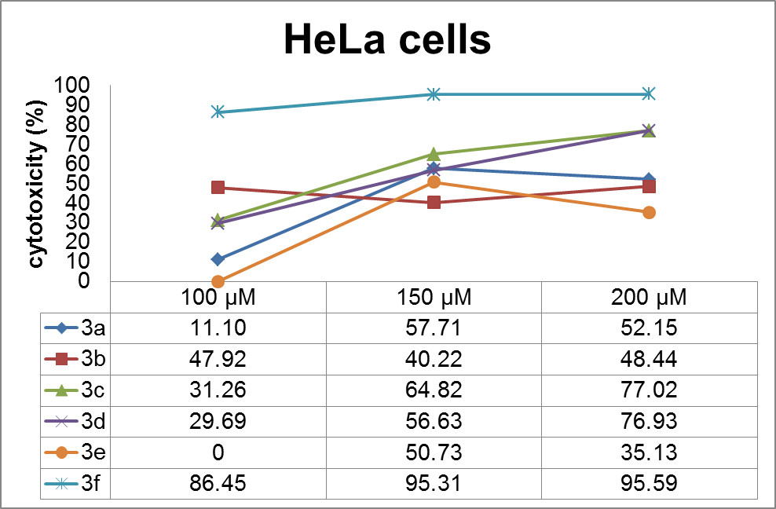
The cytotoxic effects of investigated pyrazolines are shown on Figure 5.
All compounds have cytotoxic activity against HeLa cells line, except 3e on 100µM concentration. Compounds 3c, 3d and 3f showed better cytotoxic effects compared to other test substances, and 3f exhibited the most effective cytotoxic effect on HeLa cells (100µM-86.45%; 150µM–95.31%; 200µM–95.59%).
Figure 5. The cytotoxic effects of 3a-f on HeLa cells after 48h treatment with various concentrations

Slide 12
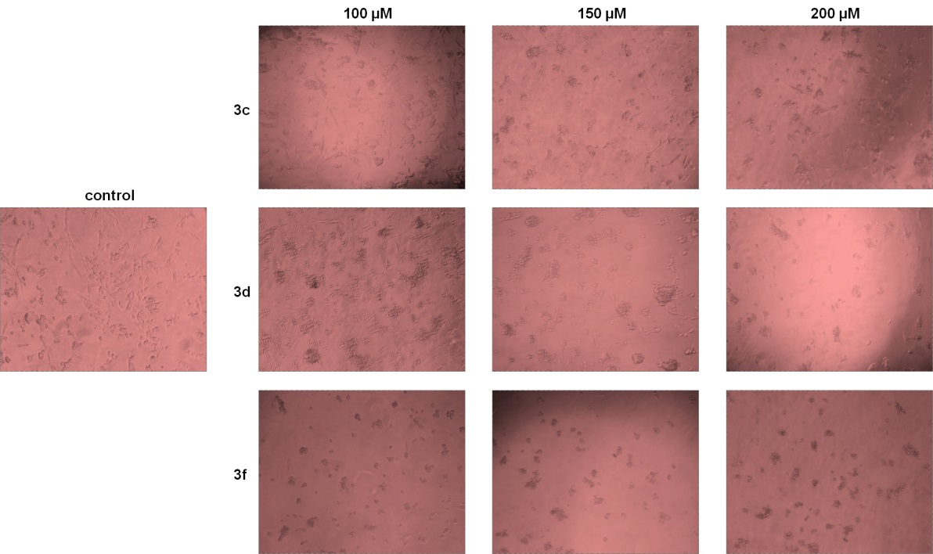
In order to determine and compare the cytotoxic effects of the tested substances on the morphology of treated and untreated HeLa cells, we have used phase-contrast microscope. The HeLa cells were seeded in a 24-well plate and incubated for 48h with different concentrations pyrazolines (100, 150 and 200 µM). Morphological changes of both (Figure 6), experimental and control HeLa cells, were visualized with phase contrast microscopy under 100 X magnification on Olympus microscope (model BX51).
Our results showed that compounds 3c, 3d and 3f induced morphological changes of HeLa cells in dose dependent manner compared to the control group. Morphological changes (loss of shape cells and decrease in the number cells) were observed by phase-contrast microscopy.
Figure 6. Changes of the HeLa cells morphology after 48h treatment with selected substances (3c, 3d and 3f).

Slide 13
Conclusions
Dehydrozingerone is present in different bioactive compounds and it is well known that he show a broad spectrum of biological activity. Conjugate enone system, which is presented in the dehydrozingerone, can be easily transformed. It is therefore, not surprising that many synthetic methods have been developed for the preparation of heterocycles. From this point of view the new derivative of pyrazolines were synthesized in very good yields starting from dehydrozingerone and its derivatives. All compounds were identified with IR and NMR spectra.
In vitro cytotoxic activity against HeLa cell line was performed in different concentration, and results showed that products have a very pronounced cytotoxicity, especially compounds 3c, 3d and 3f. In order to compare cytotoxic effects the most active substances, morphology changes of HeLa cells were monitored.
The results showed that our compounds would be good candidates for further investigation of antitumor activity and more detailed investigation are in progress.

Slide 14
References
Badreldin, H.A., Gerald, B., Musbah, O.T., Abderrahim, N. Food Chem. Toxic. 2008, 46, 409.
Nile, S.H., Park, S.W. Ind. Crop. Prod. 2015, 70, 238.
Zhang, M., Viennois, E., Prasad, M., Zhang, Y., Wang, L., Zhang, Z., Han, M.K., Xiao, B., Xu, C., Srinivasan, S. Merlin, D. Biomaterials 2016, 101, 321.
Kumar, N.V., Murthy, P.S., Manjunatha, J.R., Bettadaiah, B.K. Food Chem. 2014, 159, 451.
Citronberg, J., Bostick, R., Ahearn, T., Turgeon, D.K., Run, M.T., Djuric, Z., Sen, A., Brenner, D.E., Zick, S.M. Cancer Prev. Res. 2013, 6, 271.
Dugasani, S., Pichika, M.R., Nadarajah, V.D., Balijepalli, M.K., Tandra, S., Korlakunta, J. N. J. Ethnopharmacol. 2010, 127, 515.
Nakamura, H., Yamamoto, T. Mutat. Res. Lett. 1983, 122, 87.
Semwal, R.B., Semwal, D.K., Combrinck, S., Viljoen, A.M. Phytochemistry 2015, 117, 554.
Abdel-Rahman, A.A.H., Abdel-Megied, A.E.S., Hawata, M.A.M., Kasem, E.R., Shabaan, M.T. Monatshefte 2007, 138, 889.
Kalirajan, R., Sivakumar, S.U., Jubie, S.; Gowramma, B., Suresh, B. Int.J. ChemTech. Res. 2009, 1, 27.
Wang, Y., Tan, W., Li, W.Z., Li , Y. J. Nat. Prod. 2001, 64, 196.
Huang, C., Zhang, Z., Li, Y. J. Nat. Prod. 1998, 61, 1283.
Katritzky, A.R., Long, Q., He, H., Qiua, G., Wilkox, A.L. Arkivoc, 2006, vi, 868.
Tatsuzaki, J., Bastow, K.F., Nakagawa-Goto, K., Nakamura, S., Itokawa, H., Lee, K. J. Nat. Prod. 2006, 69, 1445.
Leov, B., Dawson, C.R. J. Am. Chem. Soc. 1956, 78, 6095.
Ratković, Z., Muškinja, J., Burmudžija, A., Ranković, B., Kosanić, M., Bogdanović, G.A., Simović-Marković, B., Nikolić, A., Arsenijević, N., Đorđević, S., Vukićević, R.D. J. Mol. Struct. 2016, 1109, 82.
Riss, T.L., Moravec, R.A., Niles, A.L., Duellman, S., Benink, H.A., Worzella, T.J., Minor, L. Cell Viability Assays, Assay Guid. Man. 2013, 114, 785.

Slide 15
Acknowledgments
The authors are grateful to the Ministry of Education, Science and Technological, Development of the Republic of Serbia (Project number 172034) for financial support.

