Slide 1
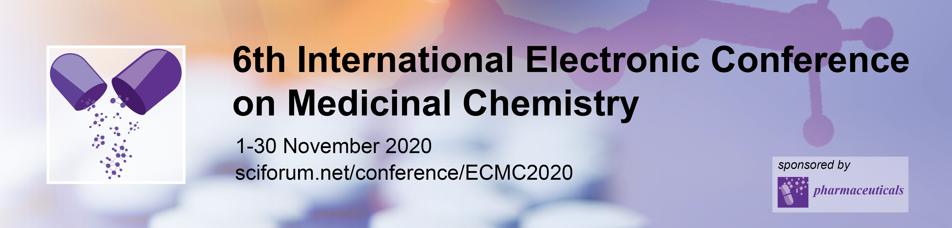
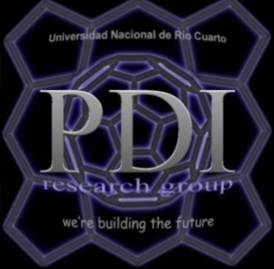


Evaluation of different quantification methods to determine the photodynamic inactivation of bacterial biofilms
Rocío Acosta¹, Verónica González¹, Edgardo Durantini¹ and Mariana Spesia^{1,}*
¹ Departamento de Química, Instituto de Desarrollo Agroindustrial y de la Salud (IDAS) – Universidad Nacional de Río Cuarto (UNRC) – CONICET, Ruta Nacional 36 Km 601, X5804BYA Río Cuarto, Córdoba, Argentina
* Corresponding author: mspesia@exa.unrc.edu.ar

Slide 2
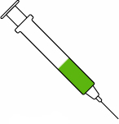
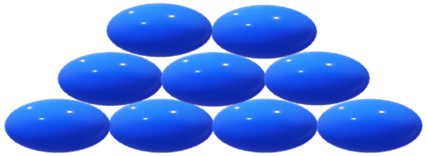
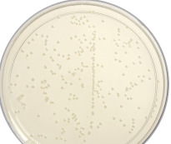



Evaluation of different quantification methods to determine the photodynamic inactivation of bacterial biofilms
Graphical Abstract
Mature biofilm
Photosensitized biofilm
Photoinactivated biofilm
Spread plate
method
Crystal violet assay
MTT assay
DMMB assay

Slide 3
Abstract: Biofilms are a crucial factor in persistent infections. This global health threat has stimulated interest in the development of effective antimicrobial drugs and therapies. Photodynamic Inactivation (PDI) uses a photosensitizer and light to produce reactive oxygen species under aerobic conditions, which damage cellular components, inducing the death of microorganisms. In this work, the photodynamic action of 5,10,15,20-tetra (4-N,N,N-trimethylammoniophenyl) porphyrin (TMAP⁴⁺) on the Gram positive Staphylococcus aureus and the Gram negative Escherichia coli biofilms was quantified by different methods. First, the plate count technique showed that PDI is more efficient on S. aureus than E. coli biofilm, and the photodynamic effect increases with irradiation time. The crystal violet staining did not allow distinguishing significant differences between biofilms with or without treatment of both bacteria. On the other hand, the MTT method showed that there was a decrease in the number of viable cells as the irradiation time increased for both strains. Finally, DMMB staining determined that the amount of matrix present in the biofilm decreased as fluence increased, being more evident in S. aureus than in E. coli. Increasing knowledge about the PDI target on biofilms allows the design of more specific control strategies for its efficient eradication.
Keywords: bacteria - biofilms - photodynamic inactivation - porphyrin - quantification methods

Slide 4
Introduction
Photodynamic inactivation of biofilms
Biofilm
Photosensitized biofilm
Photoinactivated Biofilm
Photosensitizer
Bacteria
Gram positive
Staphylococcus aureus ATCC 25923
Gram negative
Escherichia coli
λ_{abs}(nm) | λ_{em}(nm) | ε (M⁻¹cm⁻¹) | Φ_{F} | Φ_{Δ}
412 | 644 | 1,78x10^{5 a} | 0,12^{b} | 0,65^{b}
ª water, ^{b} DMF

Slide 5
Results and discussion
Spread plate method
Planktonic
S. aureus
E. coli
̴4 log
̴2 log
PDI of both planktonic bacteria was possible with low concentrations of TMAP and light doses

Slide 6
Results and discussion
Spread plate method
Biofilm
S. aureus
E. coli
̴ 2 log
̴ 3 log
PS concentrations and light doses must be higher to get a PDI similar to that obtained in planktonic cultures.

Slide 7
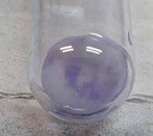
Results and discussion
Crystal violet assay
S. aureus
E. coli
No significant differences were found between the control and treated biofilms. This is because this assay stain both living and dead cells and the extracellular matrix that surrounds them.

Slide 8
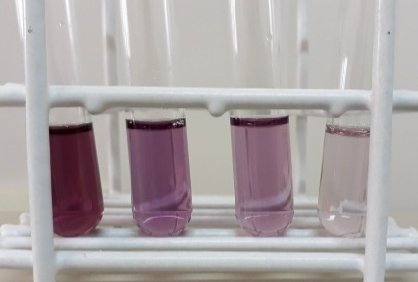
Results and discussion
3-(4,5-dimethylthiazol-2-yl)-2,5-diphenyl tetrazolium (MTT) assay
S. aureus
E. coli
 | Absorbance 550 nm
Control | 0.609
Dark Control | 0.600
Wash Control | 0.569
10 min irradiation | 0.193
20 min irradiation | 0.118
30 min irradiation | 0.070
 | Absorbance 550 nm
Control | 0.174
Dark Control | 0.125
Wash Control | 0.100
10 min irradiation | 0.058
20 min irradiation | 0.056
30 min irradiation | 0.050
68,3 %
66,7 %
80,6 %
67,8 %
88,5 %
71,3 %
Decrease in cell viability in irradiated biofilms as the time of exposure to light increases.

Slide 9
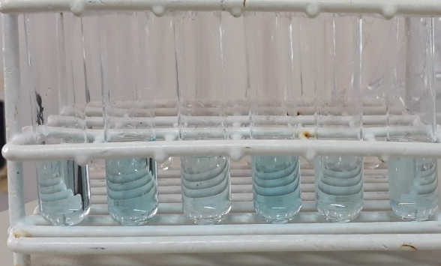
Results and discussion
1,9-Dimethyl-Methylene Blue (DMMB) assay
S. aureus
E. coli
 | Absorbance 620 nm
Control | 0.250
Dark control | 0.180
Wash control | 0.134
10 min irradiation | 0.165
20 min irradiation | 0.133
30 min irradiation | 0.102
 | Absorbance 620 nm
Control | 0.242
Dark control | 0.246
Wash control | 0.180
10 min irradiation | 0.167
20 min irradiation | 0.160
30 min irradiation | 0.139
34,0 %
31,0 %
46,8 %
33,9 %
59,2 %
42,6 %
The combination of TMAP⁴⁺ and white light induces a decrease in the exopolysaccharide matrix, increasing its destruction as the irradiation times lengthen.

Slide 10
Conclusions
Spread plate method: Longer irradiation times and PS concentrations were required to produce an efficient inactivation in biofilms similar to that achieved in planktonic state in both strains.
CV Assay: This technique cannot be used to quantify the effect of PDI because the dye stains total biomass.
MTT Assay: A decrease in viable cells was observed as the time of exposure to light increased in both bacterial strains.
DMMB Assay: The amount of extracellular matrix present in the biofilm decreases with increasing irradiation times.
TMAP⁴⁺ is an effective cationic PS for the eradication of both Gram positive and negative bacterial biofilm and therefore, PDI can be considered as an interesting alternative therapy for the treatment of bacterial biofilms infections.

Slide 11
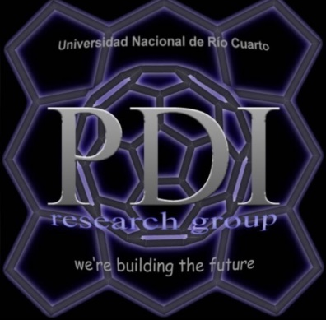



Acknowledgments

