Slide 1


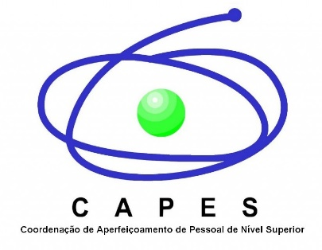

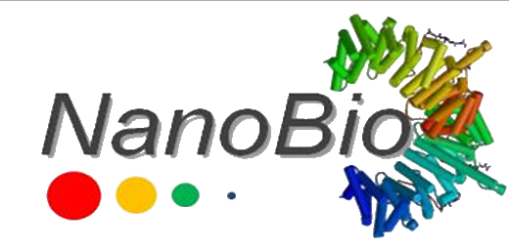
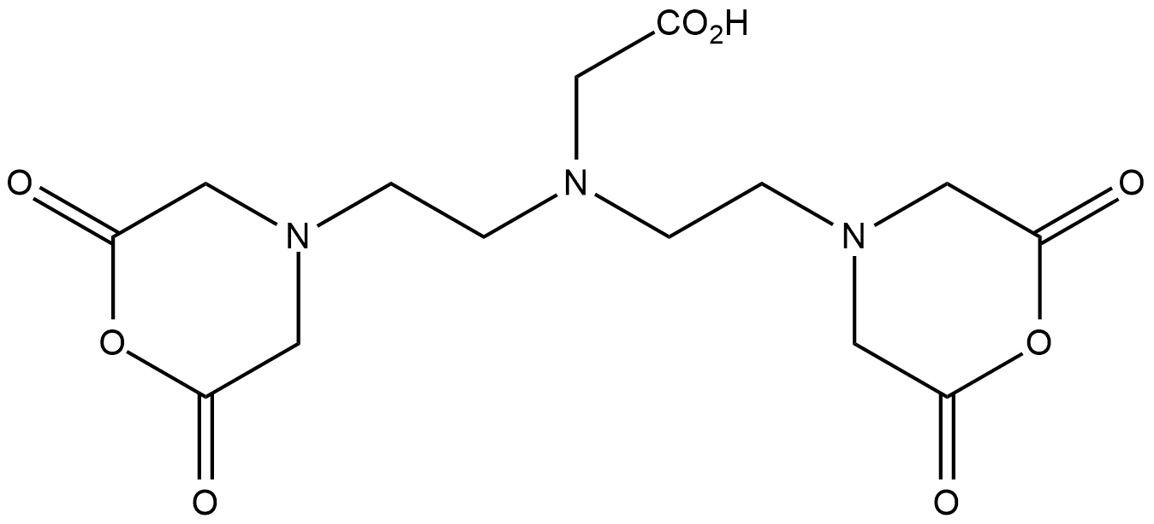
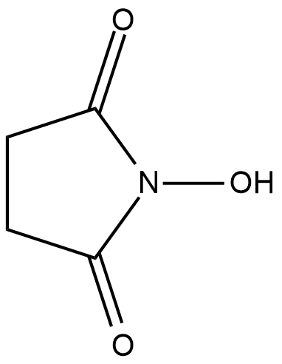
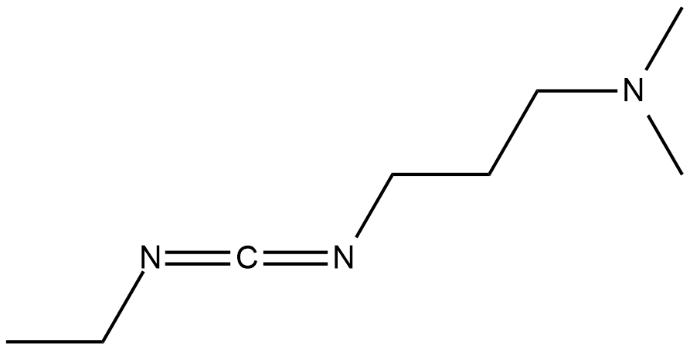
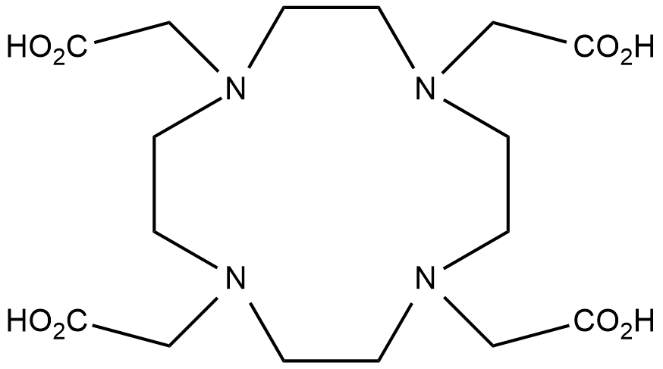
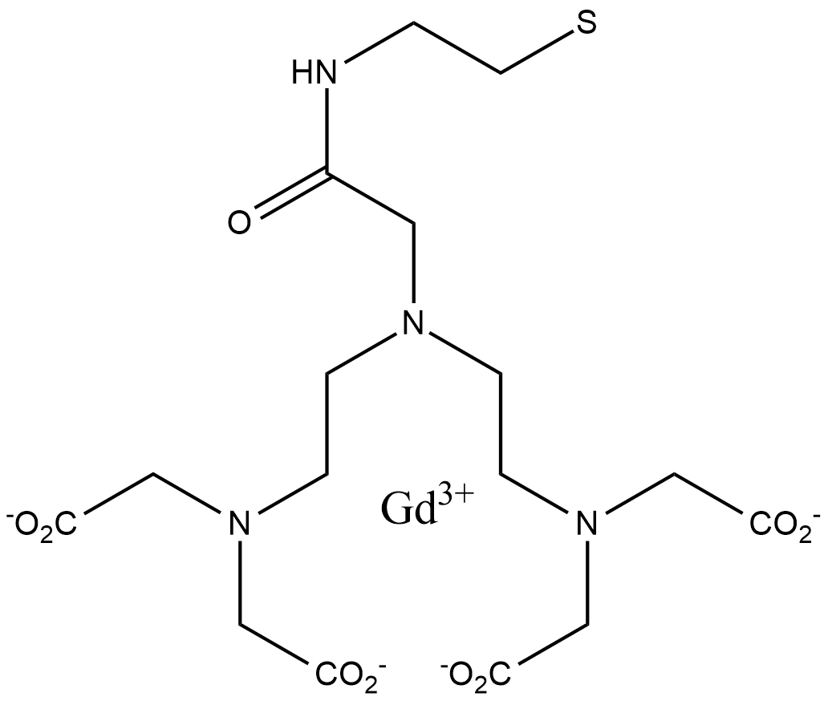
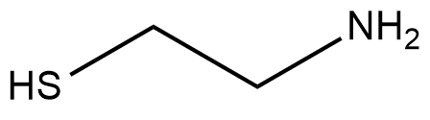
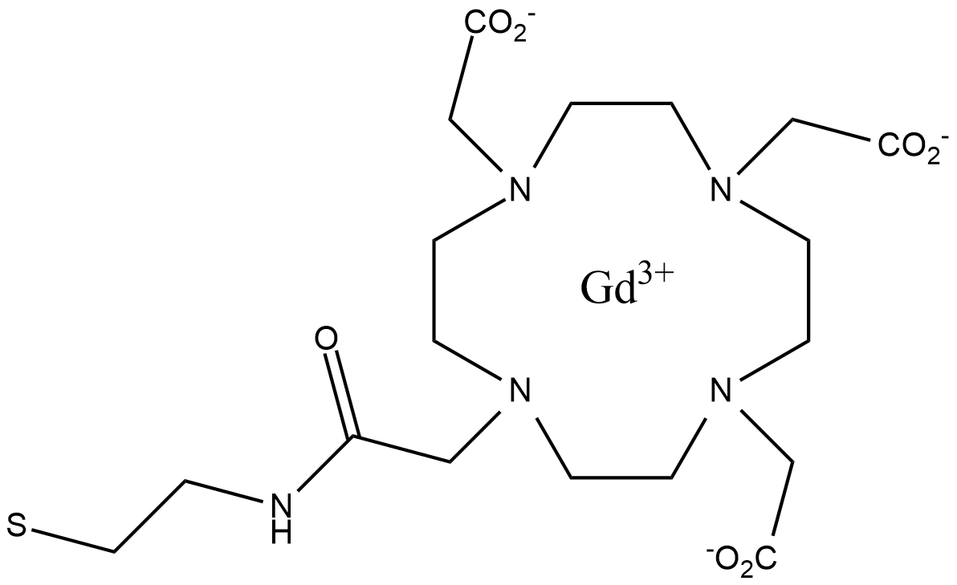
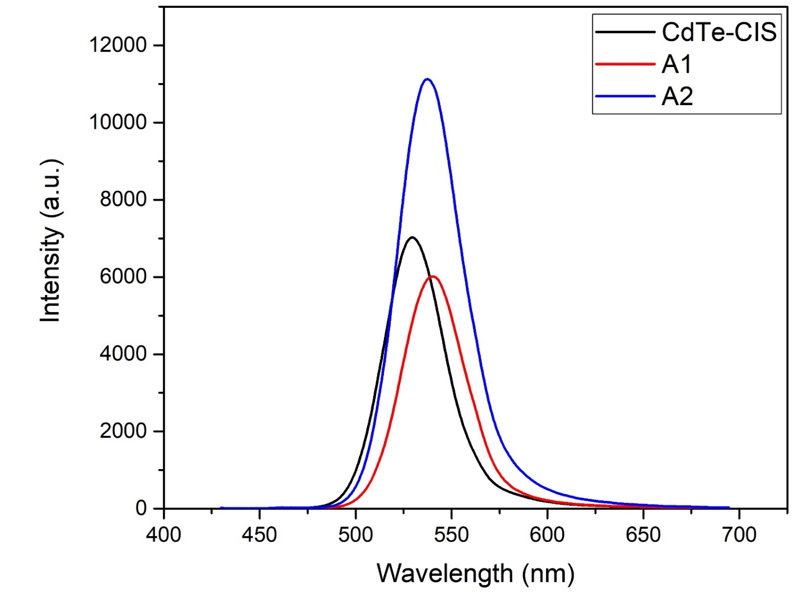
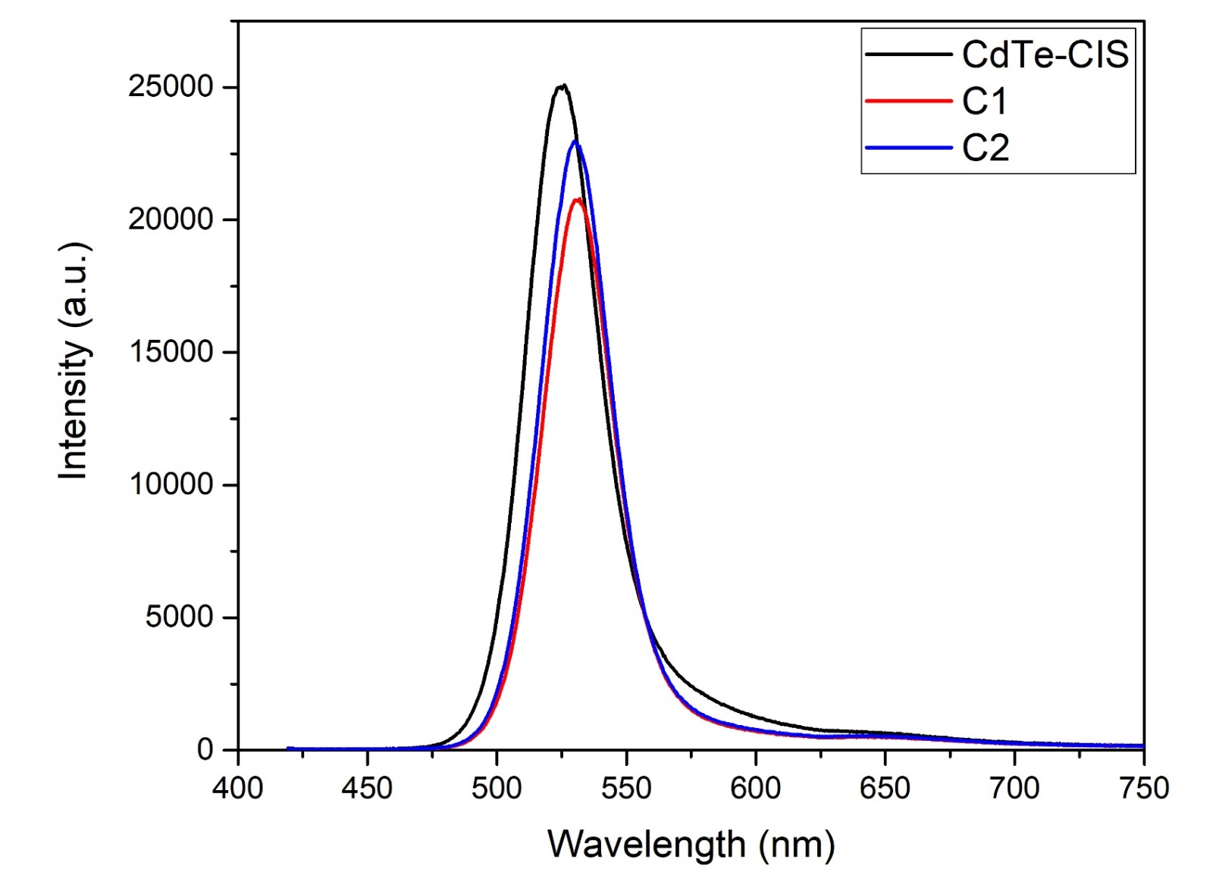

Bimodal nanoprobes based on cationic quantum dots and Gd³⁺ chelates prepared by covalent and dative bonds for optical and magnetic resonance imaging
Samantha Dantas Coiadoª*, Gabriela M. Albuquerqueª, Izabel G. Souza Sobrinhaª, Giovannia A. L. Pereiraª, Goreti Pereiraª
ªFundamental Chemistry Department, Federal University of Pernambuco, Recife, Brazil.
*e-mail:samanthadantasc@hotmail.com
INTRODUCTION
Magnetic Resonance Imaging (MRI) is a non-invasive diagnostic technique that allows the visualization of soft tissues. Despite offering advantages over other methods, it has low sensitivity, making it necessary sometimes to use contrast agents (CAs). To improve de CAs efficiency, new strategies have been developed. Among them are the bimodal systems that associate nanoparticles and gadolinium chelates.¹
Quantum dots (QDs) are fluorescent nanoparticles, made of semiconductor material, that have unique optical properties. These nanoparticles have been widely used in biomedicine, because they have an active surface, allowing conjugation with (bio)molecules. Thus, they can contain a large number of Gd³⁺ complexes on their surface, consequently increasing the contrast enhancement.²
In this work, CdTe QDs functionalized with cysteamine were conjugated to gadolinium complexes (DOTA e DTPA), obtaining bimodal systems with optical and paramagnetic properties.
METHODOLOGY
Covalent Approach
Gd³⁺
(GdCl₃)
Covalent
System A1: 1) DTPAa + EDC+NHS; 2) QD; 3) Gd³⁺
System A2: 1) DOTA + EDC+NHS; 2) Gd³⁺ ; 3) QD
Non-covalent
System C1: 1) DTPAa + EDC+NHS; 2) CIS; 3) Gd³⁺; 4) QD
System C2: 1) DOTA + EDC+NHS; 2) CIS; 3) Gd³⁺; 4) QD
DTPAa
NHS
EDC
Gd³⁺
(GdCl₃)
DOTA
NHS
EDC
Non-Covalent Approach
Gd³⁺
(GdCl₃)
OR
DOTA
NHS
CIS
OR
DTPAa
EDC
RESULTS
Optical characterization
CdTe-DTPA-Gd
(A1 e C1)
Relaxometric characterization
Systems | T₁ (ms) | r₁* (mM⁻¹s⁻¹)
 |  | Per Gd | Per QD
CdTe-CIS | 3630 | - | -
A1 | 1710 | 7,3 | 29,5
A2 | 1376 | 13,7 | 43,1
C1 | 1750 | 6,2 | 25,1
C2 | 2400 | 3,3 | 10,3
CdTe-DOTA-Gd
(A2 e C2)
CONCLUSION
References:
¹Pereira, G. A.; Geraldes, C. F. G. C., Ann Magn Reson 2007, 6, 1-33.
²Pereira, G.; Leite, E. S.; Pereira, G. A. L.; Fontes, A.; Santos, B. S. Quantum Dots. In: Margarita Sanchez-Dominguez, Carlos Rodriguez-Abreu. (Org.). Nanocolloids. 1ed.: Elsevier, 2016, 1, 131-158.
³Matos, A. L. L.; Pereira, G.; Cabral Filho, P. E.; Santos, B. S.; Fontes, A. J. Photochem. Photobiol. B, 2017, 171, 43.
Acknowledgements: CNPq, CAPES and UFPE.
For CdTe-DTPA-Gd systems, it was not observed a significant difference between the two methodologies. However, for the bimodal systems CdTe-DOTA-Gd, the covalent approach seems more adequate, since the relaxometric properties were enhanced, giving CAs with a relaxivity value of 3 times higher thant the clinically used DOTA-Gd. The results obtained showed that these systems are promising bimodal agents for biological studies by fluorescence and MRI.

