Slide 1
Vanillin based chalcone analogue induces cell death in HeLa and HCT-116 cell line through mitochondrial apoptotic pathway
Jovan Lukovic ¹, Marina Mitrovic ¹, Zoran Ratković ², Jovana Muškinja ², Marija Anđelković ¹, Marina Živić ³, Tanja Zečević-Luković ⁴, Ivana Nikolic ^{1,}*
¹ University of Kragujevac, Serbia, Faculty of Medical Sciences, Department of Biochemistry; Svetozara Markovica 69, 34000 Kragujevac, Serbia
² University of Kragujevac, Department of Chemistry, Faculty of Science, Radoja Domanovića 12, 34000 Kragujevac, Serbia
³ University of Kragujevac, Serbia, Faculty of Medical Sciences, Department of Physical medicine and rehabilitation; Zmaj Jovina 30, 34000 Kragujevac, Serbia
Dom Zdravlja Cajetina, 34000 Serbia
* Corresponding author – Ivana Nikolic: angelkg2009@gmail.com

Slide 2
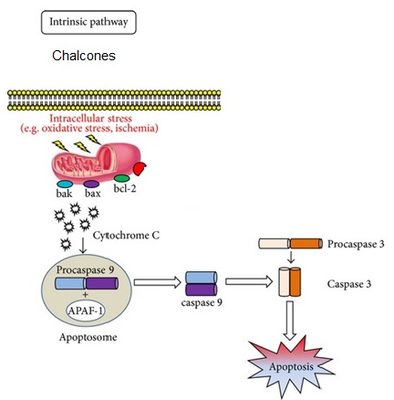
Vanillin based chalcone analogue induces cell death in HeLa and HCT-116 cell line through mitochondrial apoptotic pathway
Graphical Abstract

Slide 3
Abstract:
Application of organic heterocyclic compounds as anti-tumor therapeutics are limited due to therapeutic drawbacks including resistance of tumor cells, non-selectivity of the administered drug towards healthy cells and abundance of unwanted side effects.
The aim of our research was to investigate and compare both the antitumor effect and the mechanism of action of newly synthesized, so far untested chalcone analogue on HeLa, HCT-116 cells and healthy human fibroblast lung cell line (MRC-5).
The antitumor efficiency of investigated chalcone analogue was compared to the antitumor effects of dehydrozingerone and cysplatin that were used as referent substances. Cytotoxic and apoptotic effect were evaluated using both MTT test and flow cytometry by Annexin V-FITC/7-AAD staining.
The results of our investigation indicated that newly synthesized chalcone analogue H5 expressed more powerful antitumor effect compared to the effects of both dehydrozingerone and cisplatin. Cell death was mediated via apoptotic pathway.
Keywords: apoptosis, chalcone, cell death

Slide 4
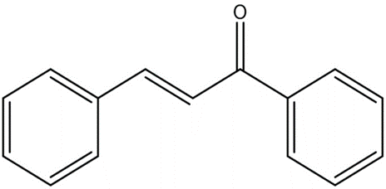
Introduction
Chalcones represent precursor compounds for flavonoids biosynthesis in plants. Chalcones, 1,3-diaryl-2-propen-1-ones, have unique chemical structure with conjugated double bonds and delocalized -electron system on both aromatic rings.
Chalcones structural formula
Various studies have shown that chemical structure of chalcone is responsible for their antitumor effect.

Slide 5
Introduction
In our research we have evaluated antitumor effect of vanillin based chalcone analogue (E)-1-(3-metoxy-4-propoxyphenyl)-5-methylhex-1-en-3-оn (marked as H5) on tumorous HeLa, HCT-116 cells and healthy MRC-5 cells.
The concentrations of H5 that were used in order to determine the cytotoxic effect were in the range of 0.3; 1; 3; 10; 30; 100 and 300 µM.
Antitumor effect of our chalcone analogue was compared with the effect of dehydrozingerone and cysplatin after 24 and 48 h treatment.
Methods that were used in our experiments were MTT test for the determination of cytotoxic effect and flow cytometry by Annexin V-FITC/7-AAD staining for the purpose of determination of the type of the cell death and expression and localization of N terminal, active Bax protein using immunofluorescence method.

Slide 6
Results and discussion
The data indicate that H5 showed the concentration-dependent significant cytotoxic effect on both HeLa and HCT-116 cells after 24 and 48 h treatment (slide 7 and 8).
The cytotoxic effect of H5 on healthy MRC-5 cells in evaluated time periods and concentrations was not significant (slide 9).
IC50 values for all tested substances that were tested in both time intervals were calculated and demonstrated on slide 10.
These concentrations were used in order to determine apoptotic mechanism.
In the next experiment we have evaluated the type of the cell death induced by H5 (slide 11) as well as expression of active Bax protein (slide 12).

Slide 7
Results and discussion

Slide 8
Results and discussion

Slide 9
Results and discussion

Slide 10
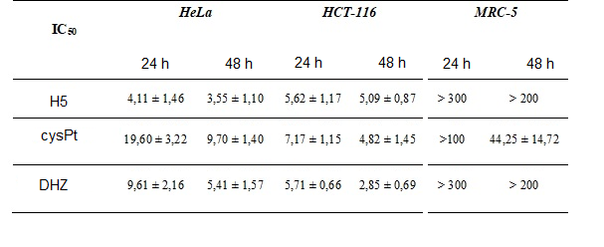
Results and discussion
IC₅₀ concentration values for all tested substances during 24 and 48 h period

Slide 11
Apoptotic effects of all tested substances during 24 and 48 h period
N- necrosis; LA- late apoptosis; EA- early apoptosis

Slide 12
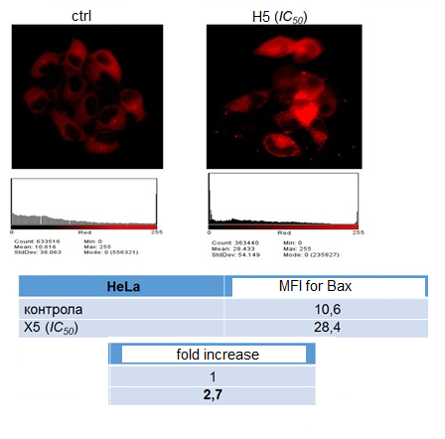
Results and discussion
In order to determine the apoptotic mechanism involved in H5 induced cell death, HeLa and HCT-116 cells were treated with IC50 concentration of H5, after witch the expression and localization of mitochondrial, active Bax (N-terminal) protein was evaluated using specific antibody and immunofluorescence method.
Intensity of immunofluorescence was evaluated using ImageJ software.
Results indicate that treatment of HeLa and HCT-116 cells with H5 caused 2.7 and 2.6 fold increase in the expression of N terminal, active Bax protein compared to control, untreated cells.

Slide 13
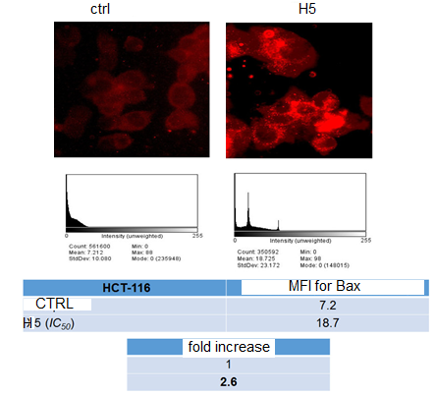
Results and discussion
The data indicate that H5 treatment caused delocalization of active, N terminal Bax protein from cytosol to mitochondria, consequently causing the release of cytochrome c into cytosol and formation of APAF-1, thus indicating the involvement of mitochondria in H5 mediated cell death

Slide 14
Results and discussion
There are many options in cancer therapy, including surgery, radiotherapy and immunotherapy, but nevertheless treatment with anti-cancer drugs due to their non-selective cytotoxicity remains the primary option.
Due to the cytotoxic and numerous adverse effects of currently available anti-cancer drugs on healthy cells, it is necessary to synthesize new compounds
with more efficient antitumor effect.
Chalcones are precursor compounds for flavonoids biosynthesis in plants. Changes in their chemical structure have offered a high degree of biological diversity that has proven to be useful for the development and synthesis of new medicinal agents.
These medicinal agents exhibit lesser toxicity on normal cells and greater selectivity towards tumor cells compared to natural agents.
For example, twelve structural Millepachine analogues (especially(3-hydroxy-4-methoxyphenyl)(5-methoxy-2,2-
dimethyl-2H-chromen-8-yl)methanone) showed more effective anti-proliferative activity on five human cancer cell lines (A549, HeLa, HCT 116, A2780 and MGC803) compared to natural compound, Millepachine.

Slide 15
Conclusions
We herein reported for the first time anti-tumor effect H5 chalcone analogue and we showed that our synthesized chalcone had more effective antitumor
effect compared to other anti-tumor drugs, cysplatin and dehydrozingerone.
Antitumor effect was carried out with induction of inner, mitochondrial apoptotic pathway, the expression of active, N terminal, mitochondrial Bax protein was significantly higher in H5 treated cells compared to the control cells. This finding point out involvement of inner, mitochondrial pathway in apoptosis realization.
The effect of H5 on healthy cells was insignificant compared with the effect on HeLa and HCT-116 cells.

Slide 16
Acknowledgments
This study was financially supported by Faculty of Medical Sciences, University of Kragujevac (JP14/17)- Antitumorski efekat novosintetisanih analoga halkona na
vijabilnost tumorskih ćelija in vitro. Тhe authors wish to thank project called ‘’Preklinička ispitivanja bioaktivnih supstanci (PIBAS)’’, registry number 41010 for support.
We cordially thank for the help and courtesy of Suzana Popović (Faculty of Medical Sciences, University of Kragujevac, Serbia Center for Molecular Medicine and Stem Cell Research), prof. Zoran Ratković and dr Jovana Muškinja, Faculty of Chemistry, University of Kragujevac.

