Slide 1



2,6-Diphenyl-Imidazopyridine Derivatives as Novel Prototypes of Anticancer Agents Targeting Aldehyde Dehydrogenases.
Giovanni Petrarolo ^{1,}*, Edoardo L. M. Gelardi ², Giorgia Colombo ², Francesca Picarazzi ³, Mattia Mori ³, Silvia Garavaglia ², Fiona M. Frame ⁴, Klaus Pors ⁵ and Concettina La Motta ¹
¹ Department of Pharmacy, University of Pisa, Via Bonanno 6, 56126, Pisa, Italy;
² Department of Pharmaceutical Sciences, University of Piemonte Orientale, A. Avogadro, Novara, 28100, Italy;
³ Dipartimento di Biotecnologie, Chimica e Farmacia, University of Siena, 53100, Siena, Italy;
⁴ Cancer Research Unit, Department of Biology, University of York, Heslington, North Yorkshire YO10 5DD, UK;
⁵ Institute of Cancer Therapeutics, School of Pharmacy and Medical Sciences, Faculty of Life Sciences, University of Bradford, West Yorkshire BD7 1DP, UK .
* Corresponding author: giovanni.petrarolo@phd.unipi.it

Slide 2
2,6-Diphenyl-Imidazopyridine Derivatives as Novel Prototypes of Anticancer Agents Targeting Aldehyde Dehydrogenases.
Graphical Abstract
GA11
2,6-Diphenyl-Imidazopyridine Derivatives

Slide 3
Abstract:
Aldehyde dehydrogenase (ALDH) superfamily comprises 19 different enzyme types located in specific subcellular districts, including cytosol and mitocondria. Their main function is to oxidize endogenous and exogenous aldehydes produced in human cells. In particular, isoforms 1A1, 1A2 and 1A3 catalyze the transformation of retinal into retinoic acid, which is a potent differentiation tissue factor for cellular development. Overexpression of these three isoforms in cancer stem cells (CSC), underlined in recent studies, is to date extremely important in cancer field, as it offers the chance to use these proteins both as prognostic marker and as novel targets in the fight against cancer. Here we present a novel series of 2,6-diphenyl-imidazol[1,2-a]pyridines, designed as aldehyde dehydrogenase inhibitors by means of a structured-based optimizations of a previously developed lead, GA11. The novel compounds were evaluated in vitro for their activity and selectivity against the three isoforms of the ALDH1A family, and investigated through crystallization and modeling studies for their ability to interact with the catalytic site of the 1A3 isoform. Tested in vitro on different populations of CSCs, obtained from glioma, colorectal and prostate tissue specimens, they exhibited a relevant anti-proliferative efficacy, thus paving the way for treating cancer by means of the still untapped aldehyde dehydrogenases.
Keywords: ALDH1A;ALDH1A3 subtype, ALDH1A3 inhibitors, cancer; Imidazo[1.2-a]pyridine.

Slide 4
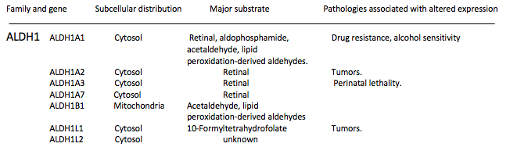
ALDHs
ALDH8
ALDH1
ALDH3
ALDH5
ALDH7
ALDH2
ALDH4
ALDH6

Slide 5
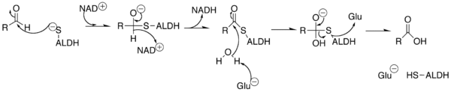
MAIN ALDHs FUNCTIONS
•
Reducing oxidative stress
ROS Production
•
Retinaldehyde
Retinoic Acid

Slide 6
Retinoic Acid
Two different pathways
Non-Target Tissue
Target Tissue
CYP26
Degradation
initiate the transcription of different kind of genes for differentiation, apoptosis.

Slide 7
• Metabolism of Glucose / Lipids
• Activity linked with several pathological conditions and cancer
• Highly active in both normal and
cancer stem cells (CSC)
ALDH1A overexpressed in CSC.
ALDH1A both as a prognostic marker and novel target against cancer

Slide 8
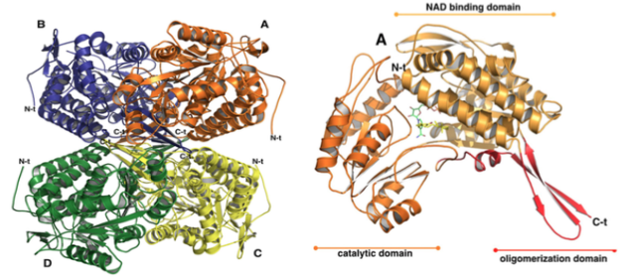
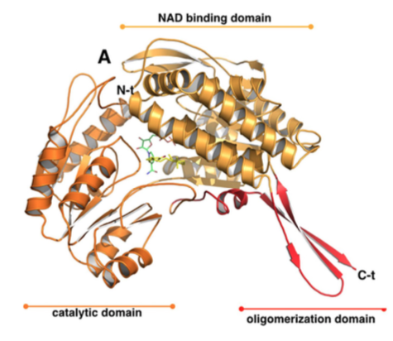
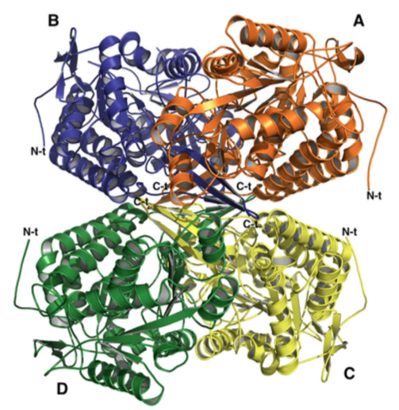
ALDH1A3
• molecular weight is around 224000 Da
•Despite this structure, each monomer is autonomously able to transform a single molecule of substrate in a molecule of product reducing NAD⁺.
• catalytic pocket: goes from the protein surface to the catalytic cysteine
• To govern substrate specificity, ALDH1A3 uses special residues (G135, L471, T315) located in the tunnel

Slide 9
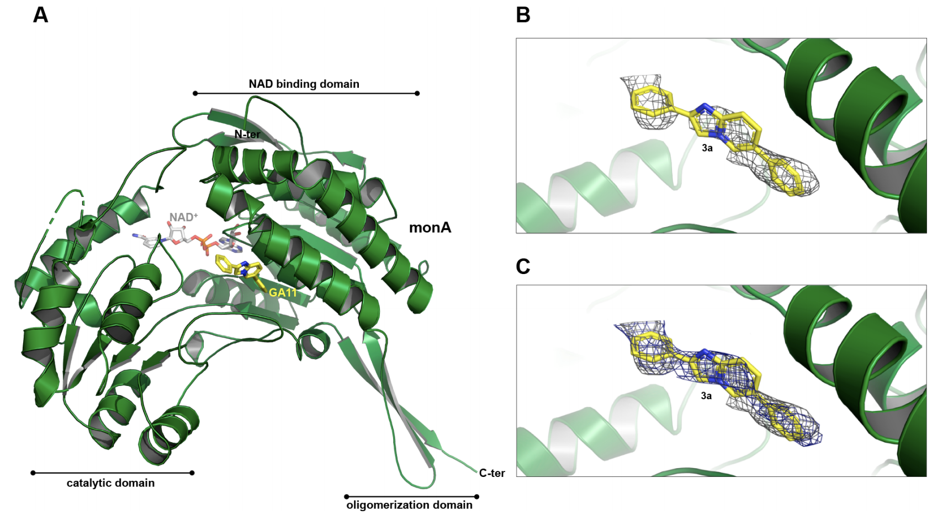
GA11
Anti-proliferativ efficacy on Glioma Stem Cells in the nanomolar/picomolar range
6
1
•π−π stacking interaction with W189
•Van der Waals contacts with G136, L185 and L471
Quattrini et al. J. Med. Chem., 2020, 14, 4603

Slide 10
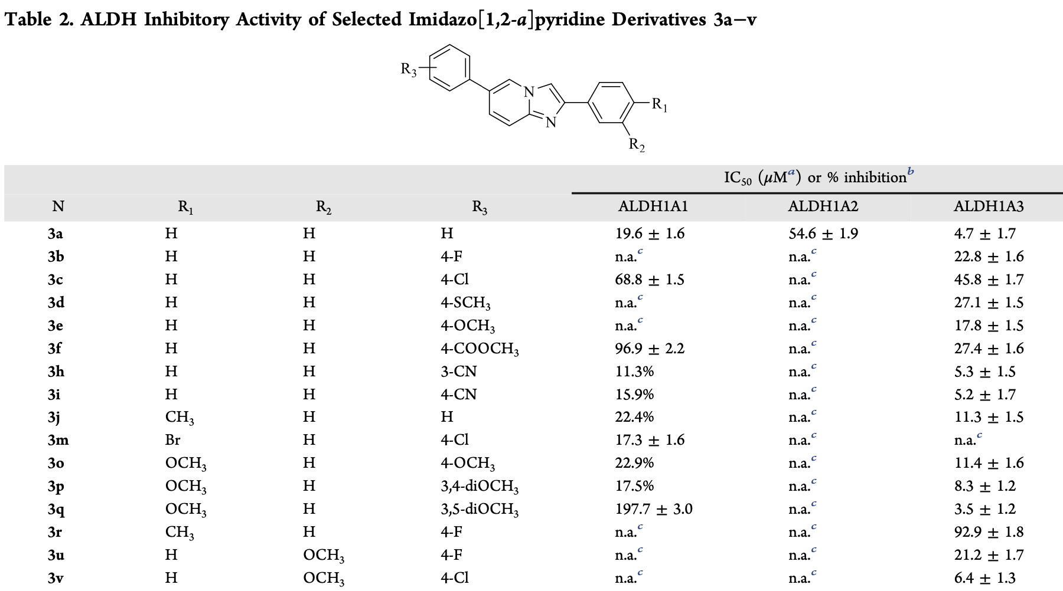

Slide 11
CYANIDE 2,6-DIPHENIL-IMIDAZO PYRIDINE
HALOGEN 2,6-DIPHENIL-IMIDAZO PYRIDINE
GLIOMA AND COLORECTAL CANCER CELL LINES
GLIOBLASTOMA AND PROSTATE CANCER CELL LINES

Slide 12
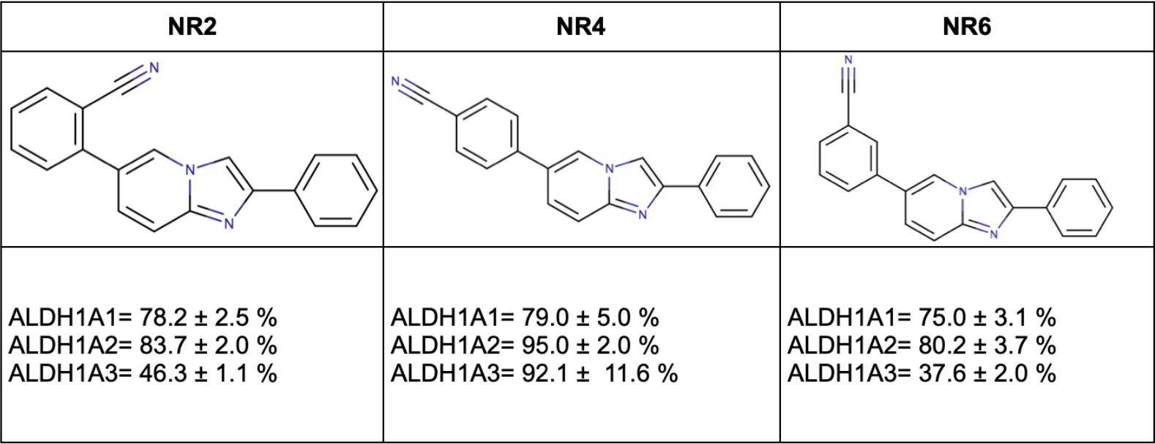
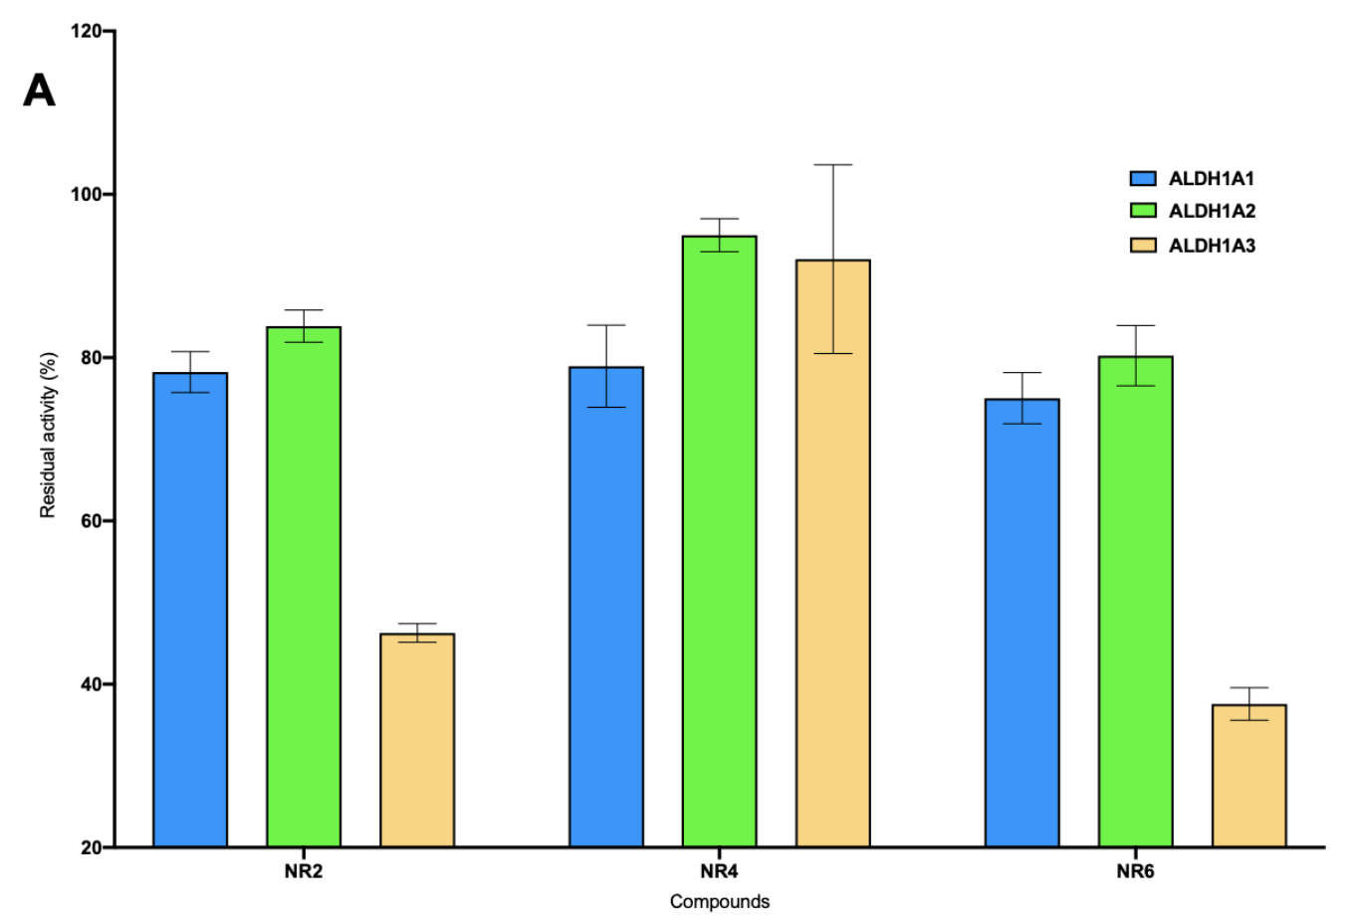
CYANIDE 2,6-DIPHENIL-IMIDAZO PYRIDINE
NR6, showed the best inhibitory activity at 25 μM; further investigation revealed a potent inhibitor activity with high specificity on isoform 1A3.
 | ALDH1A1 | ALDH1A2 | ALDH1A3
K_{i} (μM) | 262.2±76.4 | 257.6±26.4 | 3.7±0.4

Slide 13
•hU87MG (glioblastoma);
•hHCT116 (colorectal tumor).
ALDH1A3⁺
NR2
•hHEK293T
(human embryonic kidney).
ALDH1A2⁺
NR4
•hASTRO (foetal astrocytes).
ALDH1A1⁺
•h4T1 (mammary carcinoma).
NR6

Slide 14
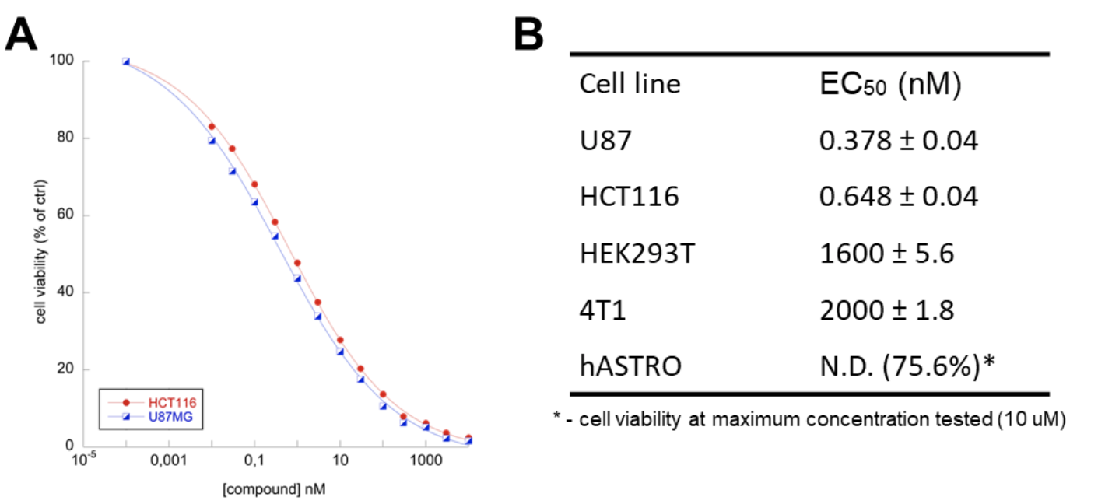
AFTER 72h TREATMENT

Slide 15
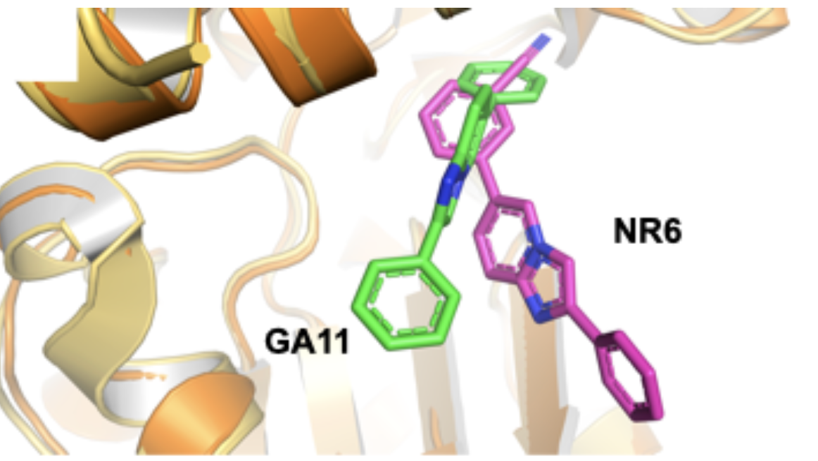
NR6
• NR6 not reaches the catalytic cysteine C314.
•The heterocyclic cores lie in the hydrophobic pocket at the entrance of the catalytic tunnel.
•the phenyl ring in 6 of the nucleus establishes Van der Waals contacts and hydrophobic interactions with the residues G136, R139, W189, N469, A470, L471 and Y472

Slide 16
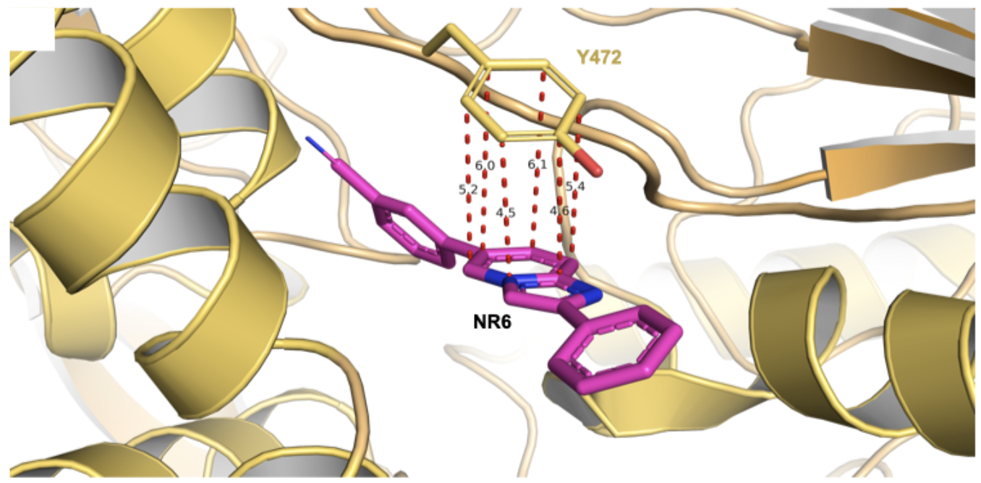
NR6
NOTABLE IMPORTANCE:
• Interaction of the pyridinc ring with Y472(edge-to face π-π stacking interaction) , for 1A3 specifity;
•Cyanide group that blocks the inhibitor in only one orientation toward Y472 (Difference with the symmetric structure of GA11).

Slide 17
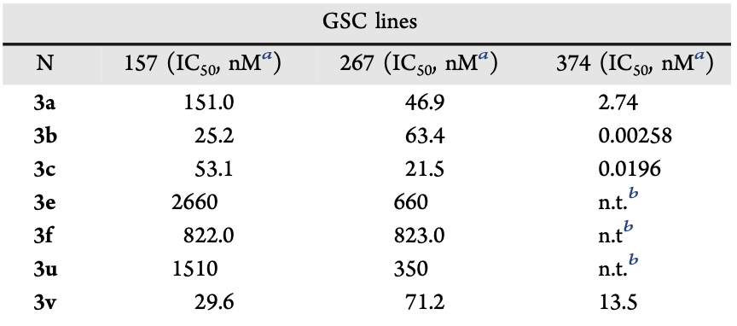
HALOGEN 2,6-DIPHENIL-IMIDAZO PYRIDINE
Test for antiproliferative efficacy against three different patient-derived glioma sphere samples; proneural (PN-157) and mesenchymal (MES-267 and MES-374). 72h EXPOSURE
The 6-(4-fluoro)phenyl derivative (3b), combining the best functional profile in terms of activity and selectivity against the ALDH1.

Slide 18
P4E6 (immortalised human prostate cell line)
LNCaP (androgen-sensitive human prostate adenocarcinoma cells)
Derivative 3b turned out to be the most potent analogue against P4E6 and PC3, with a reduced but comparable activity between LNCaP and the normal epithelial PNT2-C2 cell line.
PC-3 (human prostate cancer cell line)
PNT2-C2 (normal prostate epithelial cell line)
EC₅₀ (nM)
 | P4E6 | PC-3 | LNCaP | PNT2-C2
3b | 4.038 | 70.92 | 240.0 | 217.0
3c | 33.39 | 321.9 | 323.1 | 324.7
After 72 hours of exposure, all the compound exhibited antiproliferative activity in the nanomolar (nM) range in a dose-dependent manner.

Slide 19
Conclusions
•Moving from the previously described hit GA11 and taking advantage of both crystallographic studies and molecular modeling investigations, we succeeded in customizing the selectivity profile of the compound by varying its substitution pattern on both the pendant phenyl rings.
•Studies in vitro on recombinant human isoforms of ALDH1A, and on cell lines highlights the importance of this novel group of compounds in the fight against cancer targeting CSC and the overexpression of ALDH1A.
•in particular, the cyanide derivatives showed high efficacy on glioma and colorectal tumor cell lines instead the fluoro and chlorine derivatives underlined their potent activity on glioblastoma and prostate cancer cell lines.

Slide 20






Acknowledgments
Syntehsis:
•Vito Coviello.
•Luca Quattrini.
•Aida Agovi.
•Azzurra Mochi.
•Eleonora Vanni.
•Elisa Nannizzi.
For biological tests:
•Edoardo Luigi Maria Gelardi.
•Silvia Garavaglia.
•Menico Rizzi.
•Andrea Mangione.
•Davide M. Ferraris.
For modelling and docking tests:
•Mattia Mori.
•Francesca Picarazzi.
•Menico Rizzi.
•Ichiro Nakano.
•Fiona M. Frame.
•Norman J. Maitland.
•Klaus Pors.
•Maria Sadiq.
•Eleonora Aronica.

