Slide 1


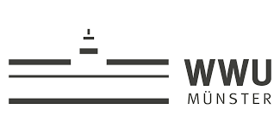

Indeno[1,2-b]indole Scaffold in Drug Discovery:
An Effective Template in Kinase Inhibitor Medicinal Chemistry
Robin Birus ¹, Christelle Marminon ^{2,3}, Dagmar Aichele ¹, Samer Haidar ¹, Marine Ousset ¹, Laurent Ettouati ², Faten Al Chab ², Solène Audebert ³, Marc Rolland de Ravel ³, Noël Pinaud ⁴, Zouhair Bouaziz ², Jean Guillon ⁵, Joachim Jose ^{1,}*, and Marc Le Borgne ^{2,3,}*
¹ Institute of Pharmaceutical and Medicinal Chemistry, University of Muenster, PharmaCampus, 48149, Münster, Germany; ² EA 4446 B2MC, Université Claude Bernard Lyon 1, Univ Lyon, 69373, Lyon France; ³ Small Molecules for Biological Targets Team, Centre de recherche en cancérologie de Lyon, Centre Léon Bérard, CNRS 5286, INSERM 1052, Université Claude Bernard Lyon 1, Univ Lyon, Lyon, 69373, France; ⁴ ISM - UMR5255, Univ Bordeaux, 33405 Talence cedex, France; ⁵ ARNA Laboratory, INSERM U1212, UMR CNRS 5320, Université de Bordeaux, Bordeaux, France.
* Corresponding authors: joachim.jose@uni-muenster.de; marc.le-borgne@univ-lyon1.fr

Slide 2
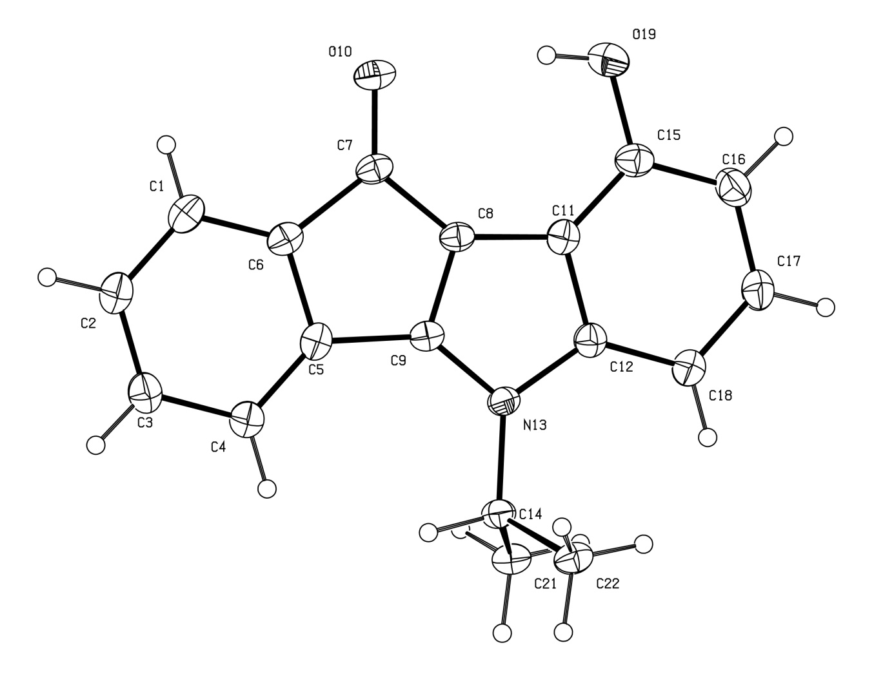
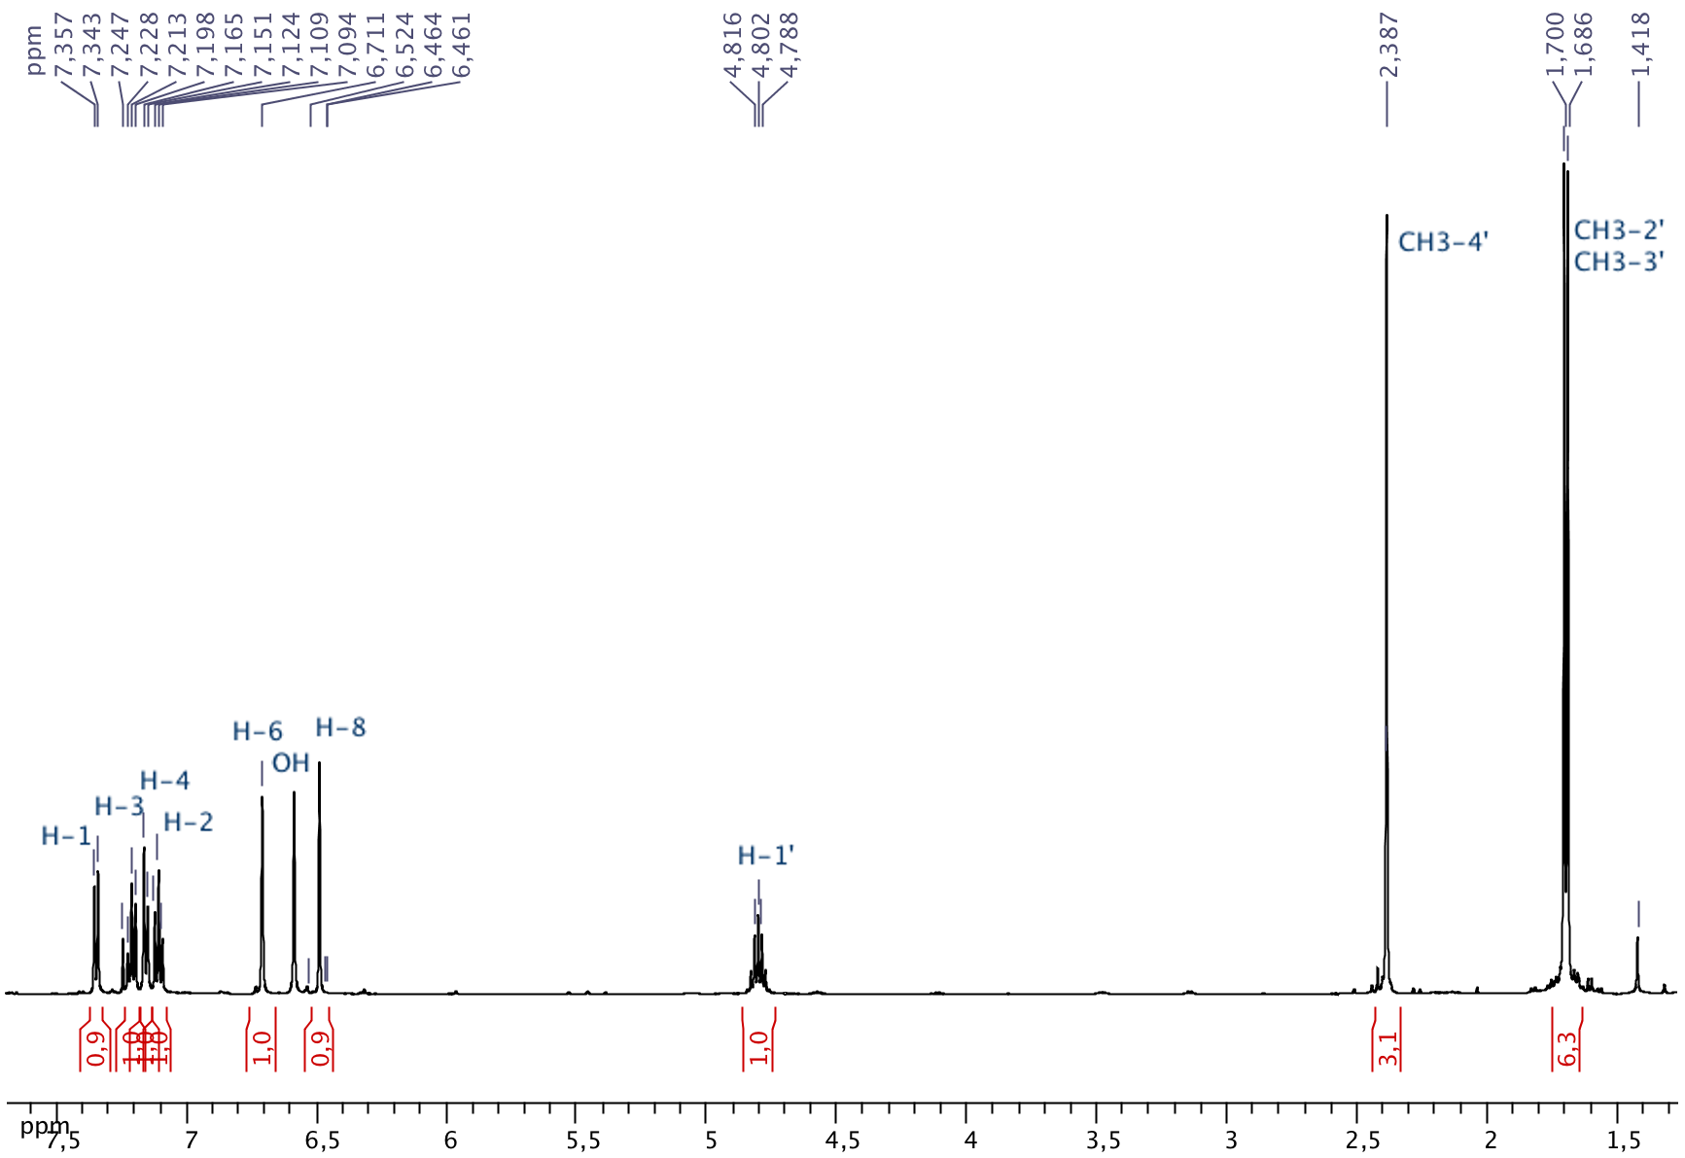
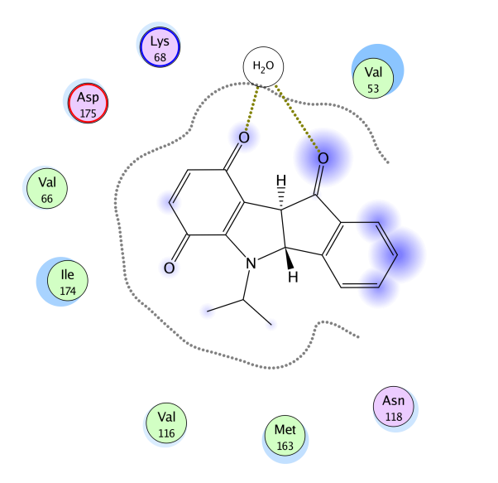
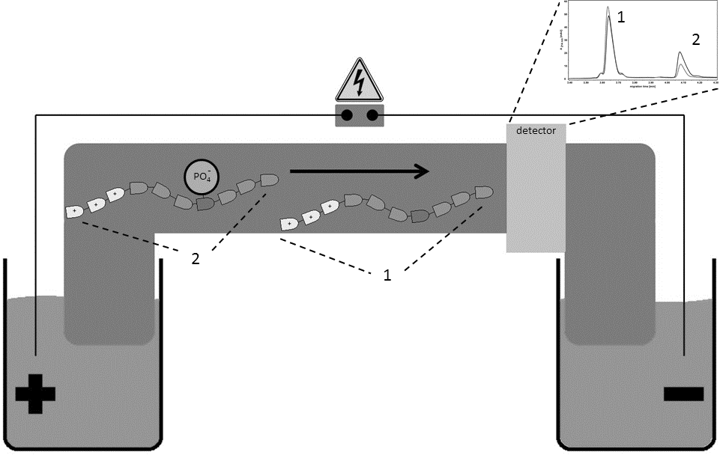
Indeno[1,2-b]indole Scaffold in Drug Discovery:
An Effective Template in Kinase Inhibitor Medicinal Chemistry
x-Ray
Graphical Abstract
¹H NMR
ring D
modulation
CE-assay

Slide 3
Abstract:
Casein kinase 2 (CK2) is a highly pleiotropic serine/threonine protein kinase whose list of substrates includes >300 proteins implicated in a wide variety of cell functions. The catalytic subunits of CK2 (alpha and/or alpha’) are constitutively active either alone or in combination with the regulatory beta-subunits to give a heterotetrameric protein. High constitutive activity of CK2 is related to contribute to cancer. Based on recent years of effort, a German French collaborative network has developed indeno[1,2-b]indole scaffold for designing novel inhibitors of human CK2. The aim of this study is to develop functionalized indeno[1,2-b]indoles and to investigate their potential inhibitory activity against human CK2. The different aspects of medicinal chemistry will be discussed, namely synthesis, NMR investigations, X-ray crystallography, CK2 inhibition, in cellulo activities, molecular modelling and physico-chemical properties.
Keywords: indenoindole synthesis; spectra resources; protein kinase CK2; physico-chemical properties; in cellulo permeability

Slide 4
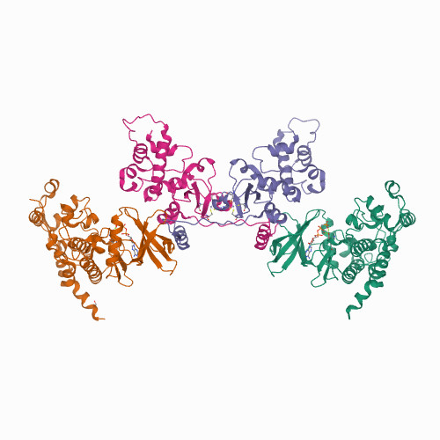
Introduction
Protein kinase CK2
First kinase discovered in 1954
Highly expressed in
many cancers
Fused bicyclic molecules
as CK2 inhibitors:
Crystal structure: α2β2
(PDB code 4NH1)
TBB
IC₅₀: 0.50 μM
Schnitzler, A. et al. J Mol Biol 2014, 426:1871-82
Sarno, S. et al. Biochem J 2003, 374(Pt 3):639-46

Slide 5
Introduction
Tricyclic backbones of known ATP-competitive low molecular weight (LMW) inhibitors of CK2
IC₅₀: 1.00 μM
FL12
IC₅₀: 0.39 μM
IQA
IC₅₀: 2 μM
Emodin
CX-4945
IC₅₀: 1 nM
Cozza, G. et al. ChemMedChem 2011, 6:2273-86
Protopopov, M.V. et al. Bioorg Chem 2020, 102:104062

Slide 6
Introduction
for ring D
keto
phenol
Connecting two bicyclic backbones
Indeno[1,2-b]indoles
para-quinone
+
ring D

Slide 7
Results and discussion – Synthesis of indeno[1,2-b]indoles

Slide 8
Results and discussion – Synthesis of indeno[1,2-b]indoles
Sealed vessel
Microwaves for oxidation of indan-1-one derivatives into ninhydrin derivatives
Classic 20 min, 77%
MW 5 min, 84%
Process
optimization
R₁= 1-CH₃, 79% (litt. 21%)
R₁= 1-Br, 70%
R₁= 1-OCH₃, 87%
R₁= 3-OH, 73%
Marminon, C. et al. Tetrahedron Lett 2015, 56:1840-42
8

Slide 9
Results and discussion – Synthesis of indeno[1,2-b]indoles
Microwaves for oxidation of ketonic derivatives into phenols
Process
optimization
9

Slide 10
Results and discussion – 24 indeno[1,2-b]indoles synthesized
4b
AR15
CM3146B
4p
NA8b
NA28-1
AF3
4v
10
10
10

Slide 11
Results and discussion – 24 indeno[1,2-b]indoles synthesized
4d
SiA3
5b
BZA1
BZA3
AF4
BZA32
ZW18

Slide 12
Results and discussion – 24 indeno[1,2-b]indoles synthesized
6b
CM3079B
AP05
6c
AF5
AF20
AF15
BZA21
12
12
12

Slide 13
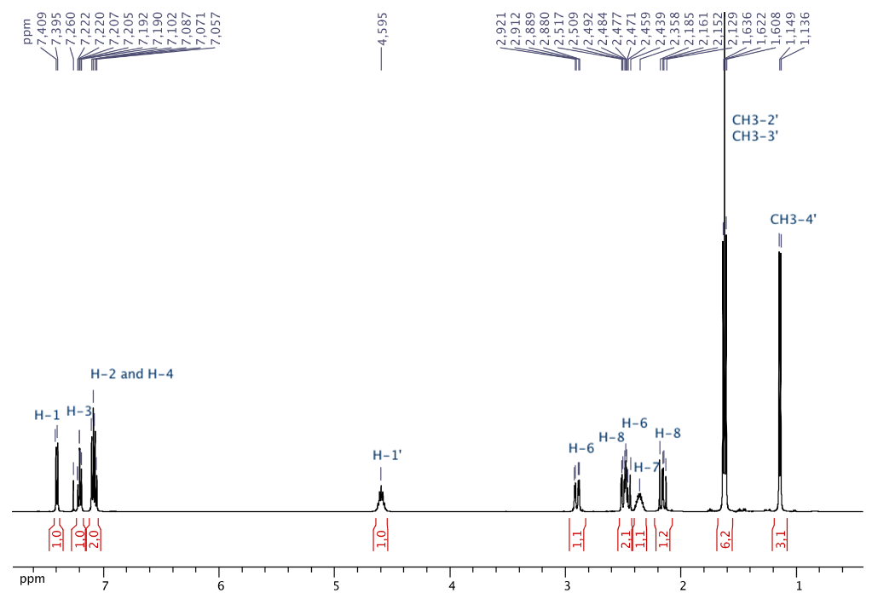
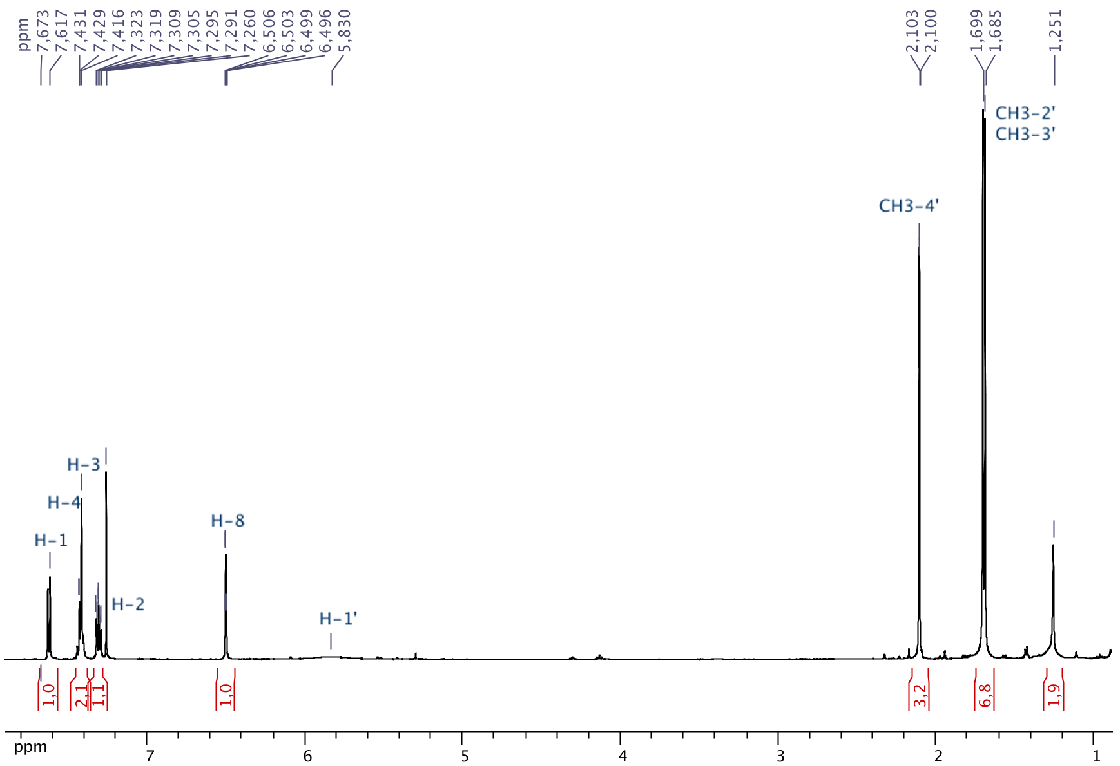
Results and discussion – NMR data
AF4
AF3
AF5
13
13

Slide 14
Results and discussion – NMR data
AF3
AF4
AF5
Al Chab, F. et al. Magn Reson Chem 2013, 51:837-41
14
14
Notes:
Complete ¹H and ¹³C NMR assignements have been carried out with one-dimensional and two-dimensional experiments on a Bruker AV500 Avance III spectrometer (500.13 MHz for ¹H and 125.77 MHz for ¹³C) (Al Chab et al., 2013).
Table Y. ¹H and ¹³C NMR chemical shifts (δ, ppm), H multiplicities (mult) and coupling constants (J, Hz) and ¹H–¹³C correlations in HMBC spectra for compounds 4u, 5u and 6u in CDCl₃.

Slide 15
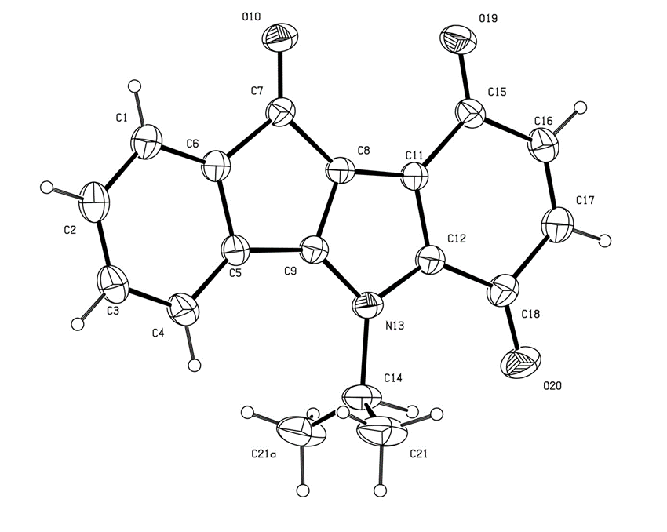
Results and discussion – X-ray crystallography
View of the crystal structures of 5b and 6b with our numbering scheme, displacement ellipsoids are drawn at the 20% probability level.
5b
6b
Red single crystal
(0.12 x 0.12 x 0.02 mm³)
CCDC-832080
Red single crystal
(0.09 x 0.02 x 0.02 mm³)
CCDC-832081
nearly planar with a mean out-of-plane deviation of 0.0271 Å with the largest deviation of 0.0542 (14) Å for atom C14
almost planar with a maximum deviation from planarity of 0.2430 Å, and the maximum deviation from planarity is found for C(14) lying 0.3379 (9) Å from the plane defined by the hetero-tetracyclic system
15
15

Slide 16
Results and discussion – CK2 inhibitory activities
Schematic illustration of the CE-assay
CE-electropherograms of CK2 reaction with and without inhibitor
RRRDDDSDDD
A sample 20 nl of a CK2 reaction is injected into the capillary which is subsequently dipped into buffer vials containing the background electrolyte. The applied electronic field of 30 µA current with flexible voltage separates the CK2 substrate 1 and its phosphorylated analog 2 while they migrate towards the cathode. An UV detector set to 214 nm at the outlet side of the capillary (20 cm effective length) quantitatively detects both peptides 1 and 2.
Gratz, A. et al. Electrophoresis 2010, 31:634-40

Slide 17
Results and discussion – CK2 inhibitory activities
Best CK2 inhibitor
No compound | % inhibition (10 μM)ª | IC₅₀ (μM)^{b}
4b | 99 | 0.36^{c}
AR15 | 85 | 0.89
CM3146B | 100 | 0.11
4p | 99 | 0.14
NA8B | 100 | 0.14
NA28-1 | 100 | 0.045
AF3 | 94 | 0.17
4v | 94 | 0.43
4d | 59 | 7.0
SiA3 | 66 | 2.50
5b | 72 | 2.0
BZA1 | 77 | 2.04
NA28-1
ª The percent inhibition of CK2 activity was determined for each compound at a fixed concentration of 10 μM.
^{b} Determinations were performed in triplicate in independent experiments.
^{c} For the best compounds producing at least 50% inhibition at 10 μM, the concentration was varied to precisely determine the IC⁵⁰ values.
17
17

Slide 18
Results and discussion – CK2 inhibitory activities
Best CK2 inhibitor
No compound | % inhibition (10 μM)ª | IC₅₀ (μM)^{b}
BZA3 | 81 | 3.44^{c}
AF4 | 64 | 1.27
BZA32 | 48 | n.d.
ZW18 | 91 | 1.76
6b | 60 | 5.55
CM3079B | 40 | n.d.
AP05 | 63 | 5.93
6c | - | 1.49^{d}
AF5 | 87 | 0.43
AF20 | 82 | 1.65
AF15 | 42 | n.d.
BZA21 | 44 | n.d.
AF5
ª The percent inhibition of CK2 activity was determined for each compound at a fixed concentration of 10 μM.
^{b} Determinations were performed in triplicate in independent experiments.
^{c} For the best compounds producing at least 50% inhibition at 10 μM, the concentration was varied to precisely determine the IC⁵⁰ values.
^{d}measured by the radiometric assay.
18
18

Slide 19
Results and discussion – In cellulo activities of 16 indenoindoles
MTT test
5 compounds active in cellulo
BZA21
CM3079B
BZA32
ZW18
AP05
3 compounds inactive in cellulo
NA28-1
CM3146B
NA8b
19
19
19

Slide 20
Results and discussion – In cellulo activities of 16 indenoindoles
MTT test
3 compounds active in cellulo
6b
AF15
AF20
5 compounds inactive in cellulo
4b
5b
AF3
AF4
SiA3
20
20
20

Slide 21
Results and discussion – Physico-chemical properties and Bio
Structure (code) | MarvinSketch 20.19.0 | Molinspiration v 2018.10 | ACD/ChemSketch 2020.1.2 | CK2 IC₅₀ (μM) | MCF-7 % viability
 | 3.76 | 3.79 | 4.34 +/- 1.27 | 0.17 | 24h = 68% 48h = 30%
 | 2.87 | 2.81 | 3.53 +/- 1.27 | 0.14 | 24 h = 64% 48 h = 63%
 | 3.82 | 4.08 | 4.04 +/- 1.25 | 2.0 | 24 h = 72% 48 h = 52%
(AF3)
(NA8b)
(5b)
21
21
21
21

Slide 22
Results and discussion – Physico-chemical properties and Bio
Structure (code) | MarvinSketch 20.19.0 | Molinspiration v 2018.10 | ACD/ChemSketch 2020.1.2 | CK2 IC₅₀ (μM) | MCF-7 % viability
 | 2.54 | 2.88 | 3.02 /- 1.50 | 5.55 | 24 h = 8% 48 h = 4%
 | 3.02 | 3.26 | 3.55 +/- 1.50 | 5.93 | 24 h = 5% 48 h = 4%
 | 5.45 | 5.66 | 5.97 +/- 1.51 | 44 (% inh. at 10 μM) | 24 h = 6% 48 h = 4%
(6b)
(AP05)
(BZA21)
22
22
22
22

Slide 23
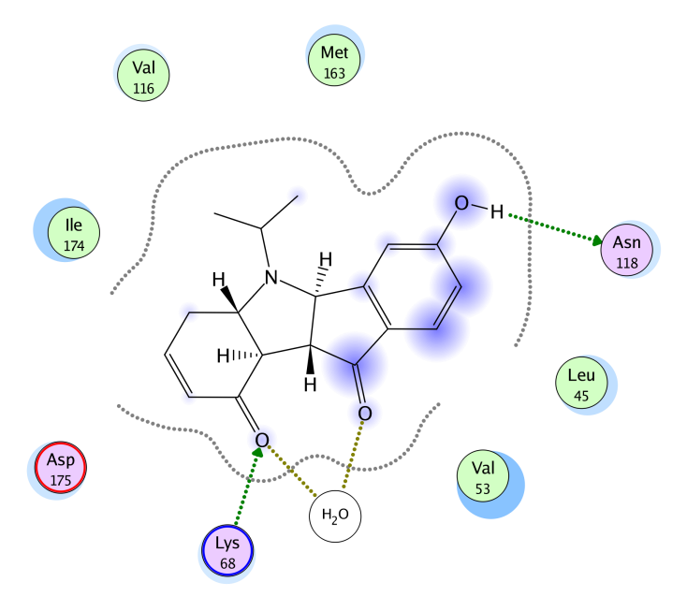
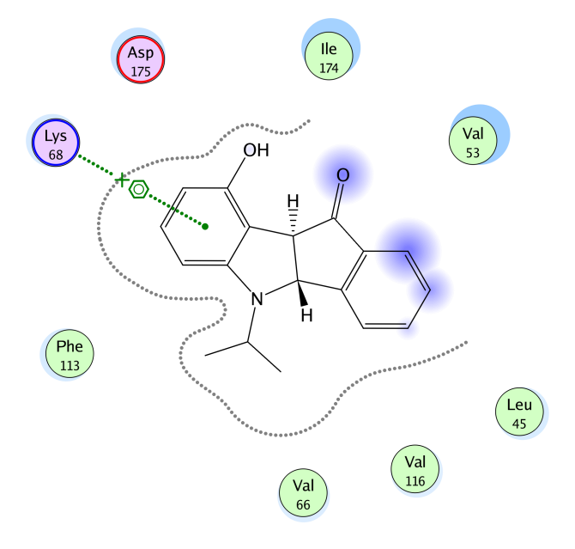
Results and discussion – Computer-assisted docking of indenoindoles
NA-8b
5b
6b
2D Interrelation of NA-8b, 5b and 6b with the amino acid residues of 3C13 crystal structure of CK2 enzyme (in the ATP binding pocket).

Slide 24
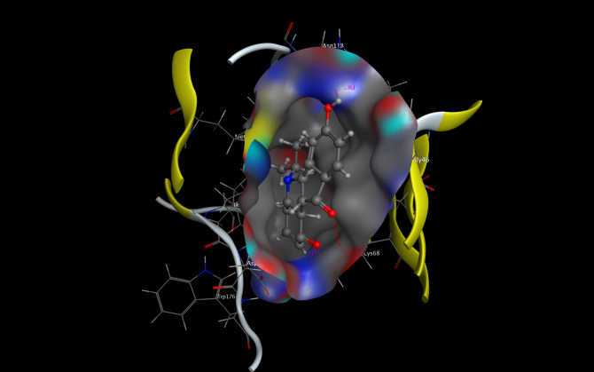
Results and discussion – Computer-assisted docking of indenoindoles
NA-8b
3D Interrelation of NA-8b with the amino acid residues of 3C13 crystal structure of CK2 (in the ATP binding pocket).

Slide 25
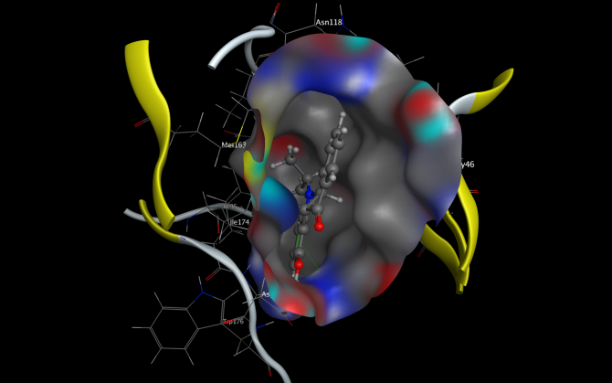
Results and discussion – Computer-assisted docking of indenoindoles
5b
3D Interrelation of 5b with the amino acid residues of 3C13 crystal structure of CK2
(in the ATP binding pocket).

Slide 26
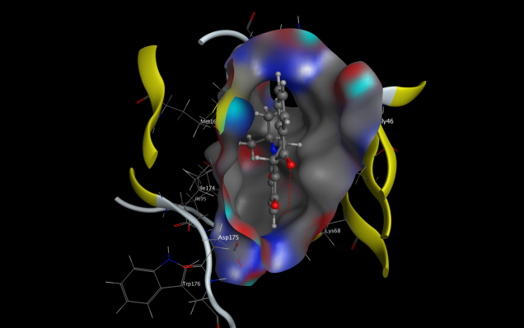
Results and discussion – Computer-assisted docking of indenoindoles
6b
3D Interrelation of 6b with the amino acid residues of 3C13 crystal structure of CK2
(in the ATP binding pocket).

Slide 27
Conclusions
cLogP and Bio data on CK2: Alkoxy group +++ on keto sub-series
Already best length?
NA8b
NA28-1
cLogP = 3.53 ± 1.27
[ACD/ChemSketch 2019.2.1]
CK2, IC₅₀ = 0.14 μM
MCF-7, % viability (after 48 h): ≈ 65%
cLogP = 4.29 ± 1.42
[ACD/ChemSketch 2019.2.1]
CK2, IC₅₀ = 45 nM
MCF-7, % viability (after 48 h): < 50%

Slide 28


Acknowledgments
Aude Rollet Alexandra Chapuis
Waël Zeinyeh Anthony Prandina
Abdelhamid Nacereddine
This scientific work was made possible by financial support from Rhône-Alpes region through the Cluster 5 Chemistry, the Canceropôle Lyon Auvergne Rhône-Alpes (CLARA) and Institut Convergence PLASCAN - Institut François Rabelais.

