Slide 1
Design and synthesis of novel alfa-mangostin-nitroimidazole hybrids with toxic effects on amastigotes of Trypanosoma cruzi
By
Douglas Pinto¹, Afonso Velez¹, Gabriella Magalhães¹, Paulo Santos¹, Marco Edilson Lima¹ Debora Ricardo² .
¹ Instituto de Química, Orgânica - IQ, Universidade Federal Rural do Rio de Janeiro (UFRuralRJ);
²Instituto de Microbiologia e Imonologia Veterinária - IV, Universidade Federal Rural do Rio de Janeiro (UFRRJ).
* Corresponding email: douglasdoti@hotmail.com
IQ-UFRRJ

Slide 2
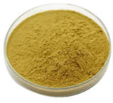
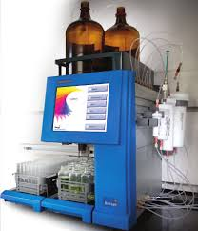
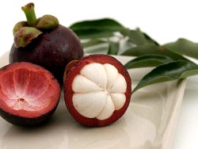
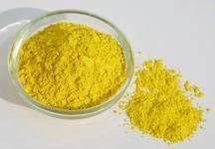
Design and synthesis of novel alfa-mangostin-nitroimidazole hybrids with toxic effects on amastigotes of Trypanosoma cruzi
Crude extract
G. Mangostana
(mangosteen)
Flash Chromatography System
Molecular modification
α-mangostin

Slide 3
alfa-Mangostin (MGT) is the main product isolated from the the fruit pericarp of Garcinia mangostana. This xanthone exhibits important toxic effects on T. cruzi forms amastigotes. We describe herein the synthesis of new hybrid derivatives of MGT and nitroimidazoles using click reaction as the key-step. Toxic effects on intracellular amastigotes of T. cruzi (Tulahuen C2C4 LacZ).
Keywords: Chagas disease, Molecular hybridization, Click reaction, Antiparasitic chemotherapy, Garcinia mangostana.

Slide 4
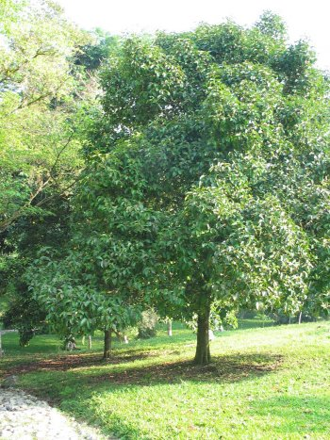
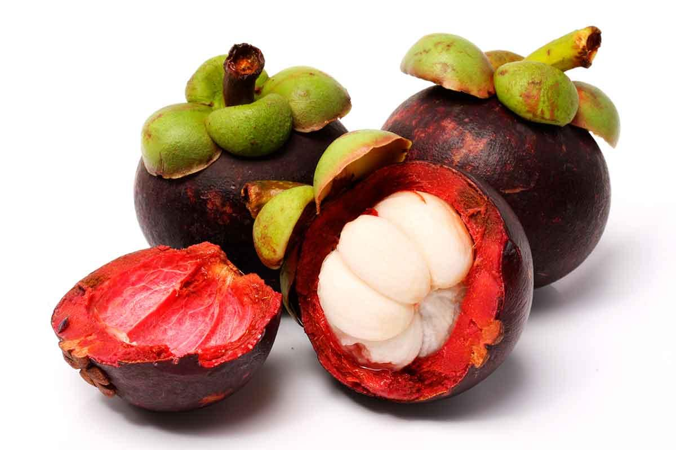
Introduction
Natural products constitute inexhaustible sources of both raw materials and inspiration for obtaining and planning new molecules with potential biological activity.
Mangosteen is a type of fruit tree that grows in the Asian region such as Malaysia, Myanmar, Thailand, Philippines, Sri Lanka and India.
In 1855, α-mangostin was found as the major xanthones taken from the pericarps of the mangosteen fruit.
Excellent biological properties
Mangosteen fruit
Garcinia mangostana L.
(Clusiaceae)
α-mangostin

Slide 5
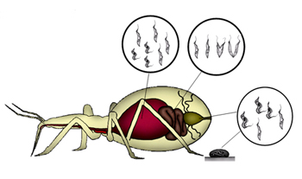
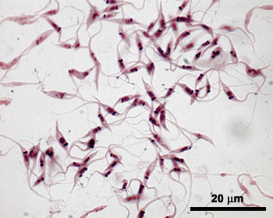
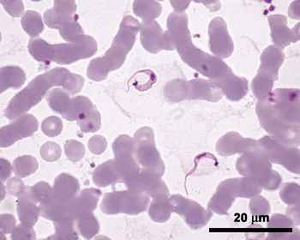
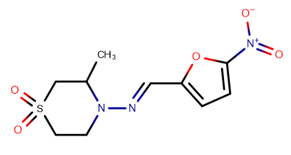
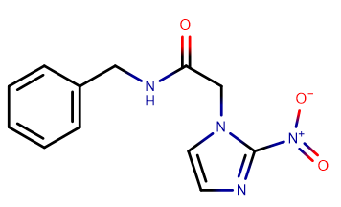
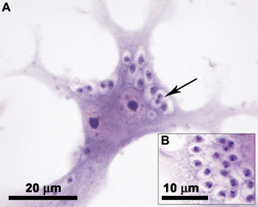
Life cycle of T. cruzi - etiologic agent of chagas disease
Epimastigote form
In the digestive tract it differentiates into trypomastigotes
Epimastigote form
Non-infective and replicative form
Triatoma infestans
Drugs used for treatment chagas disease
Blood trypomastigote form
Vertebrate blood
Extremely mobile
Infective form
Nifurtimox
Intracellular amastigote form
Vertebrate tissues
Infective and replicative form
Benznidazole

Slide 6
Our Goals
In this work we describe our efforts in the incorporation of natural xanthone α−mangostin to the set of natural molecules potentially useful to obtain new antichagasic molecules with improved activity and high selectivity against T. cruzi.

Slide 7
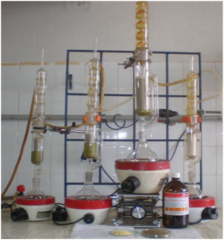
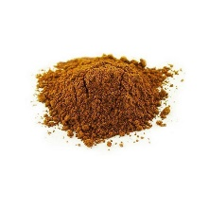
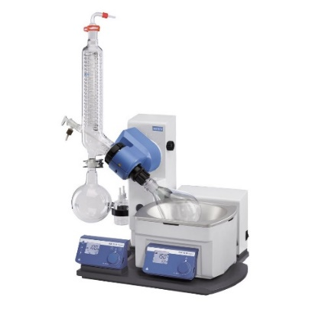
Isolation of natural product
10g dehydrated plant material
Kiln drying 45ºC / 36h
Ethyl acetate
G. Mangostana
(mangosteen)
Residue (extract)
Pericarp residue
2ª) Drying
Vacuum rotary evaporator
Crude extract 1.14g
400mg
Purification
Flash Chromatography System
α-mangostin
High yield and purity

Slide 8
Molecular Planning
Molecular hybridization as structural planning tool
Exploring synthetic and reactional versatility of α-mangostin
Molecular hybridization
Search for new therapeutic alternatives
Molecular modification Strategy
Changes in physico-chemical properties
Conformational changes
Chemical stability
Interaction with multiple targets
Molecular hybridization
New potentially active hybrid
+
Molecule B
Intrinsic characteristics
Molecule A (α-mangostin)

Slide 9
New hybrid Synthesis
Alfa-mangostin O-alkylation reaction
Scheme 1. Propargyl bromide 80% (0.814 mmol, 2.2 eq.), Anhydrous DMF (51.7 mmol), Anhydrous K₂CO₃ (0.814 mmol), 60 ⁰C, 2h, 74%.
Formation of azides from nitroimidazoles
Scheme 2. Synthesis of azides from nitroimidazoles.

Slide 10
Synthesis of the new molecular hybrid
Using the molecular hybridization strategy and having the Cu(I)-catalysed azide-alkyne cycloaddition (CuAAC) “click” reaction.
Scheme 3. NaN₃ (0.048g, 0.247 mmol), ethanol/water (4.0 mL), C₆H₇O₆Na (0.0097g, 0.049 mmol), CuSO₄•5H₂O, (0.003g, 0.0123 mmol) 50 ⁰C, 3,5h, 76.8%.

Slide 11
Conclusions
The molecular design as well the synthetic strategy developed in this work led to the preparation of a new hybrid of natural α-mangostin and metronidazole.
In preliminary evaluation (at a concentration of 100 μM) the new hybrid showed an inhibition of about 30% against intracellular amastigotes of T. cruzi.
The biological results must be refined and repeated at lower concentrations due to that low solubility of the new hybrid under the test conditions.
The preparation of other derivatives is underway as well as the in vitro evaluation of the anti-amastigote activity of the new hybrids obtained.

Slide 12
Acknowledgments
IQ-UFRRJ

