Slide 1
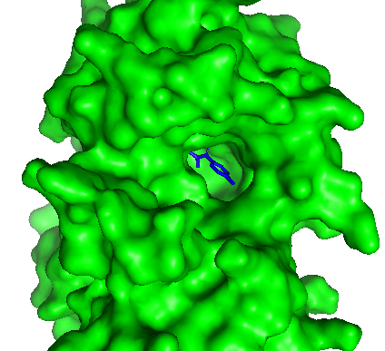
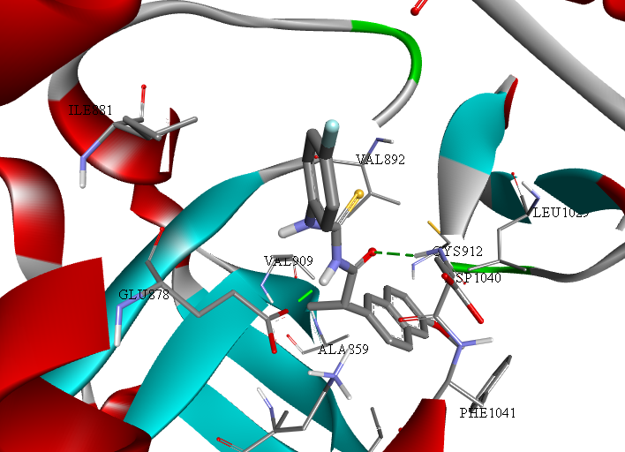
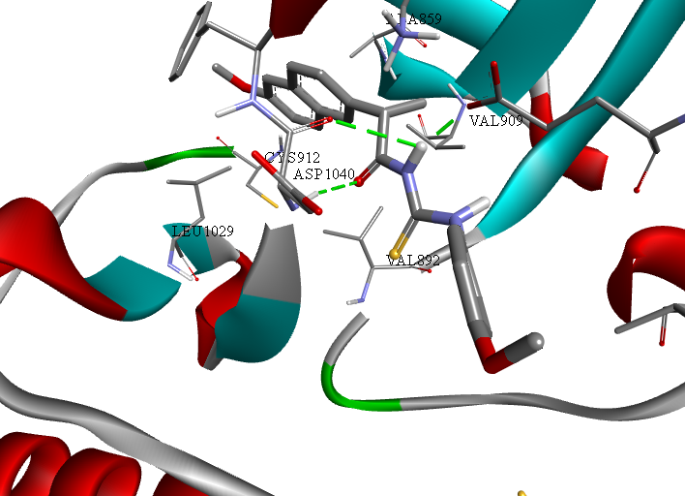
Molecular docking analysis of novel thiourea derivatives of naproxen with potential antitumor activity
Vladimir Dobričićª, Nikola Nedeljković^{b}, Marina Mijajlović^{b}, Miloš Nikolić^{b}, Zorica Vujićª
ªDepartment of Pharmaceutical Chemistry, University of Belgrade – Faculty of Pharmacy, Belgrade, Serbia
^{b}University of Kragujevac, Serbia, Faculty of Medical Sciences, Department of Pharmacy, Kragujevac, Serbia
INTRODUCTION
In the past few decades, thiourea derivatives have been intensively investigated as potential anticancer drugs [1]. This class of compounds has been recognized as agents with promising inhibitory activity towards human lung adenocarcinoma cell lines, human breast cancer cells and human colorectal carcinoma [2,3]. Antitumor activity of thiourea derivatives is based on potential inhibition of protein tyrosine kinases [4], topoisomerases [5] and carbonic anhydrase [6].
THE AIM OF THE STUDY
The aim of this study was to estimate antitumor potential of twenty newly designed thiourea derivatives of naproxen based on inhibition of selected protein kinases involved in multidrug resistance. Molecular docking analysis of these compounds was performed in two docking software packages in order to propose their potential mechanisms of action. Designed derivatives contain amino acids, esters of amino acids and aromatic amines in the side chains.
METHODS
The FRED 3.2.0.2 [7-9] and AutoDock Vina [10] software were used for the analysis of binding of designed compounds into the active sites of the selected protein kinases: EGFR (PDB ID: 1M17), AKT2 (PDB ID: 3E87), VEGFR1 (PDB ID: 3HNG) and mTOR (PDB ID: 4JSV).
RESULTS
Analysis of binding poses in FRED software revealed the key binding interactions for derivatives 1 (with AKT2 and mTor) and 20 (with EGFR and VEGFR1). In AutoDock Vina derivatives 16 and 17 formed key binding interactions with EGFR, AKT2 and VEGFR1.
CONCLUSION
These 4 derivatives possess good molecular docking rankings in both docking software and represent potential anticancer candidates capable of fighting multidrug-resistant tumors.
References:
[1]. Hu H, Lin C, Ao M, Ji Y, Tang B, Zhou X, Fang M, Zeng J, Wu Z (2017). RSC Adv. 7: 51640-51.
[2]. Li J, Tan JZ, Chen LL, Zhang J, Shen X, Mei CL, Fu LL, Lin LP, Ding J, Xiong B, Xiong XS, Liu H, Luo XM, Jiang HL (2006). Acta Pharmacol Sin. 27: 1259-71.
[3]. Lu PC, Li HQ, Sun J, Zhou Y, Zhu HL (2010). Bioorg Med Chem. 18: 4606-14.
[4]. Li HQ, Yan T, Yang Y, Shi L, Zhou CF, Zhu HL (2010). Bioorg Med Chem. 18: 305-13.
[5]. Zhao Y, Wang C, Wu Z, Fang J, Zhu L (2012). Invest New Drugs. 30: 17-24.
[6]. Moeker J, Teruya K, Rossit S, Wilkinson BL, Lopez M, Bornaghi LF, Innocenti A, Supuran CT, Poulsen SA (2012). Bioorg Med Chem. 20: 2392-404.
[7]. FRED 3.2.0.2: OpenEye Scientific Software, Santa Fe, NM, USA; http://www.eyesopen.com.
[8]. McGann M (2011). J Chem Inf Model. 51: 578-96.
[9]. McGann M (2012). J Comput Aided Mol Des. 26: 897-906.
[10]. Trott O, Olson AJ (2010). J Comput Chem. 31: 455-61.

