Slide 1





Tamoxifen bisphenol: a modulator of ERβ in estrogen receptor-positive breast cancer
Cristina F. Almeida ^{1,} *, Tiago V. Augusto ¹, Ana Oliveira ², Georgina Correia-da-Silva ¹, Maria João Ramos ², Pedro Alexandrino Fernandes ² Natércia Teixeira ¹ and Cristina Amaral ¹
¹ UCIBIO.REQUIMTE, Laboratory of Biochemistry, Department of Biological Sciences, Faculty of Pharmacy, University of Porto
² LAQV.REQUIMTE, Computational Biochemistry Group, Department of Chemistry and Biochemistry, Faculty of Sciences, University of Porto
* Corresponding author: cristina-almeida96@hotmail.com

Slide 2
Tamoxifen bisphenol: a modulator of ERβ in estrogen receptor-positive breast cancer
TB
Graphical Abstract
TB
TB
TB
ER
Breast cancer cell death
ER
ER
ERβ levels
TB
TB
ER
ER
ERE
TB
TAM-Bis
Transcription of target genes
ER
Estrogen receptor Beta

Slide 3
Abstract
Breast cancer is the main cause of cancer-related death in women worldwide, being estrogen receptor-positive (ER⁺) the most common subtype. In this type of cancer, while ERα has pro-survival effects, ERβ displays anti-proliferative actions, counteracting ERα effects. Thus, ERβ modulators may represent a great advantage for breast cancer treatment. Considering that Tamoxifen Bisphenol (TAM-Bis), a tamoxifen metabolite, can act as an ERα antagonist, our goal is to investigate whether this compound can also modulate ERβ. Through molecular docking analysis, it was addressed the ability of TAM-Bis to bind to ERβ. HFF-1 and MCF-7aro cells were used to evaluate the effects of TAM-Bis. To confirm the involvement of ERβ, the down-regulator PHTPP was used. The effects of TAM-Bis on ERβ protein levels were also investigated. Molecular docking results pointed that TAM-Bis can bind to ERβ. Moreover, this compound only decreased the viability of breast cancer cells, MCF-7aro, being this behavior reverted by PHTPP. In addition, TAM-Bis induced an up-regulation of ERβ. Our results clearly demonstrated that, besides being an ERα antagonist, TAM-Bis is an ERβ up-regulator. This is very favorable for better prognosis, since ERβ inhibits the transcriptional activity of ERα and decreases the sensitivity of breast cancer cells to estrogens, impairing tumor growth.
Keywords: Estrogen receptor-positive breast cancer; Estrogen receptor beta; Molecular docking

Slide 4
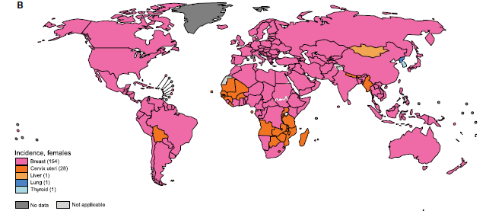
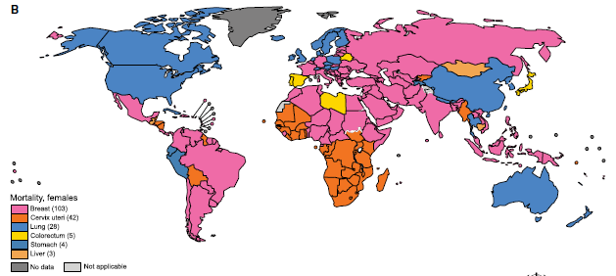
Introduction
Breast cancer
2018
Incidence
Mortality
New cases/2018: 2 088 849
Deaths/2018: 626 679
Bray F. et al (2018) CA CANCER J CLIN, 68:394–424
The Global Cancer Observatory, March 2019

Slide 5
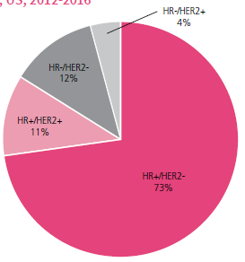
Introduction
Breast cancer
70-80% ER⁺
60% pre-menopausal women
75% post-menopausal women
Amaral C et al. (2017) J Steroid Biochem Mol Biol;171:218-28
Breast Cancer Facts & Figures 2019-2020, American Cancer Society

Slide 6
Introduction
ER⁺ breast cancer
ER⁺ breast cancer
Aromatase
ERα
ERβ
Conversion of androgens into estrogens
Growth and survival of breast epithelial cells, through cell proliferation and inhibition of apoptosis
Anti-proliferative and pro-apoptotic properties
Tumor development
Tumor development
Tumor suppression
Almeida CF et al. (2020) Biochemical Pharmacology; 177: p. 113989
Augusto TV et al. (2018) Endocr Relat Cancer;25(5):R283-R301

Slide 7
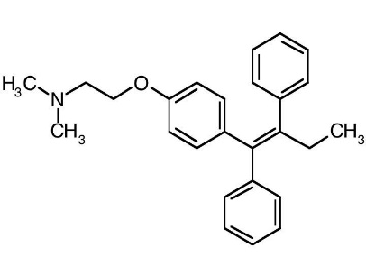
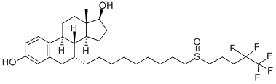
Introduction
Endocrine Therapy
ER Modulators
Tamoxifen
Fulvestrant
Pre-menopausal women
Pre- and post- menopausal women
Augusto TV et al. (2018) Endocr Relat Cancer;25(5):R283-R301

Slide 8
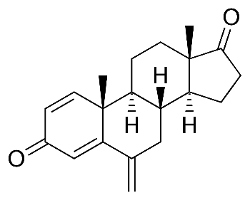
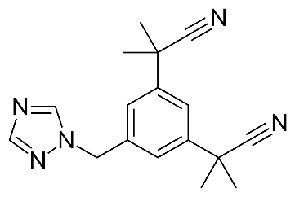
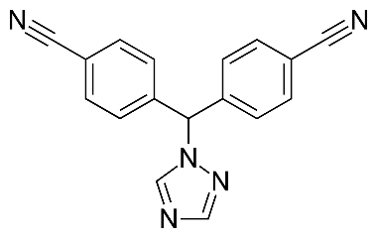
Introduction
Endocrine Therapy
Aromatase Inhibitors (AIs)
Non-Steroidal
Steroidal
Exemestane
Anastrozole
Letrozole
Post-menopausal women and pre-menopausal women after ovaries ablation
Augusto TV et al. (2018) Endocr Relat Cancer;25(5):R283-R301

Slide 9
Introduction
Tamoxifen Bisphenol (TAM-Bis)
ERα antagonist
- IC₅₀ = 15 nM
- MCF-7-2a
Aromatase inhibitor
- IC₅₀ = 24880 nM
- Recombinant enzymes
Lubczyk V. et al. (2002) Journal of Medicinal Chemistry; 45(24): p. 5358-5364
Zhao LM. et al. (2016) Bioorg Med Chem; 24(21): p. 5400-5409

Slide 10
Aim
TAM-Bis is already known to act as an AI and an ERα antagonist
Evaluate the ability of TAM-Bis to modulate ERβ
HFF-1 cells
MCF-7aro cells
Viability
ERβ protein levels
Improvement of ER⁺ breast cancer treatment

Slide 11
Results and discussion
Molecular docking study of TAM-Bis complexed with ERβ
TAM-Bis interacted with important residues for ERβ modulation

Slide 12
Results and discussion
Effects of TAM-Bis on non-cancerous cells (HFF-1)
TAM-Bis only induced a decrease in HFF-1 cell viability at 50 μM

Slide 13
Results and discussion
Effects of TAM-Bis on ER⁺ breast cancer cells (MCF-7aro)
TAM-Bis induced a decrease in MCF-7aro cell viability in a dose and time-dependent manner

Slide 14
Results and discussion
Dependence of ERβ on the effects induced by TAM-Bis
PHTPP reverted the anti-proliferative effects induced by TAM-Bis

Slide 15
Results and discussion
Effects of TAM-Bis on ERβ protein levels
ERβ
(59 kDa)
β-tubulin
(55 kDa)
TAM-Bis induced an up-regulation of ERβ

Slide 16
Conclusions
TAM-Bis interacted with key residues of ERβ
TAM-Bis did not affect the viability of the non-tumoral HFF-1 cells
TAM-Bis induced a decrease in MCF-7aro cell viability in a dose and time-dependent manner
PHTPP reverted the anti-proliferative effects of TAM-Bis, which reinforces the dependence of TAM-Bis on ERβ modulation
TAM-Bis induced an up-regulation of the ERβ protein levels
TAM-Bis may act as an ERβ agonist

Slide 17





Acknowledgments
Pedro A. Fernandes
Maria J. Ramos
Ana Oliveira
Cristina Almeida
Cristina Amaral
Tiago Augusto
Natércia Teixeira
Georgina C. Silva
SFRH/BPD/98304/2013attributed to Cristina Amaral
BD/128333/2017 attributed to Tiago Augusto
UIDB/04378/2020

