Slide 1
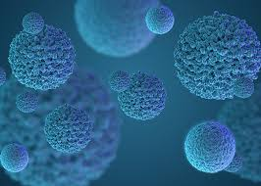


D-α-tocopherol-Based Polymeric Micelles for Successful Improving Encapsulation of Retinoic Acid
Guendalina Zuccari¹,* Sara Baldassari¹, Alice Atturo¹, Silvana Alfei¹, Giorgia Ailuno¹, Leonardo Marchitto², and Gabriele Caviglioli¹
¹ Department of Pharmacy (DiFAR), University of Genoa, Viale Cembrano 4, I-16148, Genova, Italy;
² Department of Sciences for the Quality of Life, Corso D'Augusto 237, Rimini, Department of Pharmacy and Biotechnology, Via Belmeloro 6, Bologna, University of Bologna, Italy.
* Corresponding author: zuccari@difar.unige.it

Slide 2
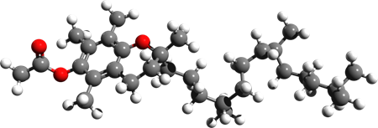
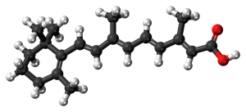
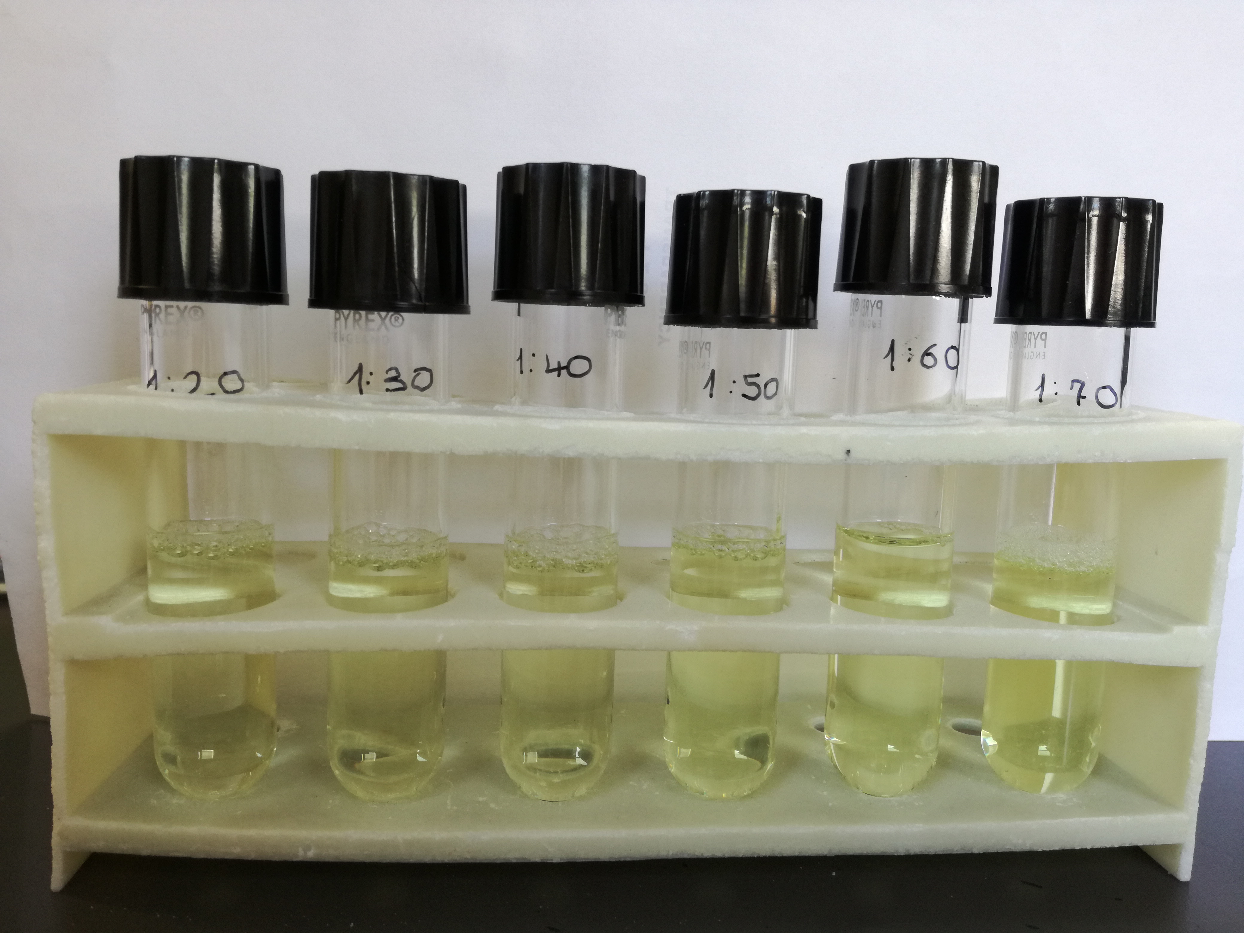
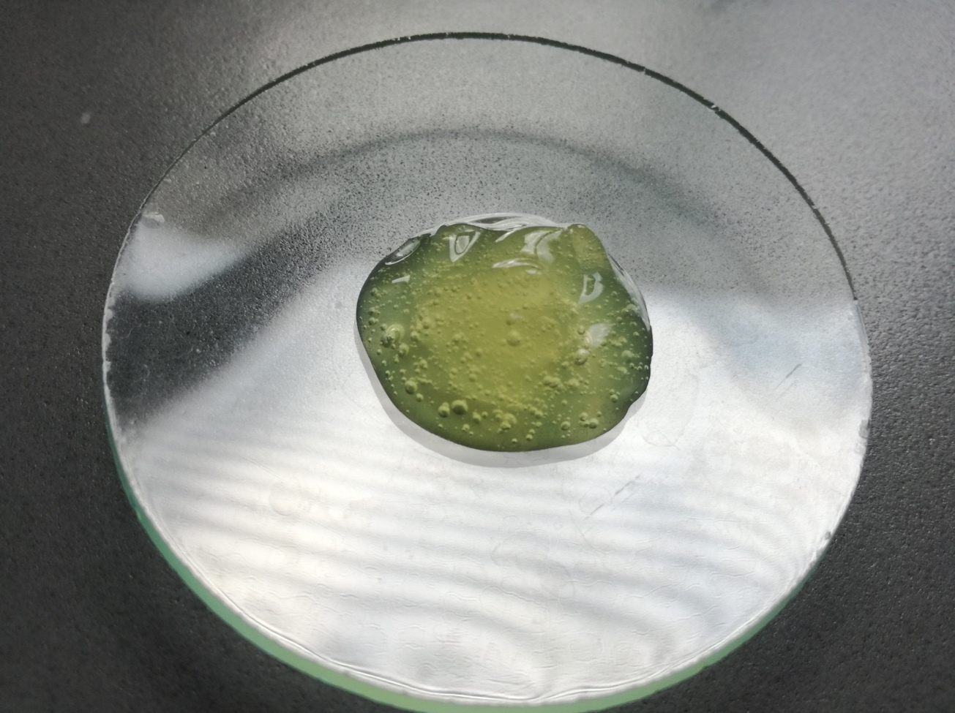
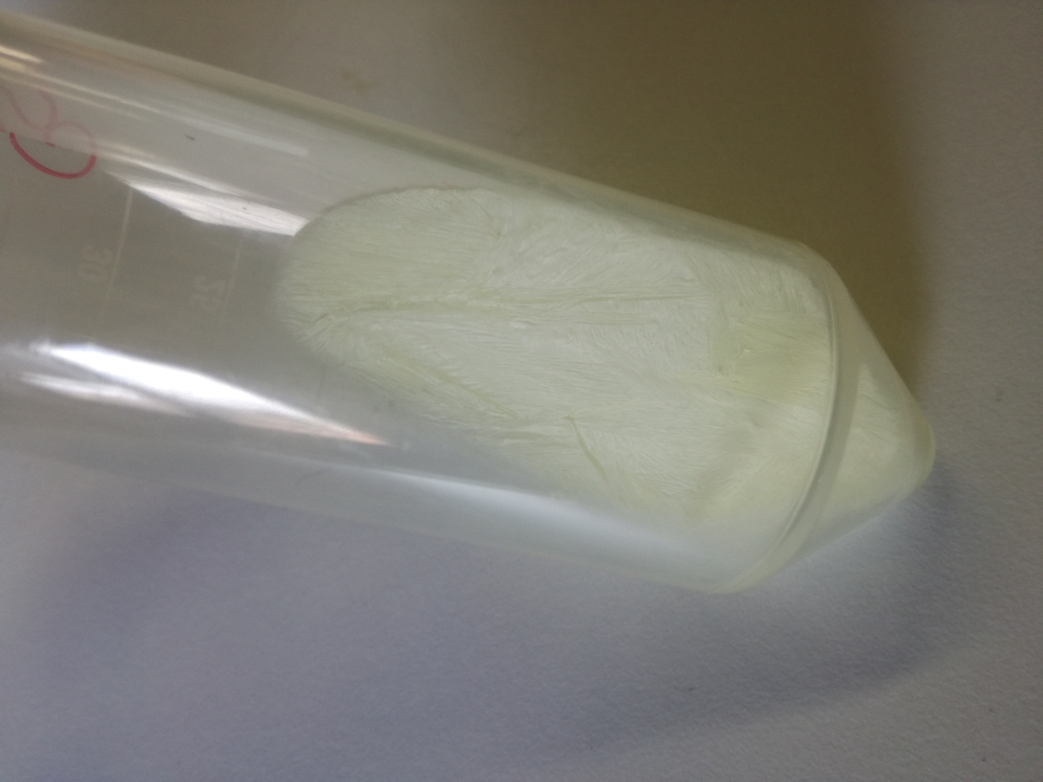
D-α-tocopherol-Based Polymeric Micelles for Successful Improving Encapsulation of Retinoic Acid
Graphical Abstract
ATRA
TPGS
11-20 nm
Low PDI
EE=36-79%
ζ = 0.5-4 mV

Slide 3
Abstract: From decades, all-trans-retinoic acid (ATRA) has been the first-choice treatment for several skin diseases, including epithelial skin cancer and acne, but its efficacy is strongly limited by its low water solubility and high instability. Different ATRA formulations are commercially available, but their prolonged use leads to loss of effectiveness and causes cutaneous side effects like redness and peeling of the skin. In this work, we studied the capability of D-α-tocopheryl polyethylene glycol succinate (TPGS), a water-soluble derivative of vitamin E able to self-assemble in core-shell nano-aggregates, to encapsulate ATRA, with the aim of overcoming the issues associated with ATRA clinical use. Firstly, this study reports a solubility study based on the equilibrium method, which explored TPGS capability to interact with the host, then ATRA-loaded polymeric micelles (ATRA-TPGSs) were prepared by solvent casting method starting from different TPGS amounts in the preparative mixture. ATRA-TPGSs showed small sizes (11-20 nm), low polydispersity, quite neutral Z potential, and proved good encapsulation efficiency, also confirmed by the FTIR spectra handled by the principal component analysis chemometric tool. The loaded micelles were stable in solution during storage at 25 °C, without the tendency to flocculate or form sediments and proved suitability for freeze-drying. ATRA-TPGSs gel formulations were obtained using Carbopol® as gelling agent and showed a non-Newtonian plastic flow. Further analyses are ongoing to evaluate ATRA-TPGSs skin permeation, and their in vitro cytotoxic effects on melanoma cell lines.
Keywords: ATRA-loaded TPGS-based micelles; enhanced solubility; improved stability; nanosized formulations; low polydispersity.

Slide 4

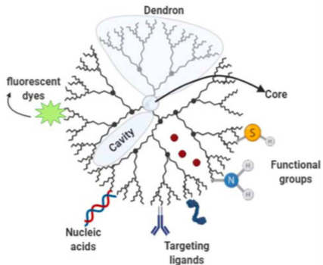
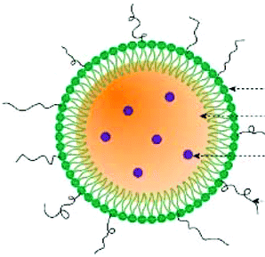
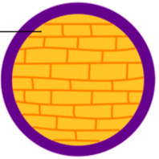
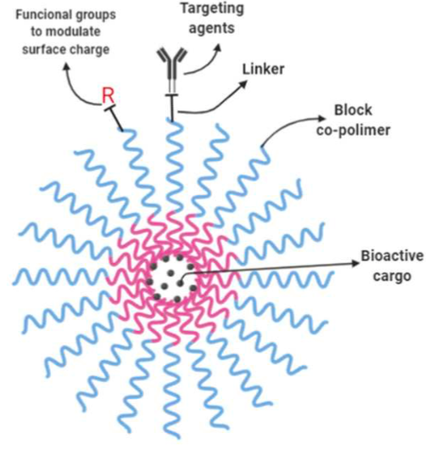
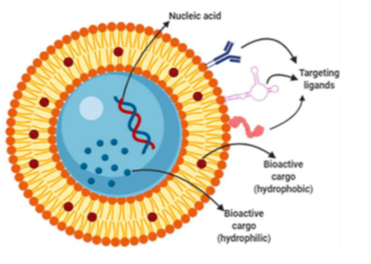
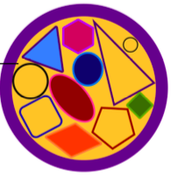


Introduction
DRUG DELIVERY SYSTEMS
Dendrimer
Lipid-Polymer
Hybrid
Nanoparticle
Solid Lipid
Nanoparticle
Polymeric Micelle
Liposome
Nanostructured
Lipid Carrier
    Improvement of physicochemical stability
    of the drug to environmental agents
    Light
      High temperature
      Moisture
      Oxygen
    Modulation of the pharmaco
    kinetics of an active ingredient
Improvement of the therapeutic efficiency
Increased shelf life
Introduction .
Goals
Methods
Results
Conclusions

Slide 5


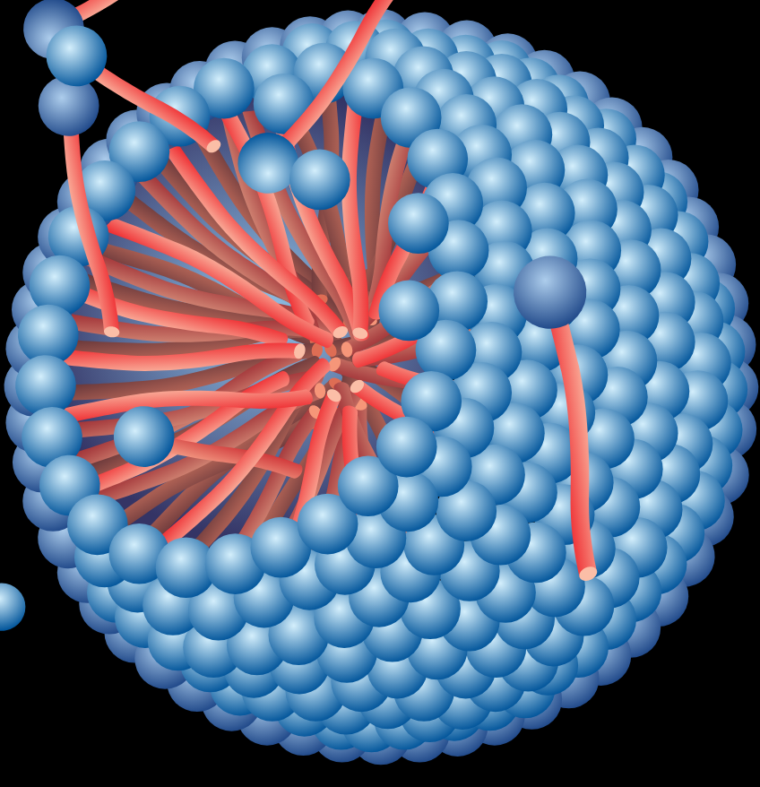
POLYMERIC MICELLES
Hydrophilic shell
Hydrophobic core
Entrapped Hydrophobic drug
Low CMC
Reduced size (10-200 nm)
High drug loading (DL%)
High drug retention
High riproducibility
Biocompatibility
Improved drug solubility stability availability
Introduction .
Goals
Methods
Results
Conclusions

Slide 6
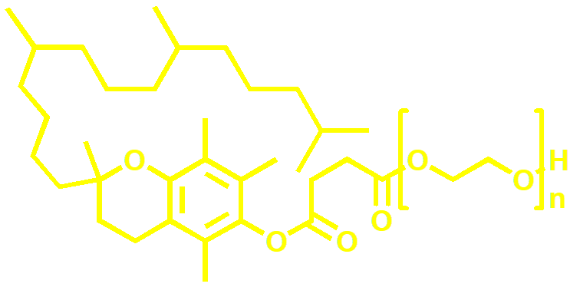



VITAMIN E TPGS
Vitamin E TPGS (D-α-Tocopheryl polyethylene glycol 1000 succinate)
Uses
Absorption promoter, drug solubilizer
Plasticizer or binder
Vitamin E source
Syntetic derivative of Vitamin E
Amphiphilic molecule
Critical micellar concentration: 0,02 wt%
Introduction .
Goals
Methods
Results
Conclusions

Slide 7
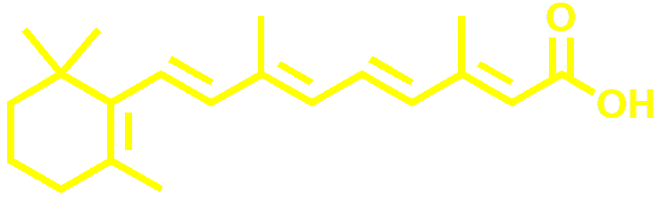



RETINOIC ACID
    Marketed Formulations
    Tretinoin Same® cream 0.05%
    Airol®cream 0,05%
    Airol ®cutaneous solution 0,05%
All-trans-retinoic acid (ATRA)
    Topical clinical applications
    Acne vulgaris
    Photodamage
    Hyperpigmentation
    Keloid scars and stretch marks
    Psoriasis
    Pharmacological Properties
    Epidermal proliferation and cell turnover
    Comedolysis promotion
    Collagen synthesis
    Melanin Reduction
Introduction .
Goals
Methods
Results
Conclusions

Slide 8




RESTRAIN OF ATRA DRAWBACKS
      Poor water solubility (6,3 x 10⁻⁴ mM)
      Chemical instability
      Adverse reactions
Erythema
Burning
Photosensitization
Photodecomposition
Oxidation
Thermal Instability
Reduction of Cutaneous Irritation
Improvement of patient compliance
Enhancement of absorption and skin retention
Improvment of solubility
Protection from chemical degradation
Enhancement of shelf life
DRUG DELIVERY SYSTEMS
Introduction .
Goals
Methods
Results
Conclusions

Slide 9
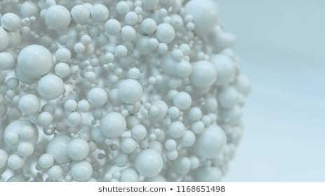



PHASE SOLUBILITY STUDIES
Shake-flask Method
ATRA in micelle
$$⇆$$
ATRA in solution
$$⇆$$
ATRA Residual
Introduction .
Goals
Methods
Results
Conclusions

Slide 10

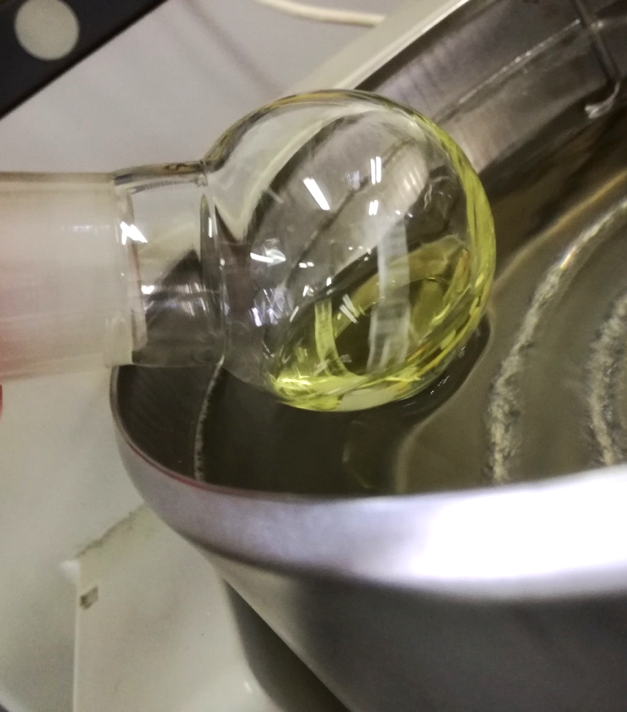
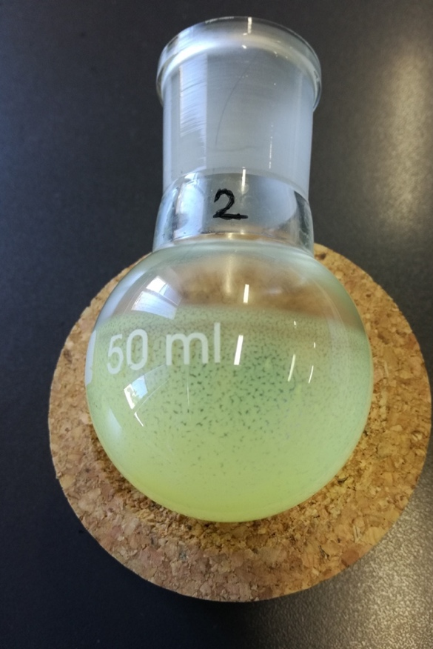
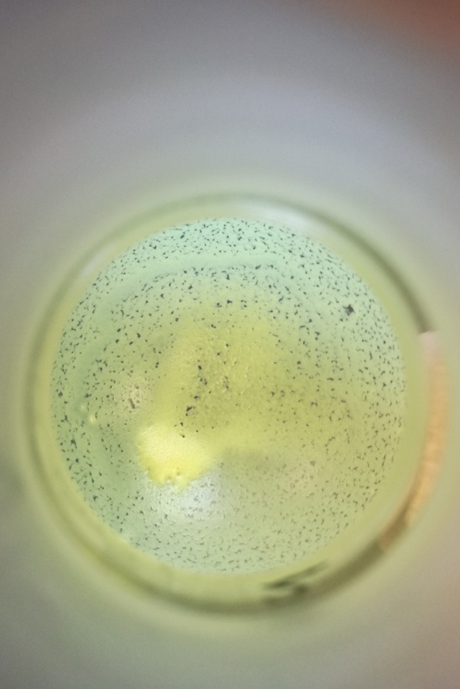
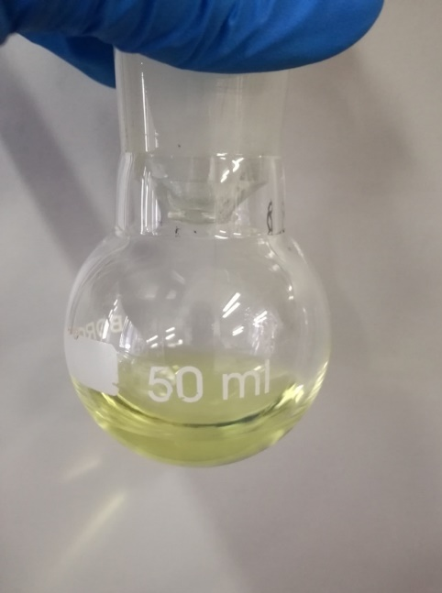

PREPARATION OF THE MICELLES
Solvent Casting Method
1
2
3
ATRA and
Vitamin E TPGS Solution in Ethanol
Solvent
removal
Formation of the thin layer
Micellar Suspension
1)Filtration
2)Analysis
Hydratation
Introduction .
Goals
Methods
Results
Conclusions

Slide 11
Results and discussion
ATRA:TPGS RATIO OPTIMIZATION
ATRA:TPGS in the preparative Mixture
1:20, 1:30, 1:40, 1:50, 1:60, 1:70
Introduction .
Goals
Methods
Results
Conclusions

Slide 12
STABILITY STUDIES
Micellar solutions in Incubator at 25°C
Analysis at 0, 24, 48 e 72 h
Filtration with 0,45 µm membrane
Absorbance measueres at 345 nm
Best Preparative Mixture 1:50
Introduction .
Goals
Methods
Results
Conclusions

Slide 13
FREEZE-DRYING
Flute beak pre-freezing in a freezer at -20 ° C
Cooling at
-30 ° C in the
freeze-drying
chamber
Primary drying
at 20 x 10⁻³ mBar
for 48 h
Secondary drying
at 25°C for 1 h
1
ADVANTAGES
Drug stabilization inside the micelle
Extended shelf life
Dimensions of the micelles unchanged after reconstitution of the powder
2
3
4
Pale yellow spongy solid easily resuspendable
Introduction .
Goals
Methods
Results
Conclusions

Slide 14
FTIR PCA-ASSISTED ASSESSMENT OF THE SUCCESSFUL ENCAPSULATION
Transmittance %
cm⁻¹
Score Plot of PCA on the FTIR data of all samples, ATRA and Vitamin E TPGS
FTIR spectra were considered in absorbance scale
Data were processed after Standard Normal Variate Trasform (SVN) and column centering
Significant bands of FTIR spectra of samples of the micelles of this study and of three additional ones having a high content of ATRA prepared as reference (1:1, 1:5, 1:10)
Introduction .
Goals
Methods
Results
Conclusions

Slide 15
PCA (absorbance scale, SVN, column centering)
Micelles samples, ATRA and Vitamin E TPGS appeared well separed on PC2
The location of all samples close to ATRA rather than to Vitamin E TPGS confirmed the presence of ATRA inside the complexes
The total samples population appeared furtherly separated on PC1
The location of samples circled in red closeer to ATRA than those circled in blue confirmed their higher content in ATRA (1:1, 1:5, 1:10) in respect of samples 01-06 of the present work (1:20, 1:30, 1:40, 1:50, 1:60, 1:70)
Introduction .
Goals
Methods
Results
Conclusions

Slide 16
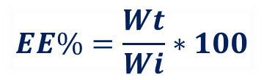
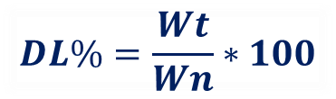
ENCAPSULATION EFFICIENCY AND DRUG LOADING
$$EE\%=\frac{Wt}{Wi}∗100$$
$$DL\%=\frac{Wt}{Wn}∗100$$
It expresses the quantity of drug encapsulated by the nanocarrier in respect to that used in the preparative mixture
It expresses the quantity of drug encapsulated by the nanocarrier in respect to the mass of the ATRA-TPGS complex
ATRA:TPGS | EE%
1 to 20 | 35,5 ± 2,2
1 to 30 | 47,4 ± 3,3
1 to 40 | 58,6 ± 0,2
1 to 50 | 64,8 ± 8,0
1 to 60 | 64,3 ± 9,4
1 to 70 | 79,1 ± 11,3
ATRA:TPGS | DL%
1 to 20 | 3,80 ± 0,04
1 to 30 | 3,74 ± 0,87
1 to 40 | 3,71 ± 1,12
1 to 50 | 3,75 ± 0,67
1 to 60 | 3,47 ± 0,73
1 to 70 | 4,22 ± 0,30
Introduction .
Goals
Methods
Results
Conclusions

Slide 17

DIMESIONAL ANALYSIS
BY DYNAMIC LIGHT SCATTERING (1)
Introduction .
Goals
Methods
Results
Conclusions

Slide 18
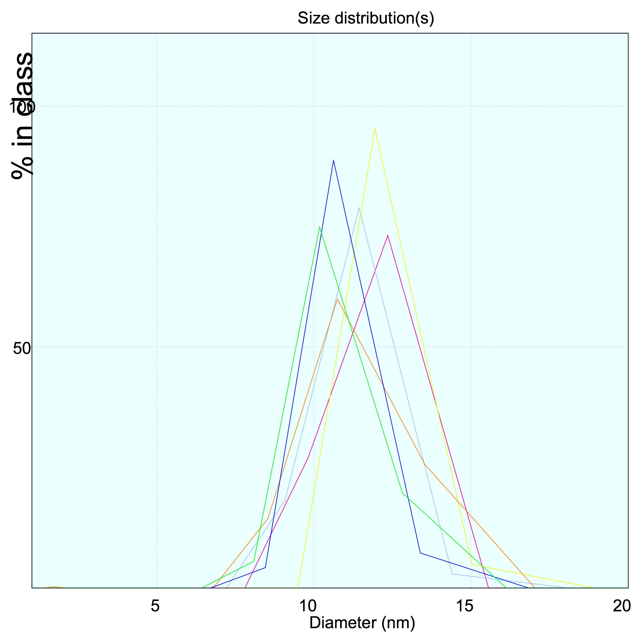
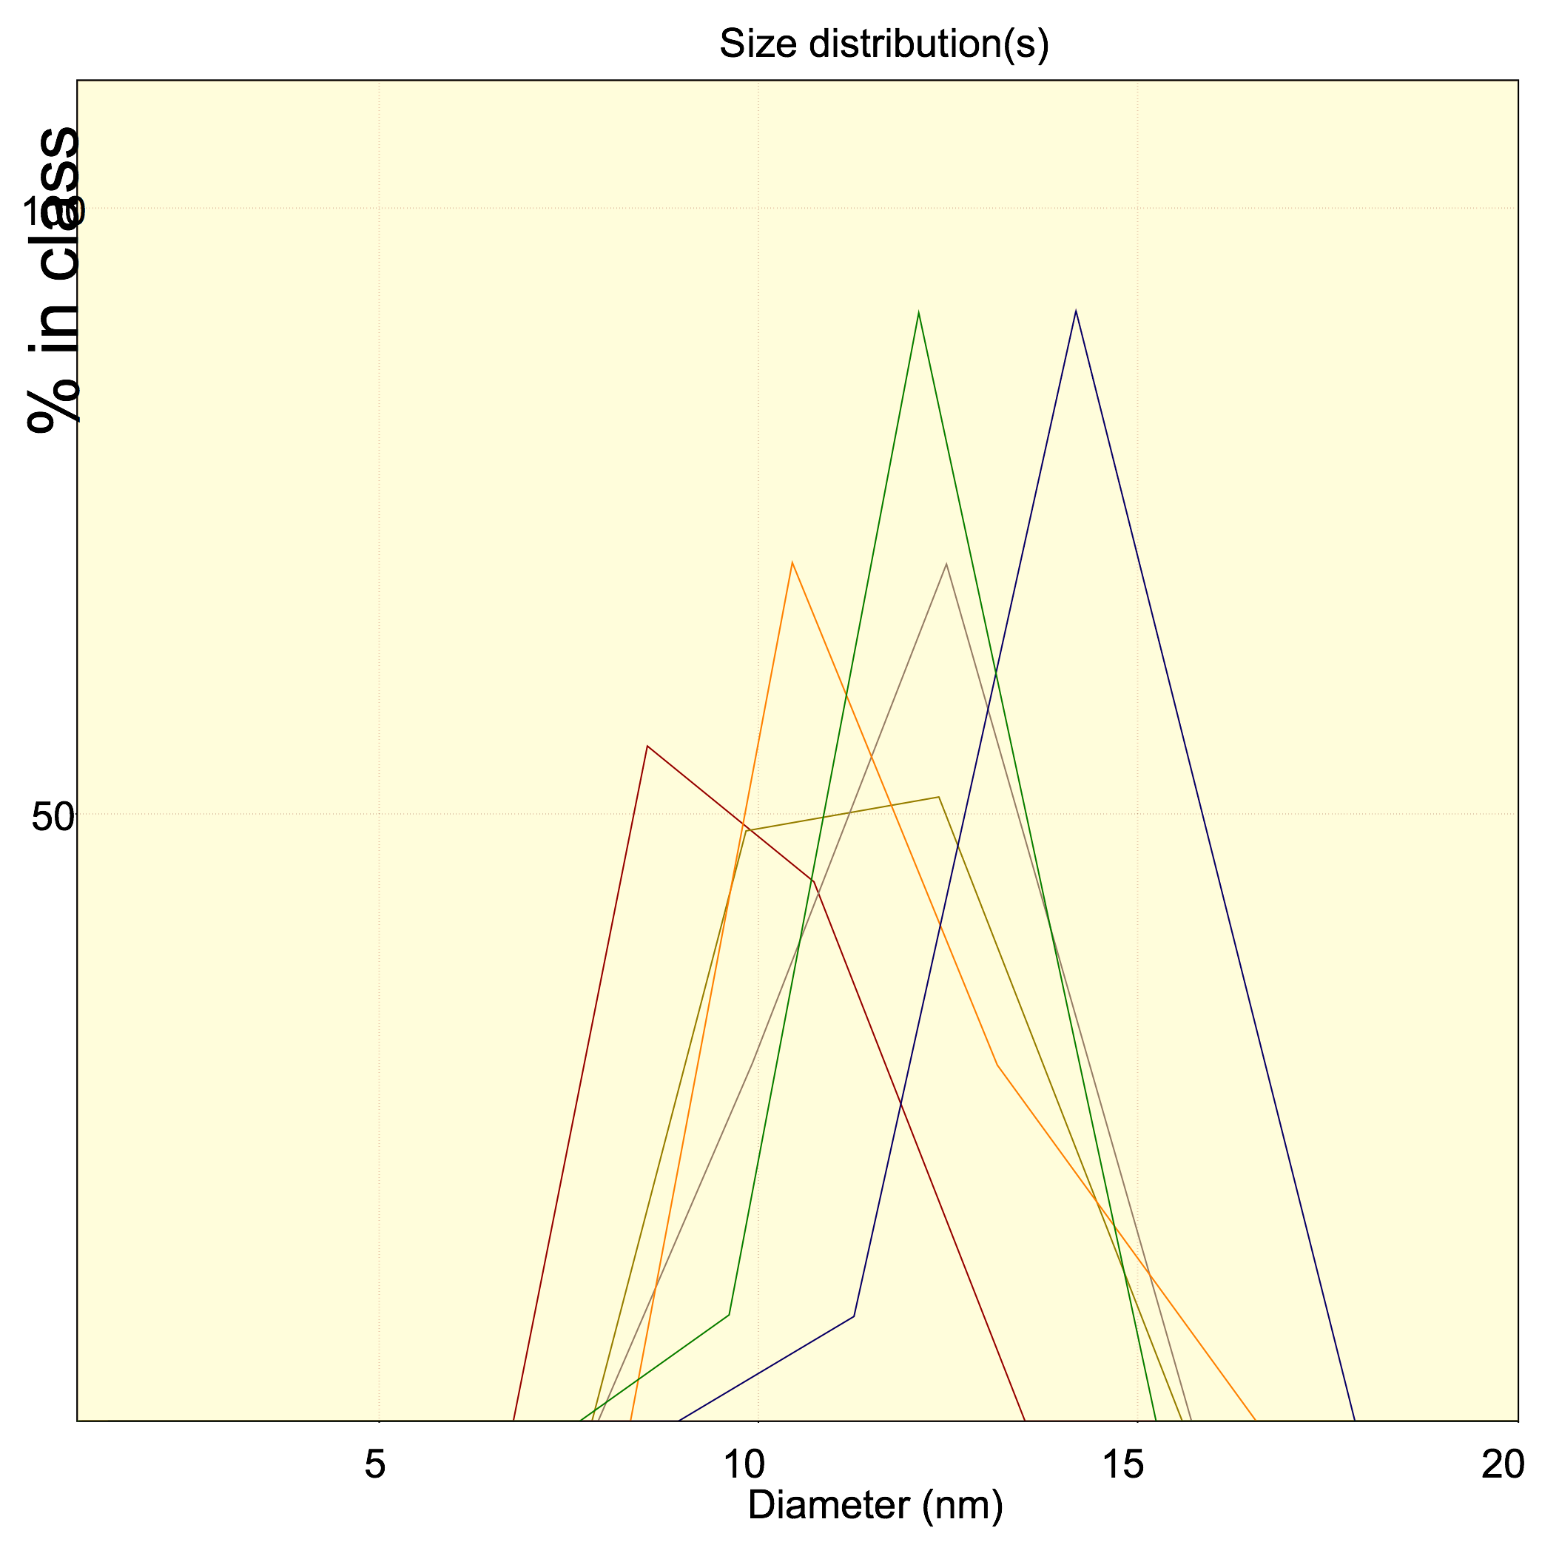
DIMESIONAL ANALYSIS BY DYNAMIC LIGHT SCATTERING (2)
Fresh
ATRA:TPGS | PDI Fresh Micelles | PDI Freeze-Dried Micelles
1 to 20 | 0,238 | 0,324
1 to 30 | 0,273 | 0,314
1 to 40 | 0,167 | 0,213
1 to 50 | 0,126 | 0,212
1 to 60 | 0,137 | 0,364
1 to 70 | 0,114 | 0,193
Freeze-Dried
Introduction .
Goals
Methods
Results
Conclusions

Slide 19
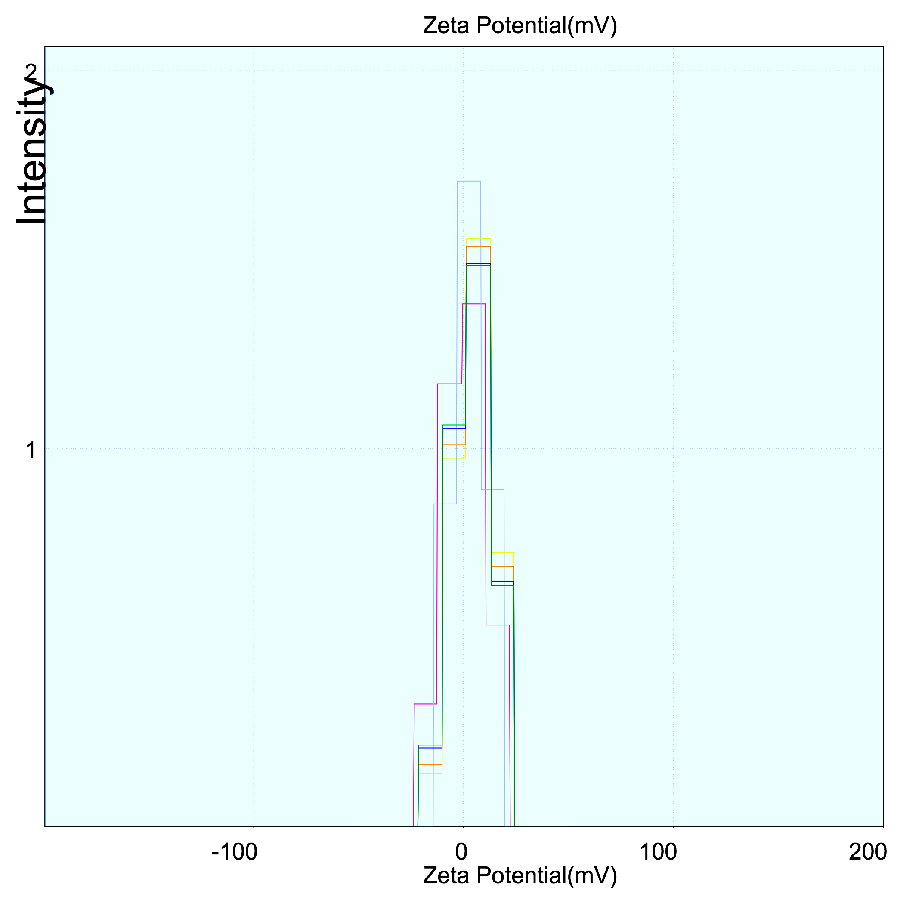
ZETA POTENTIAL (ζ)
ATRA:TPGS | 1 to 20 | 1 to 30 | 1 to 40 | 1 to 50 | 1 to 60 | 1 to 70
ζ | -7,2 | -9,3 | -12,6 | -10,8 | -13,2 | -10,1
ζ (H₂O mQ)
Mean Value = -10,5 mV
Shelf life
ATRA:TPGS | 1 to 20 | 1 to 30 | 1 to 40 | 1 to 50 | 1 to 60 | 1 to 70
ζ | -0,5 | 5,1 | -0,4 | 5,0 | 4,1 | 4,0
ζ (HEPES Buffer 5mM)
Mean Value = 2,9 mV
Stability in vivo
Introduction .
Goals
Methods
Results
Conclusions

Slide 20
GEL PREPARATION
Addition of increasing amounts of Carbopol ® 980 NF to the colloidal solution ATRA:TPGS 1:50
0,5%
1,0%
1,5%
Carbopol hydratation for 120 min
Neutralization with tryethanolamine
1
Carbopol ® (%) | pH
0,5 % | 5,8
1,0 % | 5,1
1,5 % | 5,0
2
3
Introduction .
Goals
Methods
Results
Conclusions

Slide 21
STUDY OF GELS RHEOLOGICAL PROPERTIES (1)
Viscosity varied as a function of the Shear Rate
Fluids with a SHEAR THINNING behaviour
Viscosity increased with the improvment of the concentration of the gelling agent
Viscosity was measured at 25°C while gels undergo an increasing shear rate from 0 to 500 s⁻¹ with a 100 s¹/min gradient
Introduction .
Goals
Methods
Results
Conclusions

Slide 22
STUDY OF THE GELS RHEOLOGICAL PROPERTIES (2)
The slip started after a certain shear stress value (yield value)
PLASTIC FLUIDS
Different Yield values on the base of the concentration of the gelling agent
(Bingham Model)
Introduction .
Goals
Methods
Results
Conclusions

Slide 23
CONCLUSIONS
SOLUBILITY
ATRA solubility was increased
from 6,3 x 10⁻⁴ mM to 1,22 mM
SIZE
Micelles with low size (16-20 nm)
and low polydispersity (PDI < 0,3) were achieved
STABILITY
Good stability was obtained
No aggregates or residuals formation was observed after 72 h
Materials suitable for freeze drying processes were prepared
GELS
Not Newtonian gels with plastic behaviour and isoepidermic pH were obtained
Introduction .
Goals
Methods
Results
Conclusions

Slide 24

FUTURE PERSPECTIVE
DEGRADATION
Studies concerning ATRA stability and determination of its possible degradation products by HPLC analysis
PERMEATION
Studies concerning ATRA release and skin permeation using an in vitro model (Franz cell)
BIOACTIVITY
Studies to establish the cytotoxic effects of ATRA-loaded micelles
on melanoma cells lines

Slide 25


D-α-tocopherol-Based Polymeric Micelles for Successful Improving Encapsulation of Retinoic Acid
Guendalina Zuccari, Sara Baldassari, Alice Atturo, Silvana Alfei, Giorgia Ailuno, Leonardo Marchitto and Gabriele Caviglioli

