Slide 1


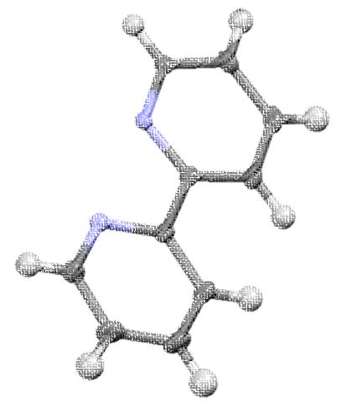


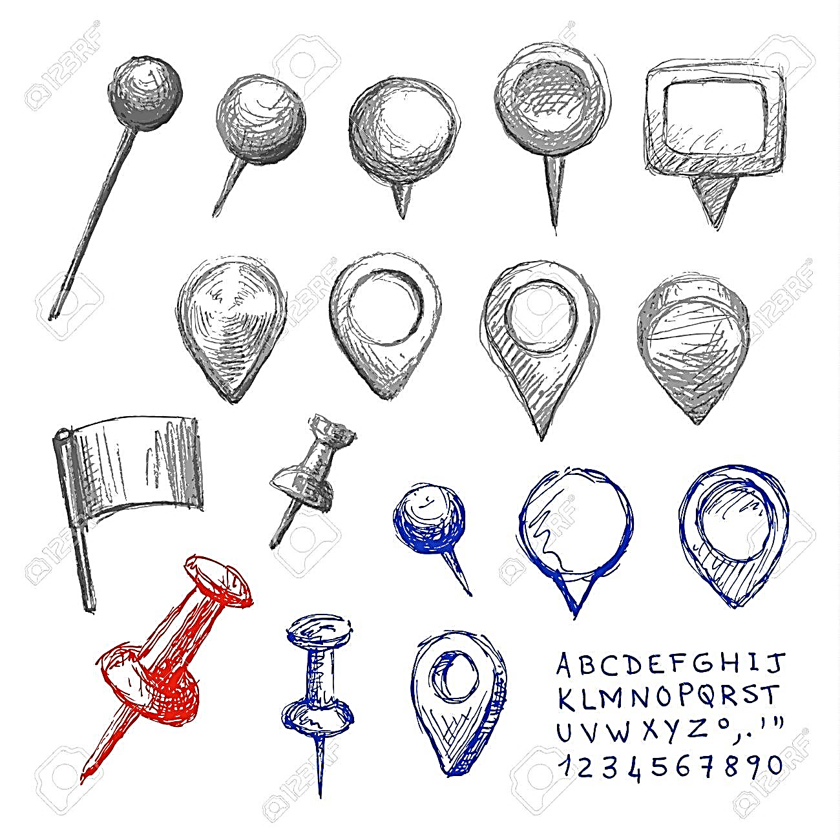
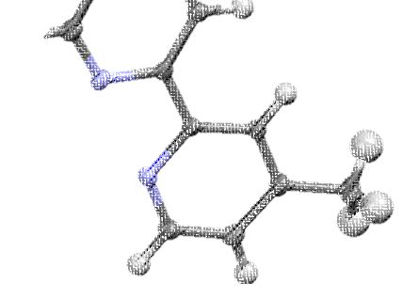

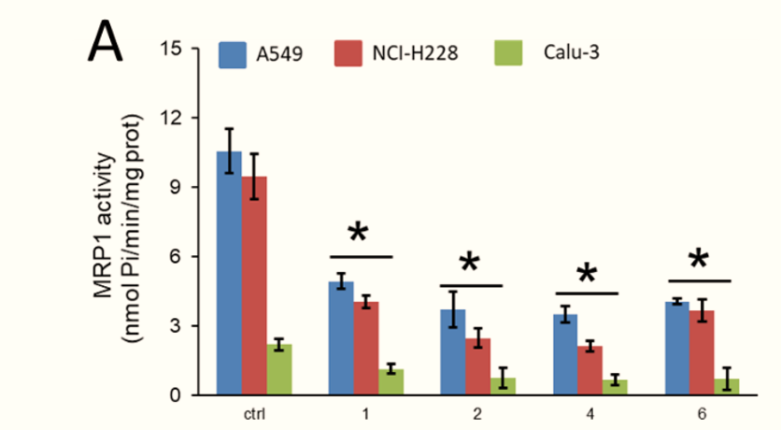
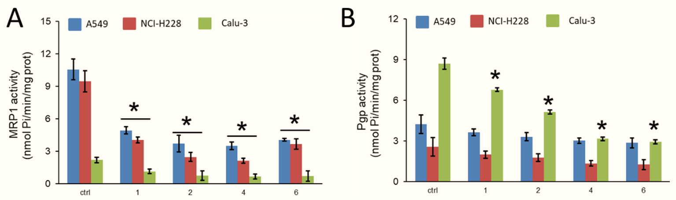
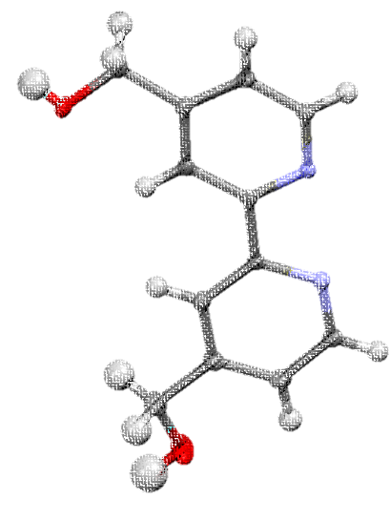


Ruthenium organometallic compounds as ABC drug efflux-targeted agents and collateral sensitizers
Ricardo G. Teixeira^{1,2}, Dimas C. Belisario³, Ana Isabel Tomaz^{1,2}, M. Helena Garcia^{1,2}, Chiara Riganti³, Andreia Valente^{1,2}
^{p}
¹ Centro de Química Estrutural, Faculdade de Ciências, Universidade de Lisboa, Campo Grande, 1749-016 Lisboa, Portugal.
² Departamento de Química e Bioquímica, Faculdade de Ciências, Universidade de Lisboa, Campo Grande, 1749-016 Lisboa, Portugal.
³ Department of Oncology, University of Torino, Italy.
rjteixeira@fc.ul.pt
BACKGROUND
Cisplatin-resistant lung cancer cell
Our research group has been focused on exploring metal-based compounds, especially incorporating the “ruthenium-cyclopentadienyl” (“RuCp”) scaffold.[1] This moiety is an appealing and robust scaffold to build new molecules from where the judicious choice of co-ligands allows to impart different properties and to fine-tune the performance of the whole complex.
In this frame, we developed new compounds based on the functionalized “RuCp” moiety containing bipyridyl ligands which were tested against four non-small cell lung cancer (NSCLC) cell lines: A549, NCI-H228, Calu-3 and NCI-H1975. Our preliminary results show that the compounds are more cytotoxic in cisplatin-resistant than in cisplatin-sensitive cells, and increased cisplatin cytotoxicity by inhibiting MRP1 and P-gp transporters. This work unveils the mechanism of action of these compounds, suggesting that drug efflux transporters could be a potential target, and, more importantly, indicates that they induce collateral sensitivity in cisplatin-resistant lung cancer cells.
Ru compound
blocks MDR efflux pump
(inhibitor)
Drug is effluxed
(substrate)
Increased drug
concentration
Cell survival
Cell death
MDR efflux
pump
Cisplatin
Our ‘RuCp’
compounds
RESULTS
Synthesis
Collateral sensitivity
‘Chemistry-on-the-complex’ reaction
Table 2. Resistance factor (Rf = IC₅₀(cisplatin)/IC₅₀(cisplatin + IC₂₅compound))
of the cell lines treated with cisplatin versus cisplatin and Ru compounds.
 | 1 | 2 | 4 | 6
A549 | 71.4 | 555.6 | 1250 | 243.9
NCI-H228 | 333.3 | 1389.9 | 588.2 | 344.8
Calu-3 | 26.3 | 126 | 33.2 | 78.7
NCI-H1975 | 2.9 | 0.6 | 1.6 | 0.7
1–4 (R’, 62–88 %)
R’ = aldehyde
5–7 (R’’, 58–64 %)
R’’ = alcohol
The selected compounds were able to increase cisplatin cytotoxicity (up to 1390-fold) when administrated at nontoxic doses
Targeting
moiety
Inhibition of ABC transporters
(1, 5)
(2, 6)
(3, 7)
(4)
Seven new compounds were synthesized and characterized by several spectroscopic techniques
Crystallographic studies confirmed the proposed ‘piano-stool’ geometry
o
All compounds are stable in aqueous solutions over 24 h
Ctrl 1 2 4 6
Ctrl 1 2 4 6
In vitro screening in NSCLC
Figure 1. MRP1 (A) and P-gp (B) ATPase activity measured on the proteins immune-purified from cells treated without (ctrl) or with 1 µM of compounds 1, 2, 4 and 6 for 24 h.
Table 1. IC₅₀ (µM) of the new ruthenium compounds and cisplatin in the cell lines analyzed after 72 h of incubation.
Compounds 1, 2, 4 and 6 inhibited MRP1 and P-gp activity in A549, NCI-H228 and Calu-3 cell lines, which overexpress these transporters.
 | 1 | 2 | 4 | 6 | Cisplatin
A549 | 10.8+1.3 | 12.4+3.6 | 15.4+2.6 | 12.5+2.1 | >100
NCI-H228 | 4.3+0.7 | 3.8+1.4 | 16.5+1.3 | 7.8+1.2 | >100
Calu-3 | 24.7+4.1 | 4.9+1.6 | 28.9+0.8 | 5.9+1.2 | 63.4 + 8.7
NCI-H1975 | 91.8+10.4 | >100 | >100 | >100 | 3.8 + 1.1
CONCLUSIONS
Compounds 1, 2, 4 and 6 show strong activity against cisplatin-resistant NSCLC A549 and NCI-H228
Compounds 3, 5 and 7 were inactive in the cell lines studied
Seven new ‘RuCp’ compounds were successfully synthesized and characterized
Compounds 1, 2, 4 and 6 were cytotoxic against NSCLC cell lines
Our compounds increased the sensitivity to cisplatin in the resistant cell lines by inhibiting MRP1 and P-gp transporters
Acknowledgements
CQE is funded by Fundação para a Ciência e Tecnologia (FCT) – UIDB/00100/2020. Financial support was also provided by FCT through PTDC/QUI-QIN/28662/2017, Lead4Target; A. Valente acknowledges CEEC-IND/01974/2017 (acknowledging FCT, as well as POPH and FSE – European Social Fund). R.G. Teixeira thanks FCT for his Ph.D. Grant (SFRH/BD/135830/2018).
References
[1] Garcia et al., Future Medicinal Chemistry, 2016, 8(5), 527–544.
Lead4Target

