Slide 1
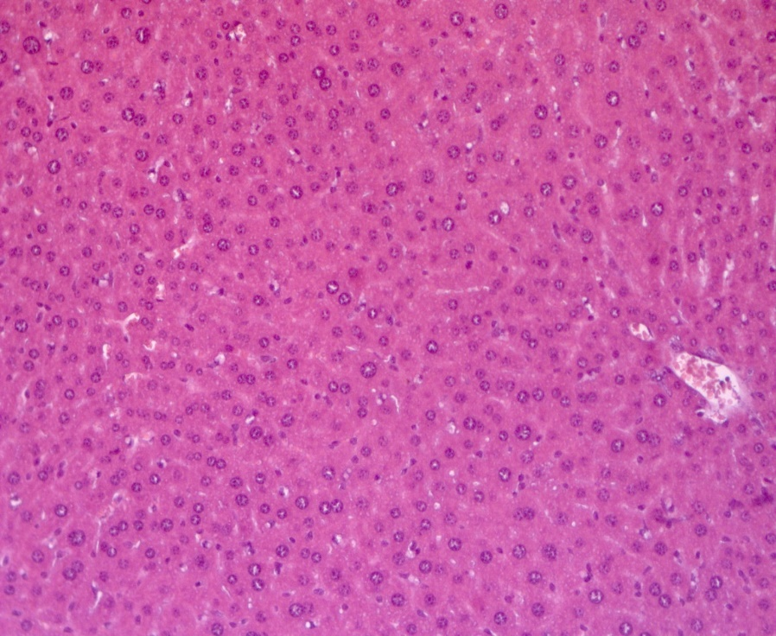
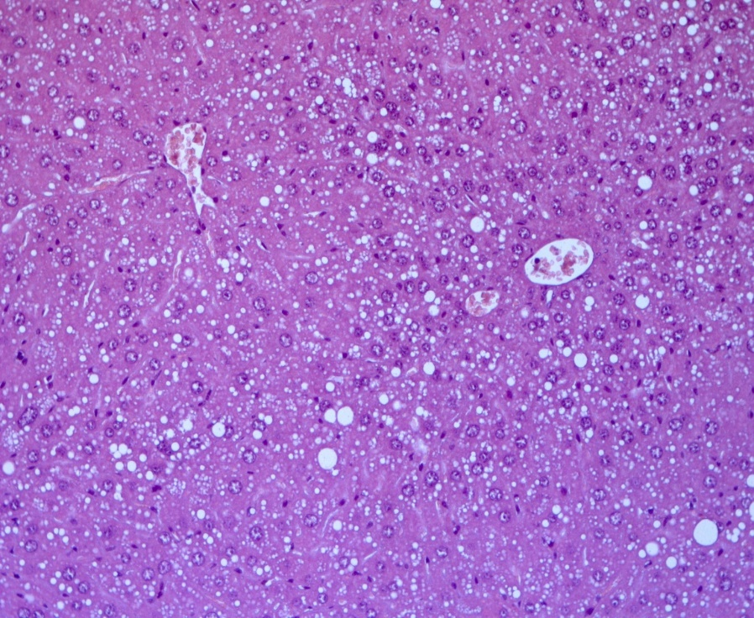
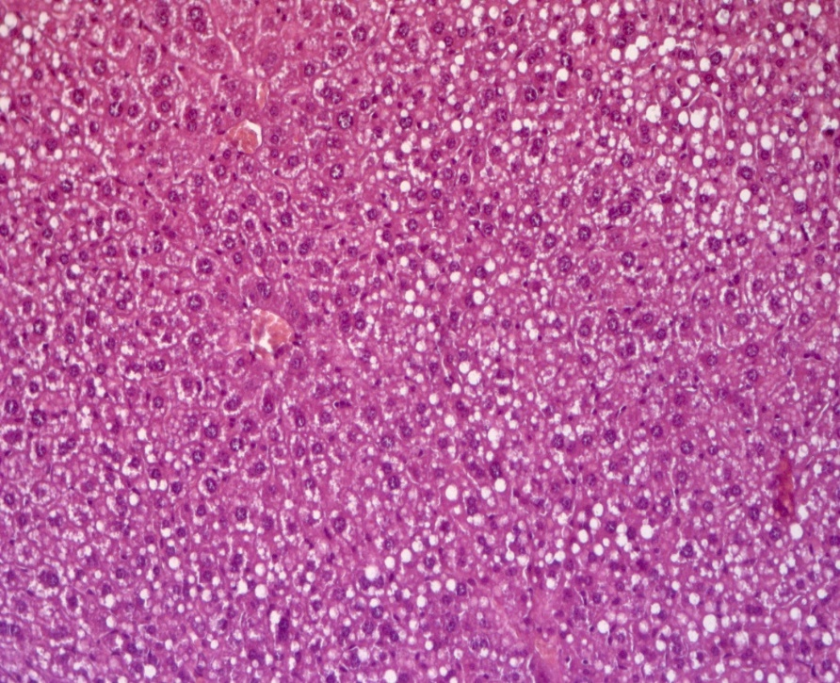
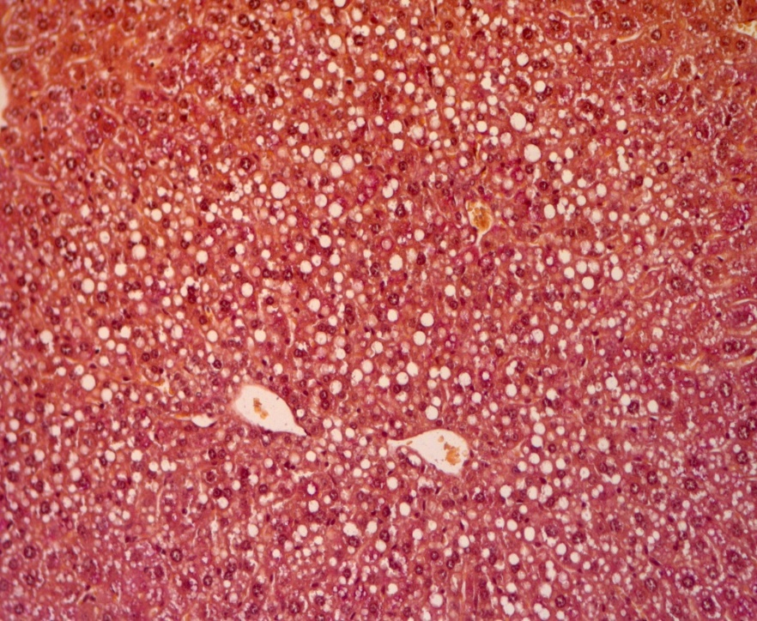
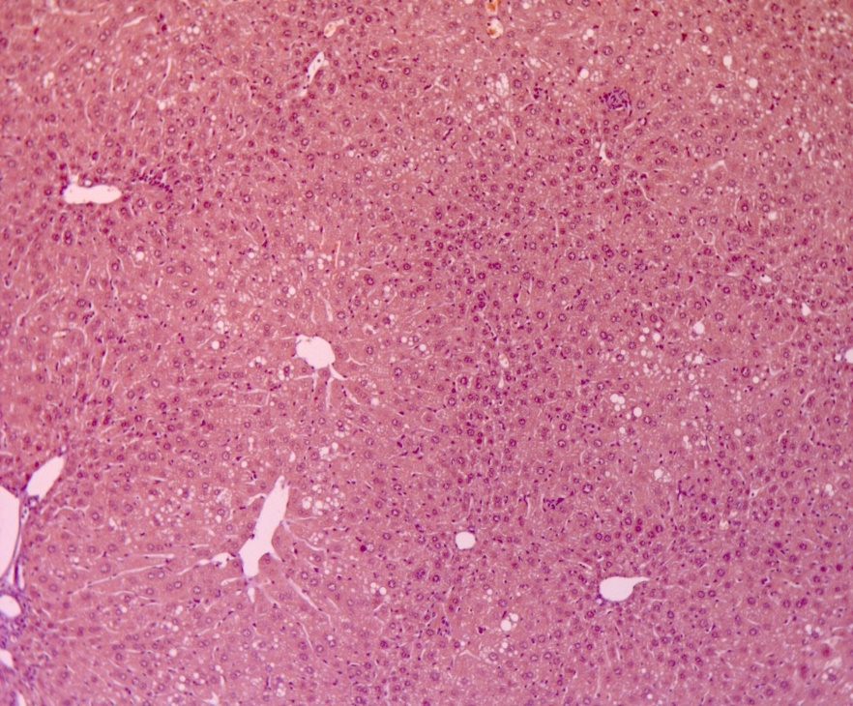
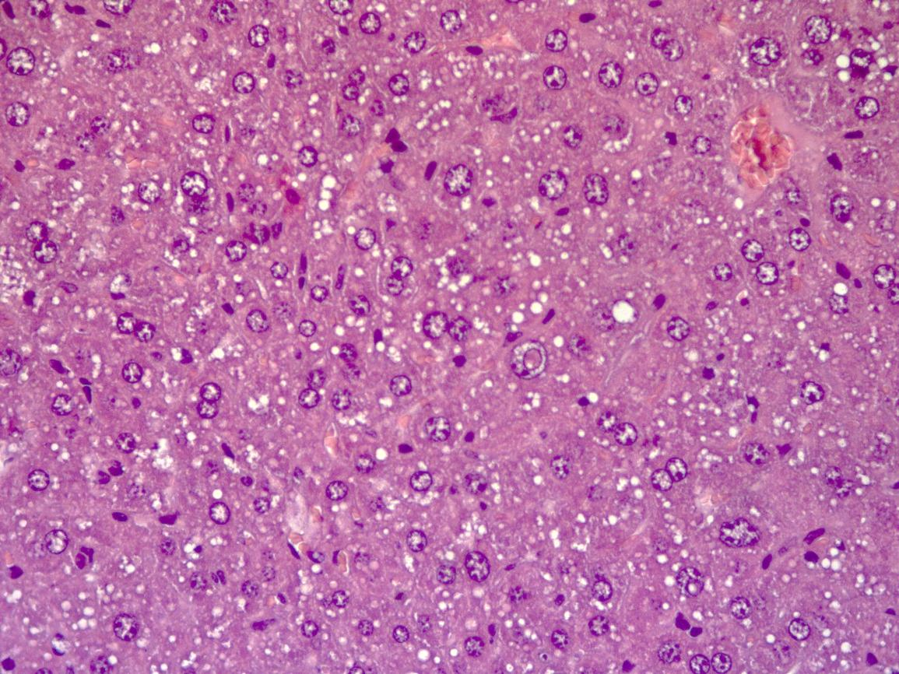
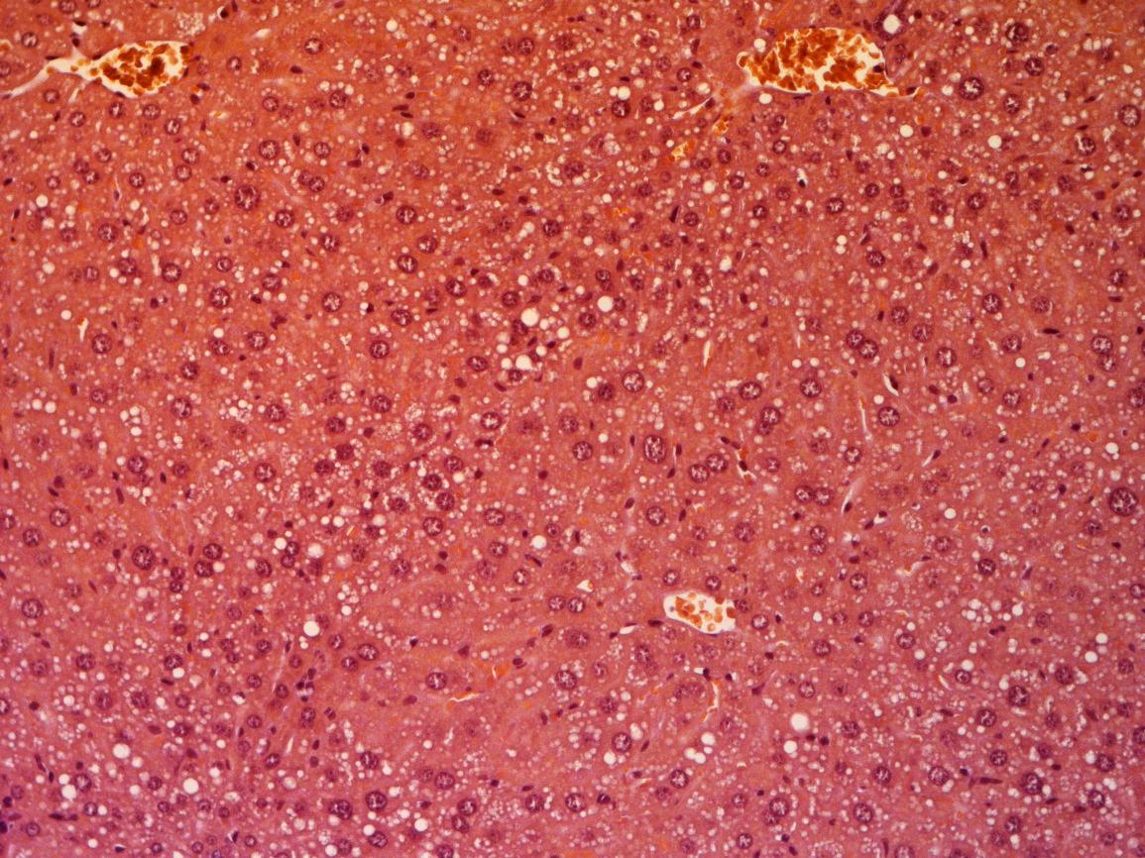
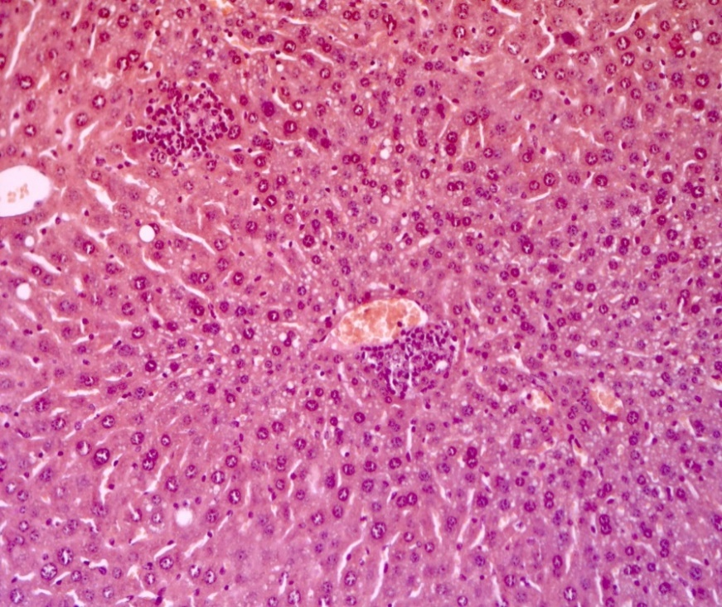
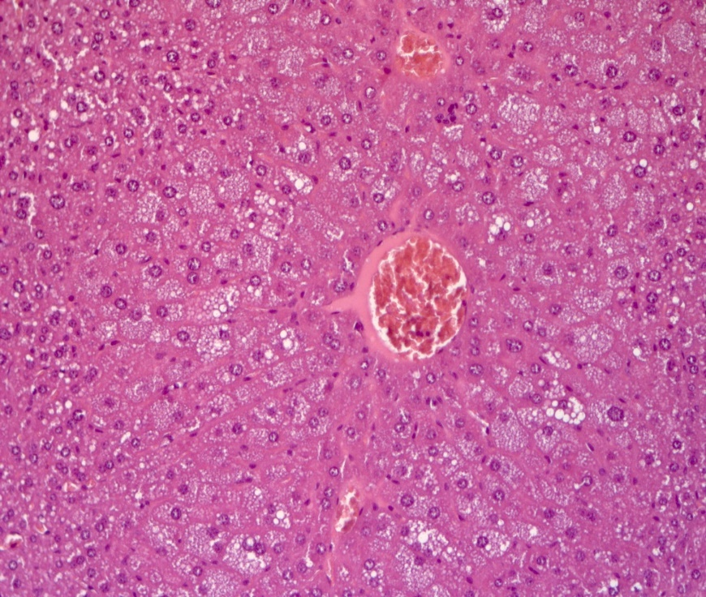
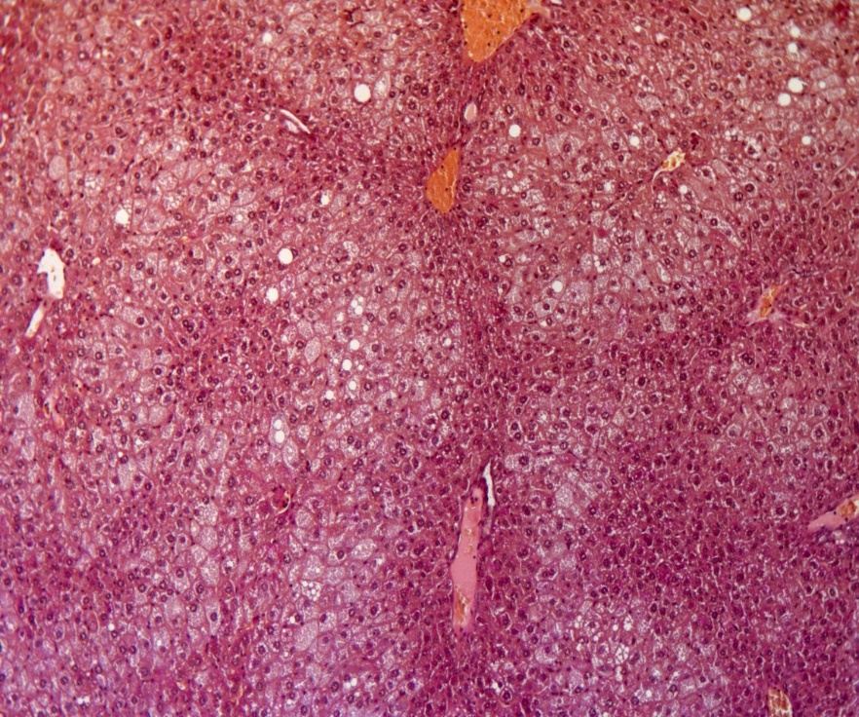
Hypoglycemic activity study of the novel bornyl derivatives of p-(benzyloxy)phenylpropionic acid
Darya Kuznetsova, Mikhail Khvostov*, Sergey Kuranov, Olga Luzina, Dmitriy Baev, Nataliya Zhukova, Tatyana Tolstikova and Nariman Salakhutdinov
N. N. Vorozhtsov Novosibirsk Institute of Organic Chemistry, 9, AkademikaLavrentieva Ave., Novosibirsk, 630090, Russian Federation *Correspondence: khvostov@nioch.nsc.ru
Introduction
Materials & methods
Type 2 diabetes mellitus (T2DM) is a serious medical and social problem because the prevalence of this disease has been increasing at an alarming rate. The several classes of antihyperglycemic drugs are used to treat T2DM, but each has its own adverse effects. The main adverse effects of modern oral antidiabetic agents include hypoglycemia, fluid retention, osteoporosis, and heart failure, which limit their clinical use. Therefore, the development of new antidiabetic candidate compounds for the control of various parameters of metabolic disturbances with minimization of adverse effects remains the primary and most important task in the treatment of T2DM. In this study we explore two bornyl derivatives of p-(benzyloxy)phenylpropionic acid 1 and 2 for their ability to normalize glucose metabolism in mice with metabolic disorders.
Animals:
male C57BL/6^{Ay} (hereafter: AY) mice weighting 45-50 g. The mice were kept on a high-calorie diet for 2 months before the drug administration.
male C57BL/6 mice weighing 22–25 g.
Agents and doses:
Agents | Doses
Compound 1 | 30 mg/kg
Compound 2 | 30 mg/kg
Vildagliptin (VIL) | 30 mg/kg
Experimental method: glucose metabolism was evaluated using oral glucose tolerance test (OGTT). Oral glucose loading (2.5 g/kg) was done in all the groups of mice. The tested compounds were given by oral gavage 30 min prior to the glucose load. Blood glucose was quantified before dosing (time 0) and at 30, 60, 90, and 120 min after the glucose load. The area under the glycemic curve (AUC) was calculated using Tai’s model.
Figure 1. New bornyl derivatives.
Results
The OGTT in AY mice
Figure 2. *p < 0.05 as compared to C57BL/6 mice, #p < 0.05 as compared to untreated AY mice. OGTT immediately performed after the first oral introduction of studied compounds to AY mice did not show ahypoglycemic effect but revealed the impaired glucose tolerance in untreated mice. Conversely administration of 1 exerted a hyperglycemic effect.
Figure 3. *p < 0.05 as compared to C57BL/6 mice, #p < 0.05 as compared to untreated AY mice. After 14 days of administration, another OGTT was carried out, where it was found that glucose tolerance in untreated AY mice remained abnormal. At the same time, a significant hypoglycemic effect was detected in mice treated by 2.
Figure 4. *p < 0.05 vs. untreated AY mice on the 1st day of dosing; #p < 0.05 vs. untreated AY mice on the 14th day of dosing; Ap < 0.05 vs. C57BL/6 mice on the 1st day of dosing; Bp < 0.05 vs. C57BL/6 mice on the 14th day of dosing; Cp < 0.05 vs. VIL 1st day of dosing; Dp < 0.05 vs. compound 1 on the 1st day of dosing; Ep < 0.05 vs. 3 on the 1st day of dosing. A significant hypoglycemic effect was detected in mice treated by 2, judging by a lower AUC. The hyperglycemic effect of 1 decreased, but the total glucose level in these animals did not differ from that in the untreated AY group. The administration of VIL for 2 weeks also improved the results of the OGTT.
Histological examination of the liver of а C57BL/6 mouse (A) and an untreated AY mouse (B-D) at the end of the experiment
Histological examination
Histological examination of the liver of AY mice treated with
VIL or compounds 1 or 2
Figure 6. A. The liver of an AY mouse after 14 days of VIL administration. Polymorphic lipid infiltration and hepatocyte polymorphism. Staining: hematoxylin and eosin; magnification ×200. B. The liver of an AY mouse after 14 days of administration of VIL. Polymorphic lipid infiltration, no glycogen. Staining: periodic acid-Schiff, hematoxylin, and orange G; magnification ×200. C. The liver of an AY mouse that received 1 for 14 days. Polymorphic lipid infiltration, no glycogen. Staining: periodic acid-Schiff, hematoxylin, and orange G; magnification ×200. D. The liver of an AY mouse that received 1 for 14 days. Fine necrosis of hepatocytes. Staining: hematoxylin and eosin; magnification ×200. E. The liver of an AY mouse who received 2 for 14 days. Small-vesicle fat dystrophy, hepatocyte hypertrophy. Staining with hematoxylin and eosin; magnification ×200. F. The liver of an AY mouse that received 2 for 14 days. Small-vesicle fat dystrophy, no glycogen. Staining: periodic acid-Schiff, hematoxylin, orange G. magnification ×200.
A
B
A
B
C
C
D
Figure 5. A. Nuclear polymorphism of hepatocytes. Staining with hematoxylin and eosin, magnification ×200. B. Polymorphic lipid infiltration of hepatocytes. Staining with hematoxylin and eosin; magnification ×200. C. Polymorphic lipid infiltration, nuclear polymorphism of hepatocytes. Staining with hematoxylin and eosin; magnification ×400. D. Polymorphic lipid infiltration, no glycogen. Staining: periodic acid-Schiff, hematoxylin, and orange G; magnification ×200.
D
E
F
During histological examination of the mice’s liver at the end of the experiment it was found that in animals received 1 for 14 days, there was alleviation of metabolic disturbances whereas is those who received 2 partial correction of the metabolic abnormalities was detected. In VIL group no correction of metabolic abnormalities was found. These differences suggest different mechanism of action of VIL and studied compounds.
Conclusion
These results indicate that 1 and 2 have a good potential as new agents for diabetes mellitus treatment with different from VIL mechanism of action.
Supported by RSF grant 20-13-00029.

