Slide 1
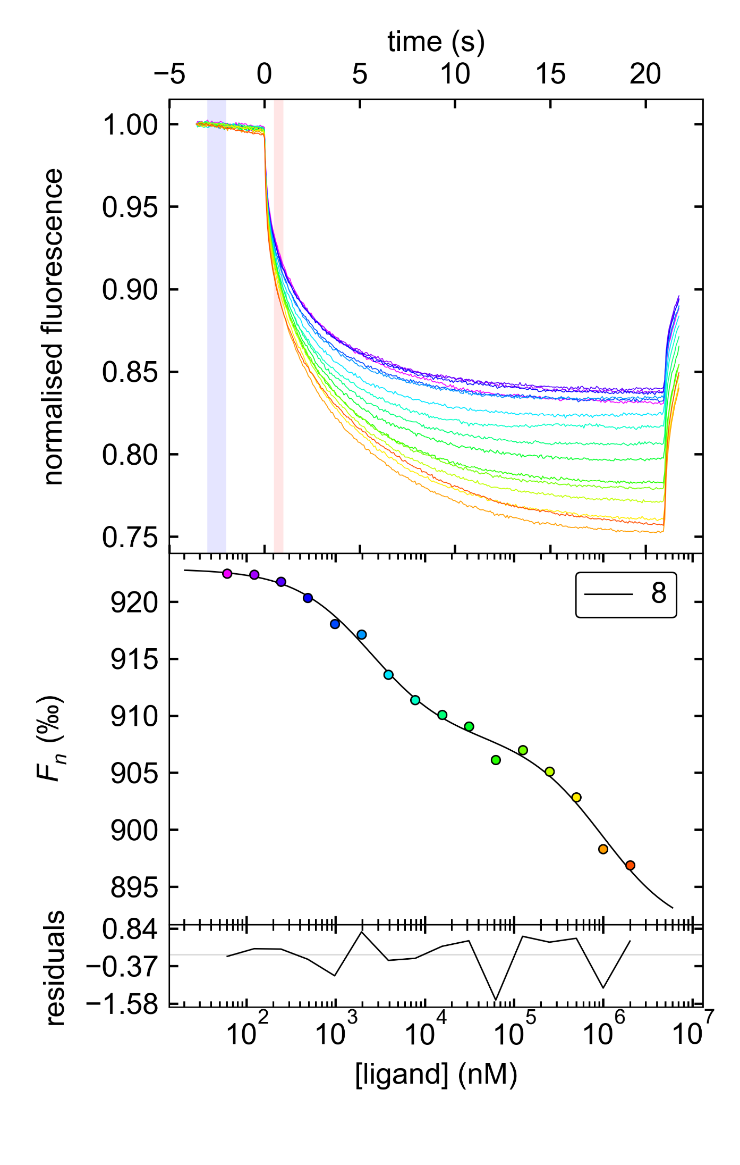
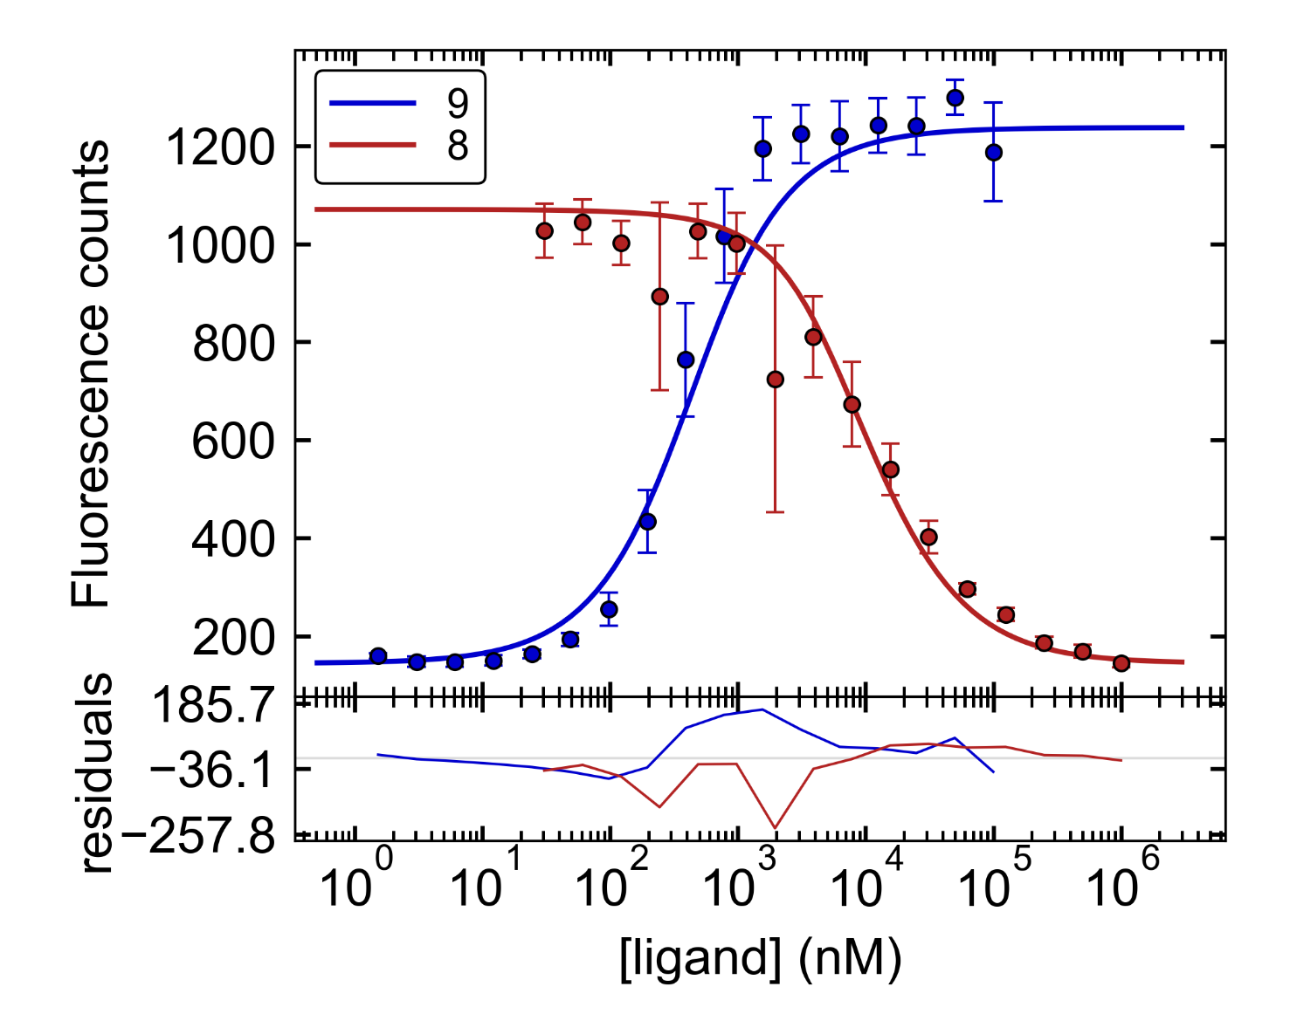
“Clickable” albumin binders to modulate pharmacokinetic properties of theranostic radioligands
Florian Brandt¹, Martin Ullrich¹, Klaus Kopka^{1,2}, Reik Löser^{1,2}, Jens Pietzsch^{1,2}, Hans-Jürgen Pietzsch^{1,2}, Robert Wodtke¹
¹Helmholtz-Zentrum Dresden-Rossendorf, Institute of Radiopharmaceutical Cancer Research, Dresden, Germany
²Technische Universität Dresden, Faculty of Chemistry and Food Chemistry, Dresden, Germany
Introduction and Objective
Reversible binding of theranostic radioligands for tumour targeting to human serum albumin (HSA) increases their blood circulation time and can lead to higher accumulation in the target tissue. N^{α}Acetyl-N^{ε}-IPB-lysine (IPB…4-(4-iodophenyl)butanoyl) was recently described as potent binder to HSA.¹ For late-stage modification of different classes of molecules (proteins, peptides, small molecules) with this albumin binder, we developed “clickable” N^{ε}-IPB-lysines bearing azide/alkyne functionalities. Application to dual targeting of somatostatin receptor subtype 2 (SSTR2) and HSA is highlighted.
Synthetic Approaches
For the selective acylation of lysine, a solid-phase synthesis concept (2-ClTrtCl-resin) was established starting from Fmoc-Lys(Alloc)-OH. For upscaling (4 mmol), a synthesis in solution starting from Boc-Lys-OH was elaborated, which provides the desired building blocks in three steps (Scheme 1). To demonstrate the suitability of the “clickable” albumin binders, compound 6 was coupled to the SSTR2 agonist Tyr³-octreotate (TATE, D-Phe-c(Cys-Tyr-D-Trp-Lys-Thr-Cys)-Thr), modified with (R)-NODAGA-l-Pra-O2Oc, by on-resin Cu-catalyzed azide-alkyne cycloaddition to yield 10 (Figure 1).
Scheme 1. Synthetic approaches for selective acylation of lysine exemparily shown for compound (8) a) 20% piperidine/DMF, 2×10 min; b) 4-azidobenzoic acid, HATU, DIPEA, 2 h; c) 5mol% Pd(PPh₃)₄, phenylsilane, CH₂Cl₂, 2×10min; d) 4-(4-iodophenyl)butanoic acid, HATU, DIPEA, 2 h; e) HFIP/CH₂Cl₂ 1:4 (v/v, 3×10 min each 3 mL); f) 4-(4-iodophenyl)butanoic acid NHS ester, THF/H₂O 1:1 (v/v), NaHCO₃, 2 h; g) CH₂Cl₂/TFA 1:1 (v/v), 2 h; h) 4-azidobenzoic acid NHS ester, CH₃OH/THF 1:1 (v/v), Et₃N, 2 h
Characterisation of compounds
Figure 1. Structure of 10
Characterisation of N^{ε}-IPB-lysines towards HSA binding
HSA binding was characterised by a microscale thermophoresis-based assay (MST, Monolith, NanoTemper Technologies) and a fluorimetric competitions assay (Figure 2). For MST, HSA (fatty acid free) was labeled using the Protein Labeling Kit RED-Maleimide according to the manufacture’s instructions. For the competition assay, the change in fluorescence intensity of N^{α}-6-FAM-N^{ε}-IPB-d-lysine (9) by displacement from HSA was recorded. All measurements were performed in PBS (pH 7.4, 2% DMSO) at 37°C. Samples were loaded into Monolith NT.115 capillaries. Data of three independently pipetted measurements were analysed by the MST analysis software PALMIST² to provide K_{d} values for the different N^{ε}-IPB-lysines (see Table below).
Figure 2. MST (left) and fluorescence (right) data for the interaction of 8 with HSA Left: The top panel shows the thermophoretic time-traces from one experiment (color-coded, purple and red representing the lowest and highest concentration of 8, respectively, shaded blue and pink areas were used for calculation of F_{n}) . The lower panel shows the resulting binding curve (color-coding of data points according to their respective time-trace). Right: Binding curves for 9 (ligand is HSA) and 8 (in the presence of 9) are shown in blue and red, respectively.
All novel N^{ε}-IPB-lysines showed similar affinity to HSA as N^{α}-Acetyl-N^{ε}-IPB-lysine (1 or 2)
Configuration of lysine (S or R) seems to be of minor importance for binding to HSA
Esterification and amidation of the α-carboxylic group lead to significant loss of binding affinity to HSA
Data from MST assay indicate binding of N^{ε}-IPB-lysines to a second binding site at HSA with low affinity (K_{d,2} = >500 µM for 8, Figure 2)
Characterisation of ⁶⁴Cu-10 towards HSA and SSTR2 binding
To determine binding of ⁶⁴Cu-10 to plasma proteins in comparison to its alkyne analog ⁶⁴Cu-10A, a ultrafiltration assay was applied using Centrifee Ultrafiltration devices (30 kDa nominal molecular weight limit, 4104, Millipore, Figure 3).³ Mouse pheochromocytoma cell (MPC) membranes were used for saturation binding experiments to quantify affinities of ⁶⁴Cu-10 and ⁶⁴Cu-10A towards SSTR2.⁴
No. | R = | Config. | X | K_{d} (µM)
1 | Acetyl | R | OH | 7.0 8.0*
2 |  | S | OH | 3.1
3 |  | S | OCH₃ | 110.0
4 |  | S | NH₂ | 70.0
5 | 5-Pentynoyl | R | OH | 7.0
6 | 5-Azidopentanoyl | R | OH | 8.0
7 |  | S | OH | 6.0
8 | 4-Azidobenzoyl | R | OH | 1.2 2.6*
9 | 6-FAM | R | OH | 0.23
* Determined by MST assay, all other K_{d} values were determined by the fluorimetric competition assay
⁶⁴Cu-10 binds almost completely to plasma proteins in contrast to its alkyne analogue ⁶⁴Cu-10A demonstrating successful targeting of HSA
Both compounds maintained excellent binding affinity to SSTR2 with K_{d} values of 1.2 and 2.6 nM for ⁶⁴Cu-10 and ⁶⁴Cu-10A, respectively (K_{d} = 1.8 nM for ⁶⁴Cu-DOTA-TATE)
Figure 3. Results of ultrafiltration assay for ⁶⁴Cu-10 and ⁶⁴-10A
Conclusion and Outlook
The synthesis of “clickable” N^{ε}-IPB-lysines has been established. The compounds maintained their binding potency to HSA. Application for the late-stage modification of sstr2 agonist TATE was successful and the dual targeting behavior of ⁶⁴Cu-10 towards HSA and sstr2 was demonstrated. In current studies, biodistribution and tumour uptake of ⁶⁴Cu-10 (vs. ⁶⁴Cu-10A) will be studied preclinically in MPC tumour bearing mice by small animal PET imaging.
References
1 Dumelin et al. Angew. Chem. Int. Ed. 2008, 47, 3196 –3201
2 Scheuermann et al. Anal. Biochem. 2016, 496, 79-93
3 Müller et al. J. Nucl. Med. 2013, 54, 124−131
4 Ullrich et al. Theranostics 2016, 6, 650-665
Florian Brandt · f.brandt@hzdr.de · www.hzdr.de

