Slide 1
Trivalent chromium and male germ cells: current prospects and future trends
Maria de Lourdes Pereira ^{1,2}*, Sónia M.R. Oliveira ², Ehsan Ahmadpour ³, Bechan Sharma ⁴ and Teresa Margarida Santos ^{2,5}
¹Department of Medical Sciences, University of Aveiro, Portugal
²CICECO - Aveiro Institute of Materials, University of Aveiro, Portugal
³Infectious & Tropical Diseases Research Center, Tabriz University of Medical Sciences, Tabriz, Iran ⁴Department of Biochemistry, University of Allahabad Allahabad, India ^{2,5}Department of Chemistry, University of Aveiro, Portugal
* Corresponding author: mlourdespereira@ua.pt

Slide 2
Abstract: The dietary supplement of Cr(III)-tris-picolinate, (CrPic), have been used for diabetes, body weight and muscular growth. However, its application for humans or animals has always been debatable due to contradictory results on its safety limits. Further, long-term effects of CrPic on the immunity and the antioxidant system of treated subjects have still not been properly studied. Long-term use of CrPic may prove to be carcinogenic or clastogenic. CrPic supplements are valuable for meat and poultry industries, and fertility improvement. The potential of CrPic to increase levels of certain hormones and improve the body’s antioxidant status, while leaving untouched the secretion of other hormones remains underexplored. Comprehensive studies on the role of CrPic will help to establish safety. Combined with nanoparticles or biomimicking materials this may unleash a significant breakthrough for the treatment of conditions in menopausal and postmenopausal as for diseases affecting men (cardiovascular disorders and type 2 diabetes). This work encompasses a comprehensive analysis of the main benefits and risks of chromium compounds on male germ cells/male fertility. The role of this supplement in steroidogenesis and research pinpointing in vivo changes in testosterone-producing cells, spermatogenesis, and sperm quality. We will also postulate on their use to maximize male fertility.
Keywords: chromium picolinate; dietary supplements; fertility; male germ cells

Slide 3
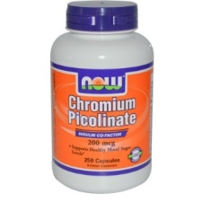
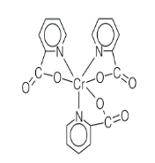
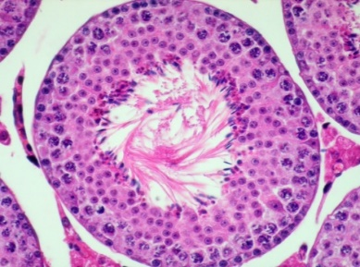
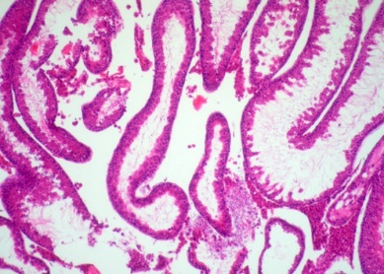
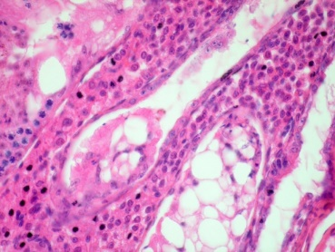
Trivalent chromium and male germ cells: current prospects and future trends
Control
[Cr(pic)₃] – Testis atrophy
[Cr(pic)₃] – Epididymis degeneration

Slide 4
Introduction
CHROMIUM ESSENTIAL OR NOT?
1
Cr(III) AND TYPE 2 DIABETES
2
3
SUPPLEMENTS AND TOXICOLOGY
RELEVANCE, IMPACT AND GOALS
4
5
RESULTS
CONCLUSIONS
6

Slide 5
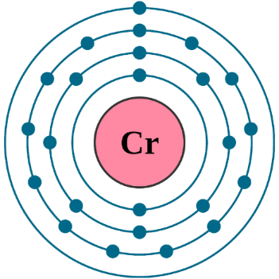
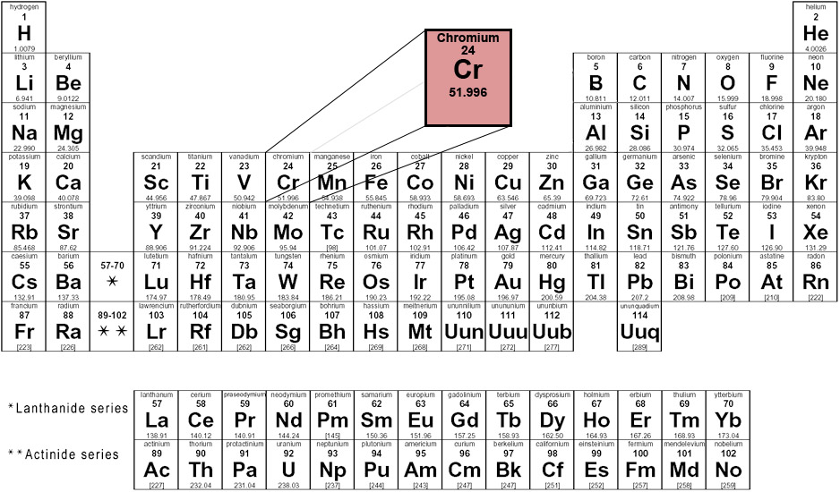
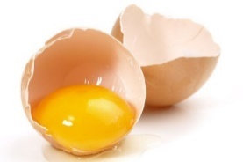
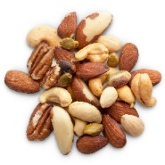
Introduction
Chromium exists in our environment as metallic Cr(O), trivalent Cr(III) and hexavalent Cr(VI)
Cr(III)
Relatively nontoxic due to poor bioavailability
Cr(VI)
Synthesized by the oxidation of Cr(III).
It is a proven human carcinogen and environmental pollutant
Santos TM, Ferreira M, Pereira ML. Chromium: The Intriguing Element. What Biological Role Has It? (Cr(III)-Tris-Picolinate—Is It Safe or Not?). In: Thomas S, ed. Microscopy Applied to Materials Sciences & Life Sciences. Academic Press USA; 2018:427-459.
Cefalu WT, Hu FB. Role of chromium in human health and in diabetes. Diabetes Care. 2004;27(11):2741-2751.

Slide 6
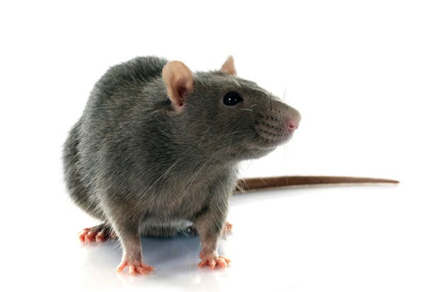
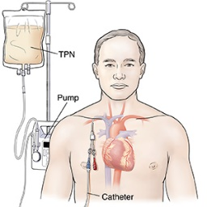
Introduction
Cr(III) is studied and proposed as an essential element
1955
Mertz and Schwarz showed a
correlation between Cr(III) and glucose
Torula yeast-based diet absent in Cr(III)
Impaired glucose tolerance
reversed by adding foods rich in chromium
Chromium proposed as an essential element based on evidence from patients receiving total parenteral nutrition (TPN)
TPN solution
without Cr(III)
Diabetic symptoms refractory to insulin but reversed by addition of Cr(III)
Mertz W, Schwarz K. Impaired intravenous glucose tolerance as an early sign of dietary necrotic liver degeneration. Arch Biochem Biophys. 1955;58(2):504-506.
Vincent JB. The Nutritional Biochemistry of Chromium (III). 1st ed. (Vincent JB, ed.). Elsevier Science; 2007.

Slide 7
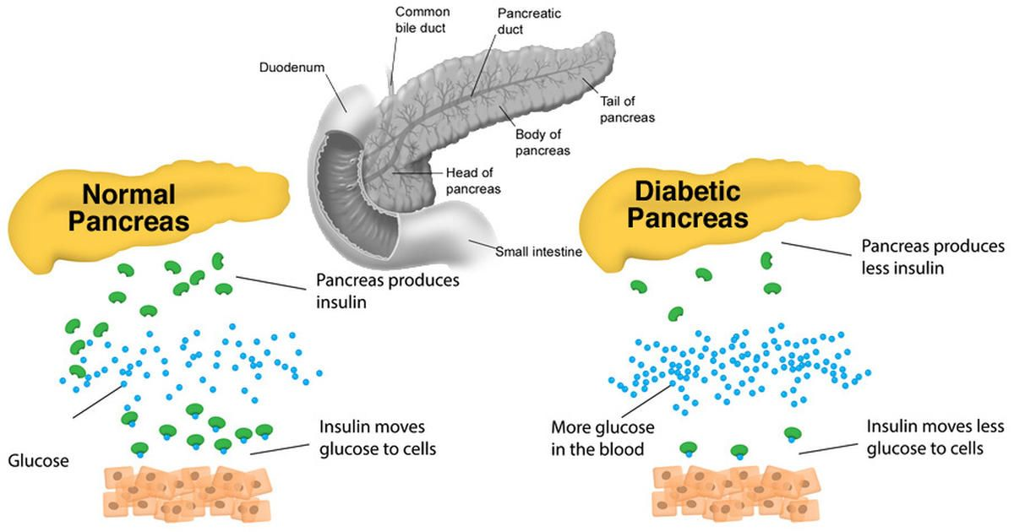
Introduction
Type 2 Diabetes
Usually affects adults; an increase in child obesity leads to development in children and adolescents
β - cell disfunction Inadequate insulin secretion and hyperglycemia
Insulin resistance
Peripheral tissues become less responsive to insulin
Kumar V, Abbas AK, Aster JC. Robbins Patologia Básica.; 2013.

Slide 8
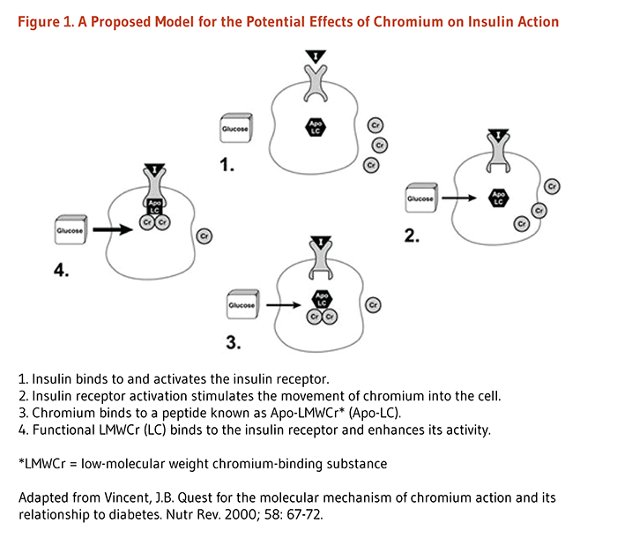
Possible reduction of insulin resistance and reduction of hyperglycemia
Cr(III) has a role in carbohydrate and lipid metabolism
It is thought that it may have an effect on Type 2 Diabetes
Cr(III) supplements as an alternative to common medications used to improve insulin sensitivity, as these have several adverse effects.
Introduction - Cr(III) and type 2 diabetes
Hua Y, Suzanne C, Jun R, Nair S. Molecular Mechanisms of Chromium in Alleviating Insulin Resistance NIH Public Access. J Nutr Biochem. 2013;23(4):313-319.
Potential effects of Chromium on insulin action

Slide 9
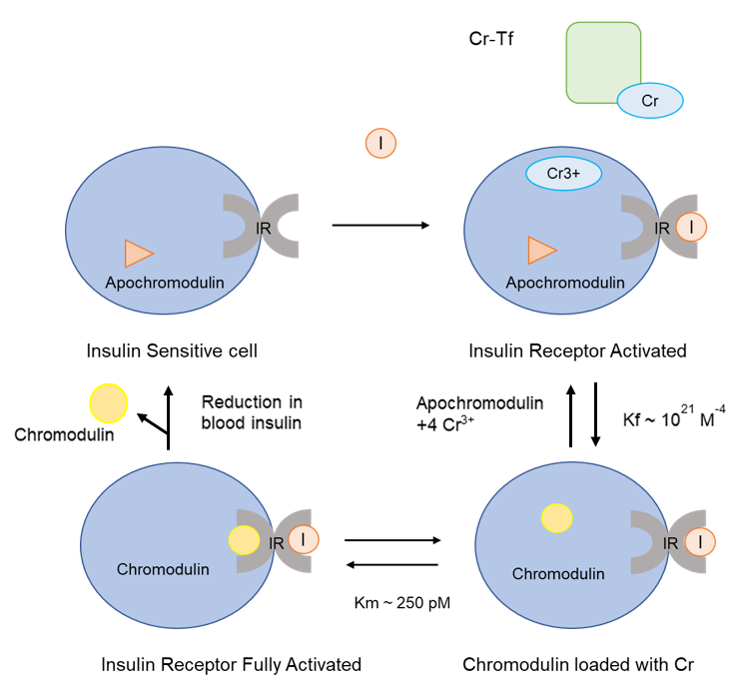
Introduction
Mechanism of Action:

Slide 10
Introduction
Is Cr(III) essential or not?
“(…) patients on TPN have developed impaired glucose tolerance and neuropathy or encephalopathy that could be reversed only by Cr infusion.”
“These studies do not provide evidence for chromium being an essential element, but they may suggest that large doses of chromium may have pharmacologic effects in humans (…)”
“(…) nutritional studies have failed to provide evidence that chromium is an essential element (…)”
Vincent JB. Chromium: Celebrating 50 years as an essential element? Dalt Trans. 2010;39(16):3787-3794.
Vincent JB. New Evidence against Chromium as an Essential Trace Element. J Nutr. 2017;147(12):2212-2219.

Slide 11
Introduction
Chromium, as Cr(III) has been considered in the last 50 years an essential micronutrient, associated to lipid and carbohydrate metabolism.
impact on reproductive hormonal axis, control on spermatogenesis,
DNA damage,
oxidative stress
Strong evidences confirm spermatogenesis disruption and poor semen quality.

Slide 12
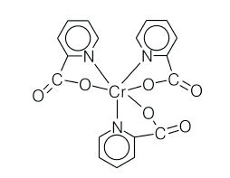
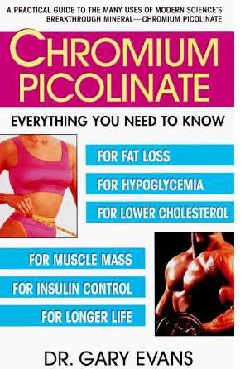
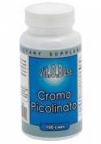
Introduction
Nutritional Supplements with Cr(III):Tris–Picolinate Chromium(III)
Medicinal Pharmacology/ Industry of Food Supplements
Cr(III) – classified as an essential element due to its (possible) important role in living systems (Vincent, 2010) – Regulation of carbohydrates and lipid metabolism
Diabetes Mellitus type II
Weight Loss/ Obesity
Muscle Gain
Cardiovascular Disorders
Vincent JB. Dalton Transactions 2010; 39: 3787–3794.

Slide 13
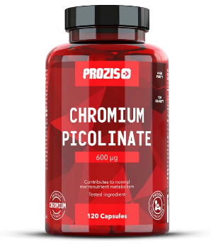
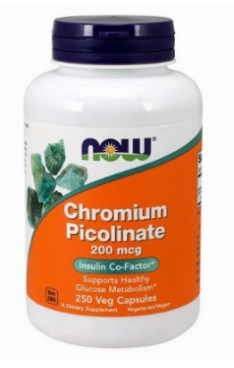
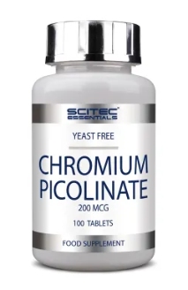
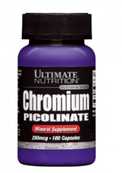
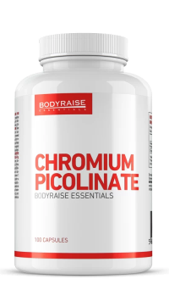
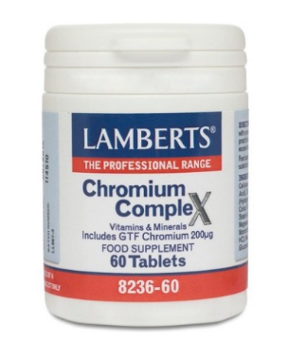
Introduction
Supplements
Cr(III) supplements became famous in the 1990’s for their claims to improve muscle development and help with weight loss.
Claims
Industries that produce them have a revenue of around $85 million per year, which accounts for almost 6% of the supplement market.
Sales
Even though studies have not shown robust results related to these claims; supplements are still commercialized, and the recommended doses are not yet known to be safe.
Danger
Merry C. Do Chromium Supplements Do Anything? We Review The Research. Healthy But Smart.com.

Slide 14
Introduction - Cr(III)-tris(picolinate) - dietary supplement, recommended for humans and cattle
USA Academy of Sciences & National Research Council recommends: 50 – 200 μg/day
Food & Nutrition Board of the USA National Academy of Sciences recommends : 25 - 35 μg/day
Some available:
Tablets,
Sport beverages,
Gums,
provides ca 200-600 μg Cr / day,
10 – 20x the recommended values for Cr(III) intake!!!
Yeast
Coffee
Oysters
Cheese
Liver
Yolk
Potatoes
Daily intake: 10 - 40 µg
Normal plasma values: 0.1-2.1 µg/mL

Slide 15
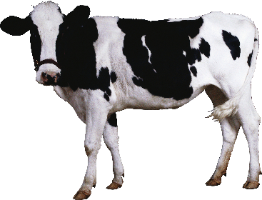
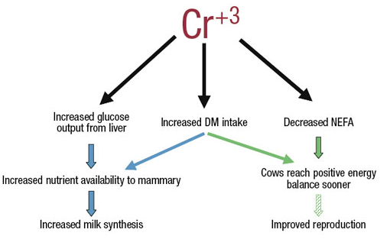
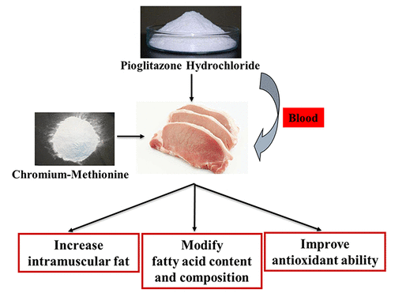
Introduction - Dietary chromium supplementation recommended in cows, pigs and poultry
Supplementation of dairy cattle diets with trivalent chromium has great potential to improve glucose and NEFA (non-esterified fatty acid) metabolism, dry matter (DM) intake and milk yields, particularly in transition cows.
M. A. Soltan, 2009, J Anim Physiol a Anim Nutr 94(2):264-72.
Cheng-long Jin et al., J. Agricul. Food Chem 2018, 66(17), 4345-4351.
This Photo by Unknown Author is licensed under CC BY-NC
Notes:
Improvements in glucose and NEFA metabolism also have implications for better reproduction. The largest benefit may be in reducing the incidence of periparturient diseases, such as ketosis, displaced abomasums, fatty liver, metritis and mastitis.
Ver: https://www.progressivedairy.com/topics/feed-nutrition/get-to-know-about-supplementing-chromium-metabolic-effects-and-potential-benefits
Effect of dietary chromium supplementation on productive and reproductive performance of early lactating dairy cows under heat stress
November 2009
J Anim Physiol a Anim Nutr 94(2):264-72
DOI: 10.1111/j.1439-0396.2008.00913.x
Dietary Supplementation with Pioglitazone Hydrochloride and Chromium Methionine Improves Growth Performance, Meat Quality, and Antioxidant Ability in Finishing Pigs
Cheng-long Jin, Qiang Wang, Zong-ming Zhang, Yin-long Xu, Hui-chao Yan, Hai-chang Li, Chun-qi Gao*, and Xiu-qi Wang*Cite this: J. Agric. Food Chem. 2018, 66, 17, 4345–4351
Publication Date:April 23, 2018https://doi.org/10.1021/acs.jafc.8b01176

Slide 16
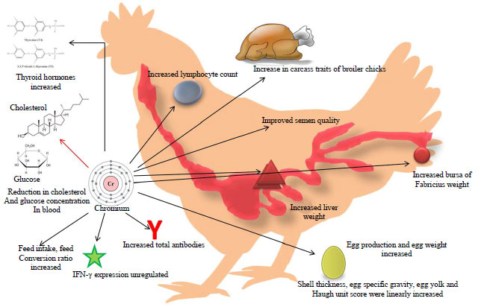
Dietary chromium supplementation already recommended in poultry nutrition
Chromium importance in the poultry industry: improve antioxidant status, meat quality and immune resistance
Dietary supplementation of CrPic (and nano-Cr) can improve performance and antibody titers against avian influenza and infectious bronchitis under heat stress conditions in broiler chick; improve body weight gain and feed conservation rate; Cr also linked to increased protein percentage in the meat.
Cr ➡️ stress-associated immunosuppression alleviation & enhanced immune response via interferon-gamma upregulation
Farag M. et al., 2017. Int J Pharmacol, 13: 907-915. Hajializadeh F. et al., 2017. Vet Res forum 8(3), 259–264.
Notes:
Burton JL, Mallard BA, Mowat DN, J Anim Sci. 1993 Jun; 71(6):1532-9. Bhagat J, Ahmed KA, Tyagi P, Saxena M, Saxena VK, Res Vet Sci. 2008 Aug; 85(1):46-51.
Ver: https://scialert.net/fulltext/?doi=ijp.2017.907.915 / DOI: 10.3923/ijp.2017.907.915

Slide 17
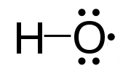
Introduction
Toxicology
Although Cr(III) is usually nontoxic, it can still present a threat to human health. Acute toxicity of Cr(III) can appear as teratogenic, carcinogenic, hematological toxicity, renal and liver failure.
Release of Cr from CrPic for use in cells requires reduction of the chromic center, which can potentially lead to production of harmful hydroxyl radicals.
Some cases of kidney injury in people who took CrPic were reported; these facts raised questions on Cr(III) supplements’ safety.
Merry C. Do Chromium Supplements Do Anything? We Review The Research. Healthy But Smart.com.

Slide 18
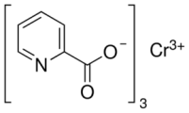
Methods
[Cr(pic)₃] on mice testis and epididymis exposed to different doses
Histology investigation
Speen
Kidney
25, 50 mg/kg orally
for 14 days
Liver
Testis
Epididymis

Slide 19
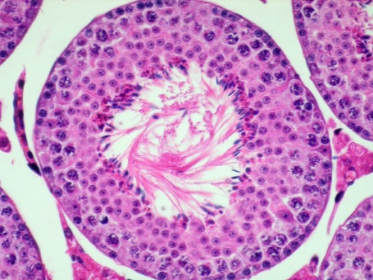
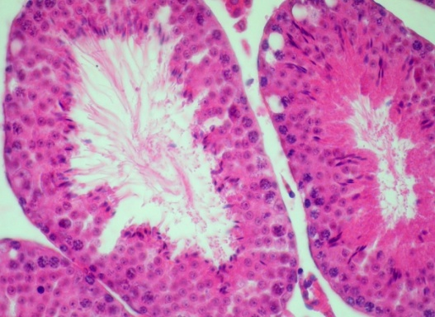
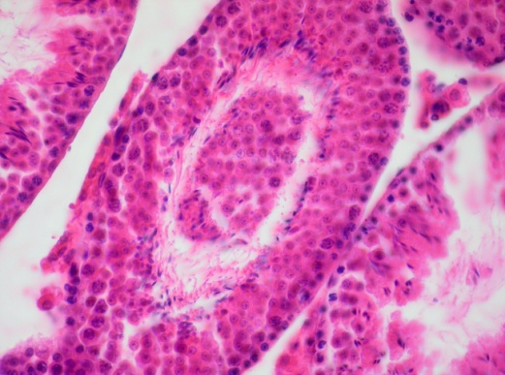
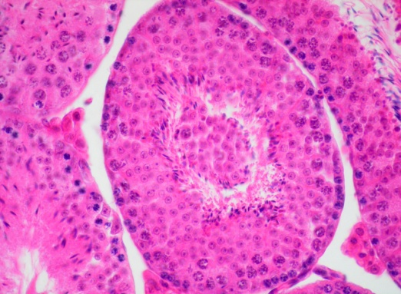
Results and discussion - [Cr(pic)₃] – Testis atrophy
a
b
c
d
e
f
a-Control; 25 mg/kg/bw – 2 weeks (b-d); 50 mg/kg/bw [cr(pic)₃]- (e-f)
Ferreira et al., 2013 Microscopy & Microanalysis 19, Supplement S4, 47-48.

Slide 20
Results and discussion - [Cr(pic)₃] – Epididymis degeneration
a
b
Control
50mg/Kg [Cr(pic)3]
Degenerative changes
Premature release of germ cells
Cell depletion
Santos TM et al., Chromium: The Intriguing Element. What Biological Role Has It? (Cr(III)-Tris-Picolinate—Is It Safe or Not?). In: Thomas S, ed. Microscopy Applied to Materials Sciences & Life Sciences. Academic Press USA; 2018:427-459.

Slide 21
Conclusions of this study
Considerable damage on male reproductive organs in mice in a dose dependent manner.
Concerns on using dietary supplements based on [Cr(pic)₃] remain to be elucidated in future work;
Long-term studies using several doses and perhaps higher;
Evidence of the possible effects of [Cr(pic)₃], beneficial or
toxic, they are not well understood and are not conclusive;
Caution is advised in the use of [Cr(pic)₃], and controversy still remains.

Slide 22
Perspectives - Chromium supplementation and nano-applications
Harvest the benefits of a targeted therapy while avoiding possible element toxicity!
Chromium(III) oxide nanoparticles – nanodots or nanopowder - have cytotoxic potential in vitro!
Miyauchi A, et al., Environ Toxicol 2013 8(2):61-75.
BUT
HOWEVER
adverse effect on the antioxidant status
regulate the level of hormones of carbohydrate metabolism
Supplementation with Cr can increase serotonin levels and improve the antioxidant status of chickens, with no adverse effect on the secretion of other hormones
oxidative
increasing insulin levels
reducing glucagon levels
Cr (3 and 6 mg/kg) and two Cr sources: Cr-picolinate (Cr-Pic) and Cr-nano (Cr-NP)
Dose-dependent effects!
Stępniowska A. et al., Animals 2019, 24;10(1):45

Slide 23
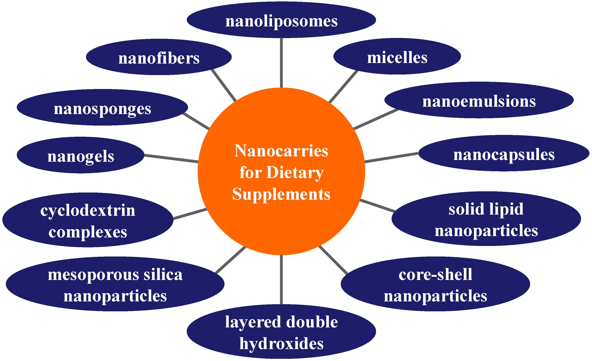
Perspectives - Cr supplementation and nano-applications
Main goals: improve bioavailability, protect active ingredients against degradation or reduce side effects
Jampilek J. et al., Nanomaterials 2019, 9(2), 296.

Slide 24
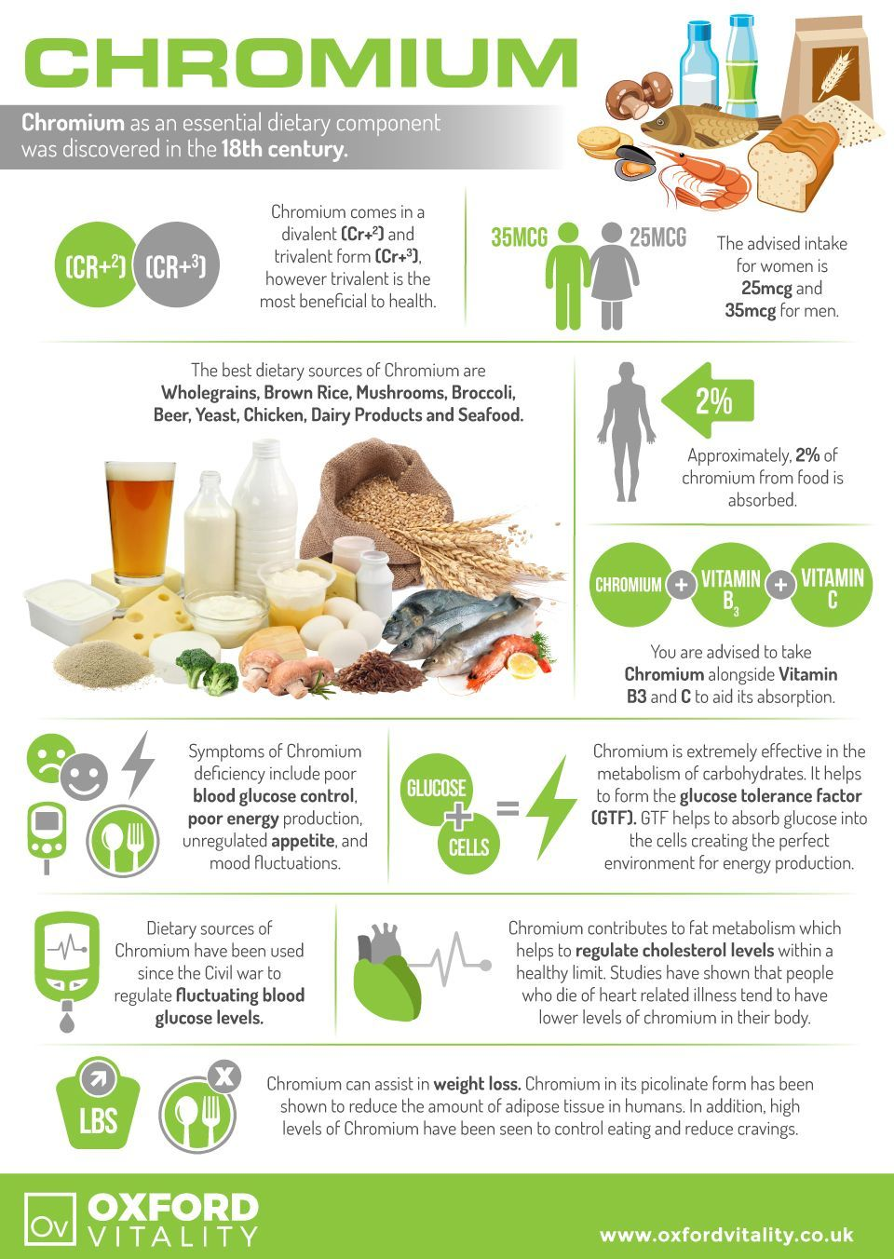
Conclusions
Chromium is vital in human and animal diets!
Supplementation should be assessed at individual levels!
Fine line between beneficial and prejudicial!
Nanoapplications provide new mechanisms for targeted delivery where Cr is needed
e.g. the pancreas of diabetic patients
More comprehensive studies are needed to fully characterize chromium III mechanisms in human diet and health

Slide 25
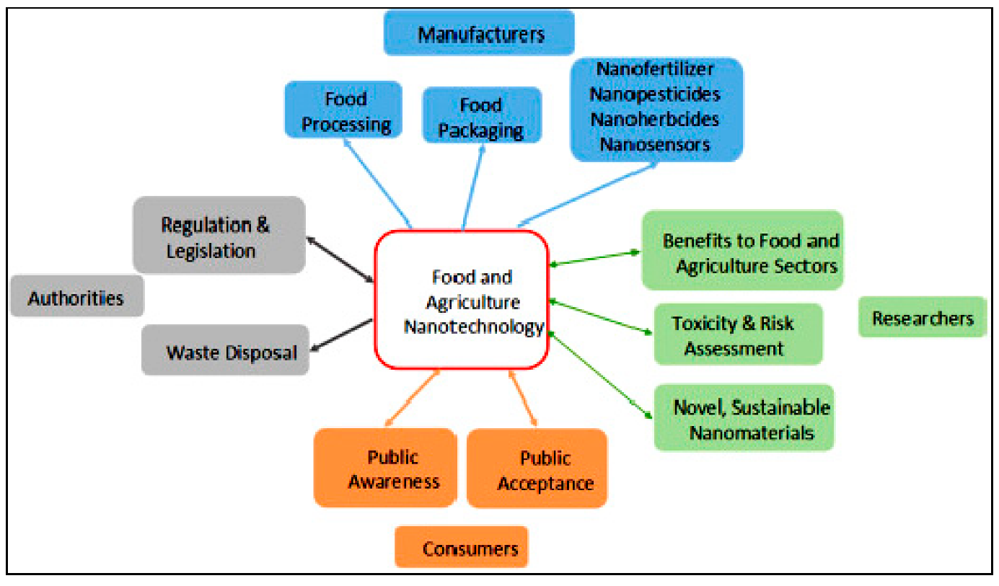
Nanotechnology will be crucial for improved human and animal nutrition
New nanomaterials along with their applications are emerging within the upcoming years;
Also essential is the improvement of analytical tools that will allow accurate and reliable quantification of the planned nanomaterials in a multifaceted (micro)environmental sample
Nano-medicine
Bio-kinetics
Pharmacology
Molecular biology
Physiology
Health nutrition improved!
He X et al. J. Food Drug Anal. 2019, 27, 1–21
Das G. et al., Int. J. Environ. Res. Public Health 2019, 16(23), 4848.

Slide 26
Acknowledgments
Project CICECO-FCT UIDB/50011/2020 & UIDP/50011/2020

