Slide 1



Viability and oxidative response of human colorectal HCT-116 cancer and human lung healthy pleura MRC-5 cell lines treated with novel bridged heteronuclear Zn(II)-L-Cu(II)
Asija Halilagić¹, Tanja Soldatović ^{1,}*, Enisa Selimović ¹, Nevena Milivojević ², Katarina Virijević ², Marko Živanović² and Biljana Šmit ²
¹ Department of Chemical-Technological Science, State University of Novi Pazar, Vuka Karadžiča bb, 36300 Novi Pazar, Serbia;
² Institute for Information Technologies, Department of Science, University of Kragujevac, Jovana Cvijića bb, 34000 Kragujevac,
Serbia.
* Corresponding author: tsoldatovic@np.ac.rs

Slide 2
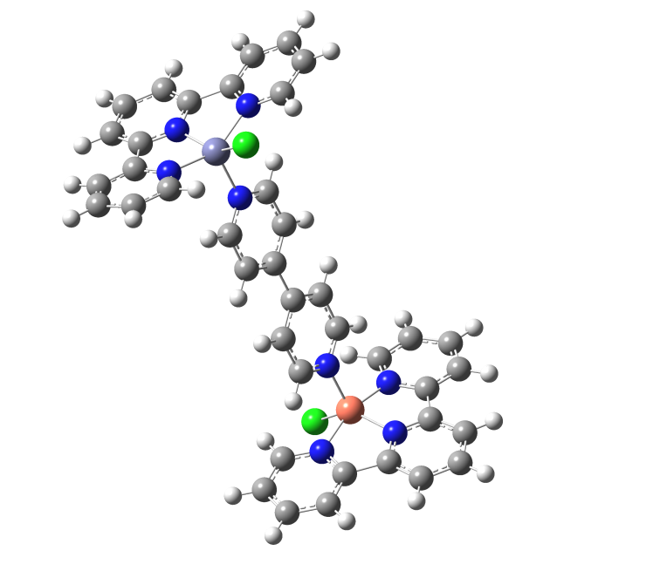
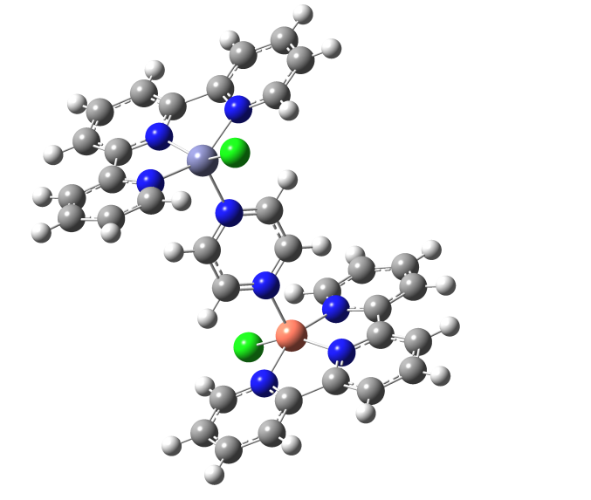
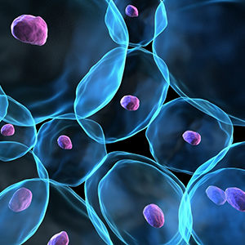
Viability and oxidative response of human colorectal HCT-116 cancer and human lung healthy pleura MRC-5 cell lines treated with novel bridged heteronuclear Zn(II)-L-Cu(II)

Slide 3
Abstract: Design of novel non-platinum DNA and protein targeting metal-based anticancer agents have gained importance in recent year. They could be alternatives to platinum-based drugs due to their better characteristics and less negative side effects. Zinc and copper ions play important role in many enzymatic reactions and their antagonist property is essential for biological functions. One of the important zinc and copper enzyme, superoxide dismutase (SOD) keeps the cell safe from the metabolic wastes. Bridged heteronuclear Zn(II)-L-Cu(II) complexes could have improved cytotoxic activity and induce better oxidative response of cancer cells.
The novel heteronuclear complexes [{ZnCl(terpy)(μ-pyrazine)CuCl(terpy)}](ClO₄)₂ (Zn-L1-Cu) and [{ZnCl(terpy)(μ-4,4′-bipyridyl)CuCl(terpy)}](ClO₄)₂ (Zn-L2-Cu) (where terpy = 2,2′:6′,2′′-terpyridine, L1 = pyrazine, L2 = 4,4′-bipyridyl) were synthesized. The cytotoxic activity of heteronuclear Zn-L1-Cu and Zn-L2-Cu complexes was determined on human colorectal (HCT-116) and human lung healthy pleura (MRC-5) cancer cell lines. Both complexes significantly reduced cell viability on tested cell lines and exerted significant cytotoxic effects, with better effect on HCT-116 cells than cisplatin, especially after 72 h (IC₅₀ < 0.01mM). Selective-index (SI) was calculated by comparing pure compound IC₅₀ values in MRC-5 cell line against the IC₅₀ of the same compound in cancer cell lines. Results of investigated redox parameters indicated significant increase in superoxide anion radical and nitrites in treated cells. Complexes induced significant increase in reactive radical species which consequently induced cell death and thus lower IC₅₀ values. As the response of the cells to an increased radical level induced by treatment, glutathione level also increased in a time and dose dependent manner.
Keywords: zinc(II); copper(II); heteronuclear complexes; cytotoxic activity

Slide 4
Introduction
Design of novel non-platinum DNA and protein targeting metal-based anticancer agents with potential in vitro toxicity have gained importance in recent year. The non-platinum antitumor complexes could be alternatives to platinum-based drugs due to their better characteristics and less negative side effects. Two metal ions zinc and copper play important role in many enzymatic reactions they antagonist property is essential for biological functions. One of the important zinc and copper enzyme, superoxide dismutase (SOD) keeps the cell safe from the metabolic wastes. The novel bridged heteronuclear Zn(II)-L-Cu(II) complexes could have improved cytotoxic activity and induce better oxidative response of cancer cells.

Slide 5
Results and discussion
Synthesis and characterisation of the heteronuclear complexes with general formula Zn(II)-L-Cu(II) starting from square-pyramidal Cu(II) and square-pyramidal Zn(II) complexes using various types of bridging ligands.

Slide 6
Results and discussion
Synthesis of Zn-L-Cu complexes

Slide 7
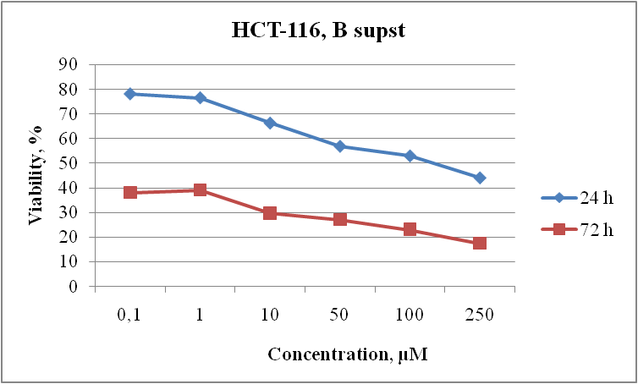
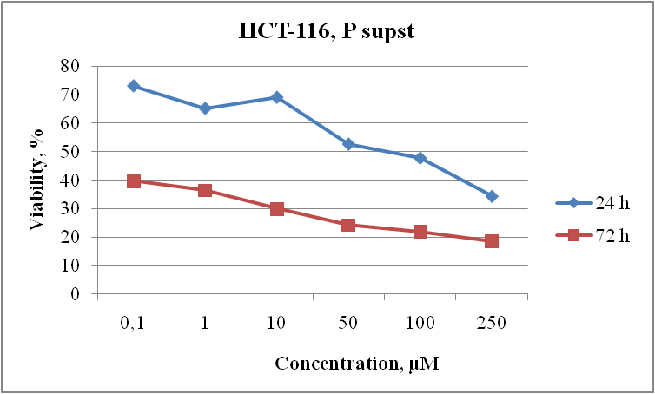
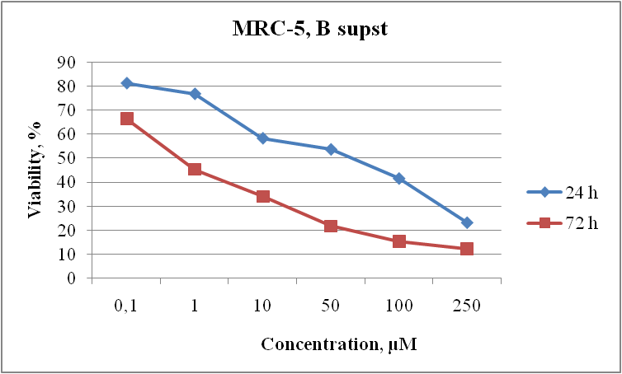
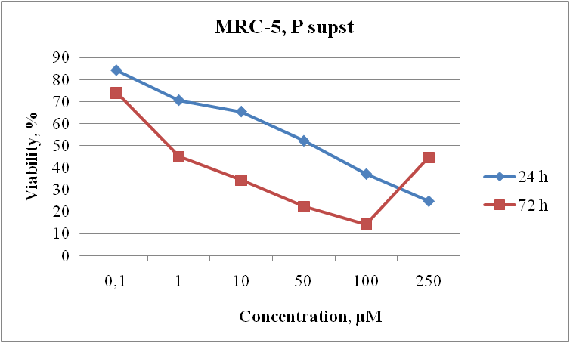
MTT – CYTOTOXICITY
IC50 – supst B
HCT-116
24 h | 72 h
168,64 | 0,01
HCT-116
IC50 – supst P
HCT-116
24 h | 72 h
52,9 | 0,01
IC50 – supst B
MRC-5
24 h | 72 h
62,3 | 0,80
MRC-5
IC50 – supst P
MRC-5
24 h | 72 h
53,8 | 0,69

Slide 8
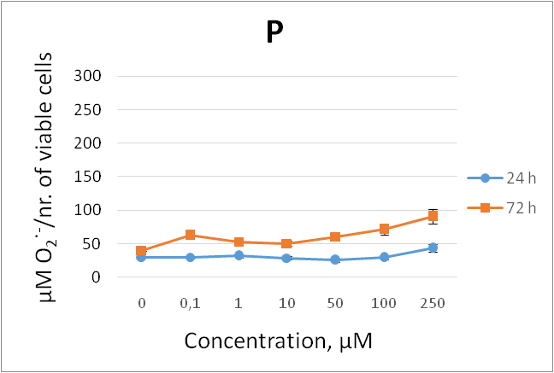
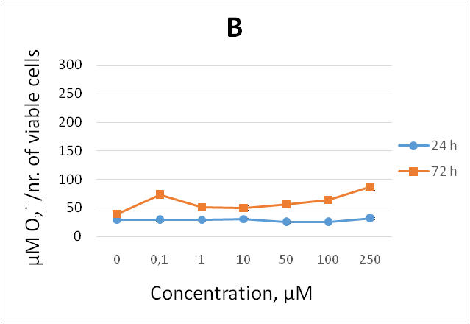
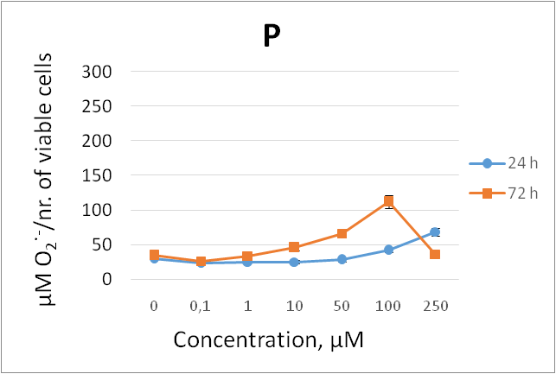
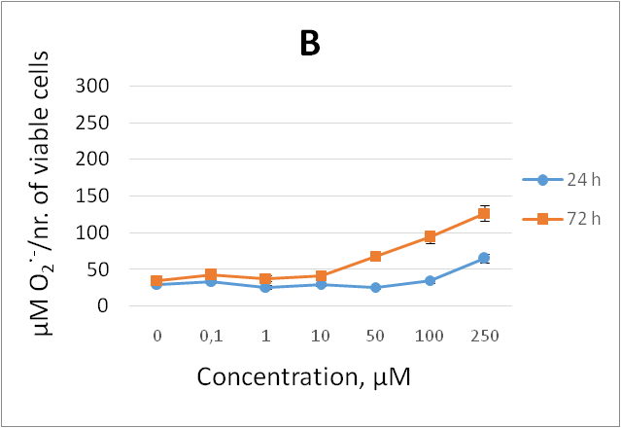
Superoxide anion radical (O₂ •–) concentration
HCT-116
MRC-5
The effect of Zn-L1-Cu (P) and Zn-L2-Cu (B) complex on the HCT-116 and MRC-5 cell lines expressed as the O₂•– concentration after 24 h and 72 h of exposure

Slide 9
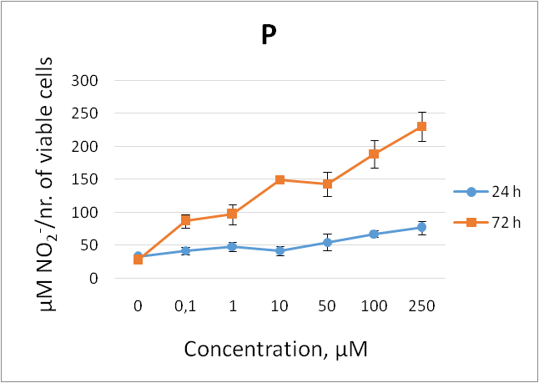
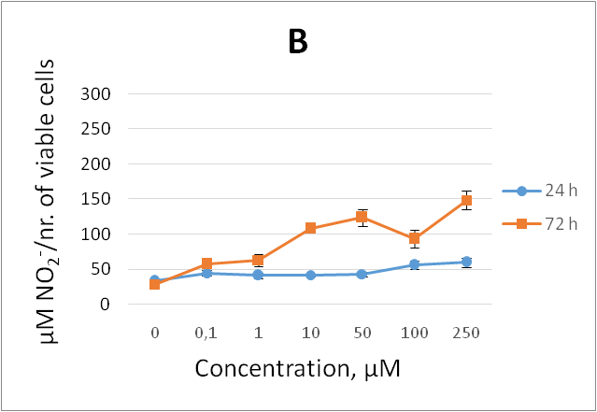
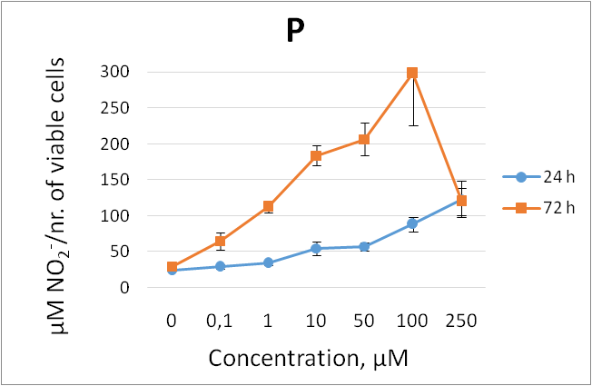
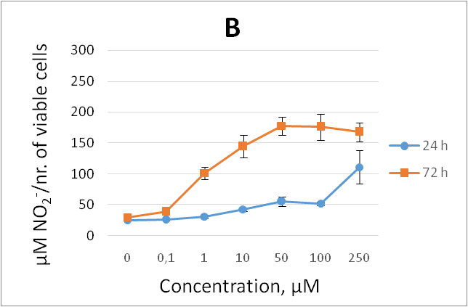
Nitrites (NO₂⁻) concentration
HCT-116
MRC-5
The effect of Zn-L1-Cu (P) and Zn-L2-Cu (B) complex on the HCT-116 and MRC-5 cell lines expressed as the NO₂– concentration after 24 h and 72 h of exposure

Slide 10
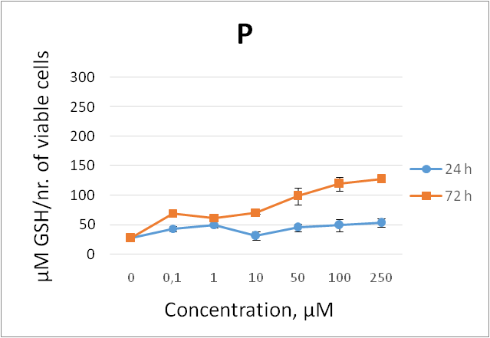
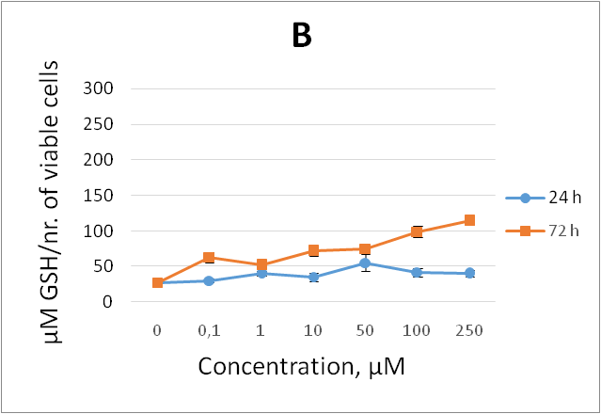
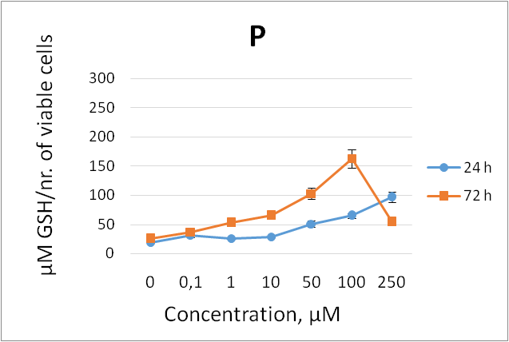
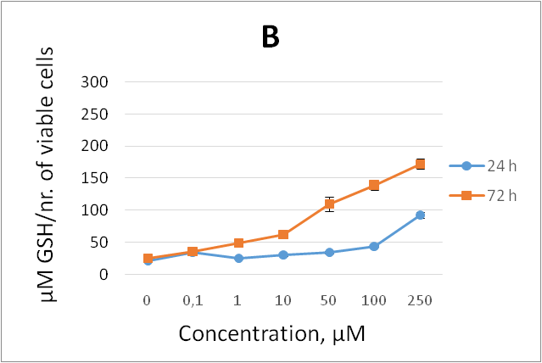
Reduced glutathione (GSH) concentration
HCT-116
MRC-5
The effect of Zn-L1-Cu (P) and Zn-L2-Cu (B) complex on the HCT-116 and MRC-5 cell lines expressed as the GSH concentration after 24 h and 72 h of exposure

Slide 11
Conclusions
The novel heteronuclear complexes [{ZnCl(terpy)(μ-pyrazine)CuCl(terpy)}](ClO₄)₂ (Zn-L1-Cu) and [{ZnCl(terpy)(μ-4,4′-bipyridyl)CuCl(terpy)}](ClO₄)₂ (Zn-L2-Cu) (where terpy = 2,2′:6′,2′′-terpyridine, L1 = pyrazine, L2 = 4,4′-bipyridyl) were synthesized and characterized.
The cytotoxic activity of heteronuclear Zn-L1-Cu and Zn-L2-Cu significantly reduced cell viability on tested cancer human colorectal (HCT-116) and human lung healthy pleura (MRC-5) cell lines with better effect on HCT-116 cells than cisplatin, especially after 72 h (IC₅₀ < 0.01μΜ).
Cytotoxic selectivity of tested complexes is very good, because selective-index, SI ≥ 10 was consider to belong a selective compound. Our complexes, Zn-L1-Cu and Zn-L2-Cu, show selective-index 69 and 80, respectively and could be considered as selective compounds again HCT-116 cell line.
Results of investigated redox parameters indicated significant increase in superoxide anion radical and nitrites in treated cells. This leads us to the conclusion that substances induce significant increase in reactive radical species which consequently induce cell death and thus lower IC₅₀ values. As the response of the cells to an increased radical level induced by treatment, glutathione level also increased in a time and dose dependent manner.

Slide 12

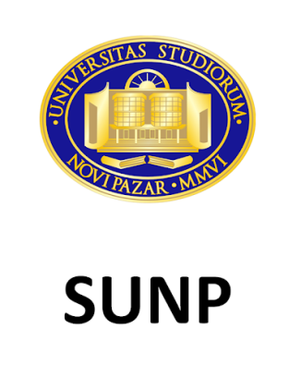
Acknowledgments
The authors are grateful for the support to the Ministry of Education, Science and Technological Development of the Republic of Serbia. T. Soldatović and E. Selimović gratefully acknowledge financial support from State University of Novi Pazar, Novi Pazar, Republic of Serbia.

