Slide 1
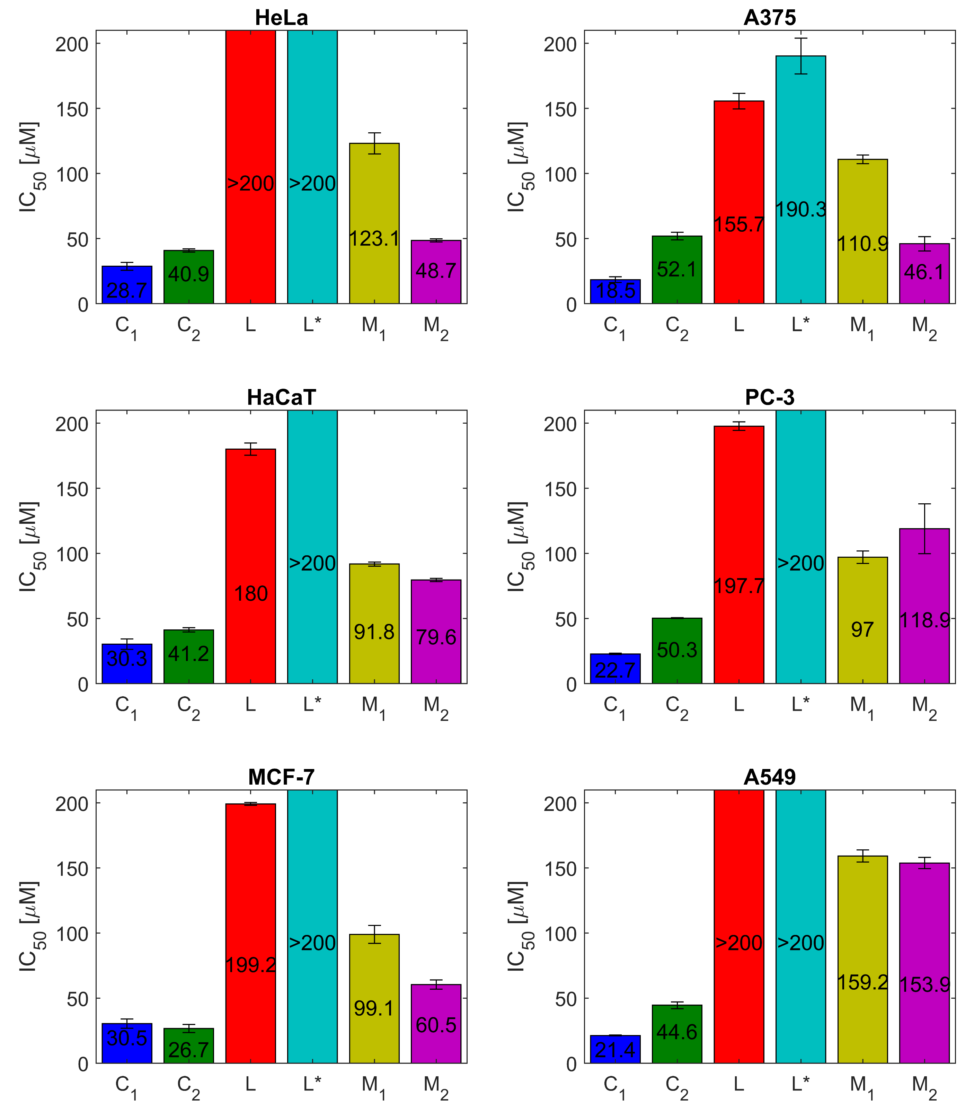
Synthesis, characterization and cytotoxicity of Mn(II) and Cu(II) complexes with N-substituted glycine hydrazone
Snežana Selaković¹, Ivana Matić², Dragana Mitić¹, Maja Šumar-Ristović³, Božidar Čobeljić³ and Katarina Anđelković³
¹Innovation center of the Faculty of Chemistry, University of Belgrade, Studentski trg 12-16, 11000 Belgrade, Serbia
²Institute of Oncology and Radiology of Serbia, Pasterova 14, Belgrade, Serbia
³Faculty of Chemistry, University of Belgrade, Studentski trg 12-16, 11000 Belgrade, Serbia
Synthesis:
Scheme 1: Synthesis of complex [Mn₂L₂(_{µ-1,1-}N₃)₂(N₃)₂]MeOH
Scheme 2: Synthesis of complex [CuL(N₃)(MeOH)]BF₄
Structure:
Picture 2: Graphical presentation of the molecular structure of [CuL(N₃)(MeOH)]BF₄. Thermal ellipsoids are drawn at the 40% probability level.
Table 2: Selected bond lengths (Å) and angles (°) for complex [CuL(N₃)(MeOH)]BF₄, with esd’s in parentheses
Cu(1)–N(5) | 1.924(3)
Cu(1)–N(2) | 1.927(2)
Cu(1)–O(1) | 1.971(2)
Cu(1)–N(2) | 2.046(3)
N(5)–Cu(1)–N(2) | 174.73(12)
N(5)–Cu(1)–O(1) | 98.54(11)
N(2)–Cu(1)–O(1) | 79.27(9)
N(5)–Cu(1)–N(1) | 100.88(11)
N(2)–Cu(1)–N(1) | 80.69(11)
O(1)–Cu(1)–N(1) | 158.98(11)
Structure:
Picture 1: Graphical presentation of the molecular structure of [Mn₂L₂(_{µ-1,1-}N₃)₂(N₃)₂]MeOH. Thermal ellipsoids are drawn at the 40% probability level
Cytotoxicity:
C₁ = [CuL(N₃)(MeOH)]BF₄; C₂ = [Mn₂L₂(_{µ-1,1-}N₃)₂(N₃)₂]MeOH; L* = NaN₃; M₁ = Cu(BF₄)₂·6H₂O; M₂ = MnCl₂·4H₂O
Table 1: Selected bond lengths (Å) and angles (°) for complex [Mn₂L₂(_{µ-1,1-}N₃)₂(N₃)₂]MeOH, with esd’s in parentheses
Mn(1)–N(8) | 2.112(2)
Mn(1)–O(1) | 2.1879(16)
Mn(1)–N(5) | 2.229(2)
Mn(1)–N(5) | 2.2425(19)
Mn(1)–N(2) | 2.2500(18)
Mn(1)–N(1) | 2.3668(19)
N(8)–Mn(1)–O(1) | 98.88(9)
N(8)–Mn(1)–N(5) | 147.86(10)
O(1)–Mn(1)–N(5) | 107.66(8)
N(8)–Mn(1)–N(2) | 121.21(9)
O(1)–Mn(1)–N(2) | 69.51(6)
N(5)–Mn(1)–N(2) | 85.67(7)
N(8)–Mn(1)–N(1) | 86.84(9)
O(1)–Mn(1)–N(1) | 134.91(7)
N(5)–Mn(1)–N(1) | 87.04(7)
N(2)–Mn(1)–N(1) | 69.46(7)
Conclusion: Mn(II) and Cu(II) complexes with N-substituted glycine hydrazone ligand were synthesized and characterized. Complexes exerted strong to moderate cytotoxic activities against tested malignant cell lines. Cu(II) complex showed higher cytotoxic effects on malignant cells when compared to Mn(II) complex, except against MCF7 cells. The both complexes exhibited higher cytotoxicity in comparison with its ligand.

