Slide 1
Computational study to develop new
bromodomain-containing protein 9 inhibitors
Lucia Sessa^{1,2,}*, Anna Maria Nardiello¹, Jacopo Santoro¹, Simona Concilio^{1,2} and Stefano Piotto^{1,2}
¹Department of Pharmacy, University of Salerno, Via Giovanni Paolo II 132, 84084 Fisciano (SA), Italy
²Research Centre for Biomaterials BIONAM, University of Salerno, Via Giovanni Paolo II 132, 84084 Fisciano (SA), Italy
* Corresponding author: lucsessa@unisa.it

Slide 2
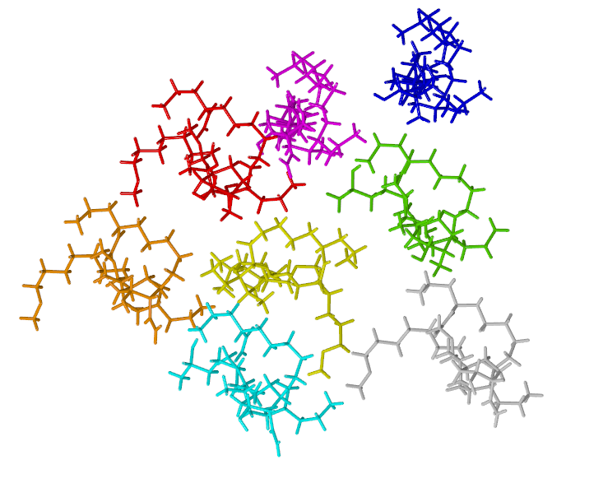
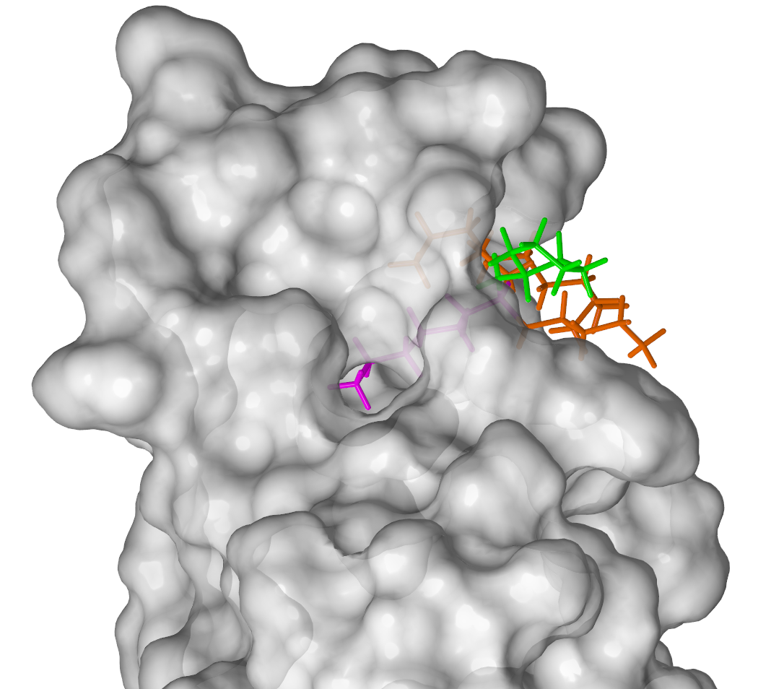
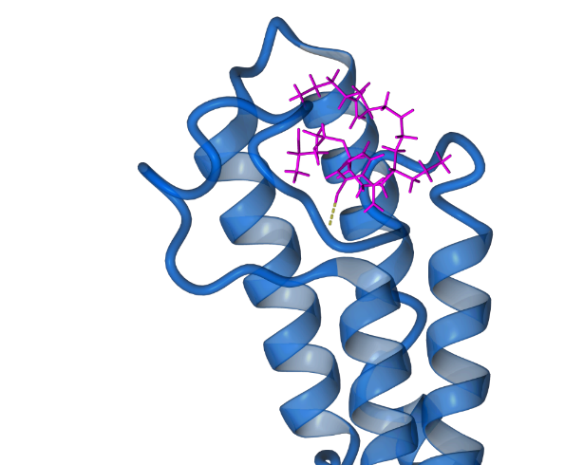
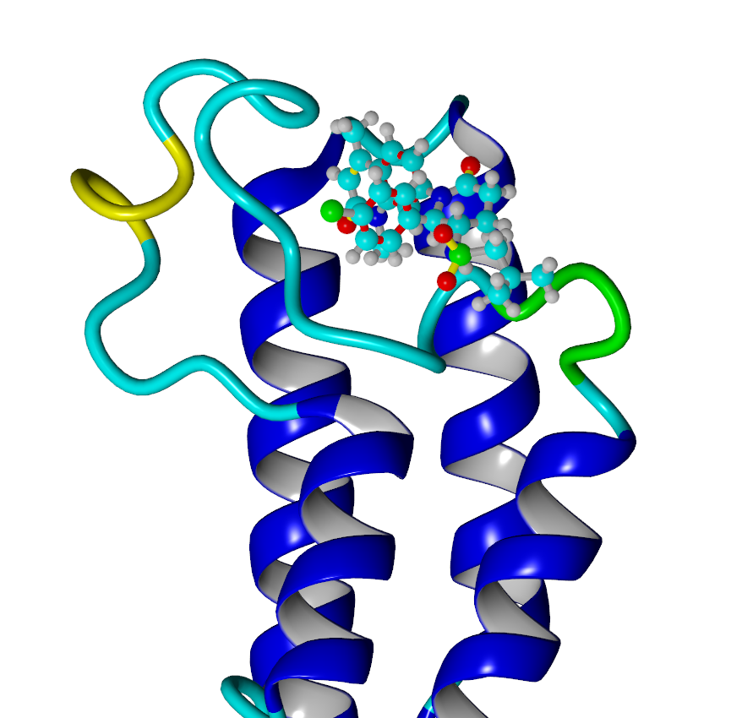
Computational study to develop new bromodomain-containing protein 9 inhibitors
Graphical Abstract
New library of potential ligands
New scaffold
identification
Lead finding
New fragment
based approach
Selection by binding affinity and kinetics aspects

Slide 3
Abstract:
Bromodomain represents a large family of evolutionary protein modules that bind acetylated lysines. Bromodomain-containing protein 9 (BRD9) plays a role in chromatin remodeling and regulation of transcription. Because of its biological role, there is growing interest in this protein as a potential therapeutic target.
The main task of this work was to identify new potential inhibitors of BRD9 by using an evolution of the classic fragment-based methods. Starting from a crystallographic structure (PDB 5IGN), we built a hit molecule directly inside the active site of the protein. We designed a structure able to interact with the key residues in the binding site and with new unexplored sites. We selected several analogs to use as lead compounds by an extensive and automatic search of the scaffold structure on ZINC databases. We created a combinatorial library of potential inhibitors based on topological information directly in the binding site during a molecular dynamics simulation.
We have selected the best inhibitor potential based on binding energy and residence time.
Our approach could be tailored to several systems.
The main strength of the approach is the speed of the analysis and the accuracy of the results.
Keywords: drug design; fragment-based; BRD9

Slide 4
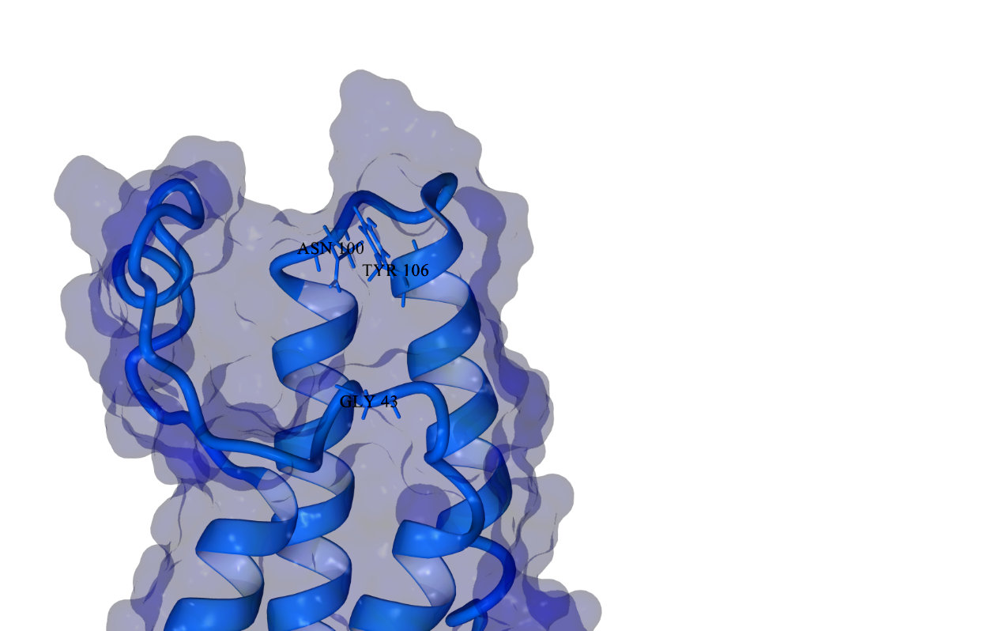
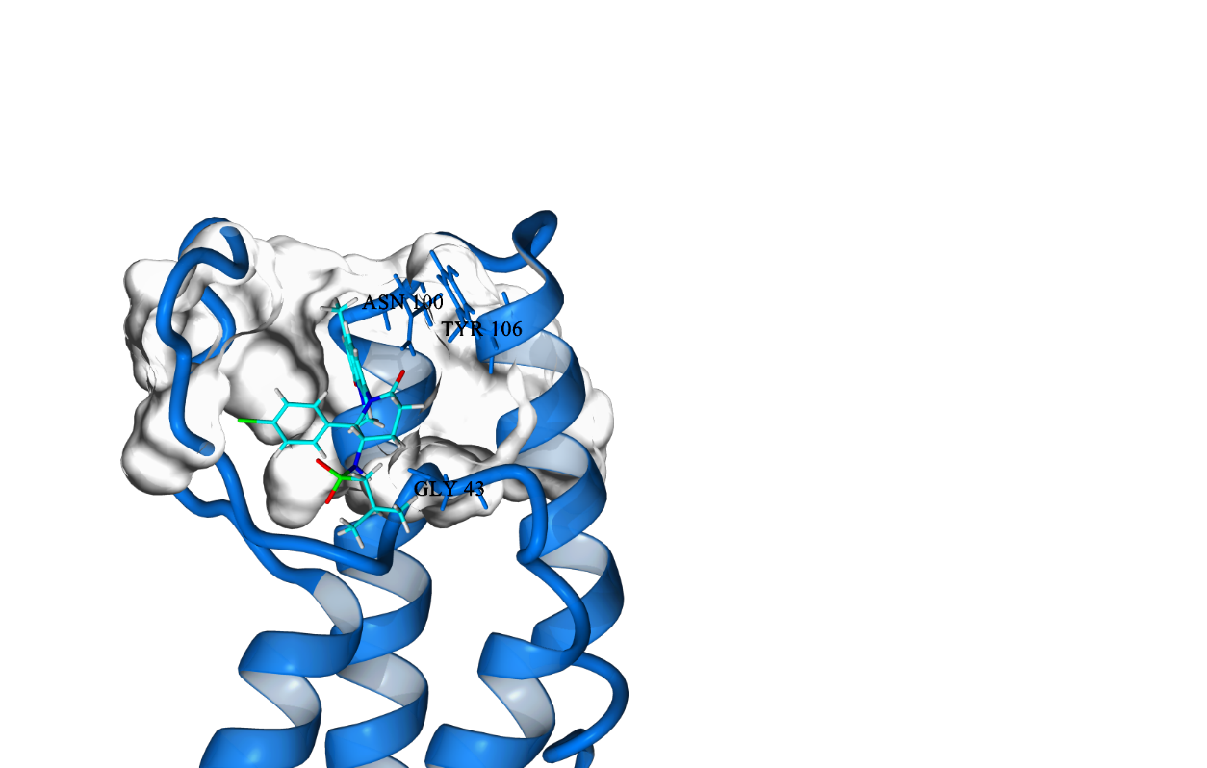
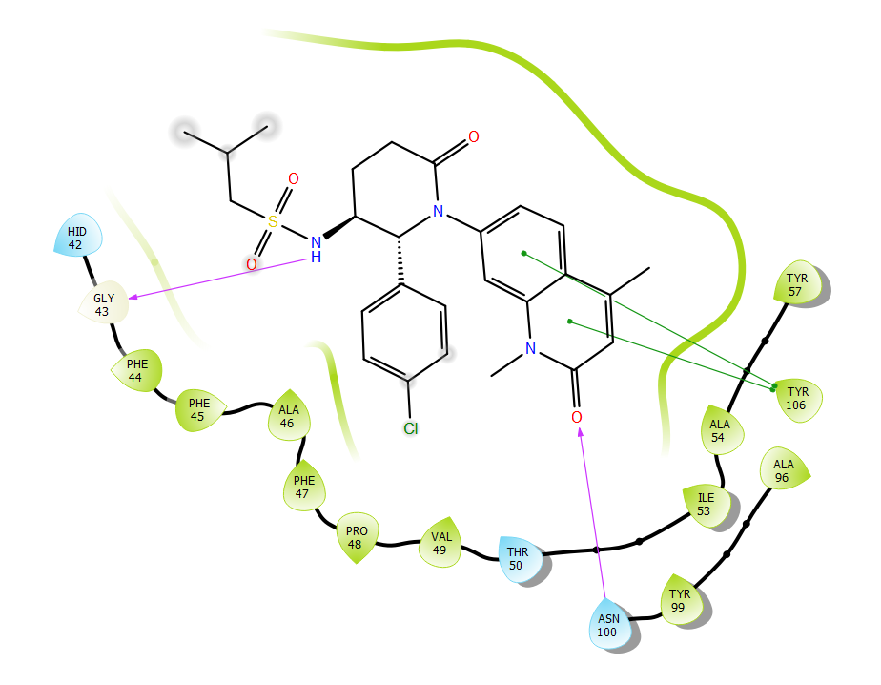
Introduction
The structure-assisted drug design and discovery process use structural information of the target to drive the synthesis of potential drugs. This information can be used to help explain the basis of their activity and to improve the potency and specificity of new lead compounds.
The main goal in drug discovery is the accurate evaluation of ligand binding to a protein receptor. In this field, the molecular docking technique is the most used tool to analyse the geometry and the interactions of a ligand in a protein binding site.
Bromodomain-containing protein 9 (BRD9), a protein-coding gene, has been employed as a potential target for anticancer drugs in recent years
We used the enzyme BRD9, in complex with a potent binder (LP99) to test our protocol for drug design.
Hydrophobic binding site
and key residues

Slide 5
Results and discussion
The investigation of the binding site revealed a small pocket buried in the receptor.
The purpose of this work was to develop new molecules capable of establishing interactions with the protein residues of this new pocket.
PDB 5IGN
PDBclean
Binding site investigation
Extragraph
Scaffold
Starting from the refined structure, we built the scaffold of a new hit molecule directly inside the active site of the protein.
*PDBclean: tool to prepare proteins for further analysis from the SoftMining Computational Platform
*Extragraph is an evolution of the classic fragment-based methods. It operates on the binding site by filling it with different types of solvent molecules, chosen for their different polarity: water, methane, and cyclohexane. Solvents molecules tend to cluster in defined sites according to their affinity with the protein surface. By exploiting this phenomenon and considering the entropic/enthalpic role of solvents, Extragraph builds a scaffold formed by atoms that interacts with all the residues in the binding site. From the SoftMining Computational Platform.

Slide 6
Results and discussion
Scaffold
The scaffold was divided into three fragments, and each one of them was used to perform an extensive search on the ZINC database to find possible analogs.
A new library of scaffolds has been built based on the retrieved analogs.
ARM
Fragment A
Fragment B
Fragment C
Scaffold optimization
*ARM: is an automatically tool to perform an extensive search on ZINC database to find possible analogues with a Tanimoto coefficient > 0.5 from the SoftMining Computational Platform

Slide 7
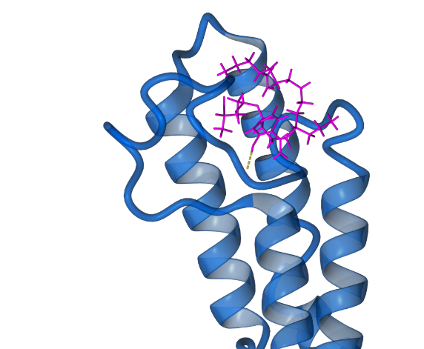
Results and discussion
Scaffold optimization
To evaluate the affinity between the predicted compounds and the receptor a docking experiment was performed.
We evaluated the kinetic aspects to calculate the association and dissociation constants of a ligand and its residence time.
DeepG
Kinetics
New potential Lead
We have selected eight molecules with high values of binding energy and residence time
*DeepG: tool to predict the binding energy of a ligand/receptor complex. The calculation algorithm behind DeepG was developed through the training of an artificial neural network. The starting dataset includes the calculation of different molecular descriptors and binding energy using well-known algorithms like AutoDock and Vina. All parameters were used to create a dataset that was submitted to the neural network. This resulted in a new equation for the calculation of the binding energy that had a prediction error, compared to the experimental value, of only 1.2 kcal/mol (SM computational platform)
*Kinetics : tool to simulate the unbinding of a ligand from the receptor, using Molecular Dynamics simulations, and to track ligand movements up and into the receptor (SM computational platform)

Slide 8
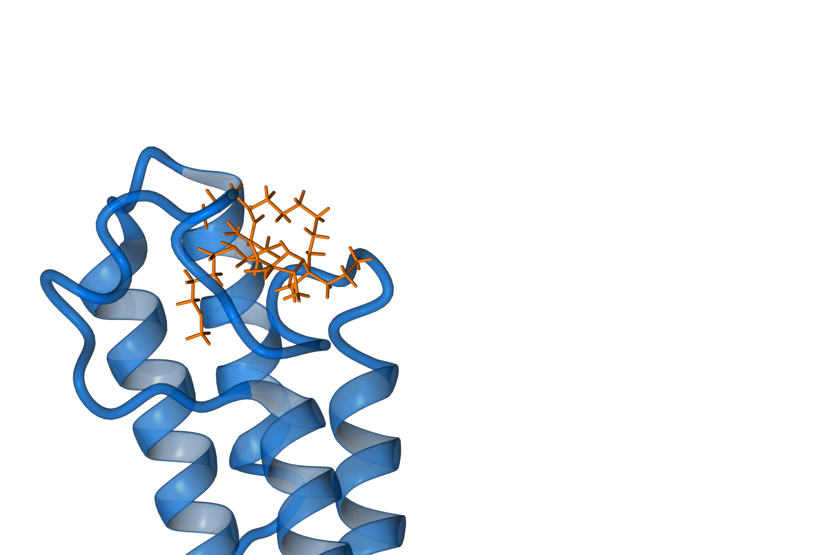
Conclusions
Starting from a crystallographic structure of BRD9, we generated a library of analogs from the known ligand directly in the binding site. The new molecules show higher binding affinity and lower residence time and can be considered good candidates for in vitro tests.
These methods combine the advantages of the Structure-Based Drug Design technique with the accuracy of the molecular dynamics, drastically reducing the number of possible compounds or sequences to analyze.
This approach in drug discovery provides the recognition of structural features that contribute to the potential binding with the target.
Our method improves our ability to critically evaluate the identification and optimization of lead compounds that have a high potential for the generation of new therapeutic agents.

Slide 9
Acknowledgments
We thank the SoftMining Academic Research Program for the support (www.softmining.it)

