Slide 1
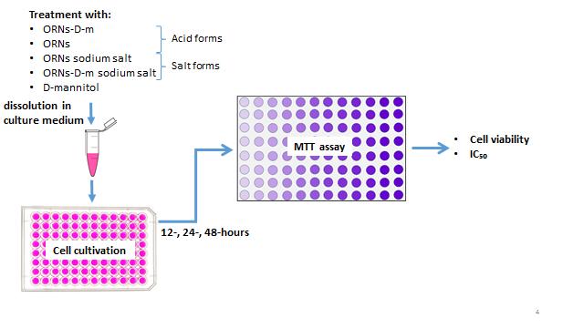
Viability of different tumor cell lines after treatment with complexes of oligoribonucleotides with D-mannitol
Ivanna Kraievska, Zenoviy Tkachuk
Institute of Molecular Biology and Genetics NAS of Ukraine
Introduction
Complexes of oligoribonucleotides with D-mannitol (ORNs-D-m) have a wide range of biological activity: antiviral, antioxidant, immunomodulatory, and others (Melnichuk et.al., 2018; Marchyshak et.al., 2018). They are obtained by the formation of complexes between the D-mannitol and total yeast RNA. It was found that the drug contains oligoribonucleotides of different lengths; the predominant fraction is from 2 to 15 nucleotides. Previous studies on the murine model of B16 melanoma have shown that solid tumor formation was not observed with the simultaneous administration of melanoma cells and ORNs-D-m (Kraievska et.al., 2019).
The aim of this work was to study the effect of ORNs-D-m on the viability of different tumor cell lines in vitro.
Materials and methods
Murine B16 melanoma and human U251 glioblastoma were used for studies. Cells (8-10×10³ cells in 100 μL medium per well) were plated in 96-well plates and treat with different substances. At the end of various treatments, MTT solution was added to each well, incubated and samples were read by an ELx800 Absorbance Microplate Reader at a wavelength of 570 nm. Cell viability was determined relative to intact control, taken as 100% viability (Fig.1). For representation on graphs, concentration data were log-transformed and the percent viability data in time-dependent graphs were fit to a nonlinear regression curve (log (inhibitor) vs. response). A comparison of the effect of compounds was carried out by the concentration of half-maximal inhibition of IC₅₀, which was determined based on dose-dependent curves. Results are expressed as the mean ± standard deviation. The statistical significance between the groups was determined by an unpaired t-test. P<0.05 was considered to indicate a statistically significant difference. All analyses were performed using the GraphPad Prism 8.0.1 software.
Results
Murine B16 melanoma
The duration and dose of ORNs-D-m treatment effects on B16 viability. Thus, the viability of cells was significantly reduced after 48-hours treatment compared to 12-hours treatment, with IC₅₀ 2.7 ± 0.2 mg/ml. In contrast, the IC₅₀ with ORNs treatment was 2,5 times higher, which indicates their less pronounced effect compared to ORNs-D-m. It was found, that the acid form of these substances is crucial for the inhibitory effect on cancer cells because sodium salts of ORNs-D-m and ORNs have no inhibitory influence on cell growth (Fig.2).
Human U251 glioblastoma
For the U251 cell line, a similar trend in viability after treatment was found, with IC₅₀ for ORNs-D-m – 1.2 ± 0.04 mg/ml, and for ORNs - in 8 times higher. As well, the level of cell viability after 48-hours treatment with salt forms of these substances for applied concentrations was higher, than 70 %, which indicates the absence of an inhibitory effect (Fig.3).
D-mannitol in concentration 2,8 mg/ml (amount in the highest dose of ORNs-D-m) did not affect both cell lines viability.
Conclusions
ORNs-D-m inhibits the viability of both cancer cell lines: murine B16 melanoma and human U251 glioblastoma, in dose- and time-dependent manner.
ORNs show a less inhibitory effect on viability.
Acid forms demonstrate an inhibitory effect on the viability of cancer cells in contrast to salt forms, which don't show this influence in applied concentrations.
Jvccggghjvjkll;5+6n
Fig.2. (A) Concentration- and time-dependent viability after treatment with ORNs-D-m
(B) IC₅₀ values after 48-hours treatment
(C) No growth inhibition after 48 hours treatment with salt forms
Fig.3. (A) Concentration- and time-dependent viability after treatment with ORNs-D-m
(B) IC₅₀ values after 48-hours treatment
(C) No growth inhibition after 48 hours treatment with salt forms
Fig. 1. Scheme of the experiment
References
Melnichuk N. et al. Complexes of Oligoribonucleotides with D-Mannitol Modulate the Innate Immune Response to Influenza A Virus H1N1 (A/FM/1/47) In Vivo //Pharmaceuticals. – 2018. – Т. 11. – №. 3. – С. 73.
Marchyshak T. et al. The potential protective effect of oligoribonucleotides-d-mannitol complexes against thioacetamide-induced hepatotoxicity in mice //Pharmaceuticals. – 2018. – Т. 11. – №. 3. – С. 77.
Kraievska I. et al. The influence of oligoribonucleotide complexes with D-mannitol on tumor formation in a murine model of B16 melanoma – ECMC5 – 2019.

