Slide 1
Analysis of the Hydrogen bond network for binding sites identification
Jacopo Santoro^{1*} , Anna Maria Nardiello¹, Lucia Sessa^{1,2} and Stefano Piotto^{1,2}
¹ Department of Pharmacy, University of Salerno, Italy;
² Research Centre for Biomaterials BIONAM, University of Salerno, Via Giovanni Paolo II 132, 84084 Fisciano (SA), Italy
* Corresponding author: j.santoro1992@gmail.com

Slide 2
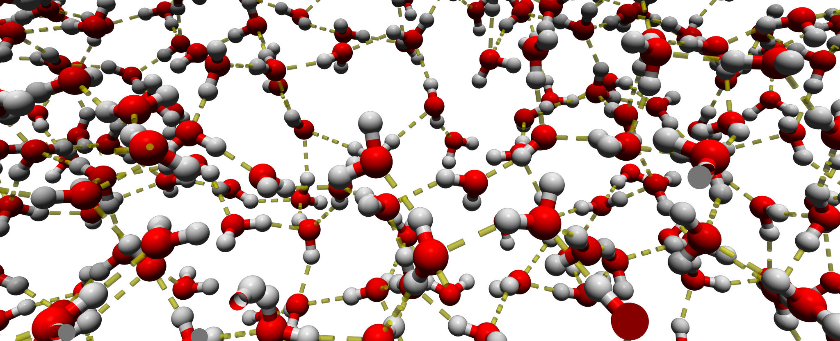
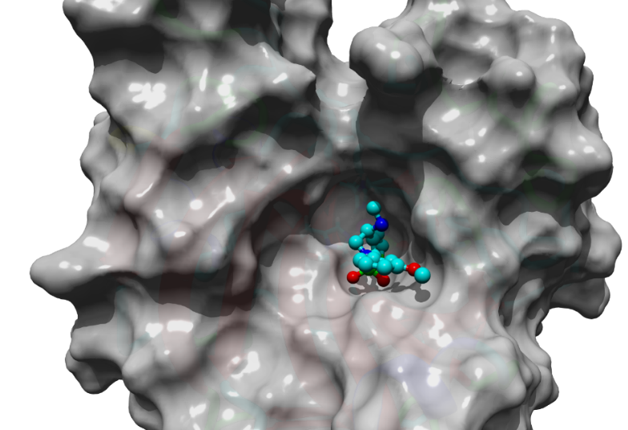
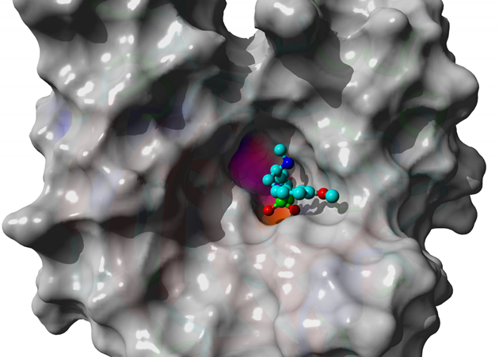
Analysis of the Hydrogen bond network for binding sites identification
Graphical Abstract

Slide 3
Abstract:
Water plays a crucial role in all biological processes due to its peculiar physical and chemical properties. It represents not only the environment for biochemical reactions but is also an active participant. Without a critical level of hydration proteins are inactive and the presence of water molecules is essential in the catalytic sites of many enzymes. From a thermodynamic point of view, water molecules can favorably contribute to the formation of protein complexes. It is, therefore, reasonable to assume that not all water molecules in contact with a protein have the same propensity for displacement by a ligand. In this work we suggest a new approach for the analysis of the entropy of water molecules by evaluating the variability of H-bond networks in the hydration shell. This type of approach has proved to be effective in improving the prediction of binding energy between receptor and ligand and has also allowed to identify new possible binding sites. The results are in accordance and expand the basic idea that binding sites often lies on conserved regions.
Keywords: Water entropy; Yada; Sequence conservation; Hydrogen bond

Slide 4
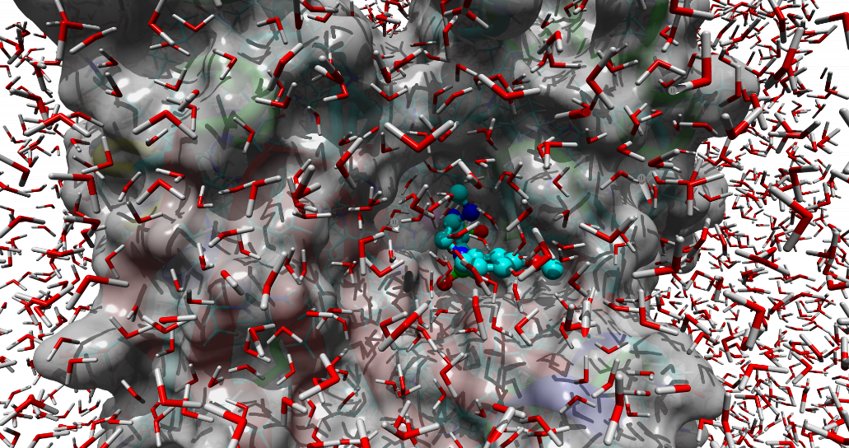
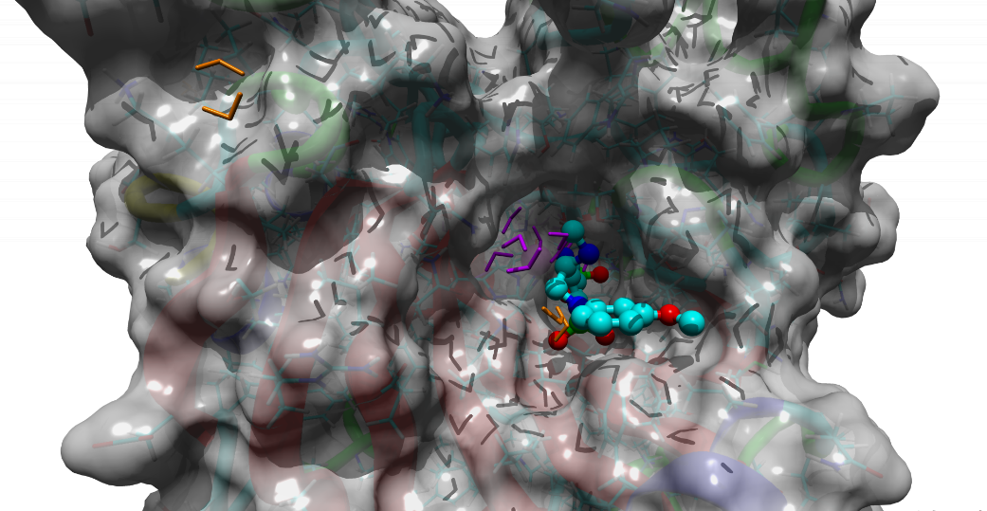
Introduction
Water molecules play a fundamental role in all biological processes. The properties of these molecules are specific to the position in which they are located. Water molecules on the surface of a protein have different kinetic and thermodynamic properties from those in bulk due to their interactions with the surface of the protein itself.
The role of water molecules is crucial in structure-based drug design. The displacement of water molecules bound to a target can result in an increased binding affinity of a ligand thanks to the gain in terms of entropy of the system. These retained molecules can target specific spots in a blind docking experiment or identify new active sites.

Slide 5
Results and discussion
The surface of the protein (PDBid: 1BNV) is colored according to the entropic contribute of the different water molecules of the solvation shell
For each water molecule, the variability of the H-bond energies was evaluated during a Molecular Dynamic simulation of 5 ns
Water molecules with low energy variability (their position are mapped on the protein surface as colored spots) present a higher entropic advantage from their displacement by the action of a ligand
This allows recognizing possible active sites that are indicated as parts of the protein where the variability is the lowest

Slide 6
Results and discussion
A similar result is obtained if the conserved sequences of the receptor structure are searched
From a Homology-Derived Secondary Structure of Proteins (HSSP) analysis, it is possible to see that the resulting preserved sequences (colored regions) match some of the previously identified regions
This supports the idea behind Yada docking tool that active sites often lie on conserved sequences and can be used as targets for blind docking experiments
Piotto S, Di Biasi L, Fino R, Parisi R, Sessa L, Concilio S. Yada: a novel tool for molecular docking calculations. J Comput Aided Mol Des. 2016 Sep;30(9):753-759. doi: 10.1007/s10822-016-9953-9.

Slide 7
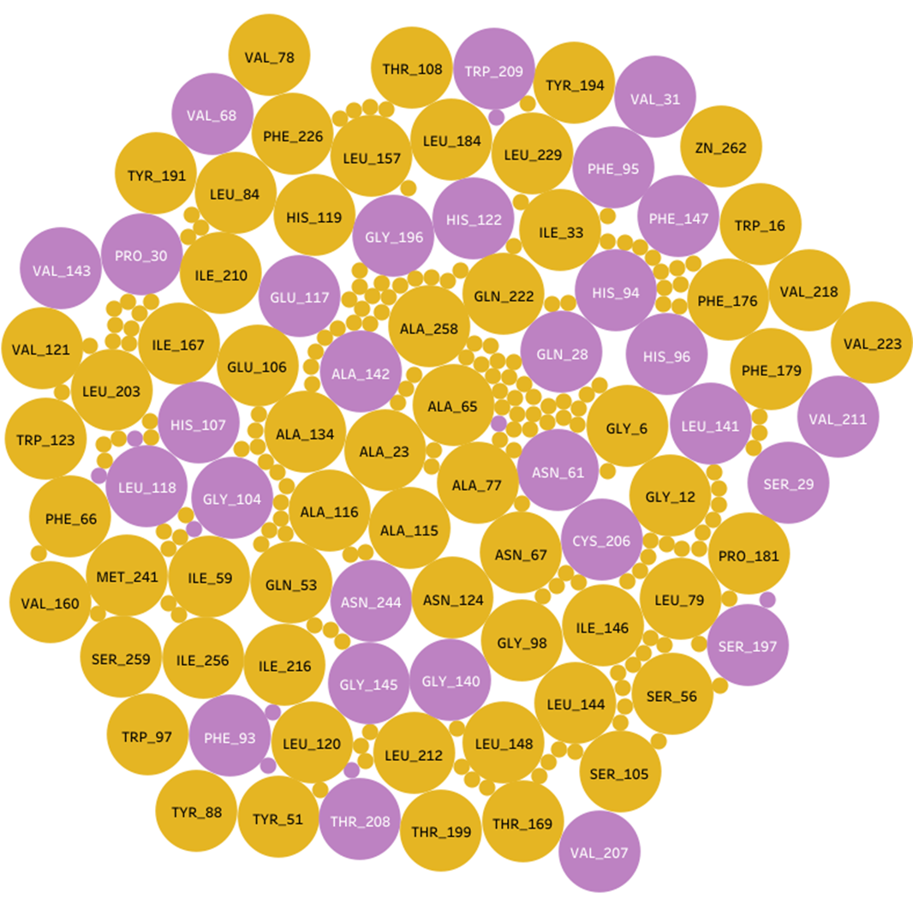
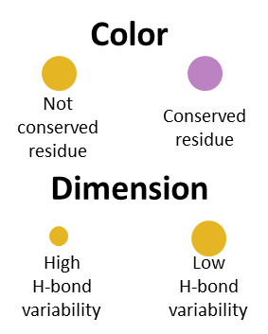
Results and discussion
Relationship between residues with low water H-bond variability and conserved one (PDBid: 1BNV).
In purple are colored the conserved residues.
Bubble dimensions are representative of the H-bond variability. Large bubbles are residues with low water H-bond variability. Residues with high H-bond variability are unlabelled to simplify the reading of the plot.

Slide 8
Results and discussion
PDBid: 3LTH
PDBid: 3R4M
In the figure are shown, as colored spots, the sites with low water H-bond variability found on 3LTH and 3R4M. In both cases, we were able to identify the binding pocket successfully and, in both cases, it shows areas with the variability is the lowest (deep blue).

Slide 9
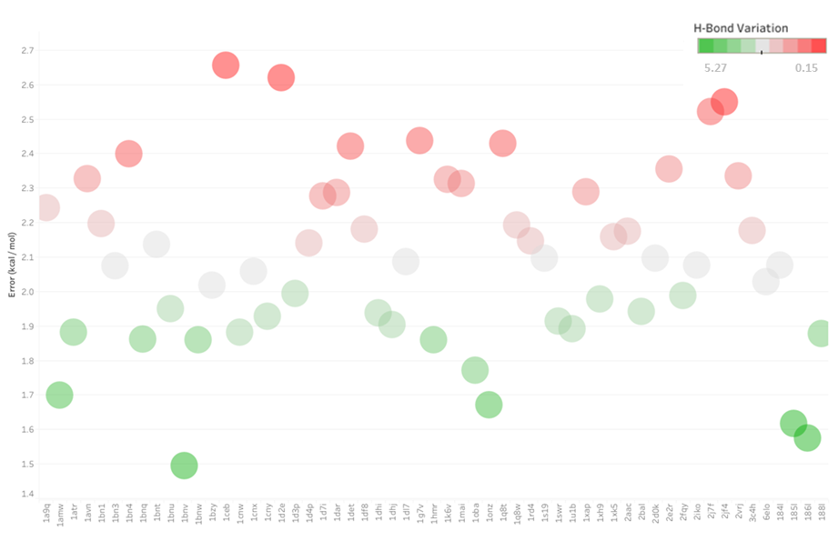
Results and discussion
On the Y-axis is represented the error of the binding energy prediction calculated using Vina compared to the experimental one.
On the X-axis the PDBid of the analyzed complex.
We have analyzed how the binding energy prediction error is related to the variability of the H-bond network.

Slide 10
Conclusions
By analyzing the variability of the H-bond network in the solvation shell of a protein, we have observed how this is related to an increase of error in the prediction of binding energy.
It can be noticed how this error is inversely proportional to the variability of the H-bond network, this because the molecules with low energy variability present higher entropic advantage from their displacement by the action of a ligand, and this advantage must be considered when a binding energy calculation is performed.
Future developments of this work will focus on implementing a new algorithm that considers the entropic contribution related to the displacement of water molecules with low variability and the creation of new tools for blind docking experiments that exploit the newly identified sites.

Slide 11
Acknowledgments
We thank the SoftMining Academic Research Program for the support (www.softmining.it)

