Slide 1
Agonist-Antagonist discrimination: a pseudo-semantic approach to Molecular Dynamics
Anna Maria Nardiello^{1,}*, Lucia Sessa^{1,2}, Jacopo Santoro¹ and Stefano Piotto^{1,2}
¹ Department of Pharmacy, University of Salerno, Fisciano, 84084, Italy
² Research Centre for Biomaterials BIONAM, University of Salerno, Via Giovanni Paolo II 132, 84084 Fisciano (SA), Italy
* Corresponding author: annardiello@unisa.it

Slide 2
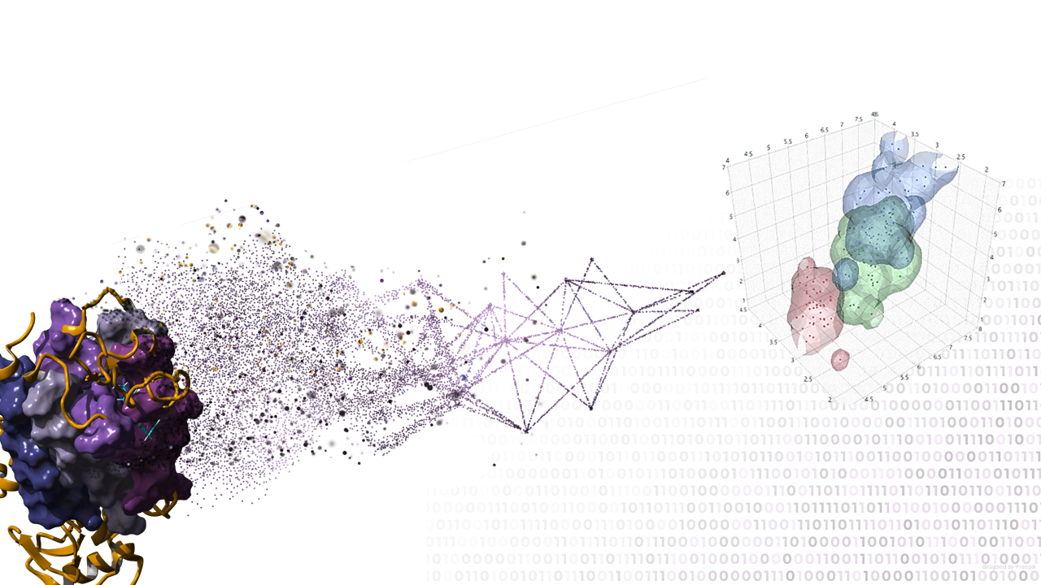
Agonist-Antagonist discrimination: a pseudo-semantic approach to Molecular Dynamics
Graphical Abstract

Slide 3
Abstract
The study of ligand-receptor interactions through computational techniques, such as molecular dynamics (MD) and docking, has several limitations due to their temporal and spatial dimensions. Docking can reasonably identify the pose and energy of interaction but cannot distinguish between agonist and antagonist. MD allows us to collect useful information on the thermodynamics and kinetics of the whole system but a method is needed to extract information on receptor activity.
In this work, we extracted the dihedral angles of the receptor backbone and the RMSD of each residue during a dynamic of 20 ns. We used Sysa coding to reduce the information of the entire receptor system to a collection of strings, one for each snapshot of the dynamics. The strings are compared with an alignment-free approach and a distance calculated for each one.
The comparison of distances makes it possible to discriminate against the overall agonist-antagonist behavior. The FFAR1 system, free fatty acid receptor 1, of which some crystallographic structures of agonists and antagonists are available, will be shown as an example.
Keywords: Molecular dynamics; semantics; ligand interaction

Slide 4
Introduction
The analysis of the mechanism of action of a ligand is a complex task to be defined by computational techniques. The simple binding of a ligand to a protein is insufficient to establish whether the ligand will act as an agonist or antagonist.
The distinction of the mechanism between agonist and antagonist cannot be reduced only to the movement of a few protein residues. The process involves complex structural modulations of the entire receptor, which may be periodic or involve overall movements that expose new protein regions. The characterization of a molecule as an agonist or antagonist requires the analysis of the overall dynamics of the receptor. This can be analyzed by clustering the various conformations that the receptor explores.
In this work, we have introduced a new method of analysis and clustering of data from MD simulation applied to the study of FFAR1 receptor ligands.
The free fatty acid receptor (FFAR1), previously known as GPR40, is a G protein-coupled receptor (GPCR) that has been identified as a possible new target for the treatment of type 2 diabetes. There is evidence that this receptor is specifically expressed in insulin-producing beta cells in the pancreas and may be implicated in the metabolic regulation of insulin secretion [1].
Tikhonova, I.G., et al., Discovery of novel agonists and antagonists of the free fatty acid receptor 1 (FFAR1) using virtual screening. Journal of medicinal chemistry, 2008. 51(3): p. 625-633.

Slide 5
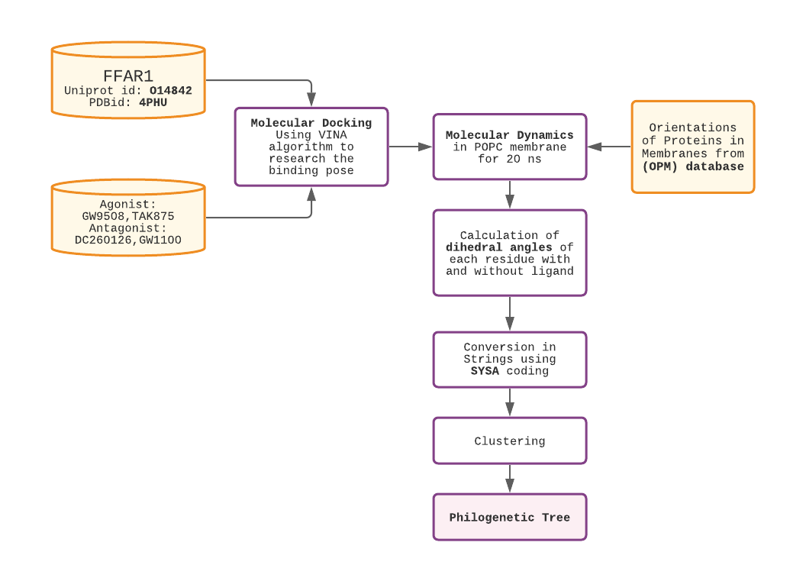
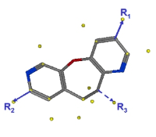
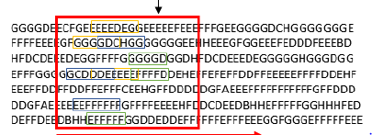
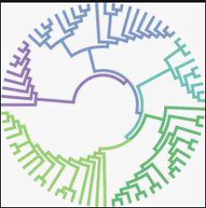
Results and discussion
Workflow:

Slide 6
Results and discussion
After molecular docking to define the correct pose of ligand, Molecular dynamics calculations were performed for the following systems:
- free receptor
- receptor bound to GW9508 [2] (agonist)
- receptor bound to TAK785 [3] (agonist)
- receptor bound to GW1100 [2] (antagonist)
- receptor bound to DC260126 [4] (antagonist)
Each system was inserted in a membrane model (POPC 100%), and a 20 ns molecular dynamics simulation was carried out. Subsequently, for each frame and residue, the values of the dihedral angles ( e ) of the receptor with the ligands were calculated, compared to the values of the dihedral angles of the free receptor.
The variations of the dihedral angles between the free protein and the protein with ligands have been calculated. The strings obtained from the coding have been processed with the Sysa web service (https://www.softmining.it/semantics), able to analyze the similarities between them.
The distance matrix has been displayed via the phylogenetic tree.
Briscoe, C.P., et al., Pharmacological regulation of insulin secretion in MIN6 cells through the fatty acid receptor GPR40: identification of agonist and antagonist small molecules. British journal of pharmacology, 2006. 148(5): p. 619-628.
Yabuki, C., et al., A novel antidiabetic drug, fasiglifam/TAK-875, acts as an ago-allosteric modulator of FFAR1. PloS one, 2013. 8(10): p. e76280.
Zhang, X., et al., DC260126, a small-molecule antagonist of GPR40, improves insulin tolerance but not glucose tolerance in obese Zucker rats. Biomedicine & pharmacotherapy, 2010. 64(9): p. 647-651.

Slide 7
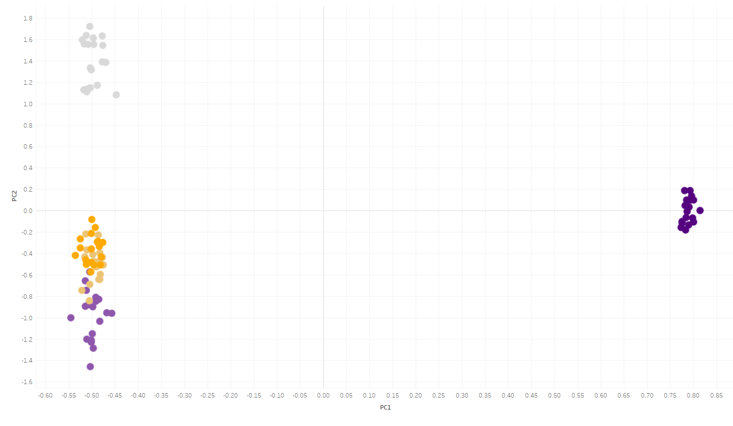
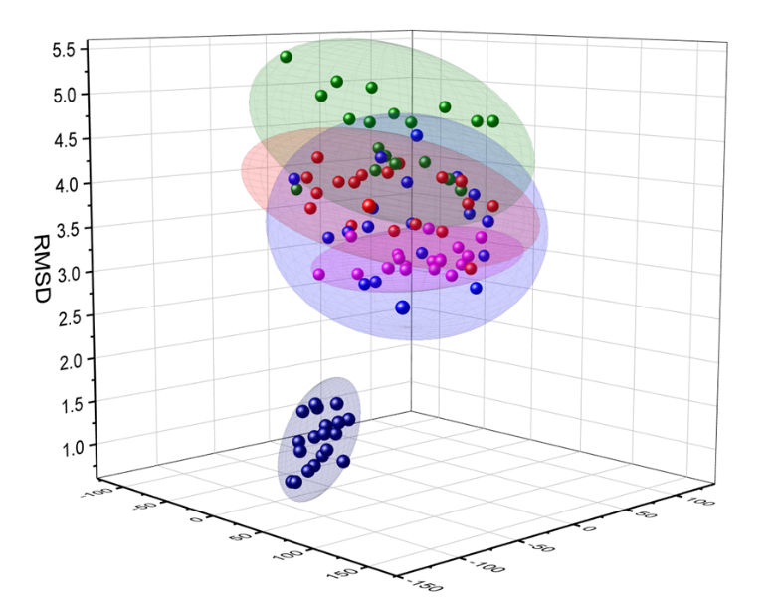
Results and discussion
The discrimination of a molecule between agonist or antagonist can be done by clustering the various conformations that the receptor explores.
PCA (Principal Component Analysis) is a technique that has already been used but was found not to be accurate enough to discriminate against small variations caused by the action of an agonist and an antagonist.
FFAR1+ DC260126
FFAR1+ GW9508
FFAR1+ GW1100
FFAR1+TAK875
FFAR1

Slide 8
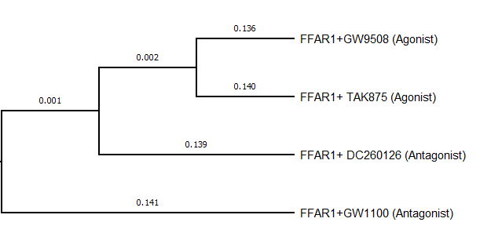
Results and discussion
The resulting phylogenetic tree is shown in the slide. As it can be observed, the two agonists are clustered together, presenting a minimal distance between them. The two antagonists are not only discriminated against by the agonists but cluster differently because of the different influences on the movement of protein residues.

Slide 9
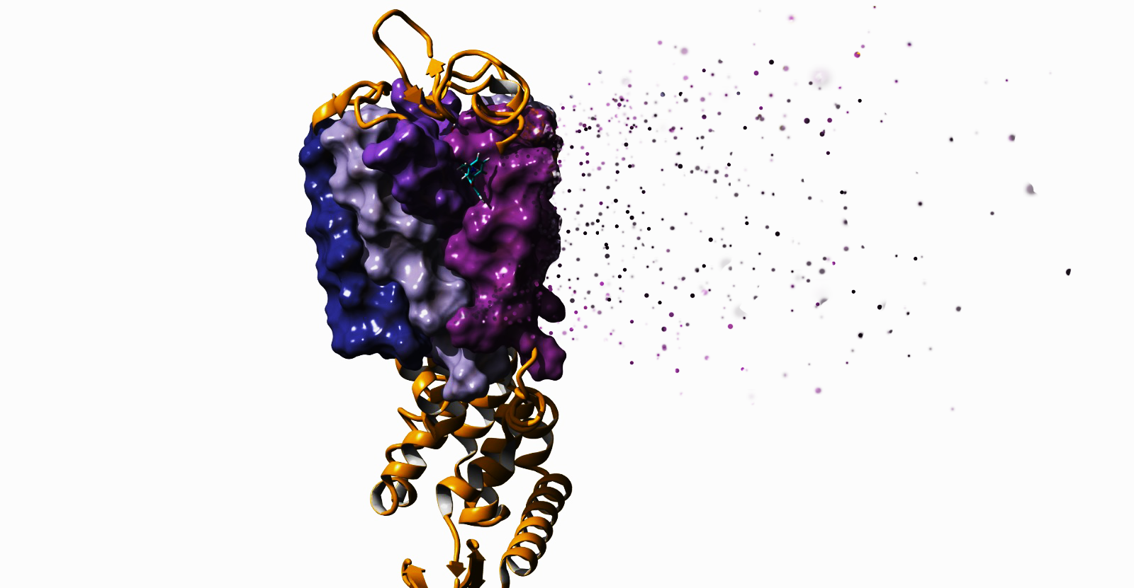
Conclusion
The interaction between the receptor and ligand in the binding pocket leads to changes in the shape of the residues in the binding pocket itself. Depending on the enzyme type, and especially for GPCRs, conformational changes affect the receptor domains, resulting in a different interaction with the G protein and in the activation of the signaling cascade.
This work proposes a pseudo-semantic approach to analyze a complex receptor-ligand MD trajectory. The conversion into strings allows us to quickly and efficiently compare the changes of the dihedral angles in the considered systems.
This approach is useful for monitoring changes in a wide range of biological systems.

Slide 10
Acknowledgments
SoftMining Academic Research Program

