Slide 1
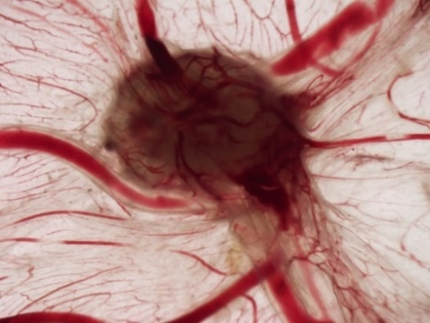
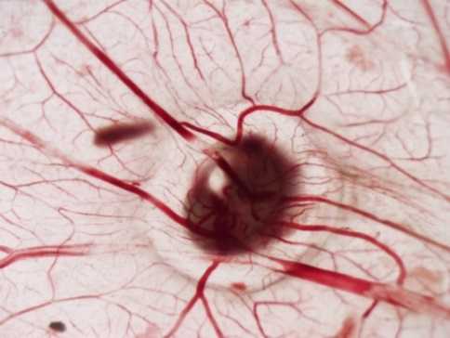
Synthesis and evaluation of the antitumor potential of novel methyl 3-(hetero)arylthieno[3,2-b]pyridine-2-carboxylates
Bruna R. Silva,^{a,b,c} Cristina P. R. Xavier,^{b,c} M. Helena Vasconcelos,^{b,c,d} Maria-João R. P. Queirozª
ª Centre of Chemistry, University of Minho, Campus de Gualtar, 4710-057 Braga; ^{b} i3S - Instituto de Investigação Inovação em Saúde, Universidade do Porto, Portugal; ^{c} Cancer Drug Resistance Group, IPATIMUP - Institute of Molecular Pathology and Immunology of the University of Porto, Portugal; ^{d} Department of Biological Sciences, FFUP - Faculdade de Farmácia da Universidade do Porto, Portugal.
INTRODUCTION
Recently, we have been interested in the synthesis of thieno[3,2-b]pyridine derivatives functionalized on the thiophene ring and in their potential antitumor activity ¹.
Herein, by C-C Pd-catalyzed Suzuki-Miyaura cross-coupling of methyl 3-bromothieno[3,2-b]pyridine-2-carboxylate with (het)aryl pinacol boranes, trifluoro potassium boronate salts or boronic acids, novel methyl 3-(hetero)arylthieno[3,2-b]pyridine-2-carboxylates 1a-1h were synthesized in moderate to high yields after column chromatography (Scheme 1), and were fully characterized by:
¹H
¹³C-NMR
HRMS
CHEMISTRY
Scheme1. Synthesis of novel methyl 3-(het)arylthieno[3,2-b]pyridine-2-carboxylates by C-C Suzuki Miyaura cross-coupling.
MATERIALS AND METHODS
Sulforhodamine B (SRB) assay was used to screen 8 synthetized compounds (48h treatments) against different cancer cell line models - pancreatic adenocarcinoma (PANC-1 and BxPC3), non-small cell lung cancer (NCI-H460) and triple negative breast cancer (MDA-MB-231 and MDA-MB-468). The cytotoxicity of the best compounds against the non-tumorigenic cell line MCF-12A was also evaluated by SRB
Trypan Blue Exclusion Assay allowed to determine the number of viable cells
The effect of the selected compounds on cell cycle profile was evaluated using Flow Cytometry with Propidium Iodide
The expression of specific proteins was analysed by Western blot
Chick Chorioallantoic Membrane (CAM) assay was performed to evaluate the angiogenesis and/or tumorigenesis
RESULTS AND DISCUSSION
Table 1 – GI₅₀ concentrations (µM) for each compound in different human tumor cell lines, using SRB the assay.
Cell line and respective GI₅₀* concentration (µM) for each compound
 | PANC-1 | BxPC3 | NCI-H460 | MDA-MB-231 | MDA-MB-468
1a | >10 | >20 | >20 | >20 | >20
1b | >10 | >10 | >10 | >10 | >10
1c | >10 | >10 | >10 | >10 | >10
1d | >50 | >30 | >30 | >10 | >30
1e | >10 | >14 | >10 | 12.56 ± 1.88 | >14
1f | >50 | >30 | >50 | 28.67 ± 1.34 | 8.73 ± 1.73
1g | >50 | >75 | >75 | >75 | >75
1h | >50 | >75 | >75 | >75 | 4.67 ± 0.68
1e
*GI₅₀ values correspond to the mean ± S.E.M. of at least three independent experiments, all performed in duplicated. Doxorubicin was used as a positive control. Doxorubicin GI₅₀ values were 68.34 ± 5.69 nM and 81.30 ± 8.99 nM in MDA-MB-231 and MDA-MB-468 cells, respectively. The concentrations tested were the ones possible without appearance of crystals or aggregates in culture.
Tumor treated with vehicle (PBS – phosphate-buffered saline)
Tumor treated with compound 1e
Figure 1. Results of viability, cell cycle profile analysis, Western Blot and CAM assay of compound 1e after 48h of treatments GI₅₀ and 2x GI₅₀ concentrations.
Table 2 – Evaluation of the toxicity of the most promising compounds in the non-tumorigenic cell line MCF-12A by SRB assay.
Compound | GI₅₀ concentration (µM) in the tumor cell lines | Tumor cell line tested | % of MCF-12A Cell Growth at GI₅₀ concentration
Compound 1e (p-Cl) | 12.56 ± 1.88 | MDA-MB-231 | 88.62 ± 4.04
Compound 1f (p-CN) | 8.73 ± 1.73 | MDA-MB-468 | 117.73 ± 3.22
Compound 1h (furan) | 4.67 ± 0.68 | MDA-MB-468 | 82.13 ± 4.78
1h
GI₅₀ concentrations values correspond to the mean ± S.E.M. of at least three independent experiments, all performed in duplicate. The % of growth of the cell line MCF-12A was achieved using the GI₅₀ concentrations of each compound in the indicated tumour cell lines.
Figure 2. Results of viability, cell cycle profile analysis and Western Blot of compound 1h after 48h of treatments at GI₅₀ and 2x GI₅₀ concentrations.
1e → lowest GI₅₀ value for the MDA-MB-231 cells
1f and 1h → very low GI₅₀ values for MDA-MB-468 cells
1e, 1f and 1h → none or little toxicity against MCF12-A cells
1e and 1h decreased the number of viable cells at 2x GI₅₀
1e seemed not to alter the cell cycle profile
1h increased G2/M phase with concomitant decrease of G1/G0
1e induced high expression of the DNA damage marker γ-H2A.X at 2x GI₅₀ concentration
1h presented high expression of the cell cycle marker p21
1e decreased the xenografted tumors size of the cells at GI₅₀ concentration by the in ovo CAM assay
CONCLUSIONS
We found 3 compounds in this series (1e, 1f and 1h) that were able to cause growth inhibition of TNBC cell lines at low GI₅₀ (5-13µM) without showing much toxicity against a non-tumorigenic cell line. Compound 1e caused an induction of DNA damage and decreased tumor size in CAM assay. Compound 1h induced cell cycle arrest at G2/M phase with high expression of p21 in the cells.
ACKNOWLEDGMENTS
We thank the FCT Portugal for financial support to CQUM (UID/686/2018-2019)
and PTNMR also financed by Portugal2020.
REFERENCES
1. Rodrigues, J. M.; Buisson, P.; Pereira, J. M.; Pinheiro, I. M.; Fernández-Marcelo, T.; Vasconcelos, M. H.; Berteina-Raboin, S.; Queiroz, M.-J. R. P. Synthesis of novel 8-(het)aryl-6H-pyrano[4′,3′:4,5]thieno[3,2-b]pyridines by 6-endo-dig cyclization of Sonogashira products and halolactonizations with Cu salts/NXS. Preliminary antitumor evaluation. Tetrahedron. 2019, 75, 1387-1397.
University of Minho
School of Sciencies

