Slide 1
Novel BODIPYs with dimethylamine substituents and their cationic and iodinated derivatives for anticancer and antibacterial photodynamic therapy
Weronika Porolnik¹*, Malgorzata Kucinska², Jolanta Dlugaszewska³, Marek Murias², Jadwiga Mielcarek¹ , Jaroslaw Piskorz¹
¹ Chair and Department of Inorganic and Analytical Chemistry, Poznan University of Medical Sciences, Grunwaldzka 6, 60-780 Poznan, Poland;
² Chair and Department of Toxicology, Poznan University of Medical Sciences, Dojazd 30 Street, 60-631 Poznan, Poland;
³ Chair and Department of Genetics and Pharmaceutical Microbiology, Poznan University of Medical Sciences, Swiecickiego 4, 60-781 Poznan, Poland.
Corresponding author: w.porolnik@op.pl

Slide 2
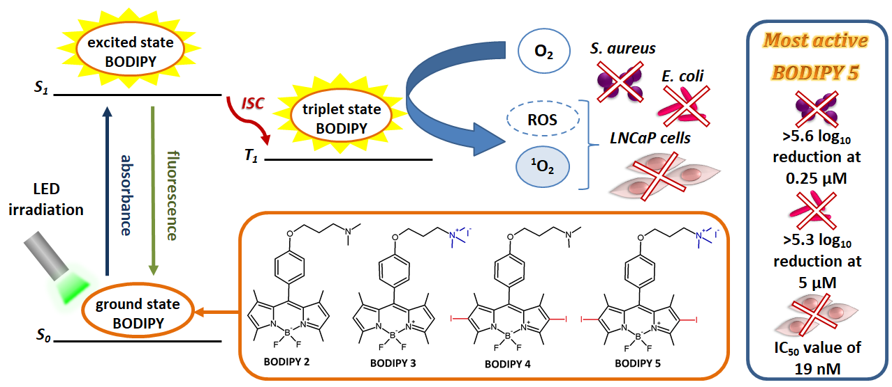
Novel BODIPYs with dimethylamine substituents and their cationic and iodinated derivatives for anticancer and antibacterial photodynamic therapy
Graphical Abstract

Slide 3
Abstract:
Photodynamic therapy (PDT) is a minimally invasive modality, clinically approved for treating several localized cancer and non-cancer lesions and also perspective modality to treat microbial induced pathologies. It utilizes a photosensitizer activated with a light of a specific wavelength to produce reactive oxygen species responsible for the cytotoxic effect.
Boron-dipyrromethene (BODIPY) derivatives are organic chromophores possessing diverse applications, including fluorescent imaging probes, labeling reagents, chemosensors, and laser dyes. In addition, BODIPYs gain increasing attention as photosensitizers due to their distinctive photophysical properties attractive for PDT.
Novel BODIPYs with dimethylaminopropoxyphenyl substituents and their cationic and iodinated derivatives were synthesized and characterized using mass spectrometry, UV-Vis spectrophotometry, and various NMR techniques. Subsequent photochemical studies allowed evaluating their absorption and emission properties and the singlet oxygen generation ability. In vitro photodynamic activity studies were performed on human androgen-sensitive prostate adenocarcinoma cells (LNCaP) and two bacterial strains (Gram-positive Staphylococcus aureus and Gram-negative Escherichia coli). Also, the impact of the presence of quaternary ammonium cation and iodine atoms, in the structure of BODIPYs, on physicochemical and photochemical properties as well as photodynamic activity was assessed. BODIPY derivative possessing both a positive charge and iodine atoms revealed the highest activity towards all studied cells.
Keywords:
BODIPY; cationic photosensitizers ; heavy atom effect; photodynamic antimicrobial therapy; photodynamic therapy

Slide 4
Introduction – Photodynamic therapy
Photodynamic therapy (PDT) is a medical treatment clinically approved to cure localized cancers such as esophageal cancer, lung adenocarcinoma, head and neck cancer, and also non-cancer diseases such as age-related macular degeneration, actinic keratosis, and some dermatological pathologies. PDT is also a perspective modality to treat microbial-induced pathologies, including those caused by antibiotic-resistant microorganisms [1,2].

Slide 5
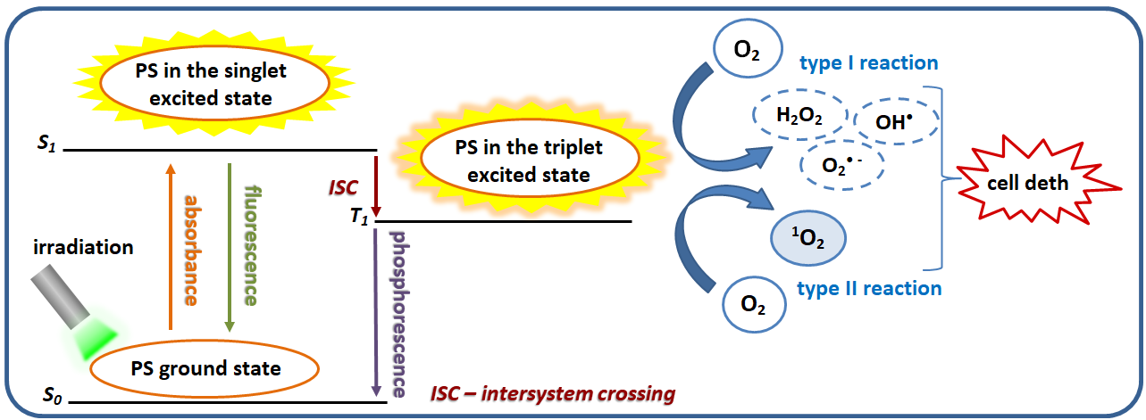
Introduction – Photodynamic therapy
PDT utilizes a light-sensitive drug called a photosensitizer (PS) and light of a wavelength corresponding to the maximum absorption peak of the selected PS. After irradiation, the PS molecule becomes excited to the singlet excited state, and then through intersystem crossing transforms into the triplet excited state. In this state, PS can react with molecular oxygen and other surrounding substrates to produce cytotoxic reactive oxygen species [1].

Slide 6
Introduction – Photosensitizers
The most commonly used compounds in photodynamic therapy belong to the group of porphyrinoids, which include e.g. clinically approved photosensitizers such as Photofrin, 5-aminolevulinic acid and verteporfin. However, currently used photosensitizers have significant disadvantages, such as poor water solubility, low absorption coefficients, or the need to use high doses, therefore there is a great interest in searching for new and more effective photosensitizers [3].

Slide 7
Introduction – Boron-dipyrromethene derivatives (BODIPY)
BODIPY dyes find a wide range of applications in various fields, such as DNA and protein labeling, diagnostic imaging, and photovoltaics. In recent years they have also been intensively researched for photodynamic therapy applications. These compounds are characterized by high molar absorption coefficients, good photostability, relatively simple synthesis, and the wide possibilities of functionalization. These features allow obtaining derivatives with the desired physicochemical properties and promising potential for application in photodynamic therapy. The basic structures of BODIPYs possess a few limitations, including high fluorescence quantum yields, low singlet oxygen generation, short maximum absorbance wavelengths, and high lipophilicity. However, the proper modifications can make them suitable as PSs [3,4].
dipyrromethane core
dipyrrin core
boron-dipyrromethene core
(BODIPY)

Slide 8
Results and discussion – general overview
Synthesis of novel BODIPYs
Structural characterization of obtained BODIPYs
Evaluation of absorption and emission properties
Singlet oxygen generation assessment
In vitro photodynamic antibacterial activity studies
In vitro photodynamic anticancer activity studies

Slide 9
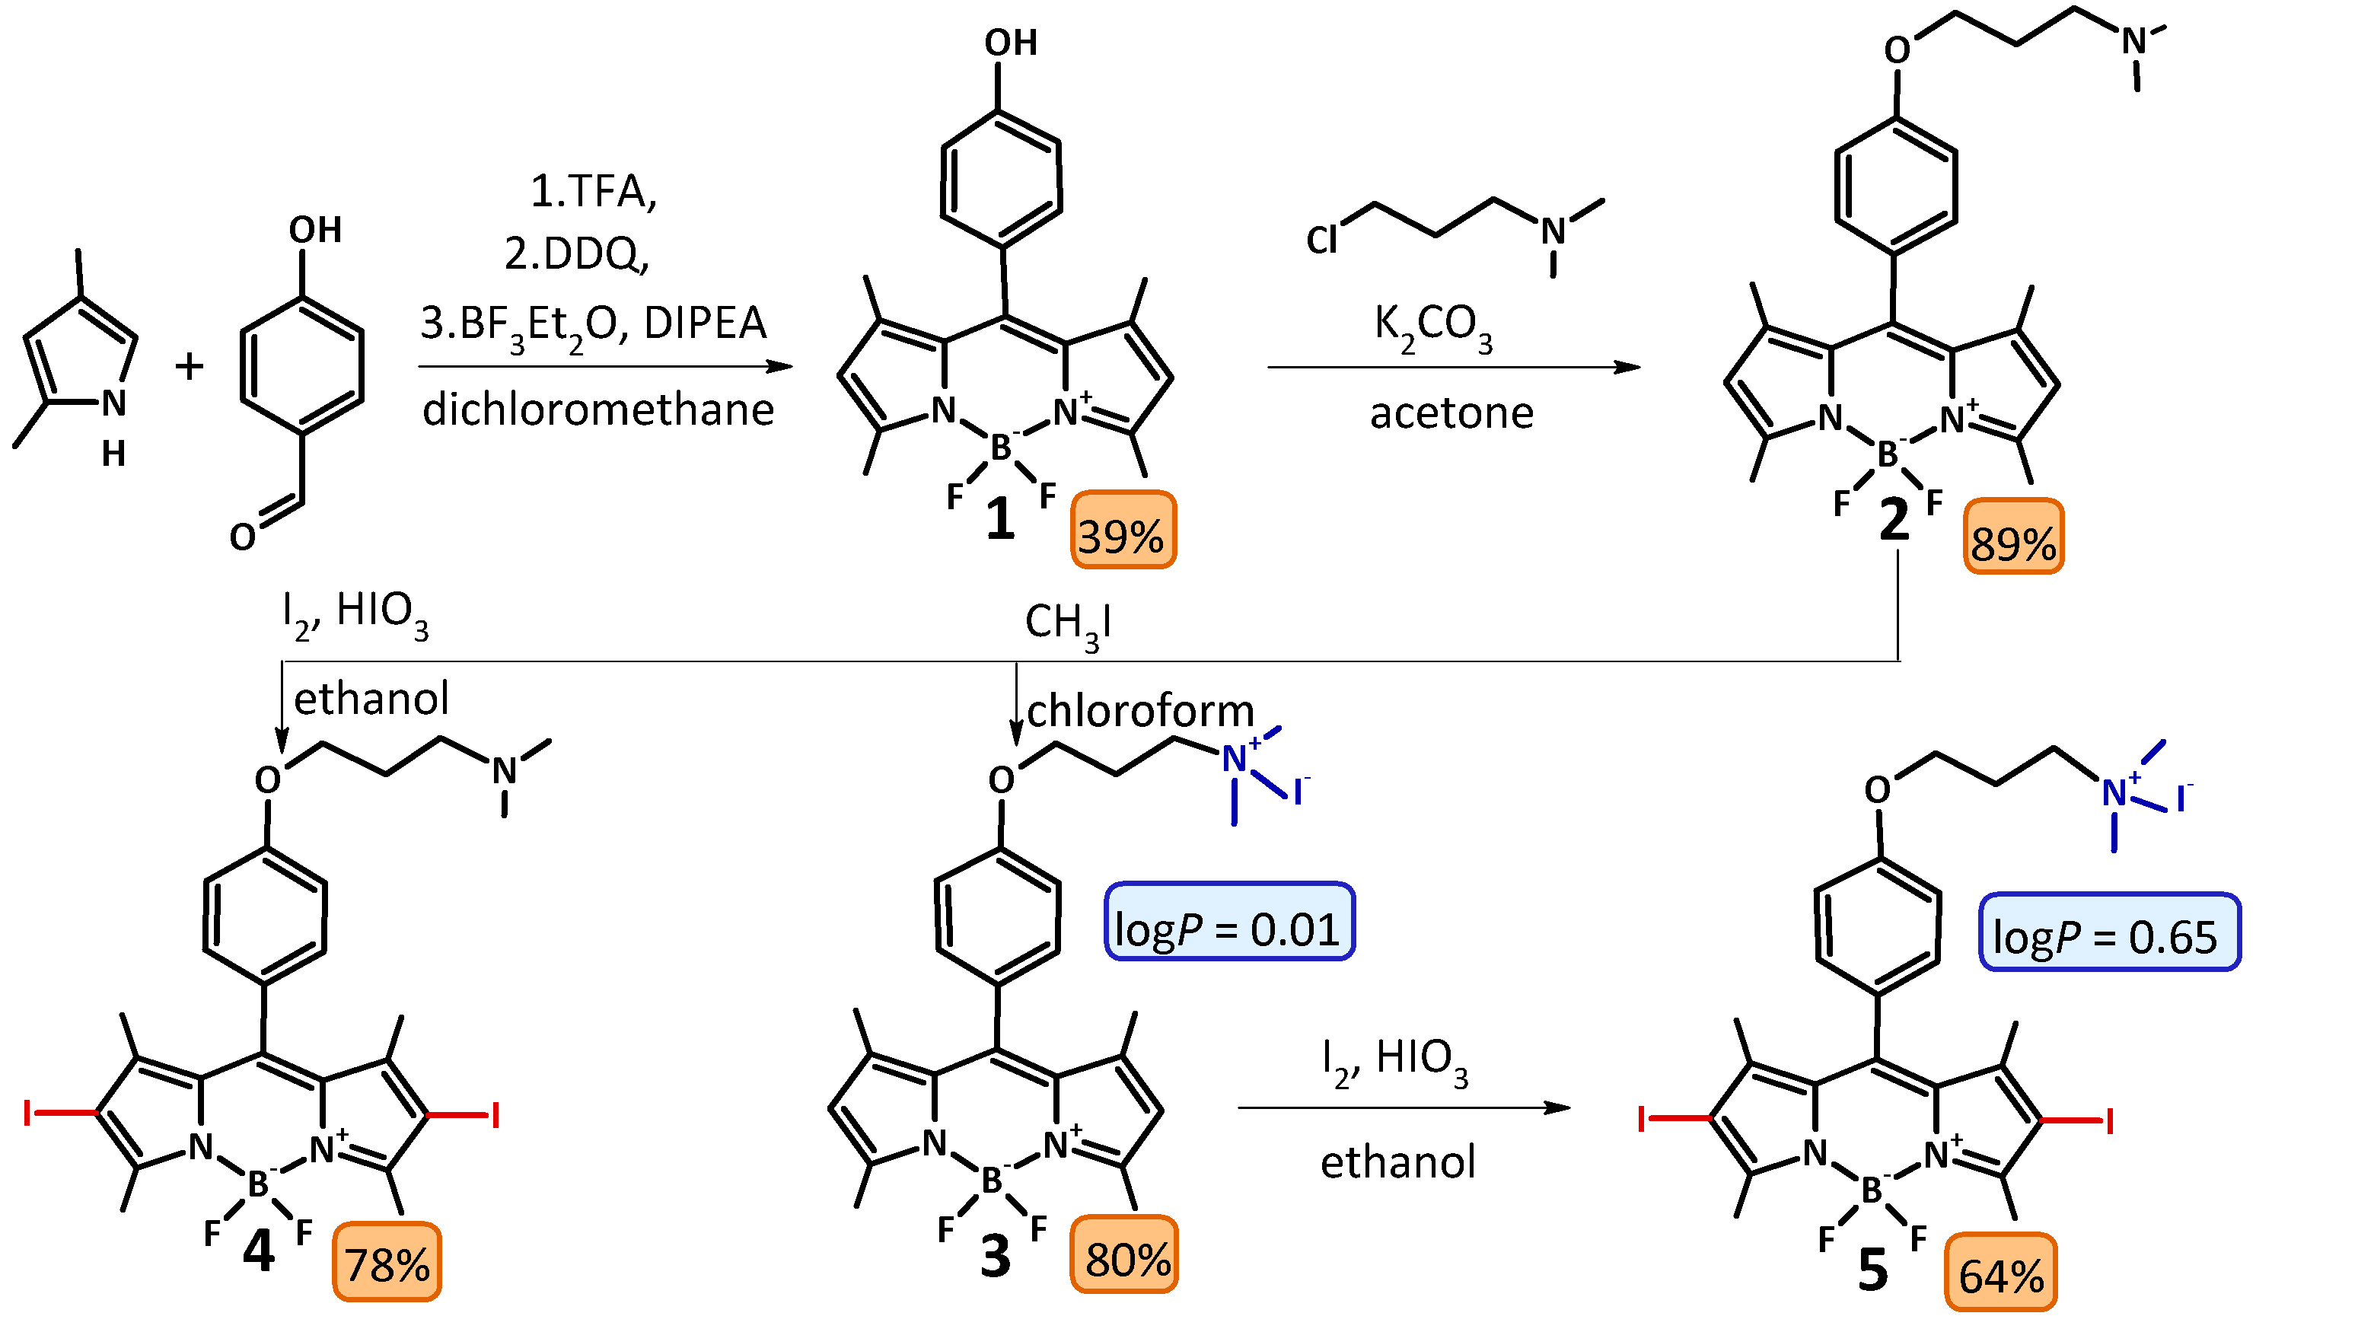
Results and discussion – synthesis
BODIPY 1 was synthesized using a three-step literature procedure [5], then the known derivative 2 was obtained by reaction with dimethylaminopropyl chloride in the presence of potassium carbonate [6]. BODIPY 2 was iodinated to obtain a new derivative 4 or quaternized to give amphiphilic BODIPY 3. This derivative was then subjected to iodination, which increased the obtained BODIPY’s 5 lipophilicity [7,8].

Slide 10
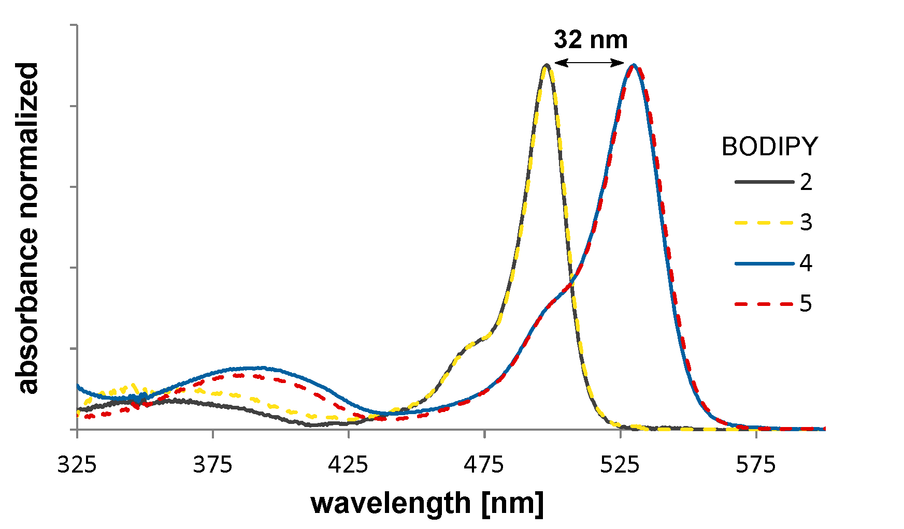
Results and discussion – structural characterization
The obtained compounds were characterized by mass spectrometry, UV-Vis spectrophotometry, and various NMR techniques. The two-dimensional spectra (¹H-¹H COSY, ¹H-¹³C HSQC, ¹H-¹³C HMBC) were especially useful and allowed assigning signals to individual hydrogen and carbon atoms.
The mass spectrometry (ESI) of BODIPY 5.
The UV-Vis spectrophotometry of BODIPYs 2-5 in MeOH.

Slide 11
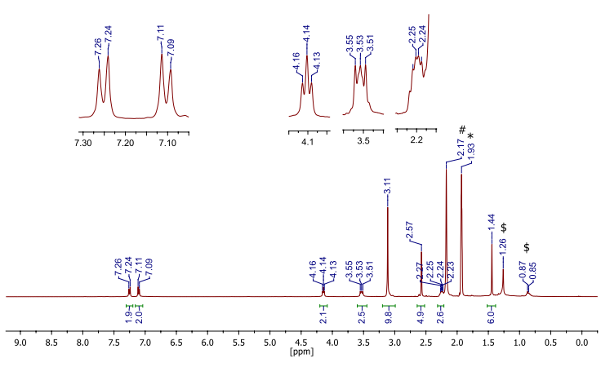
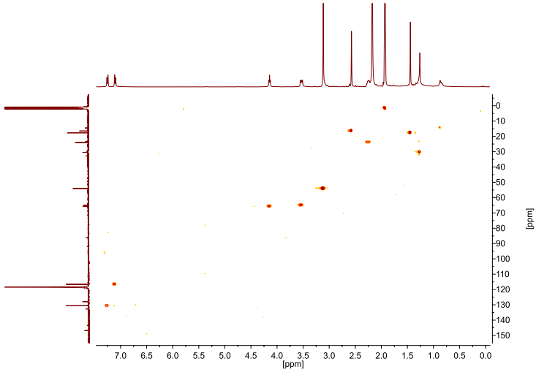
Results and discussion – structural characterization
NMR spectroscopy:
¹H NMR, ¹³C NMR, ¹H-¹H COSY, ¹H-¹³C HSQC, ¹H-¹³C HMBC
The ¹H NMR spectrum of 5 in CD₃CN.
The ¹H-¹³C HSQC spectrum of 5 in CD₃CN.

Slide 12
Results and discussion – absorption properties
Obtained derivatives 2-5 were subjected to physicochemical studies, including the determination of the absorption and emission properties. It was observed that the derivatives 2 and 3 without iodine atoms showed the maxima of the absorption wavelength about 500 nm, while the introduction of iodine atoms into positions 2 and 6 of the BODIPYs 4 and 5 core caused a bathochromic shift of the absorption maxima by about 30 nm. All derivatives showed high molar absorption coefficients in the range of 4.54-4.80, favorable for the use in PDT.
Maximum absorption (λ_{max}) and molar absorption coefficients (logε) for derivatives 2-5 in methanol
 | BODIPY
 | 2 | 3 | 4 | 5
λ _{max} (logε) | 498 (4.80) | 498 (4.54) | 530 (4.57) | 530 (4.75)
Normalized absorption spectra of BODIPYs 2-5 in methanol.

Slide 13
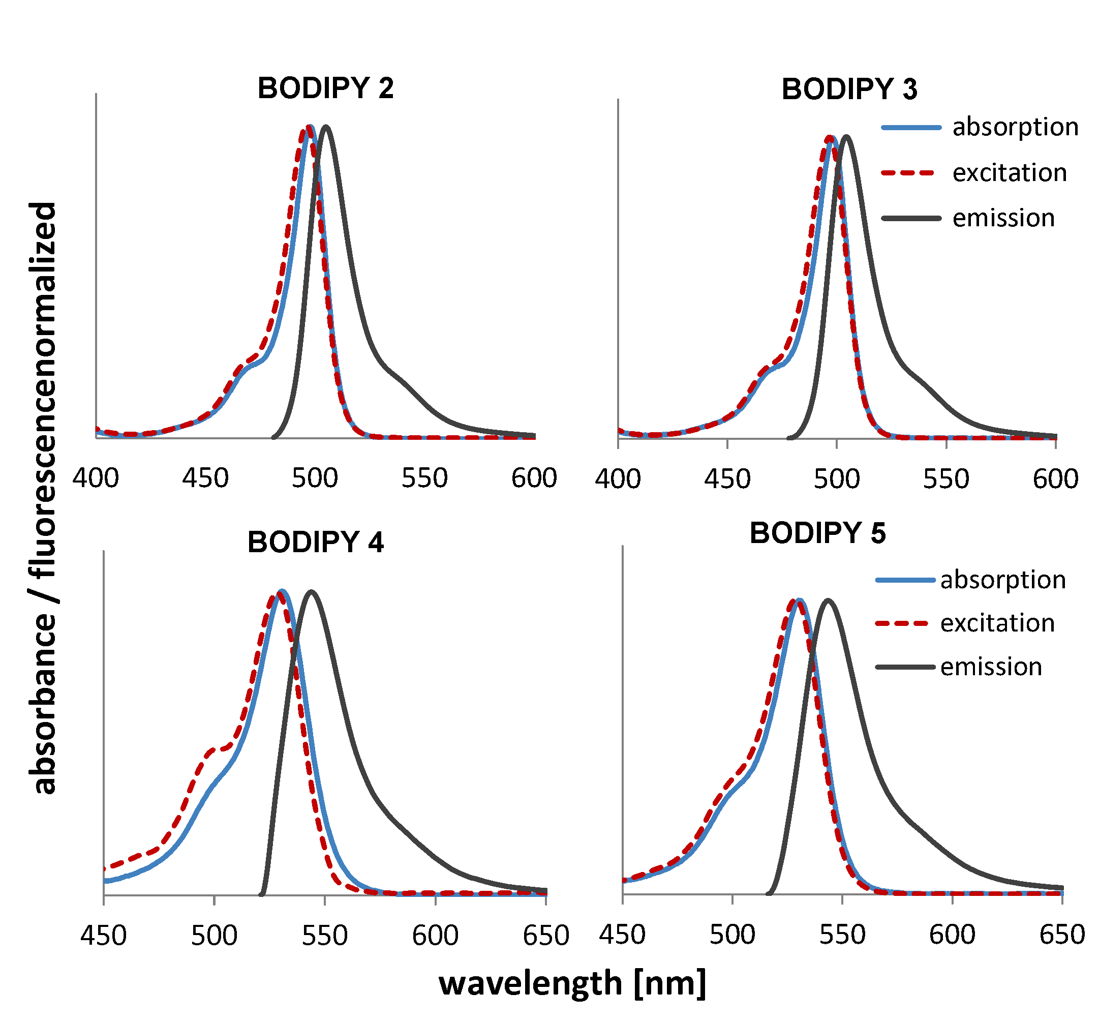
Results and discussion – emission properties
The non-iodinated derivatives 2 and 3 showed high fluorescence efficiency. The introduction of iodine atoms to the structure of derivatives 4 and 5 caused a 30-35-fold reduction in fluorescence efficiency [7]. This phenomenon, called the heavy atom effect, is caused by an increase in the intersystem crossing from the first singlet excited state to the triplet excited state and resulting reduction in fluorescence intensity.
Fluorescence quantum yields (Φ_{F}) for BODIPYs 2-5
solvent | 2 | 3 | 4 | 5
methanol | 0.69 | 0.70 | 0.02 | 0.02
ethanol | 0.61 | 0.60 | 0.02 | 0.02
The long-wavelength absorption, excitation and emission bands for BODIPYs 2-5 in methanol.

Slide 14
Results and discussion – singlet oxygen generation
The non-iodinated BODIPY derivatives 2 and 3 showed low singlet oxygen generation capacity, in contrast to iodinated derivatives 4 and 5, which revealed exceptionally high singlet oxygen generation quantum yields ​​(0.69-0.97) [7]. It is caused by the aforementioned increase in the formation of the triplet state, in which the compound can react with molecular oxygen to form highly reactive singlet oxygen.
Changes in the UV-Vis spectra for DPBF and BODIPYs 2-5 in methanol.
Singlet oxygen generation quantum yields (Φ_{Δ}) for derivatives 2-5
solvent | 2 | 3 | 4 | 5
methanol | 0.02 | 0.02 | 0.90 | 0.94
ethanol | 0.02 | 0.02 | 0.69 | 0.97

Slide 15
Results and discussion – In vitro photodynamic antibacterial activity
Log₁₀ reductions of S. aureus and E. coli treated with BODIPYs 2-5
BODIPY | 2 | 3 | 4 | 5
S. aureus | 2.5 μM |  | 0.25 μM
 | 4.1 log₁₀ | >5.8 log₁₀ | 3.9 log₁₀ | >5.6 log₁₀
E. coli | 500 μM |  |  | 5 μM
 | 1.7 log₁₀ | >5.3 log₁₀ | >5.4 log₁₀ | >5.3 log₁₀
In vitro photodynamic activity studies showed high activity of all tested compounds against Gram-positive Staphylococcus aureus. Iodinated derivatives 4 and 5 showed high activity at a low concentration of 0.25 μM, while non-iodinated BODIPYs 2 and 3 required a 10-fold higher concentration. However, for Gram-negative Escherichia coli, high inactivation was obtained only for cationic, iodinated derivative 5 at a concentration of at least 5 μM [7].

Slide 16
Results and discussion – In vitro photodynamic anticancer activity
The IC₅₀ values of BODIPYs 2-5 against prostate adenocarcinoma cell line (LNCaP)
BODIPY | non-irradiated | irradiated
2 | 9.7±1.4 | 3.3±1.5
3 | >10 | >10
4 | >2 | 0.048±0.012
5 | >0.06 | 0.019±0.004
5 (hypoxia) | >10 | >10
Both iodinated derivatives 4 and 5 showed high photodynamic anticancer activity with IC₅₀ values ​​of 48.3 nmol and 19.3 nmol, respectively. Due to the best photodynamic activity, derivative 5 was also assessed under hypoxic conditions with an oxygen content reduced to 1%. It was shown that lowering the oxygen concentration inhibited the activity of derivative 5. These results indicate that oxygen is essential for the activity of this compound and the mechanism of action is most likely related to the generation of singlet oxygen, the formation of which depends on the presence of molecular oxygen [7].

Slide 17
Conclusions
The introduction of iodine atoms to the amphiphilic derivative 3 resulted in an increase in lipophilicity, confirmed by a change in the logP value from 0.01 to 0.65.
The non-iodinated BODIPYs 2 and 3 showed strong fluorescent properties, proving that they can be used in diagnostics, e.g. as fluorescent markers.
The iodinated derivatives 4 and 5 are characterized by very high values ​​of the quantum yields of singlet oxygen generation (Φ_{Δ}) in the range of 0.69-0.97.
BODIPYs 4 and 5 showed 10-fold greater activity against gram-positive S. aureus than their iodine-free analogs 2 and 3. The presence of iodine atoms in the structure of BODIPY showed a greater impact on photodynamic activity than the presence of a positive charge.

Slide 18
Conclusions
In the case of in vitro photodynamic activity against Gram-negative E. coli, the influence of both the presence of iodine atoms and the positive charge in the structure of compounds on increasing their activity was observed.
E. coli showed less susceptibility to photodynamic therapy than S. aureus. The most active BODIPY 5 eradicated these bacterial strains at 0.25 µM and 5 µM concentrations, respectively.
The study of anticancer activity against prostate cancer cells showed a greater effect of the presence of iodine atoms in the BODIPY structure on their activity, than the presence of a positively charged substituent.
Both iodinated derivatives 4 and 5 showed very high photodynamic anticancer activity (IC₅₀ = 48.3 nmol and 19.3 nmol). BODIPY 5 showed the highest photodynamic activity related to all tested cells, which confirms its promising properties and the possibility of application in both antimicrobial and anticancer photodynamic therapy.

Slide 19
References
[1] L. Benov, Photodynamic Therapy: Current Status and Future Directions, Med. Princ. Pract. 24 (2015) 14–28.
[2] R. Baskaran, J. Lee, S.-G. Yang, Clinical development of photodynamic agents and therapeutic applications, Biomater. Res. 22 (2018) 25.
[3] S.G. Awuah, Y. You, Boron dipyrromethene (BODIPY)-based photosensitizers for photodynamic therapy, RSC Adv. 2 (2012) 11169.
[4] Y.S. Marfin, A.V. Solomonov, A.S. Timin, E.V. Rumyantsev, Recent Advances of Individual BODIPY and BODIPY-Based Functional Materials in Medical Diagnostics and Treatment, Curr. Med. Chem. 24 (2017).
[5] F. Galeotti, V. Calabrese, M. Cavazzini, S. Quici, C. Poleunis, S. Yunus, A. Bolognesi, Self-Functionalizing Polymer Film Surfaces Assisted by Specific Polystyrene End-Tagging, Chem. Mater. 22 (2010) 2764–2769.
[6] X. Zhang, B. Wang, C. Wang, L. Chen, Y. Xiao, Monitoring Lipid Peroxidation within Foam Cells by Lysosome-Targetable and Ratiometric Probe, Anal. Chem. 87 (2015) 8292–8300.
[7] J. Piskorz, W. Porolnik, M. Kucinska, J. Dlugaszewska, M. Murias, J. Mielcarek, BODIPY-Based Photosensitizers as Potential Anticancer and Antibacterial Agents: Role of the Positive Charge and the Heavy Atom Effect, ChemMedChem, 2020, doi.org/10.1002/cmdc.202000529.
[8] J. Piskorz, J. Dlugaszewska, W. Porolnik, A. Teubert, J. Mielcarek, Boron-dipyrromethene derivatives bearing N-alkyl phthalimide and amine substituents of potential application in the photoinactivation of bacteria , Dyes Pigm. 2020, 178, 108322.

Slide 20
Acknowledgments
This work was supported by the National Science Centre, Poland under grant no. 2016/21/D/NZ7/01540

