Slide 1
My thoughts be bloody, or be nothing worth:
A neurochemical approach to neuroprogression in post-traumatic stress disorder
Christos Tsagkaris^{1,}*, Nikolaos Sevdalis², Eleni Konstantara², Dajana Bilcari³
& Athanasios Alexiou^{4,5}
¹ University of Crete, Faculty of Medicine (Heraklion, Greece) ² Medical University of Sofia, Faculty of Medicine (Sofia, Bulgaria) ³ University of Sofia "St. Kliment Ohridski", Faculty of Medicine (Sofia, Bulgaria) ⁴ Novel Global Community Educational Foundation (Hebersham, Australia) ⁵ AFNP Med Austria, Haidingergasse 29, 1030 Wien, Austria
* Corresponding author: chriss20x@gmail.com , chriss20x

Slide 2
Abstract:
Introduction: Neuroprogression has been defined as pathological reorganization of the central nervous system (CNS) along the course of severe psychiatric disorders. Ιn the context of post-traumatic stress disorder (PTSD), stress affects neural substrate reactivity and promotes brain rewiring resulting in symptoms expression and increased vulnerability to adversity. While PTSD has a lifetime prevalence of 8% in the general population, its neurochemical basis is yet to be discussed. This review examines the current evidence supporting the PTSD neuroprogression hypothesis focusing on neurochemical biomarkers and therapeutic targets.
Methods: Mechanistic and clinical studies focusing on molecules mediating neuroprogression in PTSD are summarized based on PubMed/MEDLINE search and relevant articles, which have been presented at international conferences. Original, peer-reviewed studies and systematic reviews in English were included.
Results: The biological underpinnings of neuroprogression in PTSD involve cross talk between the stress and immune systems. Elevated levels of circulating peripheral IL-6, IL-1β, TNFα, and interferon ϒ have been identified in previous studies. The landscape of neuroprogression in PTSD involves chronic sympathetic and renin-angiotensin-aldosterone system (RAAS) hyperarousal glutamatergic excitotoxicity, alterations in neuropeptide Y (NPY) and brain-derived neurotrophic factor (BDNF), and underactivity of the parasympathetic, serotonergic, dopaminergic, and GABAergic system. Their involvement appears linked to the progression from PTSD to mental or physical conditions
Conclusions: The neuroprogression hypothesis is leading to the re-conceptualization of PTSD as a potentially progressive psychiatric disorder with a corollary of medical implications. In this frame identifying involved molecules that can serve as biomarkers or therapeutic targets is of high importance.
Keywords: neuroprogression, PTSD, inflammation, oxidative stress

Slide 3
Introduction
Posttraumatic stress disorder (PTSD) is an anxiety disorder that can develop following exposure to a traumatic event.
The symptoms of PTSD include flashbacks, intrusive thoughts and nightmares, rumination and avoidance of areas or circumstances. (WHO 2017)
One of the most important symptoms of PTSD is the revival of the traumatic event.
8 percent of individuals in the general population at some point during their lifetime are affected.
Estimates suggest that as many as one-third of those who develop PTSD go on to experience a chronic form of the disorder that, in many cases, lasts for years.
A link between PTSD and physical illnesses such as Type II diabetes, cardio-vascular disease, certain cancers and fibromyalgia has been noted in the literature

Slide 4
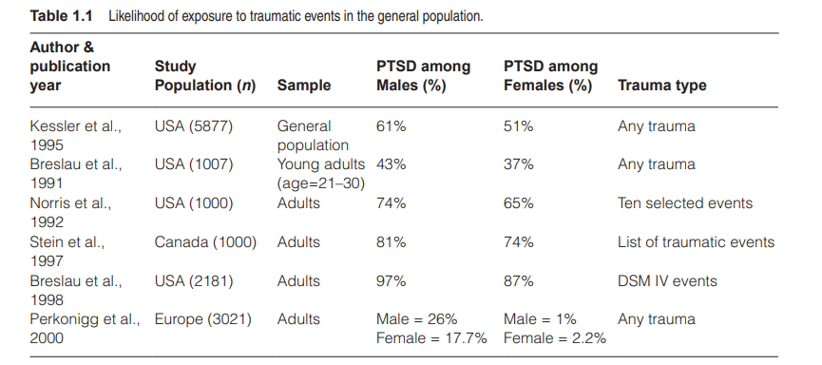
Introduction
PTSD: “event or situation of an exceptionally threatening or catastrophic nature, which is likely to cause pervasive distress in almost anyone” (WHO - ICD-10 )
Elevated prevalence of PTSD in populations exposed to war. The lifetime PTSD prevalence in Vietnam War veterans was 16.9%
PTSD occurs in other types of traumatic events such as (e.g., child abuse, rape, assault, accidents etc)
( Diagnostic and Statistical Manual of Mental Disorders, 4th edition et al.,1994)

Slide 5
Introduction
The hallmark features of PTSD are recurrent sensory-memory episodes of re-experiencing the trauma
These episodes are accompanied by phasic activations of stress-related neurobiology such as hypervigilance, heightened negative affect, and arousal
in PTSD, neural substrate reactivity is altered by stress, promoting a brain rewiring that may lead to symptom expression and an increased vulnerability to adversity (neuroprogression hypothesis)
Together, these symptoms constitute a stress-perpetuating syndrome that maintains the individual in a chronic state of sustained stress
Biological implications of PTSD include:
1.Elevated systemic levels of oxidative stress (OXS)
2.Inflammation (INF)
3.Accelerated cellular aging and neuroprogression
(Kessler RC PTSD et al.,2000)

Slide 6
Introduction
a) Elevated systemic levels of oxidative stress (OXS):When OXS is prolonged, antioxidants become depleted leading to => cell degeneration and apoptosis.
OXS is a molecular mechanism fundamental to aging and widely implicated in many common diseases. Studies have linked OXS to blood-brain barrier disruptions, altered patterns of neural growth, and changes in brain morphology
b) INF is a similarly ubiquitous cellular reaction implicated in many common diseases and initiated by cell injury. Its primary function is to destroy injurious agents and/or protect injured tissue
Emerging evidence suggests that both conditions can be triggered by chronic psychological stress and/or stress-related mental illnesses, including PTSD, and their separate and interactive effects, when chronic, may exert destructive effects on the brain and peripheral organ systems
(Kessler RC PTSD et al.,2000)

Slide 7
Aim
To examine the current evidence supporting the PTSD neuroprogression hypothesis focusing on neurochemical biomarkers and therapeutic targets

Slide 8
Methods
Mechanistic and clinical studies focusing on molecules mediating neuroprogression in PTSD are summarized based on PubMed/MEDLINE search and relevant articles, which have been presented at international conferences.
Original, peer-reviewed studies and systematic reviews in English were included.

Slide 9
Results
Oxidative stress
Inflammation
Mitochondrial dysfunction

Slide 10
Oxidative stress
Glutathione transferases normally interact with glutathione to detoxify pro-oxidant molecules.
In PTSD, studies have shown that there are low levels of glutathione transferases, so there are high levels of pro-oxidant molecules
PTSD is associated with a single nucleotide polymorphism (SNP) in the Retinoic Acid Orphan Receptor Alpha gene (RORA; rs8042149) expressed in the prefrontal cortex, hippocampus, and hypothalamus
Miller et al., 2018 Harv Rev Psychiatry
Amstader et al., 2013 Mol Psychiatry.

Slide 11
Inflammation
Metanalysis of plasma and serum studies have shown:
PTSD is associated with elevated levels of circulating peripheral IL-6, IL-1β, TNFα, and interferon ϒ
PTSD symptom severity and plasma CRP levels are associated
Passos IC et al., 2015 Lancet Psychiatry.
Dennis PA et al., 2016 J Psychosom Res.

Slide 12
Oxidative Stress & Inflammation
There is a connection between oxidative stress and inflammation in PTSD shown from animal studies’ findings :
Chronic and repeated activation of the hypothalamic-pituitary-adrenal (HPA) axis which occurs during re-experiencing the trauma.
Stress-induced glucocorticoids exert neurotoxic effects on the brain, especially on regions with a high density of glucocorticoid receptors such as the hippocampus and pre-frontal cortex (Glucocorticoid-hippocampal atrophy model)
Constantini D. et al., 2011 J Comp Physiol B.

Slide 13
Mitochondrial Dysfunction
Has long been implicated in psychopathologies and mood disorders.
In the biomarker discovery process, research showed dysregulated mitochondria-focused genes present in postmortem brains of PTSD patients.
Zhang L. et al., 2015 Transl Psychiatry

Slide 14
Mitochondrial Dysfunction
Another study found 34 mitochondria-focused genes being upregulated in “stressed-rat” amygdala. Common pathologic pathways in rats include fatty acid metabolism [Carnitine palmitoyltransferase 1B (CPT1B)] and peroxisome proliferator-activated receptors (PPAR) dysregulation in the amygdala of stressed rats. The overexpression of CPT1B mRNA was also shown in humans with PTSD.
Zhang L. et al., 2015 Transl Psychiatry

Slide 15
Mitochondrial Dysfunction
A third study that focused on differentiation of PTSD-like and resilient mice showed that animals exposed to the PTSD-induction paradigm displayed evidence of reduced mitochondrial electron transport chain complex (mtETC) activity in both cerebellum and muscle, reduced mitochondrial DNA copy number in the cerebellum and Peripheral Blood Cells, reduced flux through the fatty acid oxidation pathway, and reduced circulating carnitine and circulating short chain fatty acids.
Preston G. et al., 2020 Brain, Behavior, & Immunity - Health

Slide 16
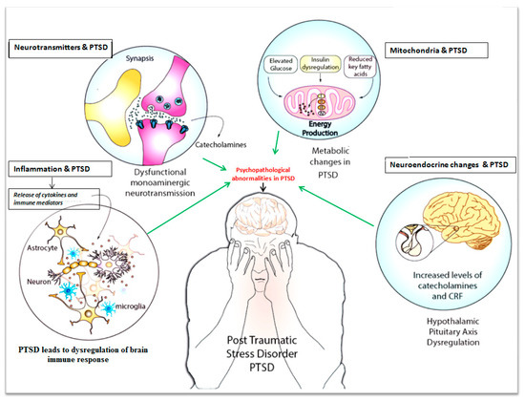
Discussion
PTSD as a model of sociobiological translation?
Underlying determinants of health and their impact on chronic diseases
(Koutis A., 2015)

Slide 17
The three facets of progression
Progression to PTSD | Progression of PTSD | Progression from PTSD
Childhood mania | History and self evaluation | Cardiometabolic Disease
Vehicle accident | Interleukin 1β, interleukin 6, and interferon γ, CRP levels | Chronic pain Sleep Disorders Comorbid traumatic brain injury
Family history of PTSD | Reductions in gray matter volumes in hippocampus, insula, orbito-/prefrontal cortex, anterior cingulate gyrus | Psychiatric comorbidity Cognitive Dysfunction and Dementia

Slide 18
Future research
Methodological implications for research
Longitudinal studies, lifelong follow up, individual trajectories
Data privacy concerns: Taking into account the GDPR legislation in Europe, data protection tends to become more and more strict
The concept of widely accessible databases, where raw data become available for secondary research - not defined whether these data can be used without a personalized consent form
Novelties in research, AI and IoT to address big datasets. Blockchain computing as a safety valve

Slide 19
Treatment implications
Translational research focusing on biomarkers and therapeutic targets
Context of precision and personalized medicine
Cost - direct and indirect cost of PTSD treatment
Insurance coverage criteria taking into account 1) the wide spectrum of PTSD related disorders 2) disparities among countries, healthcare systems

Slide 20
Thank you for your attention!
“my thoughts be bloody, or be nothing worth”
~ Hamlet Scene 4, Act 4
-Inflammatory and oxidative mediators in brain’s blood supply contributing to the pathological reorganization of the CNS shifting the progression of PTSD?
-No definitive answer about Hamlet
-Probably there will be an answer for patients with PTSD in the future

Slide 21
References
Miller MW, Lin AP, Wolf EJ, Miller DR. Oxidative Stress, Inflammation, and Neuroprogression in Chronic PTSD. Harv Rev Psychiatry. 2018;26(2):57-69. doi:10.1097/HRP.0000000000000167
Amstadter AB, Sumner JA, Acierno R, et al. Support for association of RORA variant and posttraumatic stress symptoms in a population-based study of hurricane exposed adults. Mol Psychiatry. 2013;18(11):1148–9.
Passos IC, Vasconcelos-Moreno MP, Costa LG, et al. Inflammatory markers in post-traumatic stress disorder: a systematic review, meta-analysis, and meta-regression. Lancet Psychiatry. 2015;2(11):1002–12
Dennis PA, Weinberg JB, Calhoun PS, et al. An investigation of vago-regulatory and health-behavior accounts for increased inflammation in posttraumatic stress disorder. J Psychosom Res. 2016;83:33–9.
Costantini D, Marasco V, Møller AP. A meta-analysis of glucocorticoids as modulators of oxidative stress in vertebrates. J Comp Physiol B. 2011;181(4):447–56
Zhang L, Li H, Hu X, et al. Mitochondria-focused gene expression profile reveals common pathways and CPT1B dysregulation in both rodent stress model and human subjects with PTSD. Transl Psychiatry. 2015;5(6):e580. Published 2015 Jun 16. doi:10.1038/tp.2015.65
Graeme Preston, Tim Emmerzaal, Faisal Kirdar, Laura Schrader, Marloes Henckens, Eva Morava, Tamas Kozicz,
Cerebellar mitochondrial dysfunction and concomitant multi-system fatty acid oxidation defects are sufficient to discriminate PTSD-like and resilient male mice, Brain, Behavior, & Immunity - Health,6, 2020
Acknowledgements
Dr. A. Kaye, Yale University and colleagues

