Slide 1
Barium-131 as starting point for the development of radiotheranostic approaches
Falco Reissig ^{1,2}, David Bauer ^{1,2}, Martin Ullrich ², Martin Kreller ^{1,2}, Jens Pietzsch ^{1,2}, Klaus Kopka ^{1,2}, Hans-Jürgen Pietzsch ², Martin Walther ² and Constantin Mamat ^{1,2,*}
¹ Helmholtz-Zentrum Dresden-Rossendorf, Institut für Radiopharmazeutische KKrebsforschung, D-01328 Dresden
² Technische Universität Dresden, Fakultät Chemie und Lebensmittelchemie,
D-01062 Dresden
* Corresponding author: c.mamat@hzdr.de

Slide 2
Barium-131 as starting point for the development of radiotheranostic approaches
Graphical Abstract

Slide 3
Abstract:
We understand ¹³¹Ba as a radionuclide, which enables imaging by SPECT in nuclear medicine and provides a diagnostic match for the therapeutic alpha-emitting radionuclides ²²³Ra and ²²⁴Ra. Recently, we reported on a sufficient production route for ¹³¹Ba by irradiating a ¹³³Cs target with 27.5 MeV proton beams, and the straight-forward resin-based radiochemical separation, yielding ¹³¹Ba with high radionuclide purity. An average amount of 190 MBq of ¹³¹Ba was produced per irradiation. Apart from 0.1% isotopic impurity of ¹³³Ba, no more side-products were detectable. For the first time, radiolabeling of the complexing agent macropa (known to be an appropriate ²²⁵Ac chelator) with ¹³¹Ba was reported and mild labeling conditions as well as reaction control using TLC systems were applicable. The radiopharmacological characterization of ¹³¹Ba-labeled macropa was carried out in healthy mice using uncomplexed [¹³¹Ba]Ba²⁺ as a reference, including biodistribution studies and small animal SPECT/CT. The results revealed the rapid bone uptake of free [¹³¹Ba]Ba²⁺ ions, whereas ¹³¹Ba-labeled macropa showed a fast renal clearance and significantly lower (P < 0.001) accumulation in the bones. We therefore conclude, that ¹³¹Ba is a promising “new” radionuclide for SPECT imaging purposes and delivers appropriate quality for preclinical investigations. Moreover, the successful labeling of macropa and the in vivo stability of the ¹³¹Ba-complex are viewed as a promising starting point for the development of new heavy earth alkaline metal chelators, especially for the therapeutically relevant radium isotopes. This enables ¹³¹Ba to achieve its goal as diagnostic match and monitoring tool for ^{223/224}Ra.
Keywords:
barium-131, dedicated small animal SPECT/CT, macropa targeted alpha therapy, theranostics

Slide 4
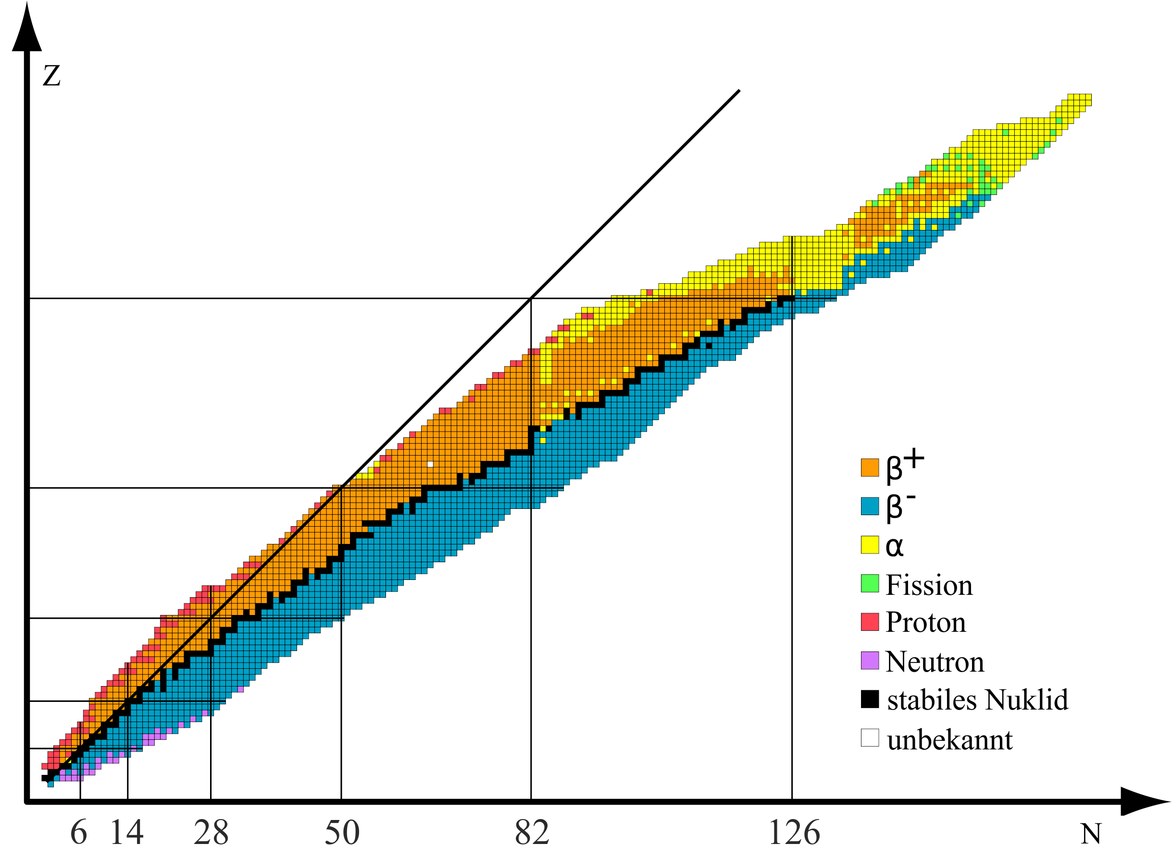
Introduction
Radiopharmaceuticals (combination of a radionuclide and a bioactive drug in trace amount) are used for imaging (Single Photon Emission Computed Tomography (SPECT) and Positron Emission Tomography (PET)) and therapy in nuclear medicine. Whereas gamma emitters and positron emitters are used for and SPECT and PET, beta⁻ emitters and alpha emitters are used for therapy. → alpha emitters possess the highest therapy efficiency
Chart of nuclides
The higher the atomic number, the higher the number of alpha-emitting radionuclides
Prominent alpha emitters with relevance for targeted cancer therapy
²¹¹At, ^{212/213}Bi, ^{223/224}Ra, ²²⁵Ac, ²²⁷Th
alpha emitters of our interest

Slide 5
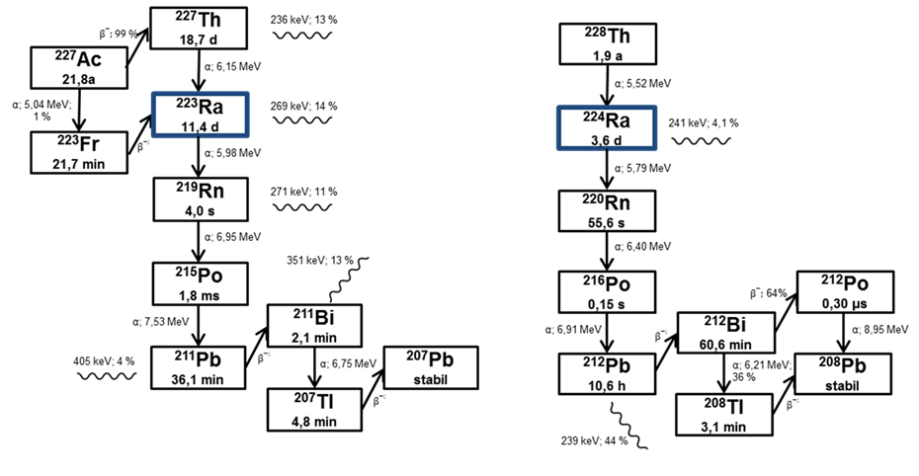
Introduction
Both radium isotopes decay in a cascade mode with 4 alpha and 2 beta decays, providing a total decay energy of approx. 30 MeV over the whole cascade
Chemically similar barium can provide an imaging tool for nuclear medicine (SPECT) – Theranostic approach via matched carrier system
Development of a carrier system
Ra²⁺
uncomplexed
ideal case: the same chelator system for barium and radium
→ Diagnosis, therapy and therapy monitoring using the same ligand structure

Slide 6
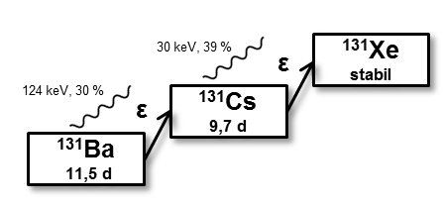
Purposes
Making barium-131 an imaging agent:
decay scheme of barium-131
Three relevant energy emissions:
124 keV
216 keV
496 keV
suitable for SPECT imaging
rather inappropriate for imaging
Main goals:
Development of a rigid and efficient cyclotrone production route for barium-131
Development of a purification procedure to achieve highest product purity
Radiolabeling with the model chelator macropa and development of reaction control systems
Experimental setup for preparing small animal studies
Radiopharmacological characterization of barium-131-labeled macropa and uncomplexed [¹³¹Ba]Ba²⁺ as reference, including biodistribution and small animal SPECT/CT studies

Slide 7
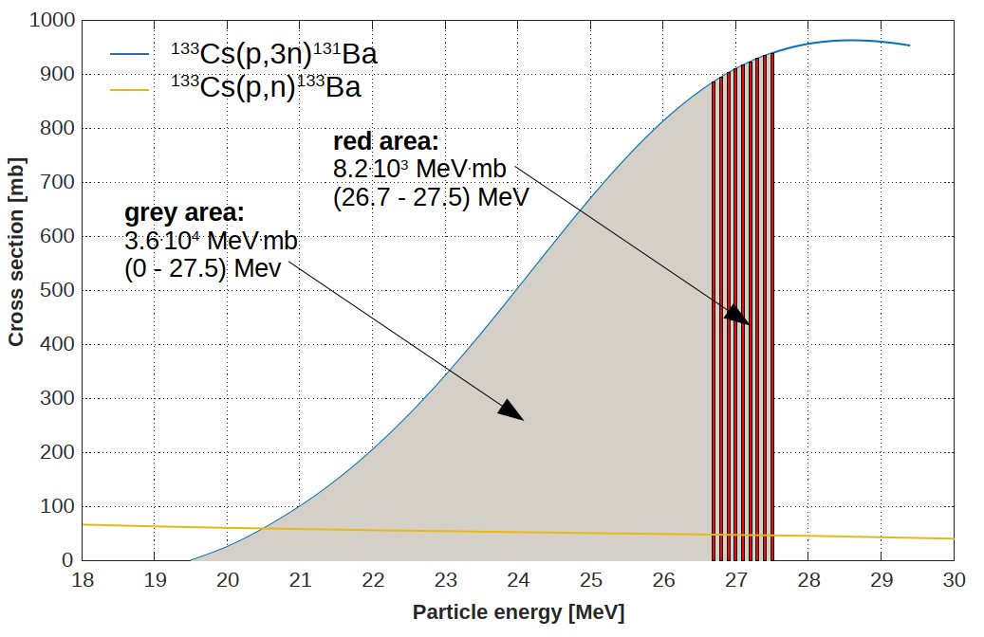
Results and discussion
Target preparation and irradiation:
Nuclear reaction: ¹³³Cs(p,3n)¹³¹Ba
Production: irradiation of 80 mg CsCl (manually pressed) for 4 h, 15 µA at max. proton beam (27.5 MeV)
Excitation function for barium-131 and isotoptic side-product barium-133
F. Reissig, D. Bauer, M. Ullrich, M. Kreller, C. Mamat, J. Pietzsch, K. Kopka, H.-J. Pietzsch, M. Walther, Pharmaceuticals 2020, 13(10), 272

Slide 8
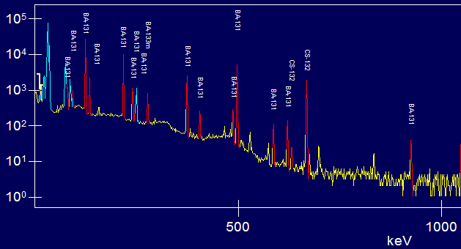
Results and discussion
Target work-up and initial characterization (gamma spectroscopy):
Target was opened after 24 h (short-lived chlorine isotopes and other activated side-products) and the material was dissolved in 500 µL of 3 M HNO₃
Gamma measurement was performed for quantification and determination of potential side products to be separated:
190 MBq barium-131 were produced per irradiation
Determined side-products:
Cesium-131 (indicator for Cs/Ba separation)
Barium-133m (responsible for long-lived barium-133 (10.5 a) as isotopic impurity

Slide 9
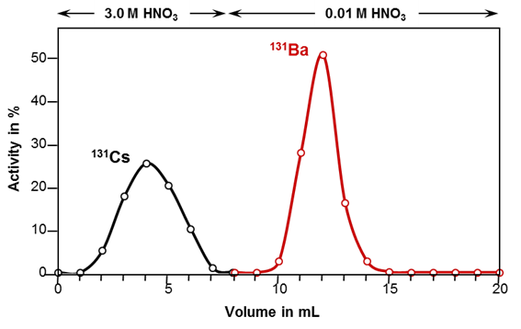
Results and discussion
Product separation using Sr Resin:
Separation procedure
Elution profile
After separation, no more cesium was detectable. Barium-131 recovery was calculated to approx. 90%. An isotopic impurity of 0.1% of long-lived barium-133 was determined via gamma spectroscopy after 10 half-lives of barium-131 and recalculated to the starting activity as reference.
F. Reissig, D. Bauer, M. Ullrich, M. Kreller, C. Mamat, J. Pietzsch, K. Kopka, H.-J. Pietzsch, M. Walther, Pharmaceuticals 2020, 13(10), 272

Slide 10
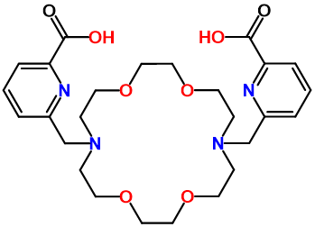
Results and discussion
Radiolabeling with macropa and quality control:
Reaction for 1 h at room temperature; reaction buffer 0.2 M ammonium acetate, ligand concentration 10⁻³M, 100 kBq
→ Quantitative labeling under the applied c conditions, less ligand concentration lllllleads to insufficient labeling yield
Stationary phase:
normal phase silica
Mobile phase:
50 mM EDTA, pH7
macropa
Reaction control was performed using two TLC systems: one normal phase system (free barium reference A at R_{f} = 0.3 and labeled macropa C at the origin) and one reversed phase system with reference B staying at the origin and complex D moving with the front.
Stationary phase:
reversed phase CN
Mobile phase:
ACN/H₂O 70/30 (V/V)
F. Reissig, D. Bauer, M. Ullrich, M. Kreller, C. Mamat, J. Pietzsch, K. Kopka, H.-J. Pietzsch, M. Walther, Pharmaceuticals 2020, 13(10), 272

Slide 11
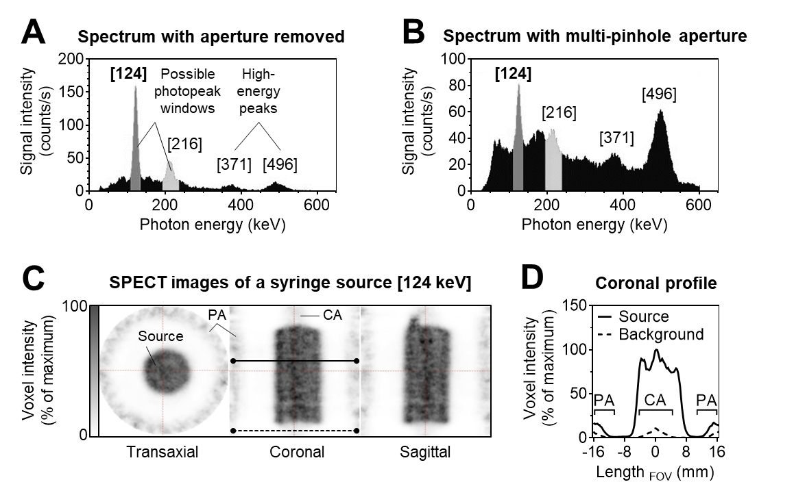
Results and discussion
Detector setup:
Two low-energy peaks for SPECT imaging and two high energy peaks (A)
496 keV peak may be problematic and cause some issues
Best phantom profile obtained for using the 124 keV window (some artifacts may be caused by high energy photon emission)
A – system without collimators
B – system with collimators
C – syringe phantom
D – coronal voxel intensity profile of C
F. Reissig, D. Bauer, M. Ullrich, M. Kreller, C. Mamat, J. Pietzsch, K. Kopka, H.-J. Pietzsch, M. Walther, Pharmaceuticals 2020, 13(10), 272

Slide 12
Results and discussion
Small animal SPECT/CT and biodistribution studies:
F. Reissig, D. Bauer, M. Ullrich, M. Kreller, C. Mamat, J. Pietzsch, K. Kopka, H.-J. Pietzsch, M. Walther, Pharmaceuticals 2020, 13(10), 272

Slide 13
Results and discussion
Insights from animal SPECT/CT and biodistribution studies:
In accordance with previous phantom experiments, imaging quality is best by only using the 124 keV window for imaging.
Nevertheless, imaging is not usable for quantification without further system development, due to high energy emissions at 496 keV.
Organs and skeleton are pictured clearly and discriminable.
Organ distribution studies illustrate the expected massive accumulation of free barium ions in the bones, already occurring 5 minutes after i.v. injection.
In contrast, barium-131-labeled macropa shows a significantly lower bone accumulation and a fast renal clearance.

Slide 14
Conclusions
Barium-131 is a well-functioning gamma emitter for SPECT imaging on small animal level.
Further improvement the collimator setup by installing high energy collimators will potentially enable quantitative imaging.
The production and purification process is established and can be further developed and easily scaled up for human use. The isotopic impurity of 0.1% barium-133 is complexed and excreted as well, should not lead to any dosimetric issues (gamma emitter) and is therefore not problematic.
The test labeling of macropa with barium-131 prefigures a high potential of this substance class for the further development of a suitable chelator for barium/radium ions, even at low ligand concentration values – based on the K2.2 scaffold.

Slide 15
Thank you for you interest in reading this presentation ☺
Alpha Emitters Group
Institute of Radiopharmaceutical Cancer Research
Helmholtz-Zentrum Dresden-Rossendorf
https://www.hzdr.de/db/Cms?pNid=727

