Slide 1
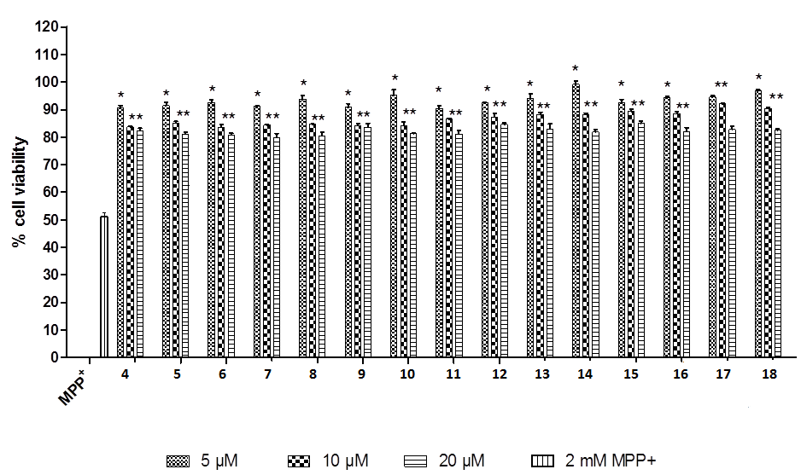
EVALUATION OF THE NEUROPROTECTIVE POTENTIAL IN MPP⁺-INDUCED NEURODEGENERATION OF NEW HETEROCYCLIC COMPOUNDS BASED ON PYRAZOLOPYRIDINE SCAFFOLD
Mohammed Loubidi ^{1,2}, Jabrane Jouha ^{2,3}, Zahira Tber ², Güliz Armagan ⁴
(1) Department of Chemistry, FST Mohammedia, University of Hassan II, BP 146, 28800, Mohammedia, Morocco (2) Institut de Chimie Organique et Analytique (ICOA), Université d’Orléans, BP 6759, 45067 Orléans cedex 2, France; (3) School of Chemistry and Chemical Engineering, Hunan University, BP, 410082, Changsha, China (4) Department of Biochemistry, Faculty of Pharmacy, Ege University, 35100 Bornova, Izmir, Turkey.
The interest for the synthesis of the pyrazolo[3,4-b]pyridines has increased in organic and pharmaceutical chemistry. This heterocyclic system is found in a number of molecules possessing biological and/or pharmacological properties. In this study, first we aim to synthesize potential neuroprotective heterocyclic compounds based on pyrazolopyridine derivatives and then to evaluate their neuroprotective and antiapoptotic effects in Parkinson’s disease model. Human neuroblastoma cell line SH-SY5Y was employed and MPP⁺ was used to generate PD model in vitro. Western blot analysis was made to assess the apoptotic effect of MPP⁺ on SH-SY5Y cells and the potential neuroprotective effects of the synthesized compounds.
1 - Synthetic strategies / Pharmacomodulations
Scope of Suzuki-Miyaura cross coupling of 4
2 - Biological studies
Cell viability studies
Fig .1. Evaluation of cell viability of SH-SY5Y cells exposed to various concentrations (0.1-10 mM) of MPP⁺ at indicated times. Cells were treated for 12, 24, 36 and 48 h at 37°C. Data represent the mean ± SD of at least six independent experiments in triplicate and are expressed as percentage of control cells.
Fig .4. The changes in bax, caspase-3, Bcl-2 and Bcl-xl protein levels following 5 µM 8, 10, 13, 14, 16 or 18 against 2 mM MPP+-induced apoptosis. Representative Western blots showing protein expression of protein levels following treatments. Graphs indicate the relative densitometric values of indicated proteins. Quantification of protein product was performed by densitometric scanning. Data are normalized by using the β-actin signal and expressed as arbitrary densitometric units. Values are means ± SD; n = 3 in each group. *p<0.05 significant difference from MPP⁺-treated cells.
Fig.2. Effects of newly synthesized compounds on cell viability in MPP⁺-induced dopaminergic cell death. All values are means ± SDs (n = 5). * p<0.05 significant difference from MPP⁺ and 10 or 20 µM concentrations of compound treatments. ** p<0.05 significant difference from MPP⁺-treated cells..
Compound | % Neuroprotection | Compound | % Neuroprotection
4 | * at 10 and 20 µM/** at 5 µM | 11 | * at 10 and 20 µM/** at 5 µM
5 | * at 10 and 20 µM/** at 5 µM | 12 | * at 10 and 20 µM/** at 5 µM
6 | * at 10 and 20 µM/** at 5 µM | 13 | * at 10 and 20 µM/** at 5 µM
7 | * at 10 and 20 µM/** at 5 µM | 14 | * at 10 and 20 µM/** at 5 µM
8 | * at 10 and 20 µM/** at 5 µM | 15 | * at 10 and 20 µM/** at 5 µM
9 | * at 10 and 20 µM/** at 5 µM | 16 | * at 10 and 20 µM/** at 5 µM
10 | * at 10 and 20 µM** at 5 µM | 17 | ** at 5 and 10 µM/* at 20 µM
 |  | 18 | ** at 5 and 10 µM/* at 20 µM
Fig .5. The changes in bax, caspase-3 and Bcl-xl protein levels following 1 µM 8, 10, 13, 14, 16 or 18 against 2 mM MPP+-induced apoptosis. Representative Western blots showing protein expression of protein levels following treatments. Graphs indicate the relative densitometric values of indicated proteins. Quantification of protein product was performed by densitometric scanning. Data are normalized by using the β-actin signal and expressed as arbitrary densitometric units. Values are means ± SD; n = 3 in each group. *p<0.05 significant difference from MPP⁺-treated cells.
The percentage of neuroprotection-induced by compounds against MPP⁺-induced neurotoxicity in SH-SY5Y cells. *Neuroprotection is between 10%-20%. ** Neuroprotection is between 20%-30%.
Protein analysis
3 – Conclusion / References
In conclusion, our results provide an evidence that these heterocyclic compounds based on pyrazolopyridine scaffold have a role on dopaminergic neuroprotection. The neuroprotection of the compounds against MPP⁺-induced apoptosis may be associated with the regulation of pro- and anti-apoptotic proteins, oxidative stress and downregulation of caspase-3 activation. According to our results, we suggest that these compounds, particularly most active ones, can be used for potential novel therapies in the treatment of Parkinson’s disease.
[1] J. Jouha , M. Loubidi, J. Bouali, S. Hamri, A. Hafid, F. Suzenet, G. Guillaumet , T. Dagcı , M. Khouili, F. Aydın, L. Saso, G. Armagan, Eur. J. Med. Chem. 129 (2017) 41-52.
[2] S. Fadel, F. Suzenet, A. Hafid, E.M. Rakib, M. Khouili, M.D. Pujol, G. Guillaumet, J. Heterocycles. Chem. 46 (2009) 1177-1184.
[3]R.L. Jayaraj, K. Tamilselvam, T. Manivasagam, N. Elangovan, J. Mol. Neurosci. 51 (2013) 863-870.
Fig .3. The changes in proapoptotic bax protein levels following MPP⁺ treatments for 3, 6, 12, 24, 48 h in SH-SY5Y cells. *p≤0.05 significant difference from control group and 3 or 6 hours MPP⁺- treated cells

