Slide 1


Targeting lipid kinase PIP5K1α as a promising strategy for the treatment of castration-resistant prostate cancer
Ehab El-Awaad ^{1,2,}*, Katja Strätker ¹, Samer Haidar ³, Ángel Amesty ⁴, Claudia Götz ⁵, Ana Estévez-Braun ⁴, and Joachim Jose ¹
¹ Institut für Pharmazeutische und Medizinische Chemie, PharmaCampus, Westfälische Wilhelms-Universität Münster, Corrensstr. 48, 48149 Münster, Germany;
² Department of Pharmacology, Faculty of Medicine, Assiut University, Assiut 71515, Egypt;
³ Faculty of Pharmacy, 17 April Street, Damascus University, Syria;
⁴ Instituto Universitario de Bio-Orgánica Antonio González, Departamento de Química Orgánica, Universidad de La Laguna, Avda. Astrofísico Francisco Sánchez Nº 2, 38206, La Laguna, Tenerife, Spain;
⁵ Medical Biochemistry and Molecular Biology, Saarland University, D-66424 Homburg, Germany.
* Corresponding author: ehab.elawaad@uni-muenster.de

Slide 2
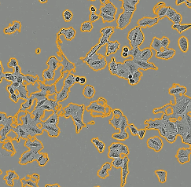
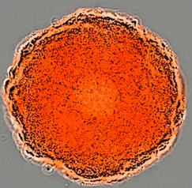
Targeting lipid kinase PIP5K1α as a promising strategy for the treatment of castration-resistant prostate cancer
Graphical Abstract
PIP5K1α
2D culture
PIP
PIP2
Fluorescence
inhibitor screening
anticancer effects
CE-based assay
live cell imaging
IC₅₀ = 1.55 µM
Time
3D culture
spheroids

Slide 3
Abstract:
Phosphoinositides are a family of tiny cellular lipids formed through a series of phosphorylation processes catalyzed by enzymes termed phosphatidylinositol-phosphate kinases (PIPKs). The phosphatidylinositol 4-phosphate 5-kinase type 1 α (PIP5K1α) is the main isoform responsible for generating membrane pools of phosphatidylinositol-4,5-bisphosphate (PIP2), which, in turn, serves as a substrate for the well-established cancer-relevant target, phosphatidylinositol 3-kinases (PI3Ks). Recent studies provide strong evidence for a key role of PIP5K1α isoform in the development of prostate and breast cancers indicating that targeting this kinase could offer an effective therapeutic strategy in certain types of cancer.
To identify small molecules that can directly inhibit the catalytic activity of PIP5K1α, we developed a robust nonradiometric assay to determine the activity of recombinantly expressed human PIP5K1α in bacterial cell lysates. This assay is based on the separation of a fluorescently labelled PIP5K1α substrate and its corresponding enzymatically phosphorylated product by capillary electrophoresis (CE).
Here, a compound with a 2‐amino‐3‐cyano‐4H‐pyranobenzoquinone scaffold is presented as an example of potent inhibitors of human PIP5K1α identified recently in our lab using the developed CE-based assay. This compound exhibited potent inhibitory effect on PIP5K1α activity with an IC₅₀ value of 1.55 µM, in a substrate‐competitive mode of action. Furthermore, its ability to induce anticancer effects in 2D and 3D cell culture experiments was evaluated. The identified compound may provide the basis for developing highly potent and selective inhibitors of PIP5K1α in cancer cells.
Keywords: capillary electrophoresis; enzyme inhibitor; lipid kinase; PIP5K1α; prostate cancer

Slide 4
Introduction-Phosphoinositides
Essential polyphosphorylated lipids docked in eukaryotic cell membrane
Biogenesis mediated by a family of lipid kinases, phosphatidylinositol-phosphate kinases (PIPKs)
PIP5K1α responsible for generating membrane pools of PIP2 from PI(4)P
PIP2 is involved in several cell signalling pathways
Plasma membrane
Cytoplasm
2
PI(4)P: phosphatidylinositol-4-phosphate
PIP2: phosphatidylinositol-4,5-bisphosphate
hPIP5K1: human phosphatidylinositol 4-phosphate 5- kinase type 1 α (PIP5K1α)

Slide 5
Introduction- PIP5K1α as a target in treatment of castration-resistant prostate cancer (CRPC)
Upstream activator of PI3K through modulating PI3K/AKT/mTOR pathway
Potential crosstalk with androgen receptor (AR)-mediated signalling
overexpression is reported in aggressive forms of prostate and breast cancers
PIP5K1α plays important roles in growth and invasion of malignant prostate (and possibly other) tumors
PTEN: phosphatase and tensin homologue; PI3K: phosphatidylinositol 3-kinase; AKT: protein kinase B; mTORC1: mammalian target of rapamycin complex 1; DHT: dihydrotestosterone; AR: androgen receptor; AR-V7: constitutively active AR variant V7

Slide 6
Results and discussion-Capillary electrophoresis-based kinase activity assay for PIP5K1α
Fluorescence [%]
Time [min]
For detailed inforamtion on the detailed assay setup please refer to
Strätker, K. et al. FEBS J, 287: 3042-3064 (2020)

Slide 7
Results and discussion-Screening of Pyranobenzoquinone derivatives for inhibitors of human PIP5K1α
Compound concentration = 50 µM
Relative enzyme activity [%]
For detailed inforamtion on the structural features of the compounds tested please refer to
Strätker, K. et al. FEBS J, 287: 3042-3064 (2020)

Slide 8
Results and discussion-IC₅₀ determination of PMA-31
Compound concentration = 50 µM
diketopiperazine fused C-1
indol-3-yl substituted 1,2,3,4-tetrahydroisoquinoline
IC₅₀ value = 1.55 µM
Relative enzyme activity [%]
Enzyme Inhibition [%]
PMA-31
ISA-2011B
PMA-31 concentration [µM]
PMA-31 is the most potent direct inhibitor of the catalytic activity of PIP5K1α identified in the screen
The recently reported PIP5K1α inhibitor (ISA-2011B) does not directly inhibit the catalytic activity of the enzyme

Slide 9
Results and discussion-Investigation of the mode of inhibition of PMA-31
PMA-31 does not inhibit ATP binding to PIP5K1α but rather exhibits a substrate‐competitive inhibition of PIP5K1α

Slide 10
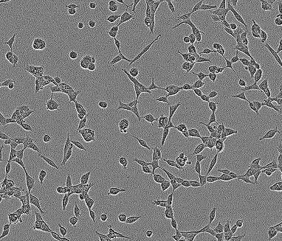
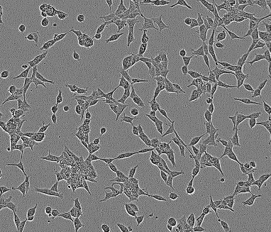
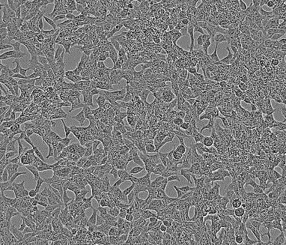
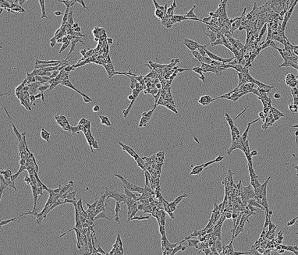
Results and discussion-Effects of PMA-31 on LNCaP prostate cancer cell line
0.5% DMSO
PMA-31 (50 µM)
0 h
72 h
PMA-31 inhibits the proliferation and induces apoptosis of 2D culture of LNCaP cells in a dose-dependent manner

Slide 11
Results and discussion-Effect of PMA-31 on the growth of spheroids of breast cancer cells
0.5% DMSO
PMA-31 (50 µM)
0 h
24 h
48 h
72 h
PMA-31 inhibits the growth of MCF7 green spheroids with a delayed onset of inhibition
96 h

Slide 12
Conclusions
Small molecule inhibitors of PIP5K1α can be identified using the developed capillary electrophoresis-based kinase assay
The pyranobenzoquinone derivative PMA-31 represents the first direct inhibitor of PIP5K1α catalytic activity with IC₅₀ = 1.55 µM
PMA-31 does not compete with ATP for its binding site but acts as a substrate competitive inhibitor
PMA-31 exhibits moderate effects on prostate and breast cancer cell lines in 2D and 3D cell culture formats,respectively
Optimization of the identified compound may lead to developing new class of highly potent and selective inhibitors of PIP5K1α in cancer cells

