Slide 1



Composition and Orientation of the Core Region of Novel HIV-1 Entry Inhibitors Influences Metabolic Stability
Rama Karadsheh ¹, and Megan Meuser ¹, Simon Cocklin ^{1*}
¹ Department of Biochemistry, Drexel University, 245 North 25th Street, Philadelphia, Pennsylvania, USA
* Corresponding author: sc349@drexel.edu

Slide 2
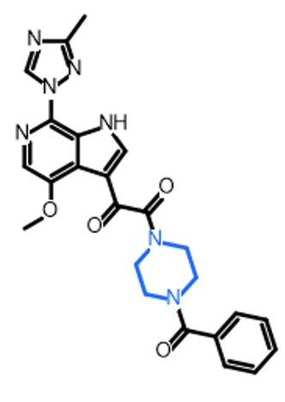

Composition and Orientation of the Core Region of Novel HIV-1 Inhibitors Influences Metabolic Stability
Graphical Abstract
Bioisosteric Replacement
Antiviral potency
SPR binding analysis
Drug-like parameter and
Metabolic stability prediction
BMS-626529

Slide 3
Abstract:
Fostemsavir/temsavir is an investigational HIV-1 entry inhibitor currently in late-stage clinical trials. Although it holds promise to be a first-in-class Env-targeted entry inhibitor for the clinic, issues with bioavailability relegate its use to salvage therapies only. As such, the development of a small molecule HIV-1 entry inhibitor that can be used in standard combination antiretroviral therapy (cART) remains a longstanding goal for the field. We previously demonstrated the ability of extending the chemotypes available to this class of inhibitor as the first step towards this overarching goal. In addition to poor solubility, metabolic stability is a crucial determinant of bioavailability. Therefore, we assess the metabolic stabilities of five of our novel chemotype entry inhibitors. We found that changing the piperazine core region of temsavir alters the stability of the compound in human liver microsome assays. Moreover, we identified an entry inhibitor with more than twice the metabolic stability of temsavir and demonstrated that the orientation of the core replacement is critical for this increase. This work further demonstrates the feasibility of our long-term goal-to design an entry inhibitor with improved drug-like qualities-and warrants expanded studies to achieve this.
Keywords: HIV-1 entry inhibitor; metabolic stability; docking; antiviral; surface plasmon resonance

Slide 4


HIV-1 Pandemic Continues to be a Global Issue
39.0 million
People currently estimated to be living with HIV
During 2019
1.7 million
0.69 million
People newly infected
HIV-related deaths

Slide 5
HIV-1 structure
Env is a heterotrimer of gp120 and gp41 dimers
  Embedded in the lipid membrane
  Sole viral protein on HIV-1 membrane
Capsid houses viral genome and replication machinery
Viral genome consists of 2 single stranded RNA molecules
Reverse Transcriptase transcribes viral RNA to viral DNA, which is incorporated into the host cells

Slide 6
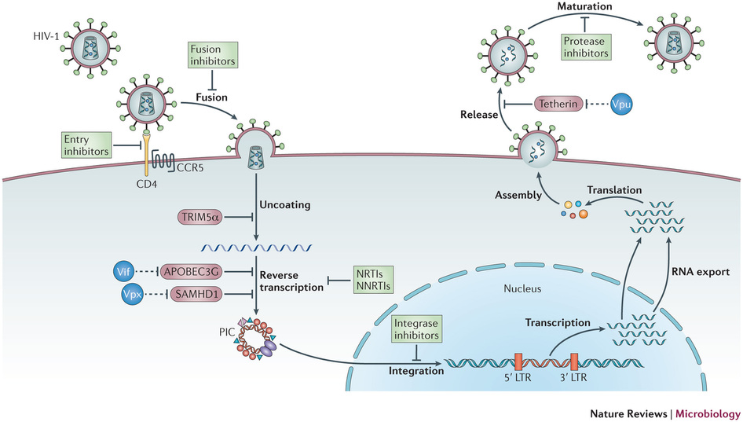
HIV-1 Replication Cycle
Current approved therapies that target different stages of the viral life cycle are highlighted by the green box.
Modified figure from Nature Reviews Microbiology 11, 877–883 (2013)

Slide 7
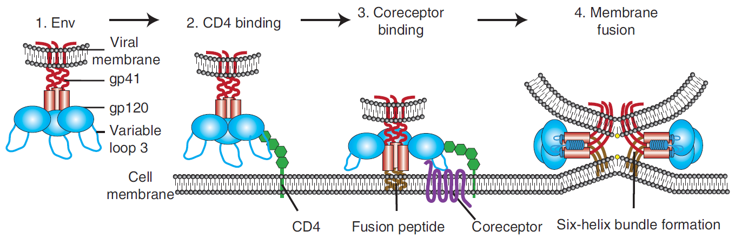
A Closer Look at HIV-1 Entry
CCR5 or CXCR4
1. Env is a trimer of gp120 and gp41 heterodimers that is conformationally metastable
2. Gp120 binds the CD4 receptor
3. Conformational rearrangements promote the gp120-CD4 complex to bind the co-receptor
4. Gp41 subunit contains a fusion peptide that inserts into the host cell membrane. Conformational rearrangements bring the viral and host cell membrane in close proximity until fusion occurs
Wilen et al., 2012. 10.1101/cshperspect.a006866

Slide 8
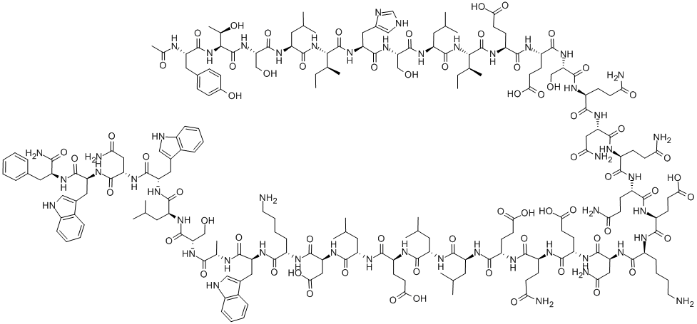
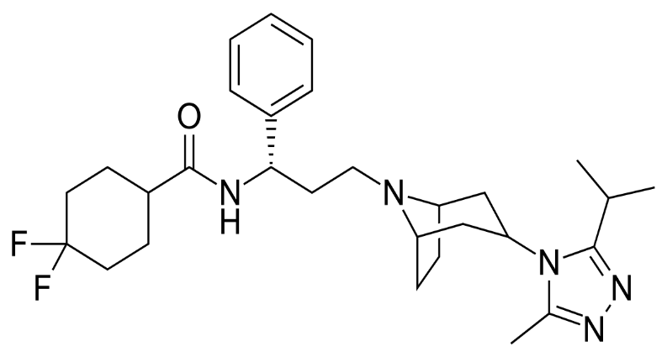
Approved Entry Inhibitors and Their Limitations…
Enfurvitide
Maraviroc
Synthetic peptide
Binds to gp41 to prevent fusion
Not available orally
Injection is necessary; however, serious reactions to local injection have been observed
Twice daily 90 mg doses
Expensive - $25,000 (22,251€) for 1 year of treatment
Targets host cell
Binds to CCR5 co-receptor to block Env binding
Inactive against viruses that us CXCR4 co-receptor
Hardy, H and Skolnik, PR. Pharmacotherapy. 2004. 24(2): 198-211.
MacArthur, RD and Novak, R. Clinical Infectious Diseases 2008. 47(2):236-241.

Slide 9
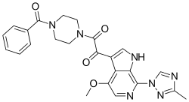
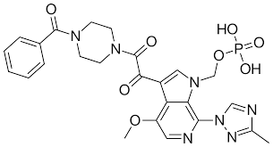
Env-targeting Attachment Inhibitors
Temsavir (BMS-626529)
  Piperizine-based chemotype
  Potent against many HIV-1 subtypes
  Low solubility
  Poor bioavailability
Fostemsavir (BMS-663068)
  Phosphooxymethyl prodrug of temsavir
  FDA approved in July 2020
  Suboptimal solubility after cleavage of the prodrug
  Breadth issues against specific HIV-1 subtypes
  Only recommended for treatment-experienced patients = limited therapeutic opportunity
  Expensive - $7,650 for 30 day supply.
Temsavir
Fostemsavir
Cahn, P., Fink, V., and Patterson, P.. Curr Opin HIV AIDS. 2018. 13(4):341-345.

Slide 10
Can we design an entry inhibitor that has a similar binding site, but has better solubility and metabolic stability than BMS-626529 (Temsavir)?

Slide 11
Multi-step Computational Design Workflow
Bioisosteric replacement
(Spark software; Cresset, UK)
Affinity prediction
(SeeSAR software; BioSolveIT GmbH)
Predicted drug-like properties analysis
(StarDrop software; Optibrium, UK)
Docking of best compounds
(AutoDock Vina; La Jolla, CA, USA)
Synthesis and testing

Slide 12
Bioisosteric Replacement Identifies Novel Scaffolds with Inhibitor Activity
piperazine
dipyrrolidine
pyrrolo-pyrazole
azetidine
azabicyclo-hexane
(reversed)
dimethyl-piperazine
azabicyclo-hexane

Slide 13
SC Derivatives Retain Binding to HIV-1 B41 Env SOSIP Trimers
SC46
SC54
Surface Plasmon Resonance (SPR) experiments show SC compounds bind to immobilized Env mimic (SOSIP)
k_{a} = association rate
k_{d} = dissociation rate
K_{D} = binding affinity

Slide 14
In silico Prediction of Drug-like Metrics
SC derivatives did not exhibit increased solubility compared to temsavir (BMS-626529)
SC12 had overall improved oral non-CNS drug profile score
Aqueous solubility
Prediction of drug-like metrics
Value range from 0 (non-drug like) → 1 (perfect drug)
StarDrop 6.6 (Optibrium, Ltd., Cambridge, UK)

Slide 15
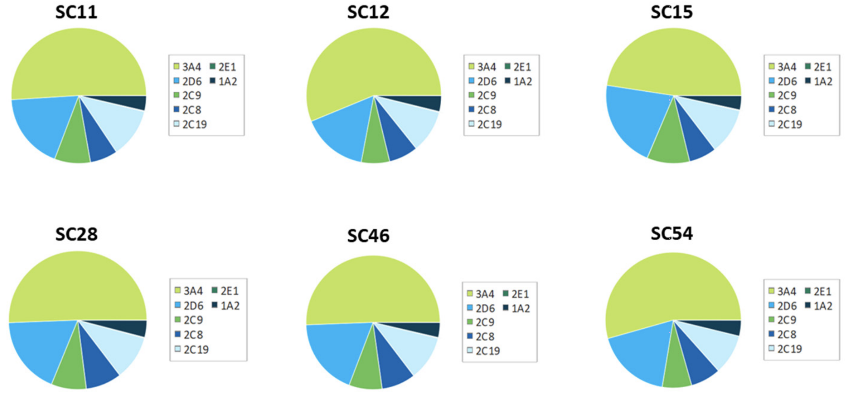
Computational Investigation of Metabolic Stability
Orally administered drugs may be adversely metabolized before adequate plasma concentrations are reached
Computational investigation of metabolic stability of SC compounds using P450 module (StarDrop 6.6 (Optibrium, Ltd., Cambridge, UK))
SC compounds are predicted to be primarily metabolized by P450 isoform CYP3A4 (lime green)

Slide 16
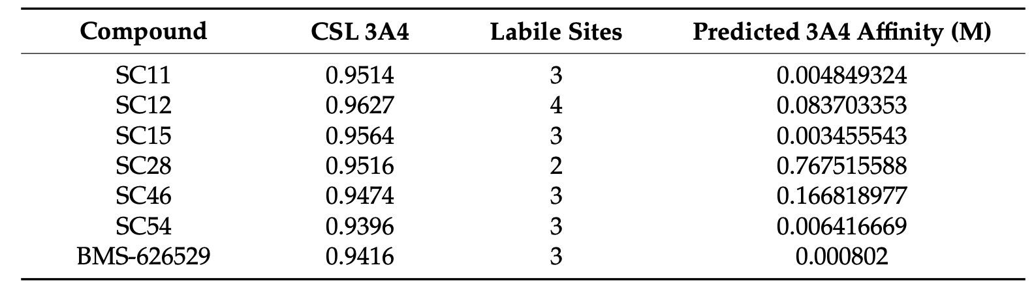
Prediction of Metabolic Lability of SC Compounds Against CYP3A4
CSL score reflects overall efficiency of compound metabolism by CYP34A
Observed minimal differences of CSL scores and labile sites on SC compounds compared to BMS-626529
This analysis assumes compounds bind to CYP3A4 with similar binding affinities
  Predicted binding affinities were determined using HYDE (hydrogen bond and dehydration) energy scoring functions (SeeSAR 9.2)
SC28 and SC46 have greater predicted metabolic stability compared to the other SC derivatives
SC12 has the lowest predicted metabolic stability

Slide 17
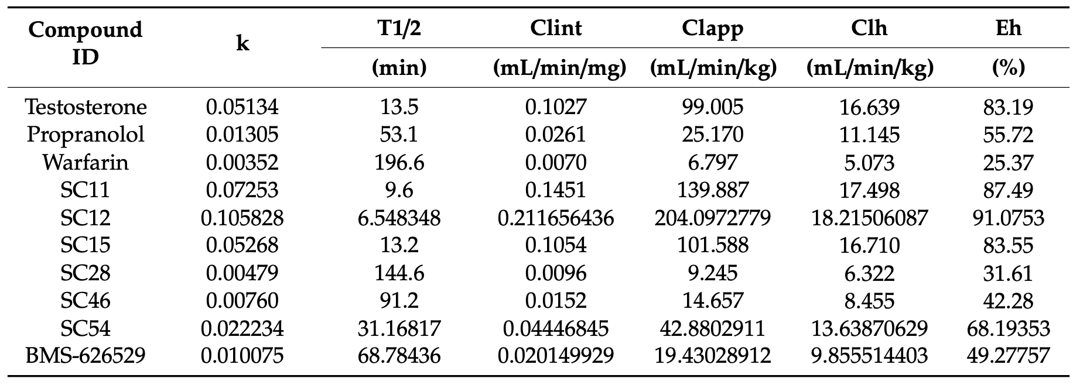
Metabolic Stability Assays Using Human Liver Microsomes & Predictive Pharmacokinetic (PK) Parameters
Testosterone → low stability; Propranolol → medium stability; Warfarin → high stability
Half-lives (T½) of SC compounds exhibit a range of stabilities
SC28 and SC46 have the longest half-lives
SC12 has the shortest half-life

Slide 18
Conclusions
Successfully used bioisosteric replacement to redesign the piperazine core of BMS-626529
Showed SC compounds retained binding to HIV-1 Env recombinant mimic via SPR analysis
Computationally investigated and compared solubility, metabolic stability and metabolic lability of BMS-626529 with SC compound derivatives
Concluded that replacement (and orientation) of the piperazine core influences metabolic stability
Established a computational workflow for next-generation compounds that includes metabolic stability prediction in the design process

Slide 19





Acknowledgements
Simon Cocklin, PhD (Drexel)
Megan Meuser, PhD candidate (Drexel)
Gabriel Ozorowski, PhD (Scripps)
Andrew B. Ward (Scripps)
Funding
1R56AI118415-01A1
1 R01 GM125396-01A1
T32-MH079785

