Slide 1


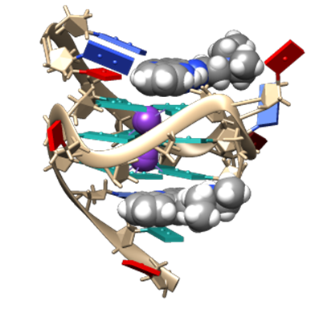
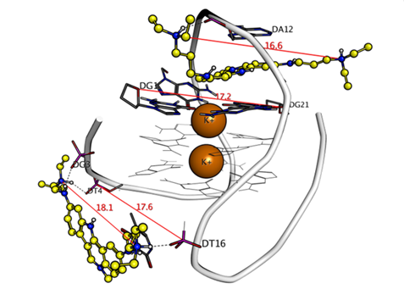
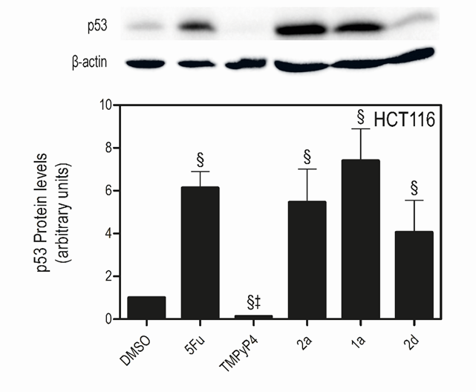


New procedure for the synthesis of indolo[3,2-b]quinoline derivatives with DNA G-quadruplex stabilization capacity
Adriana M. D. Silva¹, Eduarda Mendes¹, Maria M. Santos¹, Alexandra Paulo¹
¹Research Institute for Medicines, Faculty of Pharmacy, Universidade de Lisboa, Portugal
Email: adrianamsilva@campus.ul.pt, mapaulo@ff.ulisboa.pt
Introduction
Cancer is one of the leading causes of death worldwide and the occurrence of resistance to common anticancer drugs demands new and innovative drug design approaches. G-quadruplexes (G4s) DNA structures in oncogenic promoter regions (of c-MYC and KRAS oncogenes, for example) and telomeres are potential targets for cancer therapy. Small molecules could serve as DNA G4 stabilizers and down-regulate the targeted gene expression leading to induction of programmed cell death by apoptosis [1][2].
Indolo[3,2-b]quinoline and indolo[3,2-c]quinoline derivatives were previously reported as stabilizers of G4 DNA structures (Figure 1) and promising selective anticancer leads, as these compounds are able to preferentially target the G4 motifs in the KRAS promoter and inhibit the transcription and translation of this oncogene, inducing apoptosis of KRAS-dependent colon cancer cells by up-regulating the expression of the pro-apoptotic transcription factor p53 (Figure 2) [3][4]. Activation of p53 by small molecules is also expected to be a valuable approach in fighting cancer. In this area of research, we have previously identified other promising indole-based compounds with activity as p53 gene expression or p53 function activators [5][6]. Thus, the improvement of the synthetic procedures of these compounds are highly relevant. Herein we describe an alternative experimental procedure for the synthesis of 7-carboxylate indolo[3,2-b]quinoline tri-alkylamine derivatives 1a and 2a.
A
B
Figure 2 - Exposure to indolo[3,2-b]quinoline derivatives 1a and 2a increases p53 steady-state protein expression in HCT116 cells. (Figure from [3])
Figure 1 - A) Structure of 2:1 complex of an indolo[3,2-b]quinoline derivative with c-MYC promoter G4 (PDB ID: 2L7V). B) Molecular modelling 2:1 complex of an indolo[3,2-c]quinoline derivative with antiparallel human telemore G4 (PDB ID: 143D).[7]
Synthetic Procedures
Compounds 1a and 2a were synthesized as previously described [3], with the following modifications:
Synthesis of intermediate 5:
Work-up procedure for intermediate 6:
Spectra
a)
Previous Procedure and yield | Present Procedure and yield
A mixture of compound 4 and 4-ethylaminobenzoate in DMF was placed in a microwave apparatus, at 300 W, 140ºC, for 4 hours. Yield: 62 %. | A mixture of compound 4 and 4-ethylaminobenzoate in DMF was heated at 140ºC in a pressure tube for 6 hours. Yield: 40-60 %.
Previous Procedure and yield | Present Procedure and yield
The reaction mixture is basified to pH 4 with KOH and the product is isolated by liquid-liquid extraction with ethyl acetate. Yield: 20 %. | The reaction mixture is basified to pH 4 with KOH and the dark green sticky precipitate that is formed is filtered and then dissolved in metanol. The solubilized product is separated from unsoluble by-products by filtration. Yield: 66 %.
b)
Indolo[3,2-b]quinoline 2a preferentially binds and stabilize DNA G4 than ds-DNA. Melting temperature variations (ΔTm) of labeled G4s present in promoters of k-RAS (KRAS), human telomere (F21T) and hairpin loop sequence (T-loop) at 0.2 μM, stabilized by compound 2a. ΔTm values are averages from a triplicate experiment; std errors < 0.25 °C.
Conclusions
With the herein reported alternative method for the synthesis of intermediate 5 the microwave apparatus can be replaced by a pressure tube, a much more economic lab equipment.
An improved work-up procedure to obtain intermediate 6 is also here reported. With this procedure the yield increases from 20% to 66%.
c)
Figure 3- Proton NMR of compounds 5 (a)), 6 (b)) and 2a (c))
References
[1] A. Paulo, C. C. Castillo, and S. Neidle, “Targeting Promoter Quadruplex Nucleic Acids for Cancer Therapy,” in Comprehensive Medicinal Chemistry III, Third Edit., vol. 5–8, Elsevier, 2017, pp. 308–340.
[2] A. R. Duarte, E. Cadoni, A. S. Ressurreição, R. Moreira, and A. Paulo, “Design of Modular G-quadruplex Ligands,” ChemMedChem, vol. 13, no. 9, pp. 869–893, May 2018.
[3] H. Brito et al., “Targeting KRAS Oncogene in Colon Cancer Cells with 7-Carboxylate Indolo[3,2-b]quinoline Tri-Alkylamine Derivatives,” PLoS One, vol. 10, no. 5, p. e0126891, May 2015.
[4] J. Lavrado et al., “KRAS oncogene repression in colon cancer cell lines by G-quadruplex binding indolo[3,2-c]quinolines,” Sci. Rep., vol. 5, no. 1, p. 9696, Sep. 2015.
[5] V. Barcherini et al., “Potency and Selectivity Optimization of Tryptophanol‐Derived Oxazoloisoindolinones: Novel p53 Activators in Human Colorectal Cancer,” ChemMedChem,
doi.org/10.1002/cmdc.202000522, July. 2020.
[6] Amaral JD, Silva D, Rodrigues CMP, Solá S and Santos MMM. A Novel Small Molecule p53 Stabilizer for Brain Cell Differentiation. Front. Chem. 2019, 7:15.
[7] J. Lavrado et al., “Indolo[3,2- c ]quinoline G-Quadruplex Stabilizers: a Structural Analysis of Binding to the Human Telomeric G-Quadruplex,” ChemMedChem, vol. 10, no. 5, pp. 836–849, May 2015.
Acknowledgments
This work was supported by National Funds (Fundação para a Ciência e Tecnologia) through iMed.ULisboa (UIDB/04138/2020) and project PTDC/QUI-QOR/29664/2017

