Slide 1
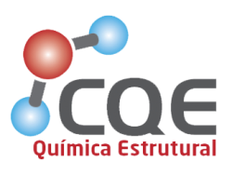
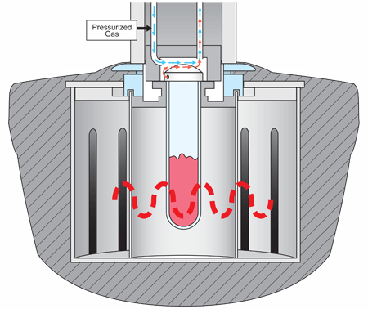
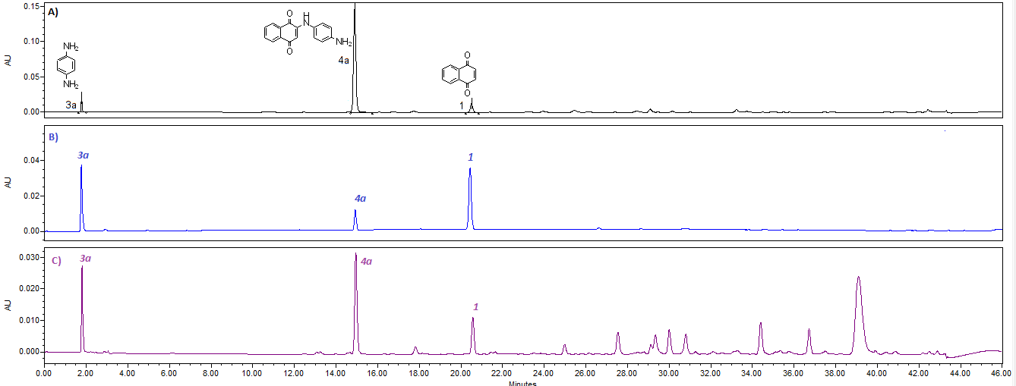
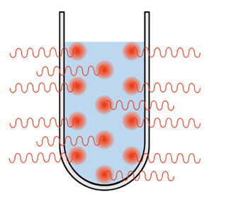
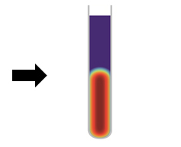
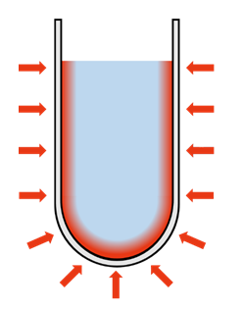
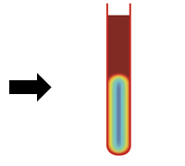
Synthesis of 1,4-naphthoquinones derivatives under non-conventional conditions and in silico studies
Ana Catarina Sousa^{a,b}*, Rafaela Cabral^{a,b} , João Costaª and Maria Paula Robalo^{a,b}
a) Área Departamental de Engenharia Química, Instituto Superior de Engenharia de Lisboa, Instituto Politécnico de Lisboa, 1959-007 Lisboa, Portugal.;
b) Centro de Química Estrutural, Instituto Superior Técnico, Universidade de Lisboa, 1049-001 Lisboa, Portugal.
*acsousa@deq.isel.ipl.pt
INTRODUCTION
Naphthoquinones have played a crucial role in the drug discovery research and have been used widely as important pharmacophores or intermediate for the synthesis of bioactive compounds. These heterocyclic compounds are known to exhibit a diverse range of biological properties, such as antimicrobial, antitumor, antioxidant, antimalarial, neuroprotectant, among others.¹⁻³ Their mechanisms of action are related to their redox properties and their capacity to accept one or two electrons to generate highly reactive radical species that can easily interact with biological molecules like DNA, enzymes and proteins.⁴ Despite the 1,4-naphthoquinone (1) and 5-OH-1,4-naphthoquinone (2) skeletons present reactivity, this can be enhanced by functionalization of 1,4-naphthoquinone ring.
Amines moieties are ubiquitously present in a wide range of compounds with proved biological activities.⁵ Their present plays a key role in many bioactive compounds. By introducing amino substituents on the quinone moiety, its redox properties can be tuned to induce oxidative stress in cells and to alkylate DNA.⁶ Also, the incorporation of thio, halo or alkyl/aryl groups into quinones improve their antifungal, antibacterial and cytotoxic activities.⁷ Driven by these facts and motivated by the principles of green chemistry, herein we report the microwave synthesis of 1,4-NQ and 5-OH-1,4-NQ derivatives (Scheme 1), their structural characterization and in silico studies.
Scheme 1. Naphthoquinone aryl and alkylamine derivatives
MICROWAVE SYNTHESIS
In silico STUDIES
In order to find the optimized MW synthesis conditions, initial screening reactions were performed with equimolar quantities in different solvents (ethanol, acetone and acetonitrile) and without solvent. Power was fixed to 200 w and reaction time was changed from 5 to 20 minutes. Different bases (CaCO₃, K₂CO₃, NaHCO₃) were also tested. Reactions were followed by HPLC and Figure 1 illustrate the HPLC profiles for the synthesis of 4a.
In the present study Molinspiration software was used to estimate Lipinski’s rule of 5 (RO5) parameters and bioactivity scores. In general, all compounds were found to be in good agreement with RO5 criteria, with polar surface areas smaller than 90 Å (except compound 5a: 92.42 Å) which indicates that these molecules could penetrate the blood-brain barrier and thus act on receptors in the central nervous system. No violations to RO5 were found. The bioactivity scores for different parameters such as binding to G protein-coupler receptor (GPCR) ligand, nuclear receptor ligand, ion channel modulation, kinase inhibition, protease inhibition and enzyme activity inhibition are presented in Table 2.
Compound | Table 2. Parameters of bioactivity scores estimated using Molinspiration software
 | GPCR ligand | Ion channel modulator | Kinase inhibitor | Nuclear receptor ligand | Protease inhibitor | Enzyme inhibitor
1,4- NQ | -0.94 | -0.46 | -0.77 | -1.00 | -1.10 | -0.34
4a | -0.11 | -0.25 | 0.46 | -0.60 | -0.30 | 0.20
4b | -0.12 | -0.28 | 0.40 | -0.12 | -0.40 | -0.14
4c | -0.19 | -0.41 | 0.32 | -0.26 | -0.42 | 0.02
4d | -0.11 | -0.32 | 0.47 | -0.13 | -0.33 | 0.12
4e | -0.17 | -0.32 | -0.02 | -0.37 | -0.42 | 0.23
4f | -0.19 | -0.31 | 0.19 | -0.74 | -0.33 | 0.29
4g | -0.19 | -0.36 | -0.06 | -0.46 | -0.62 | 0.04
5OH-1,4-NQ | -0.79 | -0.3 | -0,49 | -0.51 | -0.84 | -0.01
5a | -0.07 | -0.19 | 0.57 | -0.09 | -0.17 | 0.35
5b | -0,10 | -0.24 | 0.49 | 0.03 | -0.27 | 0.26
5c | -0.14 | -0.32 | 0.42 | -0.03 | -0.29 | 0.18
5d | -0.07 | -0.26 | 0.56 | 0.11 | -0.21 | 0.27
5e | -0.10 | -0.23 | 0.15 | -0.04 | -0.25 | 0.43
5f | -0.11 | -0.21 | 0.36 | -0.36 | -0.15 | 0.50
5g | -0.12 | -0.27 | 0.12 | -0.13 | -0.44 | 0.25
Figure 1. HPLC profiles of MW synthesis of 4a; A) Acetonitrile (2mL), 1 eq CaCO₃; B); Acetonitrile (2 mL), without CaCO₃; C) Acetone (2 mL) , 1 eq CaCO₃. Power:200 w (All reactions)
For 1,4-NQ reactions, acetonitrile showed to be the best solvent and CaCO₃ was essential to increase yields of final compounds 4a-d and was not used in the synthesis of 4e-g, due to the higher nucleophilicity of alkyl amines. For 5-OH-1,4-NQ similar results were found, however the presence of CaCO₃ was counterproductive and consequently yields of arylamines derivatives decreased.
The synthesis of desirable compounds were performed under optimized conditions using a CEM Discover SP microwave reactor and were also conducted with conventional heating (oil bath) at reflux. All reactions were monitored by HPLC and achieved yields are presented in Table 1.
In general, the bioactivity scores increase with the incorporation of aryl and alkylamines into the 1,4-NQ and 5-OH-1,4-NQ skeleton. A significant improvement is observed for protein kinase inhibitor which can be used to treat diseases due to hyperactive protein kinases (including mutant or overexpressed kinases in cancer). The success of a drug candidate is determined not only by its good potential but also by a satisfactory ADME profile, so we investigated ADME properties using ADMETSar simulator. The selected properties are showed in Table 3.
Compound | Table 1. Yields (%) of naphthoquinone derivatives under microwave irradiation and conventional heating
 | Microwave irradiation |  | Conventional heating ⁴⁾
 | Time (minutes) | Yield (%) | Time (hours) | Yield (%)
4a | 10 | 76 ¹⁾ | 24 | 42
4b | 10 | 59 ¹⁾ | 4 | 64
4c | 10 | 50 ¹⁾ | 24 | 20
4d | 10 | 7 ¹⁾ | 24 | 0
4e | 5 | 73 ²⁾ | 4 | 80
4f | 5 | 66 ²⁾ | 4 | 71
4g | 5 | 65 ²⁾ | -- | --
5a | 10 | 31 ³⁾ | -- | --
5b | 10 | 24 ³⁾ | -- | --
5c | 10 | 19 ³⁾ | -- | --
5d | 10 | 0 ³⁾ | -- | --
5e | 10 | 66 ³⁾ | -- | --
5f | 10 | 78 ³⁾ | -- | --
5g | 10 | 55 ³⁾ | -- | --
Compound | Table 3. ADME properties estimated using ADMETSar simulator
 | Absorption ( values in %) |  |  | Toxicity (values in %)
 | HIA | BBB | Caco2-Permeability | AMES Toxicity | Carcinogens | Carcinogenicity (Three-class) | Acute Oral Toxicity
1,4- NQ | + (98.7) | - (25.3) | + (85.0) | + (75) | - (62.1) | No (56.3) | II (73.6)
4a | + (97.7) | + (94.7) | + (77.8) | + (68) | + (56.3) | Warning (42.6) | III (61.9)
4b | + (98.1) | + (81.9) | + (57.5) | + (66) | + (51.7) | No (50.9) | III (67.9)
4c | + (98.6) | + (94.6) | + (88.5) | + (62) | + (52.9) | Warning (43.2) | III (75.5)
4d | + (96.9) | + (96,0) | + (66.5) | + (76) | + (60.5) | No (49.3) | III (57.5)
4e | + (99.0) | + (97.2) | + (80.5) | + (53) | - (77.1) | No (64.1) | III (63.6)
4f | + (98.2) | + (96.6) | + (58.1) | + (81) | - (53.3) | No (58.9) | III (63.8)
4g | + (99.1) | + (97.4) | + (94.4) | + (64) | - (50.8) | No (44.1) | III (56.9)
5OH-1,4-NQ | + (97.9) | - (56.8) | + (82.4) | + (92) | - (64.9) | Warning (47.3) | II (72.7)
5a | + (97.1) | + (85.4) | + (72.4) | + (75) | - (53.7) | No (46.6) | III (65.1)
5b | + (97.9) | + (81.9) | + (55.0) | + (79) | - (51.1) | No (54.5) | III (64.9)
5c | + (97.9) | + (89.1) | + (83.8) | + (77) | - (57.0) | No (48.9) | III (65.7)
5d | + (96.1) | + (85.4) | + (57.5) | + (82) | - (51.1) | No (54.0) | III (56.9)
5e | + (98.6) | + (88.9) | + (54.3) | + (70) | - (75.7) | No (63.6) | III (65.7)
5f | + (97.6) | + (91.9) | - (60.6) | + (85) | - (57.8) | No (61.6) | III (69.7)
5g | + (98.8) | + (95.3) | + (93.7) | + (88) | - (62.2) | No (47.6) | III (66.5)
Equimolar quantities 50:50 mM precursor:couplers were used in all reactions. ¹⁾ Acetonitrile (2 mL), 1 eq CaCO₃, ²⁾ No solvent or CaCO₃; ³⁾ Acetonitrile (2mL), without CaCO₃; (All MW reactions were performed with 200 w Power); ⁴⁾ Reflux in 50 mL of acetonitrile and 1 eq CaCO₃.
Scheme 2. Overview of different heating methods ^{adp8}
Microwave irradiation synthesis were completed within ≤ 10 min, whereas similar reactions under conventional heating at reflux gave lower or similar yields, with comparatively longer reaction times. For arylamines derivatives (4a-d and 5a-d) yields were significantly higher for 1,4-NQ derivatives (4a-d), due to the presence of CaCO₃. For alkylamines derivatives (4e-g and 5e-g) similar results were obtained with both precursors.
Compounds were obtained by one-step Michael addition to C2 of nuclear naphthoquinone structure. Structural characterization were assigned based on their ¹H and ¹³C NMR spectra and two-dimensional NMR (HSQC and HMBC) techniques. ESI-Mass spectrometry was used to corroborate NMR data and all compounds exhibited the expected m/z signals correspondent to the protonated molecules [M+H]⁺.
In general, the AMES toxicity decreased with the incorporation of aryl and alkyl amines into the 1,4-NQ and 5-OH-1,4-NQ skeleton. All derivative compounds decreased their Acute Oral Toxicity and were classified as Category III (LD₅₀ values between 500 mg/kg and 5000 mg/kg) instead of Category II (LD₅₀ values between 50 mg/kg and 500 mg/kg) in which their precursors were inserted.
REFERENCES
CONCLUSIONS
[1] – S. Fiorito et al., Bioorg. Med. Chem. Lett. 26 (2016), 334–337. [2] – Q. Han et al., Chem. Biol. Drug. Des. 91 (2018), 681-690.
[3]- J. López et. al., Med. Chem. Res. 24 (2015), 3599-3620. [4] - D. Dmitry Aminin and Sergey Polonik, Chem. Pharm. Bull. 68 (2020), 46–57.
[5] – P. Kittakoop et al., Curr. Top. Med. Chem. 14 (2014), 239–252. [6] - A.K. Jordão et al., Eur. J. Med. Chem. 63 (2013), 196-201.
[7] – A. Kacmaz et al., Open Chem. 17 (2019), 337–345. [8] - A Chemist's Guide to Microwave Synthesis, 3rd Edition, Anton Paar.
The microwave synthesis, characterization and in silico biological parameters and activities of a series of 1,4-NQ and 5-OH-1,4-NQ derivatives have been described. Microwave synthesis showed to be an excellent green alternative to produce these compounds with relatively good yields in reaction times ≤ 10 minutes. Synthetized naphthoquinones derivatives showed promising in silico results, as indicated by their scoring functions, which showed better activities when compared to their precursors. ADME profiles revealed an increase on blood-brain barrier (BBB) penetration with the incorporation of aryl and alkyl couplers, into the nuclear scaffold and a decrease on the AMES Toxicity, suggesting that the studied compounds are promising leads for the development of selective drugs. Future studies are planned to predict the antioxidant activity and in vitro biological evaluation.
ACKNOLEGMENTS
We thank the Fundação para a Ciência e Tecnologia for financial support through projects IUD/QUI/00100/2013, PTDC/BBB-BB/0122/2014 and RECI/QEQ-QIN/0189/2012. Authors gratefully acknowledge IST-UTL NMR and MS Networks for facilities and the analysis performed by HPLC in the pHarmaLAB laboratory funded by 9ºW program of Hovione Farmaciência S.A.

