Slide 1
SOLVATOCHROMIC AND THERMOCHROMIC STUDY OF KETOCONAZOLE AND MICONAZOLE
Fernando G. Olivares ^{1,}*, María G. Barúa ¹, Francisco G. Lazcano ¹, Juan P. Escalada ¹, Graciela Pinto Vitorino ²
¹ ITA, UNPA-UARG, Av. Piloto “Lero” Rivera y Av. Gdor. Gregores S/N, (9400), Río Gallegos, Santra Cruz; ² Depto. Farmacia, CRIDECIT, FCNyCS, UNPSJB, Ruta Prov N° 1, Km. 4, (9000), Comodoro Rivadavia, Chubut.
* folivares@uarg.unpa.edu.ar

Slide 2
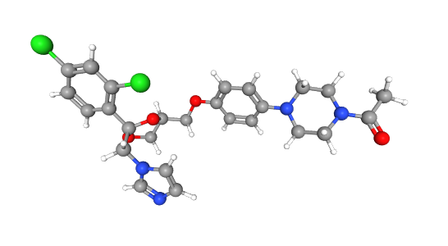
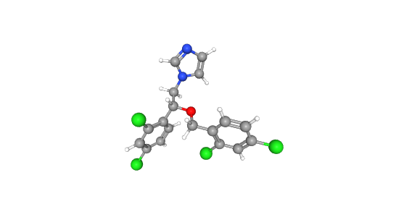
SOLVATOCHROMIC AND THERMOCHROMIC STUDY OF KETOCONAZOLE AND MICONAZOLE

Slide 3
Ketoconazole (KNZ) and miconazole (MNZ) are two of the most common topical and vaginal antifungal drugs in clinical use. Although they are imidazoles of extremely low aqueous solubility, they are presented in various pharmaceutical formulations. The purpose of this work is to analyze the solute-solvent interactions in pure solvents and the effect of temperature on KNZ and MNZ in buffer solutions at physiological pH. The study was carried out using solvatochromic and thermochromic techniques, and the multiparametric statistical analysis was performed with the method of linear solvation energy relationship of Kamlet and Taft and the Catalán method. The results showed a hypsochromic shift as the polarity of the solvents decreases. The highest relative contribution in KNZ by means of the Kamlet and Taft equation was due to the π parameter, while in MNZ it was the SP parameter by means of the Catalán equation. The thermochromic study of KNZ at physiological pH 5.00 and 7.40 allowed us to visualize a considerable increase in absorbance as temperature rises, without isosbestic points or crossovers. KNZ polarity/polarizability and MNZ polarizability are highlighted as the main non-specific interactions in solution. The hypsochromic shift observed shows that the excited state in solution is of lower polarity and higher energy than the basal state. The absorbance of KNZ observed at pH 5.00 corresponds to the higher concentration of the BH⁺ species, while at pH 7.40 it is due to the predominance of the B molecular species.
Keywords: Catalán; Kamlet and Taft; ketoconazole; miconazole; solvatochromism; thermochromism.

Slide 4
Introduction
Solvatochromism and thermochromism studies of active pharmaceutical ingredients account for solute-solvent interactions and the presence of molecular equilibria, the analysis of which provides relevant information applicable to pharmaceutical manufacturing, pharmacokinetics and pharmacodynamics stages of the drug.
Ketoconazole (KNZ) and Miconazole (MNZ) are two of the most common topical and vaginal antifungal drugs in clinical use. Although they are imidazoles of extremely low aqueous solubility, they are presented in various pharmaceutical formulations.
The purpose of this work is to analyze the solute-solvent interactions in pure solvents and the effect of temperature on KNZ and MNZ in buffer solutions at physiological pH.
KNZ
MNZ

Slide 5
Results and discussion
The study was carried out using solvatochromic and thermochromic techniques, and the multiparametric statistical analysis was performed with the method of linear solvation energy relationship of Kamlet and Taft and the Catalán method.
The quality control of the drugs was determined by measurement of the melting point and by HPLC. The solvents were tested by the refractive index.
The solvatochromic study of KNZ was performed with 1x10⁻⁵ M solutions in 5 pure polar solvents, 3 protic and 2 aprotic.
The results showed a hypsochromic shift as the polarity of the solvents decreases.

Slide 6
Results and discussion
SOLVENT | λ (nm) | $\tilde{v}$ (cm⁻¹) | π* | α | β | SP | SdP | SA | SB
Dichlorometane | 246,5044475 | 40,567219 | 0,79 | 0,04 | -0,01 | 0,761 | 0,769 | 0,04 | 0,178
Acetonitrile | 246,7390225 | 40,5286521 | 0,75 | 0,19 | 0,31 | 0,645 | 0,974 | 0,044 | 0,286
2-propanol | 242,1926825 | 41,2894391 | 0,48 | 0,76 | 0,84 | 0,633 | 0,808 | 0,283 | 0,83
Ethanol | 243,7554925 | 41,0247166 | 0,54 | 0,83 | 0,77 | 0,633 | 0,783 | 0,4 | 0,658
Methanol | 243,0220125 | 41,1485358 | 0,6 | 0,93 | 0,62 | 0,608 | 0,904 | 0,605 | 0,545
The multiple regression analysis of the Kamlet and Taft equation of KNZ at 243 nm is expressed as
$$\tilde{v} ({cm}^{−1})=\left(42065.2 ± 152.1\right)−\left(193.9 ± 185.5\right)π∗+\left(100.6 ± 35.4\right)α−\left(95.2 ± 77.3\right)β$$
Relative contribution:
𝜋 ∗ = 49.76 %, 𝛼 = 25.82 %, 𝛽 = 24.42 %, R² = 0.9706.
The analysis using the Catalán method yielded a non-significant result.
The highest relative contribution in KNZ was due to the π parameter which means that polarity/polarizability of the drug is highlighted as the main non-specific interaction in solution.

Slide 7
Results and discussion
The solvatochromic study of MNZ was performed with 2x10⁻⁴ M solutions in 7 pure polar solvents, 3 protic and 4 aprotic.
The results showed a hypsochromic shift as the polarity of the solvents decreases.
SOLVENT | λ (nm) | $\tilde{v}$ (cm⁻¹) | π* | α | β | SP | SdP | SA | SB
Chloroform | 272,529345 | 36,69329628 | 0,58 | 0,44 | 0 | 0,783 | 0,614 | 0,047 | 0,071
Dichlorometane | 271,980895 | 36,76728838 | 0,79 | 0,04 | -0,01 | 0,761 | 0,769 | 0,04 | 0,178
Ethyl acetate | 271,986495 | 36,76653137 | 0,45 | 0 | 0,45 | 0,656 | 0,603 | 0 | 0,542
Acetonitrile | 272,01491 | 36,76269069 | 0,75 | 0,19 | 0,31 | 0,645 | 0,974 | 0,044 | 0,286
2-propanol | 271,975085 | 36,76807381 | 0,48 | 0,76 | 0,84 | 0,633 | 0,808 | 0,283 | 0,83
Ethanol | 271,99063 | 36,76597242 | 0,54 | 0,83 | 0,77 | 0,633 | 0,783 | 0,4 | 0,658
Methanol | 271,99063 | 36,76597242 | 0,6 | 0,93 | 0,62 | 0,608 | 0,904 | 0,605 | 0,545

Slide 8
Results and discussion
The multiple regression analysis of the Kamlet and Taft equation of MNZ at 272 nm is expressed as
$$\tilde{v} \left({cm}^{−1}\right)=\left(36638.5 ± 44.5\right)+\left(150.5 ± 62.6\right)π∗−\left(53.8 ± 22.4\right)α+\left(121.2 ± 30.1\right)β$$
Relative contribution:
𝜋 ∗ = 46.24 %, 𝛼 = 16.53 %, 𝛽 = 37.23 %, R² = 0.8446.
The multiple regression analysis of the Catalán equation of MNZ at 280 nm is expressed as
$$\tilde{v} \left({cm}^{−1}\right)=\left(36830.9 ± 410.5\right)−\left(1358.7 ± 441.3\right)SP−\left(256.6 ± 134.4\right)SdP+\left(98.1 ± 72.2\right)SA−\left(147.3 ± 97.5\right)SB$$
Relative contribution:
SP = 73.02 %, SdP = 13.79 %, SA = 5.27 %, SB = 7.92 %, R² = 0.8888.
The highest relative contribution in MNZ by the Kamlet and Taft method was due to the π parameter while the one shown by the Catalán method was because of the SP parameter. Therefore, polarity/polarizability -especially polarizability- of the drug, is highlighted as the main non-specific interaction in solution.

Slide 9
Results and discussion
The thermochromic assays of KNZ were performed with 1x10⁻⁵ M buffer solutions at physiological pH 5.00 and 7.40. The UV-Vis absorption spectrum was measured for the 230 nm to 270 nm interval in the 5 to 75 °C temperature range.
This study allowed us to visualize a considerable increase in absorbance as temperature rises, without isosbestic points or crossovers. The acid-base equilibrium of BH⁺/B is set by pKa_{b} BH⁺ = 6.10.

Slide 10
Conclusions
KNZ polarity/polarizability and MNZ polarizability are highlighted as the main non-specific interactions in solution. The halogenated phenyl ring and the long alkylic chain of KNZ, and the two halogenated phenil rings of MNZ are responsible for this predominant interactions in solution.
The hypsochromic shift observed and the sign and magnitudes of the parameters analyzed in KNZ and MNZ shows that the excited state in solution is of lower polarity and higher energy than the basal state.
The absorbance of KNZ observed at pH 5.00 corresponds to the higher concentration of the BH⁺ species, while at pH 7.40 it is due to the predominance of the B molecular species.
Both the polarity and the polarizability of the solutes are correlated with the binding to the substrate of the target enzyme and the antifungal activity of imidazoles.

Slide 11
Acknowledgments
The authors acknowledge financial support from UNPA and UNPSJB.

