Slide 1
Pentoxifylline and Pirfenidone sensitize pancreatic cancer cells to gemcitabine treatment
Cristina P.R. Xavier^{1,2}, Inês Castro^{1,2}, Hugo R. Caires^{1,2}, Dylan Ferreira³, Bruno Cavadas^{1,2}, Luisa Pereira^{1,2}, Lúcio L. Santos^{3,4}, Maria J. Oliveira^{1,5,6}, M. Helena Vasconcelos^{1,2,7,*}
¹Instituto de Investigação e Inovação em Saúde (i3S), Universidade do Porto, Portugal; ²Institute of Molecular Pathology and Immunology, University of Porto (IPATIMUP), Portugal; ³Instituto Português de Oncologia (IPO)- Porto, Portugal; ⁴Biomedical Sciences Institute Abel Salazar (ICBAS), Portugal; ⁵Faculdade de Medicina da Universidade do Porto (FMUP), Portugal; ⁶Instituto Nacional de Engenharia Biomédica (INEB), Portugal; ⁷Faculty of Pharmacy of the University of Porto (FFUP), Portugal.
*Corresponding author: hvasconcelos@ipatimup.pt

Slide 2
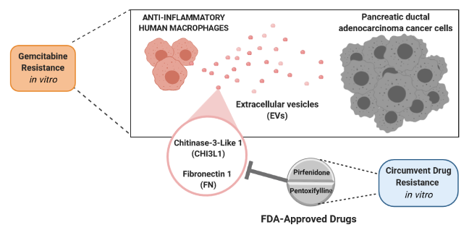
Pentoxifylline and Pirfenidone sensitize pancreatic cancer cells to gemcitabine treatment

Slide 3
Abstract
Repurposing “old” drugs is an attractive strategy for cancer drug discovery, particularly for cancers with limited chemotherapeutic options and/or high therapy resistance, such as pancreatic ductal adenocarcinoma (PDAC). Drug resistance in PDAC is highly influenced by the tumor microenvironment, especially by macrophages. Extracellular vesicles (EVs) released by macrophages might have a role in PDAC drug resistance, by carrying cargo from their donor macrophages. Therefore, we aimed to i) identify, in the cargo of EVs shed by macrophages, proteins responsible for decreasing sensitivity to gemcitabine (standard-based chemotherapy in PDAC) and ii) study in PDAC cells the antitumor effect of drugs clinically approved for other diseases and known to inhibit those protein targets as an off-target effect.
Proteomic analysis identified Fibronectin (FN1) and Chitinase 3-like 1 (CH3IL1) as abundantly present in EVs cargo released by human macrophages. Recombinant human proteins, rhCHI3L1 and rhFN, reduced PDAC cellular sensitivity to gemcitabine through the ERK pathway. Immunohistochemistry of PDAC tumor patient samples showed that expression of FN1 and CH3IL1 was associated to high presence of macrophages. The Cancer Genome Atlas confirmed an association of CHI3L1 and FN1 gene expression with PDAC patients overall survival, gemcitabine response and macrophage infiltration. Inhibition of CHI3L1 by pentoxifylline (approved drug for peripheral arterial disease) and of FN1 by pirfenidone (an antifibrotic drug for the treatment of idiopathic pulmonary fibrosis), partially reverted gemcitabine resistance induced by the respective recombinant proteins.
Additional work will be performed in xenograft mice models of PDAC, to further study the possibility of repurposing pirfenidone and pentoxifylline for PDAC treatment.
Keywords: Chitinase 3-like 1, Fibronectin, Gemcitabine resistance, Pancreatic cancer, Drug repurposing, Pirfenidone, Pentoxifylline

Slide 4
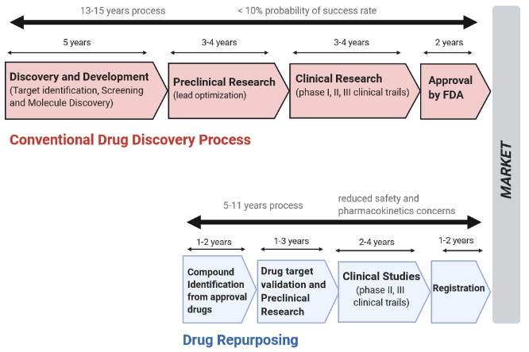
Introduction
Drug repurposing
An attractive strategy for identification of antitumor therapeutic potential on drugs previously clinically approved for other diseases
Advantages of clinically-approved drugs:
Previously established safety and toxicity
Reduce the time necessary for drug development
Less investment required
Less economic risk (less failure in the clinic)
Provide cheaper medicines

Slide 5
Introduction
Drug repurposing in PDAC
An attractive strategy for cancers with limited chemotherapeutic options and/or high therapy resistance, such as pancreatic ductal adenocarcinoma (PDAC)
A very aggressive type of cancer
Low survival rate
High rate of resistance to chemotherapy in the majority of PDAC patients undergoing gemcitabine treatment
Study the possibility of repurposing clinically-approved drugs to increase the sensitivity of PDAC to conventional chemotherapy
Find new molecular therapeutic targets for pharmacological inhibition

Slide 6
Introduction
Drug resistance in PDAC
Highly influenced by the tumor microenvironment
Macrophages are the most frequent immune cells present in the stroma of PDAC influencing therapy response, possibly through Extracellular Vesicles (EVs)
EVs released by macrophages might have a role in PDAC drug resistance, by carrying cargo from their donor macrophages
EVs are small size particles released by all cells, containing molecules and genetic material from their donor cells, which can be horizontally transferred to recipient cells, being important mediators of drug resistance

Slide 7
AIMS
Identify, in the cargo of EVs shed by human anti-inflammatory macrophages, proteins responsible for decreasing sensitivity to gemcitabine (standard-based chemotherapy in PDAC)
Study in pancreatic cancer cells the antitumor effect of drugs clinically approved for other diseases and known to inhibit those protein targets as an off-target effect

Slide 8
Results and Discussion
Successful characterisation of EVs released from human macrophages
(isolated from healthy blood donors)
Differential Centrifugation
(Cancer Letters, in Press, DOI: 10.1016/j.canlet.2020.11.013)

Slide 9
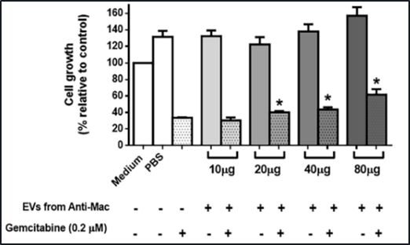
Results and Discussion
Large EVs shed by macrophages decreased PDAC cellular response to gemcitabine in a concentration-dependent manner
SRB assay
Co-culture experiments of Large EVs with BCPC3 cells
Did not affect response to gemcitabine treatment
*compared with gemcitabine alone
(Cancer Letters, in Press, DOI: 10.1016/j.canlet.2020.11.013)
Anti-Mac: anti-inflammatory human macrophages

Slide 10
Results and Discussion
Identification of Fibronectin (FN1) and Chitinase 3-like 1 (CH3IL1) as abundantly present in EVs cargo released by Anti-Mac
Proteomic analysis
To identify in the EVs cargo proteins responsible for decreased PDAC cellular response to gemcitabine
Liquid chromatography-mass spectrometry
(LC-MS/MS)
(Cancer Letters, in Press, DOI: 10.1016/j.canlet.2020.11.013)

Slide 11
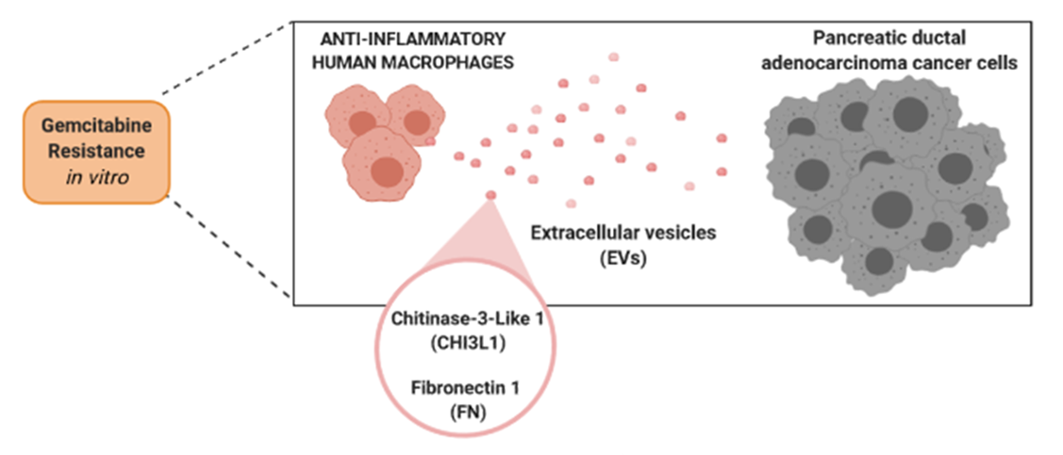
Results and Discussion
CHI3L1 and FN1 as molecular targets to overcome gemcitabine resistance in PDAC
Specific inhibitors – FDA-approved drugs
Inhibition of CHI3L1: Pentoxifylline (approved drug for peripheral arterial disease)
Decrease FN1: Pirfenidone (an antifibrotic drug for the treatment of idiopathic pulmonary fibrosis)
Recombinant human (rh) proteins
rhCHI3L1
rhFN1
(Cancer Letters, in Press, DOI: 10.1016/j.canlet.2020.11.013)

Slide 12
Results and Discussion
CHI3L1 and FN1 as molecular targets for pharmacological inhibition with Pentoxifylline or Pirfenidone to overcome gemcitabine resistance
BxPC3 cells incubated with EVs released by Anti-Mac were less sensitive to gemcitabine treatment
Concomitant treatment of gemcitabine with Pentoxifylline or Pirfenidone counteracted this drug resistance
Pentoxifylline and Pirfenidone decreased gemcitabine resistance in PDAC cells
(which have been induced by EVs secreted by anti-inflammatory macrophages)
(Cancer Letters, in Press, DOI: 10.1016/j.canlet.2020.11.013)

Slide 13
Results and Discussion
CHI3L1 and FN1 as molecular targets for pharmacological inhibition with Pentoxifylline or Pirfenidone to overcome gemcitabine resistance
rhCHI3L1 or rhFN1 significantly enhanced gemcitabine resistance in BxPC3 cells, which was partially reverted by Pentoxifylline and Pirfenidone, respectively
CHI3L1 and FN1 are involved in gemcitabine resistance and the combination of gemcitabine with Pentoxifylline or Pirfenidone could improve PDAC treatment
(Cancer Letters, in Press, DOI: 10.1016/j.canlet.2020.11.013)

Slide 14
Results and Discussion
CHI3L1 and FN1 as molecular targets to overcome gemcitabine resistance
rhCHI3L1 and rhFN also reduced PDAC cellular sensitivity to gemcitabine in another PDAC cell line
(PANC-1 cells: more resistant cells and harboring a KRAS mutation)
(Cancer Letters, in Press, DOI: 10.1016/j.canlet.2020.11.013)

Slide 15
Results and Discussion
Role of ERK pathway in gemcitabine resistance
BxPC3 cells incubated with large EVs presented higher expression of CHI3L1, β-catenin, and p-ERK
CHI3L1 and FN1 in the cargo of EVs shed by human Anti-Mac induce gemcitabine resistance through the activation of ERK signalling
BxPC3 cells incubated with rhFN1 or rhCHI3L1 under gemcitabine treatment presented higher expression of p-ERK and β-catenin
(Cancer Letters, in Press, DOI: 10.1016/j.canlet.2020.11.013)

Slide 16
Results and Discussion
Effect of Pentoxifylline and Pirfenidone in PDAC cells
* compared to gemcitabine alone
# compared to Pentoxifylline alone
SRB
Pentoxifylline and Pirfenidone decreased ERK signaling in BxPC3 PDAC cells
Pentoxifylline, at different concentrations, combined with gemcitabine reduced PDAC cell growth
(Cancer Letters, in Press, DOI: 10.1016/j.canlet.2020.11.013)

Slide 17
Results and Discussion
Expression of FN1 and CH3IL1 was associated to high presence of macrophages
Higher CD68 expression (a macrophage lineage marker) associated with higher FN1 expression
FN1 not detected inside the tumor cells but detected in the extracellular matrix
CHI3L1 presented reduced cytoplasmic expression in tumor cells and moderate cytoplasmic expression in stromal cells, especially in CD68 positive cases
Reduced CHI3L1 expression, and no relevant expression of CD68 and FN1 was found in healthy pancreas
Immunohistochemistry of three metastatic PDAC tumor patient samples
(Cancer Letters, in Press, DOI: 10.1016/j.canlet.2020.11.013)

Slide 18
Results and Discussion
Association of CHI3L1 and FN1 gene expression with PDAC patients overall survival
176 PDAC patients was investigated using the TCGA database
A higher FN1 and CHI3L1 expression were significantly associated with poorer survival (although not statistically significant for CHI3L1)
(Cancer Letters, in Press, DOI: 10.1016/j.canlet.2020.11.013)

Slide 19
Results and Discussion
Association of CHI3L1 and FN1 gene expression with PDAC patients gemcitabine response
176 PDAC patients was investigated using the TCGA database
No overall survival improvement was observed in PDAC patients treated with gemcitabine with high expression levels of FN1 or CHI3L1
(Cancer Letters, in Press, DOI: 10.1016/j.canlet.2020.11.013)

Slide 20
Results and Discussion
Association of CHI3L1 and FN1 gene expression with macrophage infiltration
176 PDAC patients was investigated using the TCGA database
Tumours expressing higher levels of CD68 also expressed higher levels of CHI3L1 or FN1
(Cancer Letters, in Press, DOI: 10.1016/j.canlet.2020.11.013)

Slide 21
Conclusions
In vitro data showed that CHI3L1 and FN1 are responsible, at least in part, for gemcitabine resistance of PDAC cells through activation of the ERK signalling
Clinical data supports that CHI3L1 and FN1 counteract cellular response to gemcitabine in PDAC patients
CHI3L1 and FN1 are potential therapeutic targets for pharmacological inhibition in PDAC

Slide 22
Conclusions
Pentoxifylline, approved for peripheral arterial disease and a known inhibitor of CHI3L1, reversed the chemoresistant effect of the EVs or of rhCHI3L1 on gemcitabine response
Pirfenidone, an antifibrotic agent used for the treatment of idiopathic pulmonary fibrosis, decreased the effect of the EVs shed by macrophages on gemcitabine resistance
Possibility of repurposing Pirfenidone and Pentoxifylline for PDAC treatment
Additional work will be performed in xenograft mice models of PDAC

Slide 23
Acknowledgments
Prof. Helena Vasconcelos (Supervisor), i3S, Portugal
Ines Castro
Dr. Hugo Caires
Cancer Drug Resistance Group
Prof. Maria José Oliveira (Co-Supervisor), i3S, Portugal
Tumour and Microenvironment Interactions Group
Prof. Lúcio Lara Santos, IPO-Porto, Portugal
Dylan Ferreira
Pathology and Experimental Therapy Group
Dr. Luisa Pereira, i3S, Portugal
Dr. Bruno Cavadas
Genetic Diversity Group
Centro Hospitalar Universitário São João (CHUSJ), Porto, Portugal
i3S Scientific Platforms, i3S, Portugal
Dr. Hugo Osório, Proteomics
Dr. Rui Fernandes, Bioimaging, and Histology and Electron Microscopy
FCT post-doctoral Grant (SFRH/BPD/122871/2016)

