Slide 1
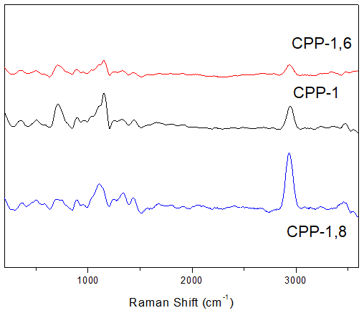
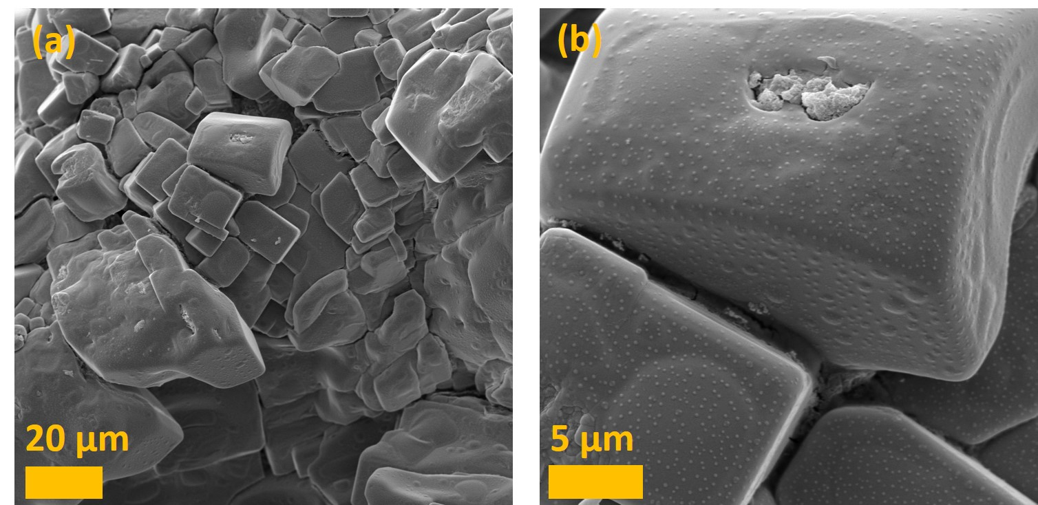
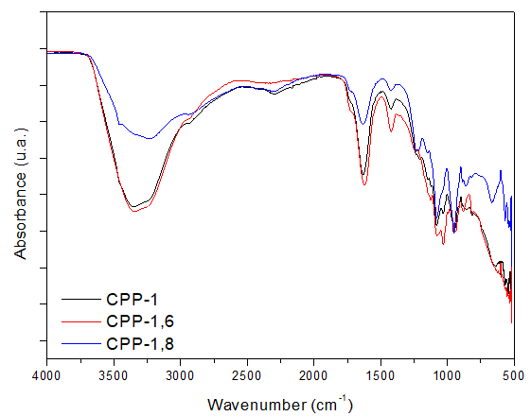
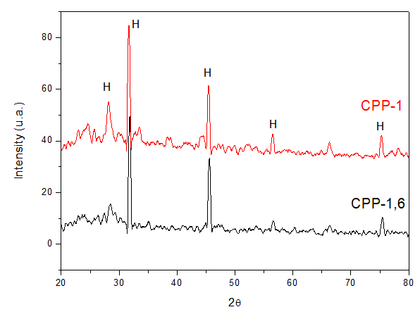
Development of Composite Biomaterials Based on Calcium Polyphosphate, Alginate, and Magnesium for Bone Tissue Applications
Joalen Pereira do Monte^{1*}; Goreti Pereira¹; Beate Saegesser Santos²
¹Departamento de Química Fundamental, Universidade Federal de Pernambuco, Recife, Brazil
²Departamento de Ciências Farmacêuticas, Universidade Federal de Pernambuco, Recife, Brazil
*joalenpm@gmail.com
INTRODUCTION
Hydroxyapatite (HAp), Ca₁₀(PO₄)₆(OH)₂, is an inorganic matrix that is the main constituent of bone tissue. Chemically, HAp has similarities with many phosphate salts. Thus, many studies use these salts to develop novel and optimized scaffolds for bone applications.^{[1]} Calcium polyphosphate (CPP) presents the potential for bone replacements due to its biocompatibility and lower toxicity.[2] Nevertheless, to obtain good mechanical properties, it is necessary to associate CPP with polymers, such as alginate (Alg). Alginate is a natural polymer, without toxicity, that has been widely used in biomedical applications.[3] Other additives can be introduced in CPP to improve its properties, such as Mg²⁺ ions. These ions participate in mechanisms that are involved in bone calcification and decalcification.[4]
In this context, this work presents the development of a composite based on CPP, alginate, and Mg²⁺ ions, as candidates for bone applications.
METHODOLOGY
Solution aqueous
Alg
NaPoliP
Addition CaCl₂ and MgCl₂
Composite
60°C
60°C
60°C
Samples
20 min
20 min
Figure 1. Esquematization of the methodology used to prepare the composite materials.
RESULTS
The precipitation of calcium polyphosphate is based on the reaction (1) under heating of 60°C.
Reaction (1):
m Ca²⁺ (aq) + (PO₃⁻)_{n} (aq) → Ca_{m}(PO₃)_{n} (s)
Raman
SEM
ATR-FTIR
COOH
Figure 3. Raman spectrum of composite materials.
Figure 5. Micrographs of the CPP-1.6 sample.
XRD
EDS
-OH
C=O
(Ca+Mg)/P ratio = 0.75
,0
Figure 2. ATR-FTIR spectrum of various composite materials.
Figure 4. Diffractogram of composites CPP-1 and CPP-1.6
Figure 6. Elemental analysis obtained by EDS of the CPP-1.6 sample.
CONCLUSION
REFERENCES
The composite materials were successfully obtained through the precipitation reaction. Through spectroscopic techniques, ATR-FTIR and Raman, CPP and alginate presence, while Mg incorporation was elucidated by EDS spectroscopy. The materials presented cubic morphology and crystalline phases referring to monetite and HAp. The results indicate the potential use of these composites as scaffolds for bone regeneration.
[1] Saenz, A.; Ceramic Biomaterials: An Introduction Overview. J. Materials Education, v. 21, p. 297-306, 1999.
[2] Wang X, Schröder HC, Müller WEG. Amorphous polyphosphate, a smart bioinspired nano-/bio-material for bone and cartilage regeneration: Towards a new paradigm in tissue engineering. J Mater Chem B. 2018;6(16):2385–412.
[3] Sancilio S, Gallorini M, Nisio C Di, Marsich E, Pietro R Di, Schweikl H, et al. Alginate / Hydroxyapatite-Based Nanocomposite Scaffolds for Bone Tissue Engineering Improve Dental Pulp Biomineralization and Differentiation. Stem Cells Int. 2018;1–13.
[4] Xiong G, Nie Y, Ji D, Li J, Li C, Li W, et al. Characterization of biomedical hydroxyapatite / magnesium composites prepared by powder metallurgy assisted with microwave sintering. Curr Appl Phys [Internet]. 2016;16(8):830–6. Available from: http://dx.doi.org/10.1016/j.cap.2016.05.004
Acknowledgements: FACEPE, CNPq, CAPES and UFPE.

