Slide 1
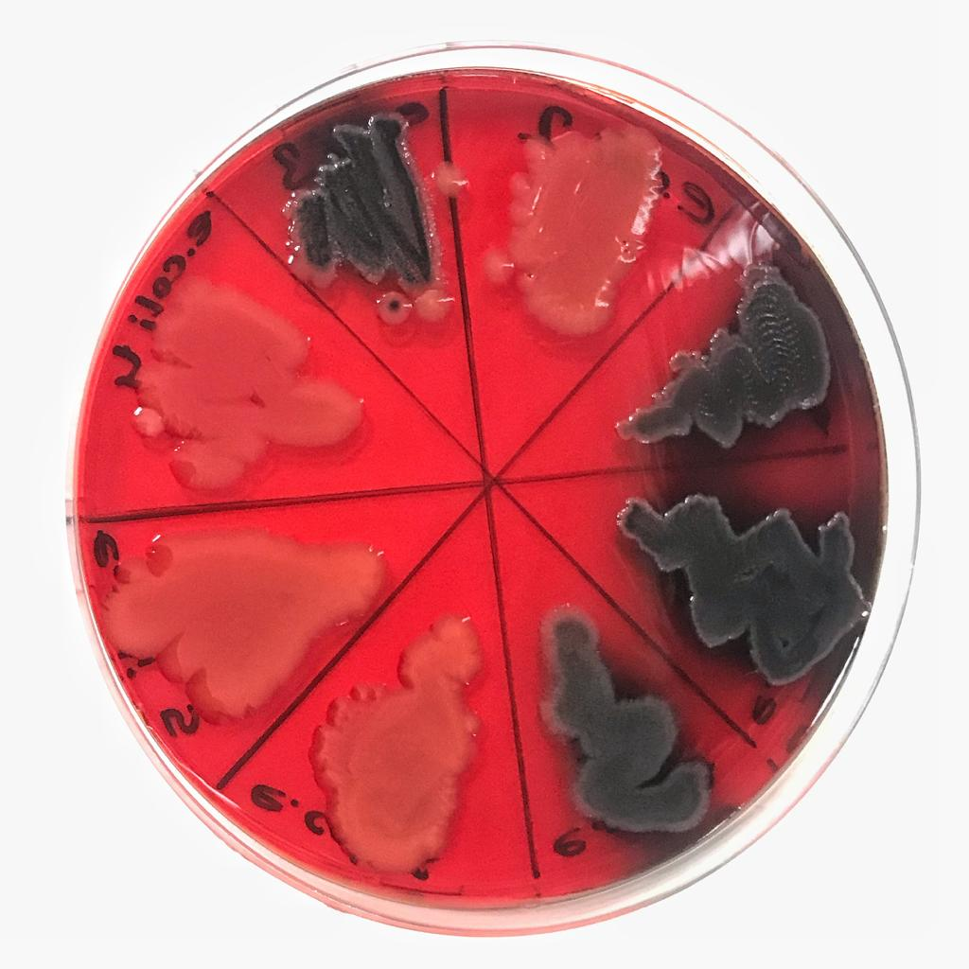
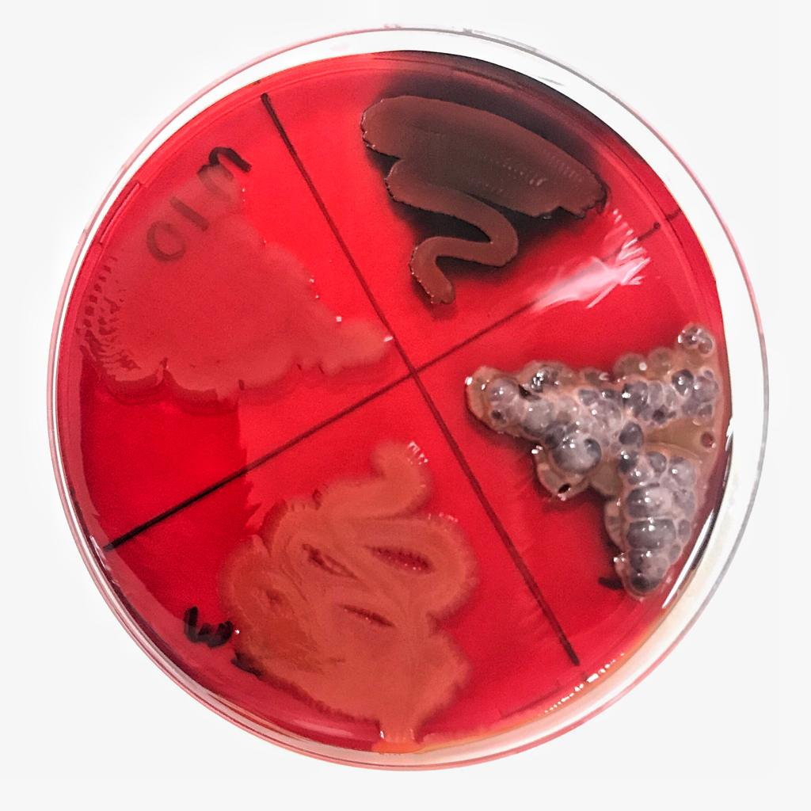
Investigation of The Biofilm Production Capacity of Clinically İsolated Multidrug Resistant Strains
Merve ŞENTURAN¹, Ergin Murat ALTUNER²
¹Kastamonu University, Institute of Science, Department of Biology, Kastamonu, Turkey
²Kastamonu University, Faculty of Science and Arts, Department of Biology, Kastamonu, Turkey
ABSTRACT: Biofilm is a gel-like layer produced by several microorganisms that consisted of exopolysaccharide (EPS), DNA, water, protein, and other polysaccharides, and is formed by attaching to any living or non-living surfaces. In addition, being one of the main causes of various infections that affect human health, biofilm is also responsible for the remarkable problems in food, agriculture, livestock industries, and irrigation and ventilation systems. Therefore, in order to take precautions against the damages, the detection of the biofilm formation is very crucial.
There are different types of methods for detecting the in vitro biofilm formation. One of them is the Congo red agar (CRA) method. In this method, a biofilm producing microorganism, changes the colour of the medium into bright black from red-pink.
In this study, it was aimed to determine the biofilm production of 21 clinical isolated multi drug resistant strains, namely 11 Escherichia coli strains, Acinetobacter baumannii, Candida albicans, Candida glabrata, Candida tropicalis, Klebsiella pneumoniae, Providencia rustigianii, Serratia odorifera, Shigella flexneri, Staphylococcus aureus MRSA and Streptococcus pneumoniae by using the CRA method. According to the results, it was determined that 10 of the existing strains (K. pneumoniae, S. aureus MRSA, C. albicans and 7 E. coli strains) produced biofilm.
KEYWORDS: Biofilm, Congo Red Agar Method
MATERIALS AND METHODS: The medium was prepared by using Brain Heart Infusion Broth (BHI) 37 g/L, sucrose 50 g/L, agar 10 g/L and Congo red 0 8 g/L. Congo red stain was prepared as a concentrated aqueous solution and autoclaved (121°C for 15 minthe microorganisms utes) separately from the other medium constituents, and was then added when the agar had cooled to 55°C. After inoculation of the Petri dishes were incubated in suitable conditions (37ºC for bacteria, 27ºC for yeasts). As a result of a biofilm production, the colour of the medium was expected to change into bright black from its initial colour, red-pink (Freeman et al. 1989; Cotter et al. 2009; Mariana et al. 2009; Kaiser et al. 2013; Rewatkar and Wadher, 2013).
RESULTS: By Congo red agar method, black colour colonies were screened for their biofilm production capacities. 10 microorganisms (K. pneumoniae, S. aureus MRSA, C. albicans and 7 E. coli strains) were observed to produced biofilm. 10 isolates gave bright black colour colonies on Congo red agar plate, while 11 isolates were formed red-pink colour colonies indicating no biofilm production. The results are given in Figure 1, Figure 2 and Figure 3.
Figure. 1 Figure. 2 Figure. 3
REFERENCES:
Cotter, J.J., O'gara, J.P., Mack, D., Casey, E. (2009). Oxygen-mediated regulation of biofilm development is controlled by the alternative sigma factor σβ in Staphylococcus epidermidis. Appl Environ Microbiol 75(1) 261–4.
Freeman, D.J., Falkiner, F.R. and Keane, C.T. (1989). New method for detecting slime production by coagulase negative staphylococci. J. Clin. Pathol, 42: 872-874.
Kaiser, T.D.L., Pereira, E.M., Netto dos Santos K.R., Maciel, E.L.N., Schuenck, R.P. and Nunes, A.P.F. (2013). Modification of the Congo red agar method to detect biofilm production by Staphylococcus epidermidis. Diagnostic Microbiology and Infectious Disease 75 235–239.
Mariana, N. S., Salman, S. A., Neela, V. and Zamberi, S. (2009). Evaluation of modified Congo red agar for detection of biofilm produced by clinical isolates of methicillin–resistance Staphylococcus aureus. African Journal of Microbiology Research, 3(6) 330-338.
Rewatkar, A. R. and Wadher, B. J. (2013). Staphylococcus aureus and Pseudomonas aeruginosa Biofilm formation Methods. IOSR Journal of Pharmacy and Biological Sciences (IOSR-JPBS), 8(5) 36-40.

