Slide 1
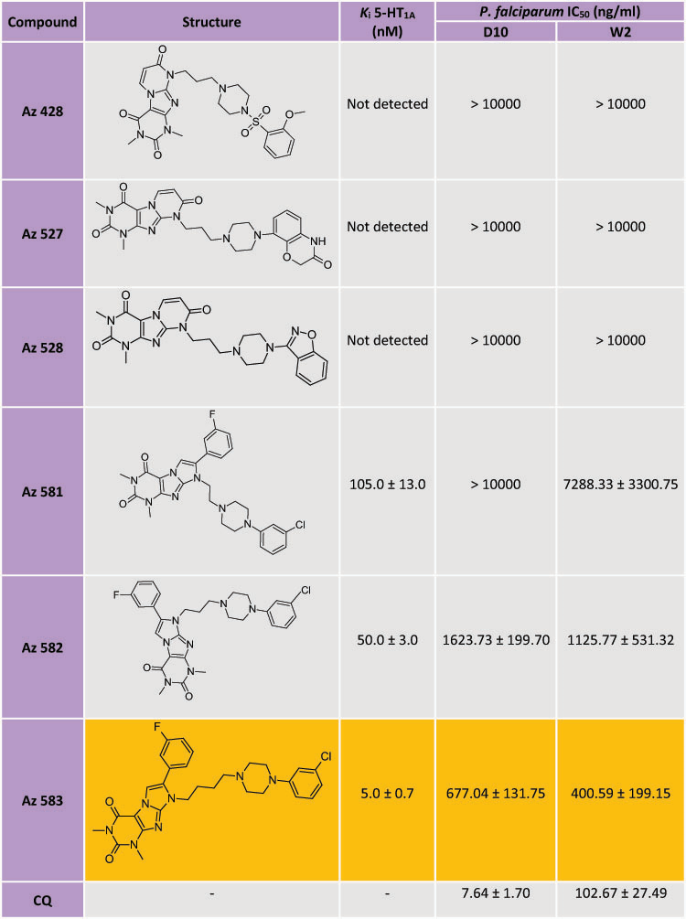
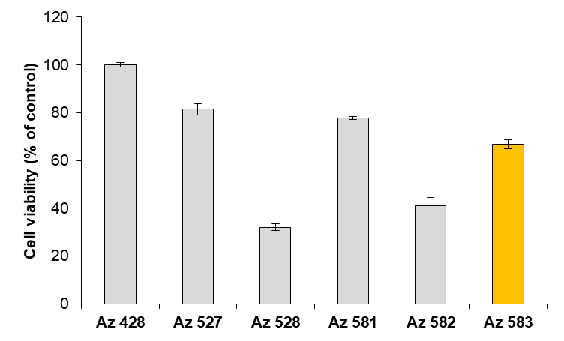
New 5-HT_{1A} receptor ligands as promising inhibitors of the growth of Plasmodium falciparum
Anna Jaromin ^{1,*}, Agnieszka Zagórska ², Silvia Parapini ³, Nicoletta Basilico ⁴, Jerzy Gubernator ¹
¹Department of Lipids and Liposomes, Faculty of Biotechnology, University of Wroclaw, Wroclaw, Poland
²Department of Medicinal Chemistry, Jagiellonian University Medical College, Cracow, Poland
³Dipartimento di Scienze Biomediche per la Salute, Università degli Studi di Milano, Milan, Italy
⁴Dipartimento di Scienze Biomediche, Chirurgiche e Odontoiatriche, Università degli Studi di Milano, Milan, Italy
Background
Quinoline derivatives are still the predominant class of antimalarial drugs, and several new antimalarial compounds in different stages of preclinical and clinical development share the same core chemistry. However, an important paradigm shift is currently emerging in antimalarial pharmacology, based upon exchanging the quinoline ring with an alternative heterocyclic ring to develop biologically active compounds with novel antimalarial activities. In particular, isosteric replacement, based on ring isosterism with antimalarial drugs such as mefloquine, chloroquine (CQ), and amodiaquine, is being widely applied to the design of new antimalarials [1].
In the current study, a series of molecules based on the 7-chloroquinoline scaffold connected by a distinct linker with arylsulfonamide fragment of sulfadoxine were designed, with the aim of enhancing the activity of quinoline, [2]. The hybrids of 4-aminoquinoline and pyrimidines showed better antimalarial activity against both chloroquine-sensitive and chloroquine-resistant strains of P. falciparum in comparison to the standard drug, chloroquine [3]. The work of Mallari et al [4] showed that a subset of purine-derived nitriles killed the parasite with moderate potency, and that these inhibitors do not seem to exert their antiproliferative effects as cysteine protease inhibitors. Derivatives of the [1,2,4]triazolo[1,5-a]pyrimidine system, with different substituents at the 2, 5 and 7 positions, were active in vitro against the W2 chloroquine-resistant P. falciparum clone strain and did not present toxicity to HepG2 cells [5]. Early work on serotonin (5-HT) subtype 1A receptor (5-HT_{1A}R) ligands as potential antimalarial drugs showed that 5-HT_{1A}R agonists inhibit P. falciparum [6]. The 5HT_{1A} receptor agonist, 8-hydroxy-N-(di-n-propyl)-aminotetralin (8-OH-DPAT), had similar levels of growth inhibition against several different P. falciparum isolates having distinct chemotherapeutic resistance phenotypes. On the other hand, agonists of 5-HT_{1A}R, such as 8-OH-DPAT, need to be modified, to prevent potential neurological side effects. A very important class of 5-HT receptors ligands are derivatives of 1,4-disubstituted arylpiperazine. Structural modifications of this pharmacophore lead to the introduction of a long, flexible, 2-5 carbon chain at the N-4 position and the amide or imide moiety at the terminal fragment, referred to as long-chain arylpiperazine derivatives (LCAPs).
Systematic structural modification of the terminal fragment of LCAPs reveal multimodal agents that could be excellent pharmacological tools as the basis for next-generation antimalarial drug discovery.
Objective
The aim of the presented study was the evaluation of antimalarial activity of a series of derivatives of purine-2,4-diones and purine-2,4,8-triones as 5-HT_{1A} receptor ligands, as well as the determination of their cytotoxic effects against a normal human fibroblast (NHDF) cell line.
Methods
P. falciparum cultures were established according to Trager and Jensen, with slight modifications [7]. Parasite growth was determined spectrophotometrically (OD₆₅₀) by measuring the activity of parasite lactate dehydrogenase (pLDH), according to a modified version of the method of Makler [8]. The antimalarial activity was expressed as 50% inhibitory concentrations (IC₅₀). Cell viability of NHDF cells was determined using the MTT assay after 48h [9].
Results
The project is co-financed by the Polish National Agency for Academic Exchange, Italian Ministry of Foreign Affairs and International Cooperation "Executive Programme for Scientific and Technological Cooperation between the Italian Republic and the Republic of Poland and supported by JUMC grant no N42/DBS/000178.
Cytotoxicity studies of studied compounds at a concentration 0.05 mg/ml
on NHDF cells for 48 h
Conclusions
Considering the obtained activities, we have selected 8-(4-(-(3-chlorophenyl)piperazin-1-yl)butyl)-7-(3-fluorophenyl)-1,3-dimethyl-1H-imidazo[2,1-f]purine-2,4(3H,8H)-dione as the most promising molecule for further studies in antimalarial chemotherapy and to determine its therapeutic efficacy in a number of in vitro and in vivo models.
Wells, T.N.; Hooft van Huijsduijnen, R.; Van Voorhis, W.C. Malaria medicines: A glass half full? Nat. Rev.Drug Discov. 2015, 14, 424–442.
Pinheiro, L.C.S.; Boechat, N.; Ferreira, M.L.G.; Junior, C.C.S.; Jesus, A.M.L.; Leite, M.M.M.; Souza, N.; Krettli, A.U. Anti-Plasmodium falciparum activity of quinoline-sulfonamide hybrids. Bioorg. Med. Chem. 2015, 23, 5979–5984.
Manohar, S., Rajesh, U.C., Khan, S.I., Tekwani, B.L., Rawat, D.S. Novel 4-aminoquinoline-pyrimidine based hybrids with improved in vitro and in vivo antimalarial activity. ACS Med Chem Lett. 2012, 3,555-559.
Mallari, J.P., Guiguemde, W.A., Guy, R.K. Antimalarial activity of thiosemicarbazones and purine derived nitriles. Bioorg. Med. Chem. Lett. 2009, 19, 3546-3549.
Boechat, N.; Pinheiro, L.C.S.; Silva, T.S.; Aguiar, A.C.C.; Carvalho, A.S.; Bastos, M.M.; Costa, C.C.P.; Pinheiro, S.; Pinto, A.C.; Mendonça, J.S.; et al. New Trifluoromethyl Triazolopyrimidines as Anti-Plasmodium falciparum Agents. Molecules 2012, 17, 8285–8302.
Locher, C.P., Ruben, P.C., Gut, J., Rosenthal, P.J. 5HT1A serotonin receptor agonists inhibit Plasmodium falciparum by blocking a membrane channel. Antimicrob. Agents. Chemother. 2003, 47, 3806-3809.
Trager, W., Jensen, J.B. Human malaria parasites in continuous culture Science. 1976, 193, 673-675.
Makler, M.T., Hinrichs, D.J. Measurement of the lactate dehydrogenase activity of Plasmodium falciparum as an assessment of parasitemia. Am. J. Trop. Med. Hyg., 1993 48, 205-210.
Mosmann, T. Rapid colorimetric assay for cellular growth and survival: application to proliferation and cytotoxicity assays. J. Immunol. Methods, 1983, 65, 55-63.
In vitro antimalarial activity of Az compounds against the D10 (CQ-sensitive) and W2 (CQ-resistant) strains of P. falciparum and K_{i} 5-HT_{1A} values (K_{i} - the inhibition constants calculated from the Cheng-Prushoff equation, an intrinsic measure of affinity)

