Slide 1
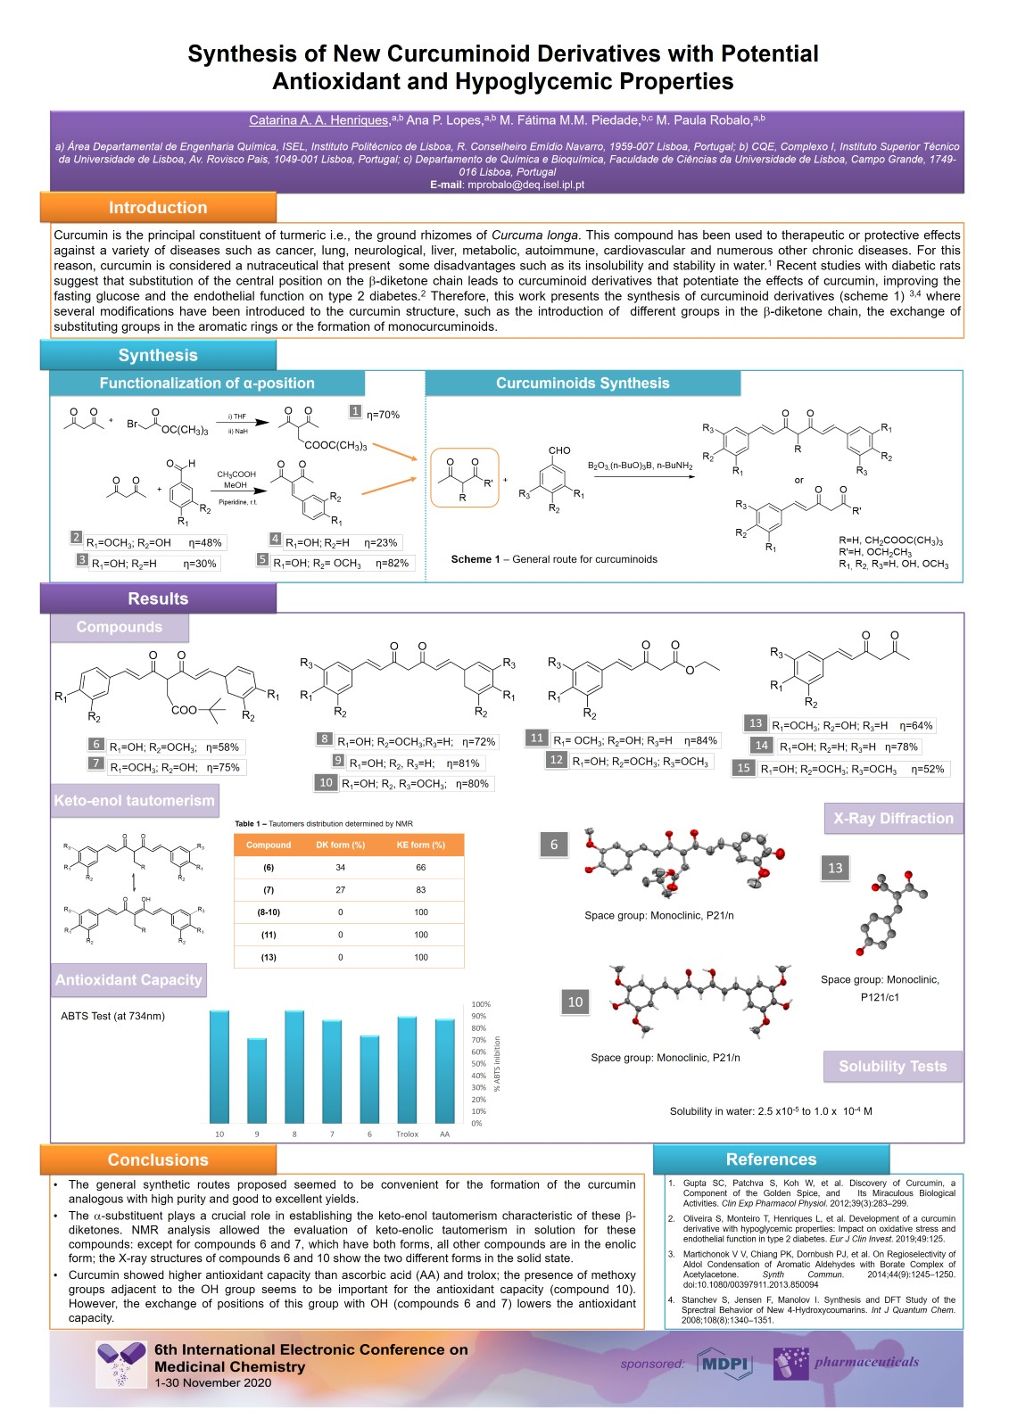
Synthesis of New Curcuminoid Derivatives with Potential Antioxidant and Hypoglycemic Properties

