Slide 1
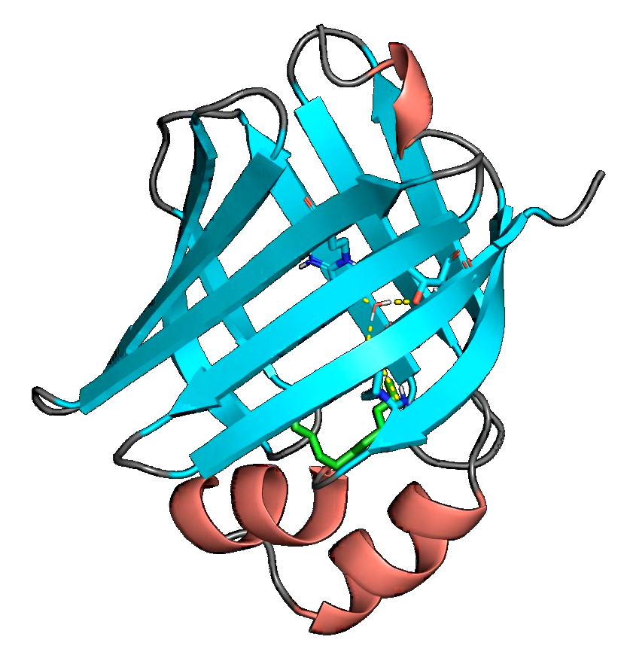
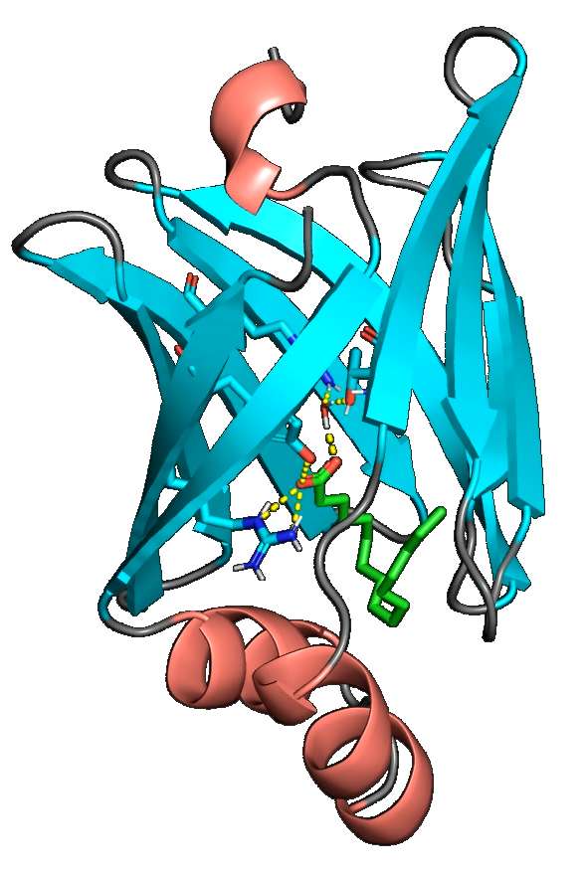
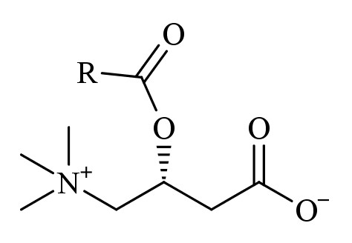
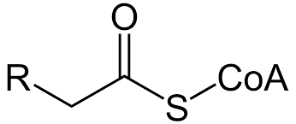
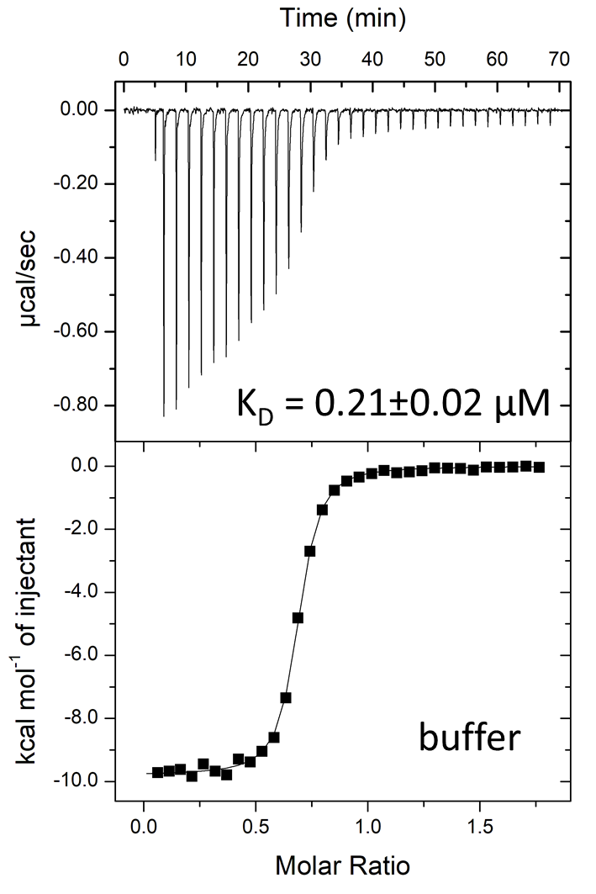
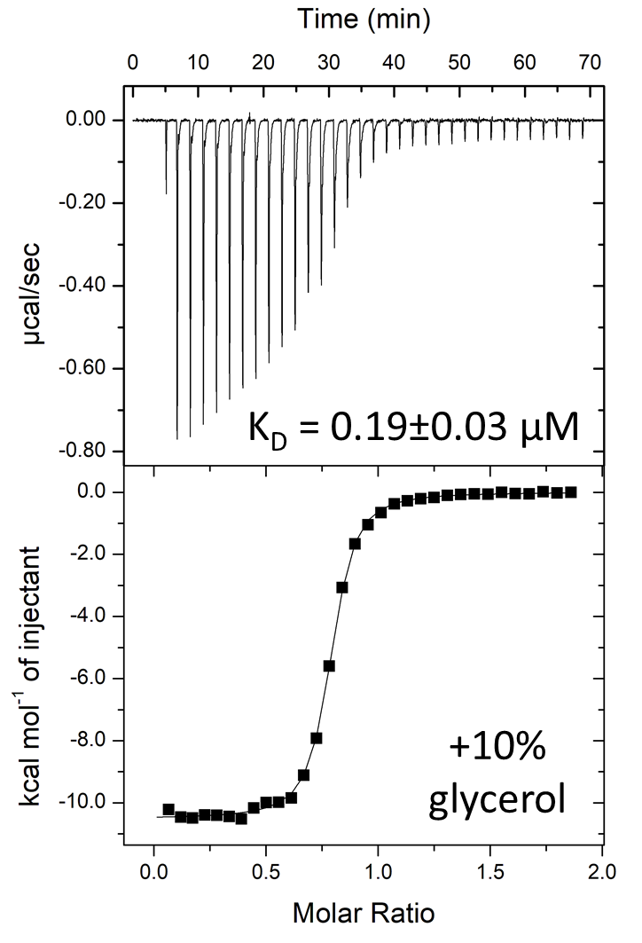
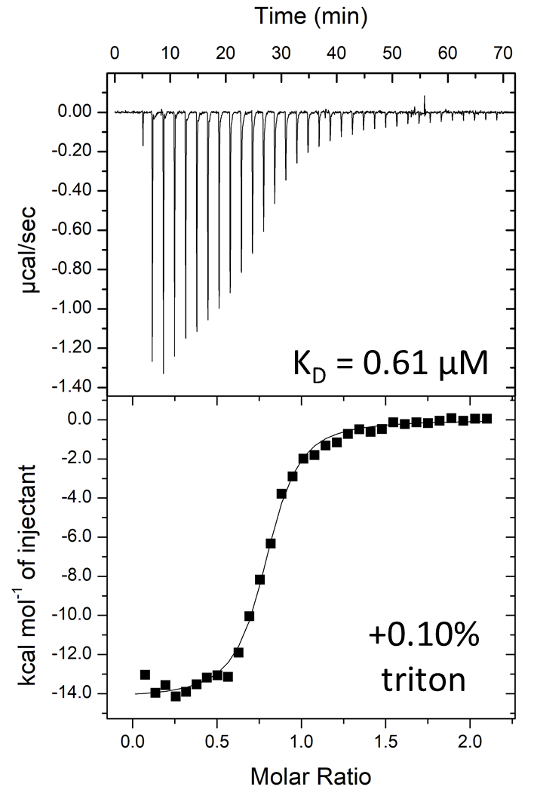
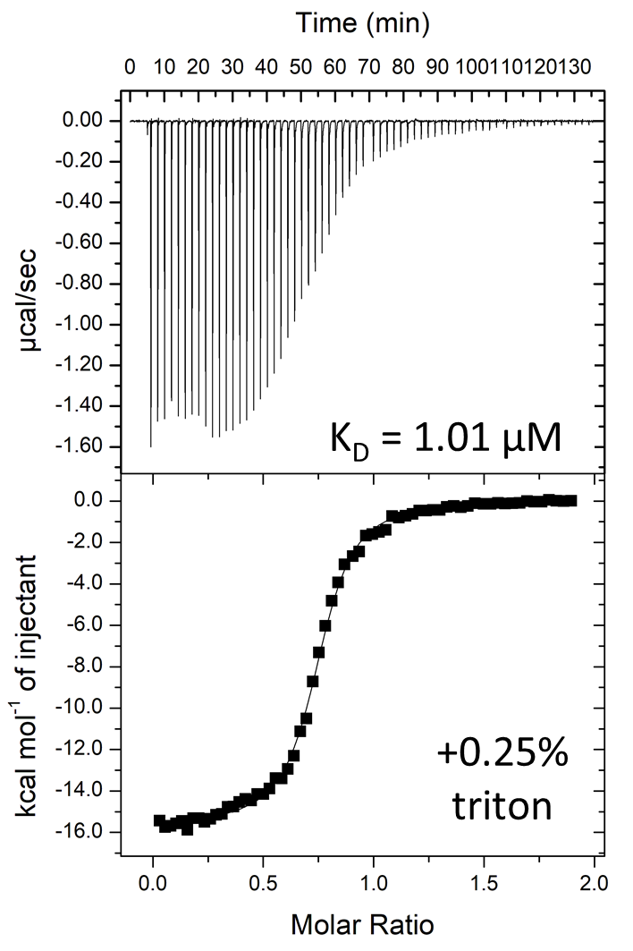
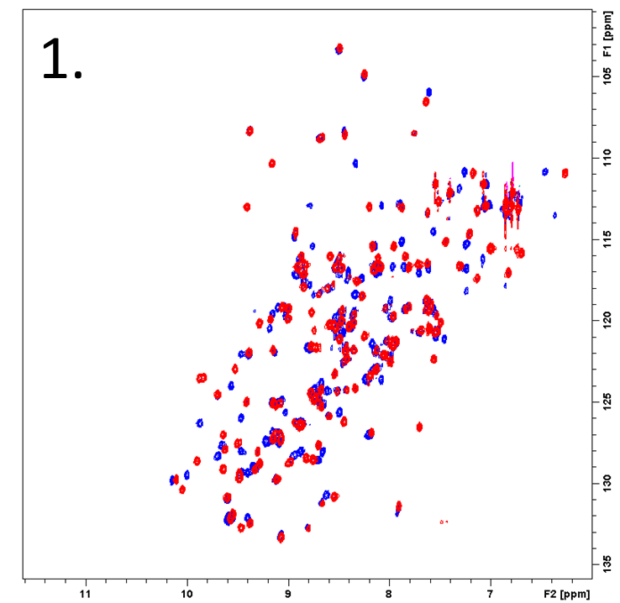
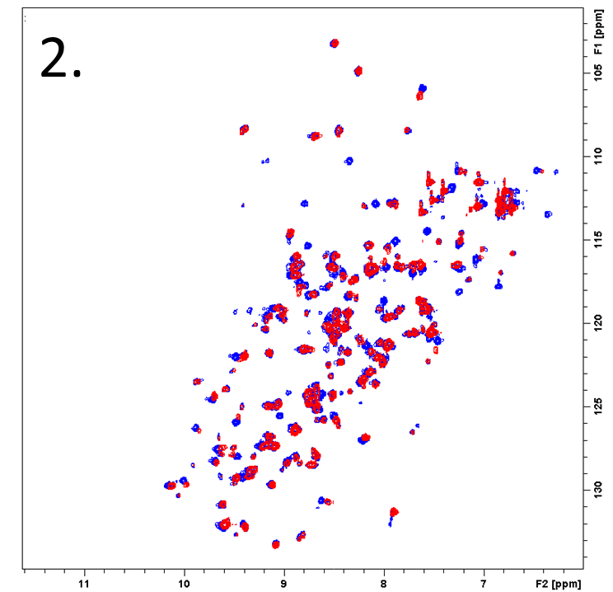
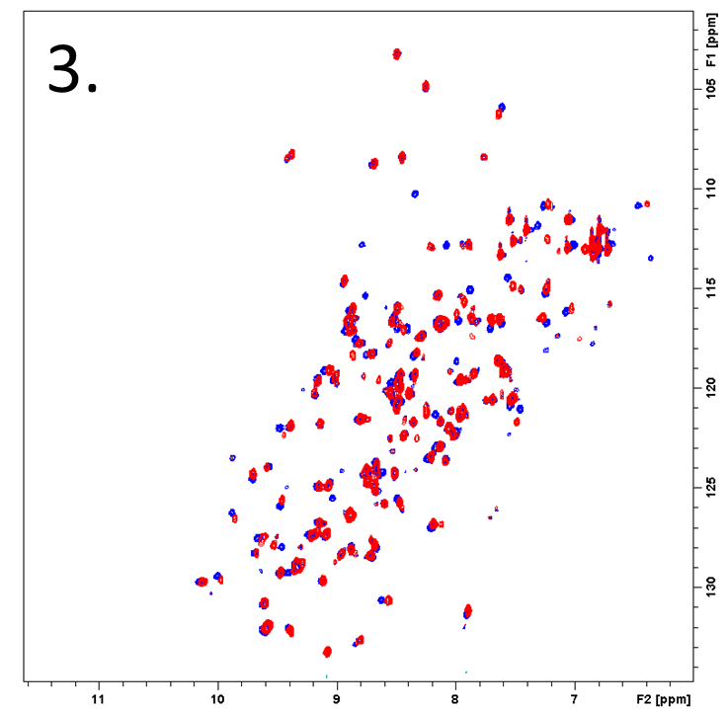
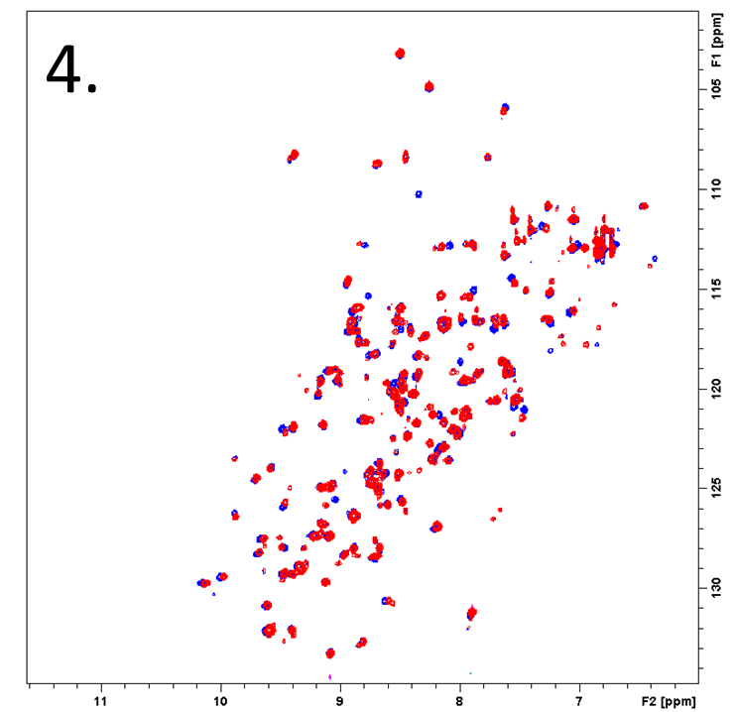
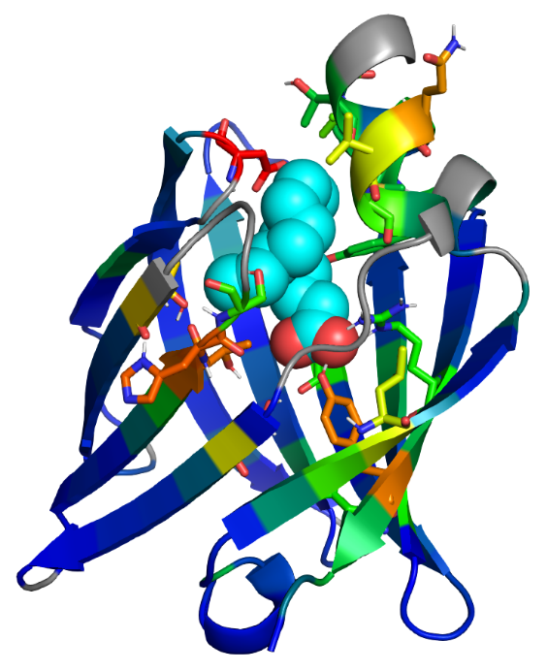
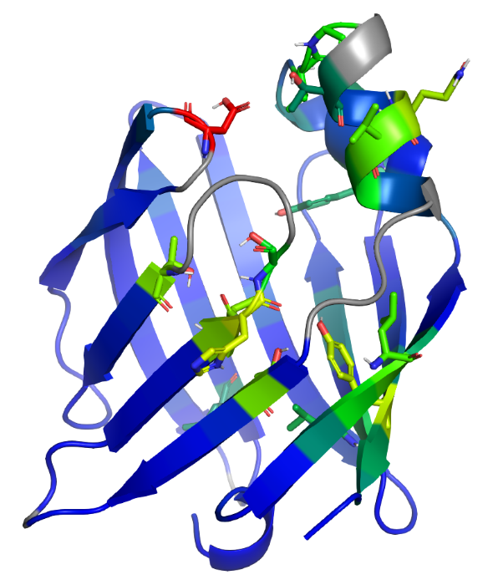
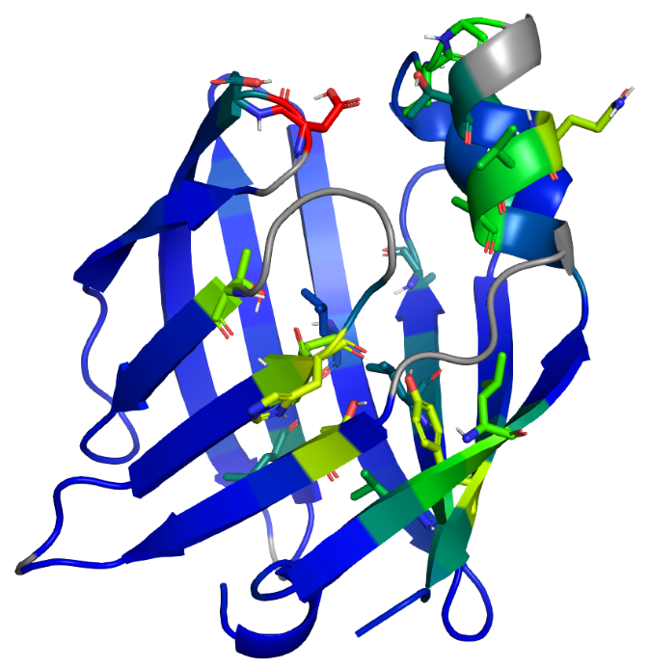
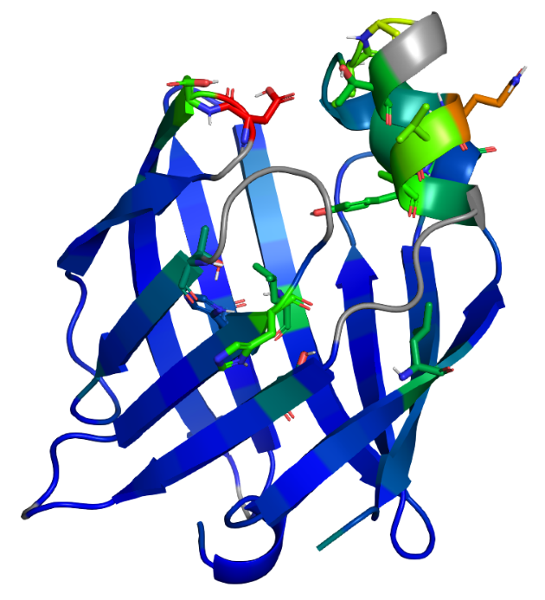
Investigation of protective effects of fatty acid binding protein 3 against long-chain fatty acid derivative-induced damage
Diana Zelencova, Karlis Vilks, Marina Makrecka-Kuka, Edgars Liepinsh, Kristaps Jaudzems Latvian Institute of Organic Synthesis, Aizkraukles 21, LV-1006, Riga, Latvia
Introduction
According to the World Health Organisation (WHO) statistical data, ischaemic heart disease (IHD) is the main cause of death and disability worldwide. Especially IHD is the main risk factor for elder people (93% of death cases caused by IHD in 2016). Thus, the development of effective cardioprotective drugs and new pharmacological target identification is extremely important. Recent studies [1] have revealed the high toxicity of the long-chain acylcarnitines that are accumulated in the ischaemic myocardium.
The aim of this study is to investigate the possible protective mechanism of fatty acid binding protein 3 (FABP3) and its ability to bind not only the long-chain fatty acids (FA) but also metabolic intermediates of FA.
90º
Crystal structure of FABP3 (PDB ID: 4TKJ [2]) represented as ribbons in complex with palmitate (green tubes).
Metabolic intermediates of FA.
MTT cytotoxicity assay on PANC-1 cells titrated with palmitoyl-carnitine (PC): control (red), FABP3 (green), and BSA (blue).
Isothermal titration calorimetry (ITC) data of lauric acid binding to recombinant human delipidated FABP3 at pH 7.6 using different buffer additives to increase FA solubility.
Thermodynamics of lauric acid binding to FABP3 at pH 7.6 using different buffer additives.
Conclusions:
Recombinant fatty-acid free FABP3 is able to protect PANC-1 cells from cytotoxicity induced by palmitoyl-carnitine.
ITC assay was developed and successfully applied to characterize FABP3 binding with long-chain fatty acids (FA) and metabolic intermediates of FA.
NMR data reveal that FA, FA-carnitines and FA-CoA bind in the active site of FABP3 in the similar manner.
2D ¹H-¹⁵N-HSQC spectra of ¹⁵N-labelled FABP3: apo-form (blue) and in complex (red) with palmitic acid (1), palmitoyl-coenzyme A (CoA) (2), eicosapentaenoyl-carnitine (3), and lauroyl-carnitine (4).
1.
2.
3.
4.
References:
E. Liepinsh et al., Biochem. J., vol. 473, no. 9, pp. 1191–1202, (1) 2016.
S. Matsuoka et al., Angew. Chemie Int. Ed., vol. 54, no. 5, pp. 1508–1511, (5) 2015.
Crystal structure of FABP3 (PDB ID: 4TKJ) coloured in gradient from blue (min) to red (max) based on chemical shift perturbation upon binding of palmitic acid (1), palmitoyl-CoA (2), eicosapentaenoyl-carnitine (3), and lauroyl-carnitine (4) to FABP3.
Acknowledgement:
This work was supported by LIOS internal student grant IG-2020-02.

