Slide 1


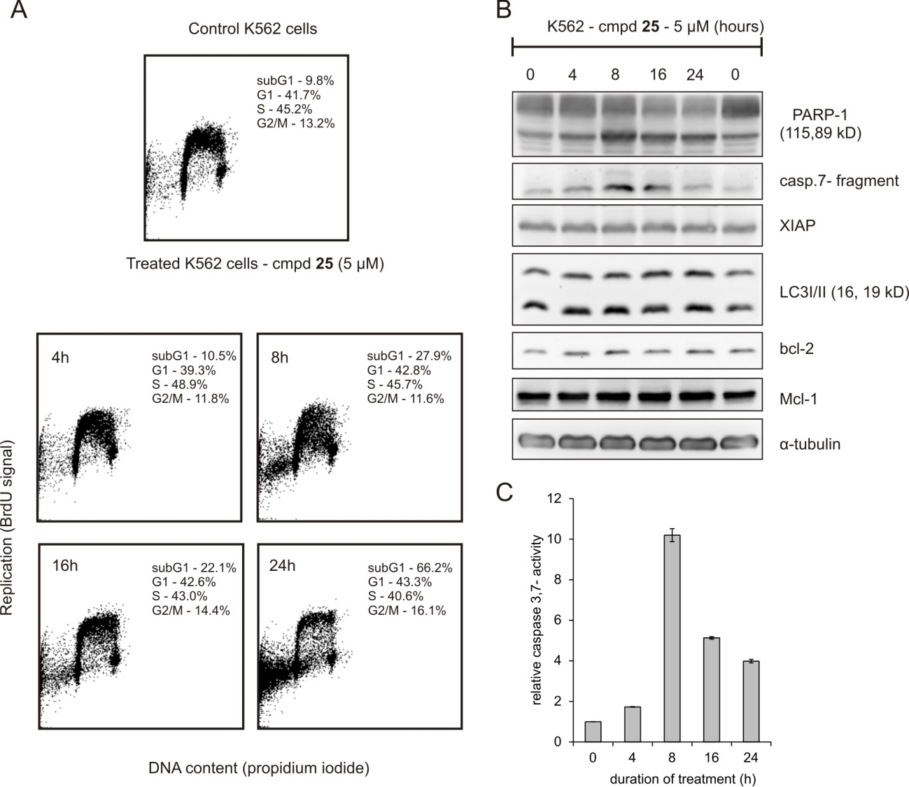

Novel Bioactive Nucleoside and Isonucleotide Analogs of Therapeutic Interest
Nuno M. Xavier,^{[a]} Rita Gonçalves-Pereira,^{[a]} Eduardo C. de Sousa,^{[a]} Radek Jorda,^{[b]} Anne Loesche,^{[c]} Immo Serbian,^{[c]} René Csuk^{[c]}
[a] Centro de Química Estrutural, Faculdade de Ciências, Universidade de Lisboa, Ed. C8, 5° Piso, Campo Grande, 1749-016 Lisboa, Portugal.
[b] Laboratory of Growth Regulators, Palacký University &Institute of Experimental Botany, The Czech Academy of Sciences, Šlechtitelů 27, 78371, Olomouc, Czech Republic
[c] Bereich Organische Chemie, Martin-Luther-Universität Halle-Wittenberg, Kurt-Mothes-Str. 2, D-06120 Halle (Saale), Germany
Abstract: Synthetic nucleosides, nucleotides and analogs have attracted much interest in medicinal chemistry, due to their ability to display a variety of biological activities. A number of nucleos(t)ide analogs became effective anticancer or antiviral drugs [1], while some reports showed the ability of these types of molecules to display antimicrobial effects [2] or to inhibit cholinesterases [3]. In this work, the synthesis of novel D-glucuronamide-based nucleosides and purine isonucleos(t)ides, and the evaluation of their antiproliferative or anticholinesterasic profiles, respectively, is presented. Some compounds emerged as promising lead molecules for cancer or for Alzheimer’s disease.
● N-Dodecyl Glucuronamide-based Nucleosides with Anticancer Potential
Mechanism of Action
Induction of apoptosis
N. M. Xavier et al.,
Pure Appl. Chem. 2019, 91, 1085.
Org. Biomol. Chem. 2017, 15, 4667.
Compounds | GI₅₀ (μM)
 | K562 | MCF-7
 | 11.2 | 7.2
 | 30.3 | 15.9
 | > 50 | > 50
 | 14.8 | 13.3
Antiproliferative Evaluation
Compounds | GI₅₀ (μM)
 | K562 | MCF-7
 | 7.4 | 10.4
 | 3.3 | 3.3
 | 6.7 | 8.6
 | 23.9 | 17.1
K562
chronic myeloid leukemia
Imatinib GI₅₀ (K562) = 0.5 μM ; GI₅₀ (MCF-7) = 26.8
- activation of caspases
MCF-7
breast adenocarcinoma
5-Fluorouracil GI₅₀ (K562) > 100 ; GI₅₀ (MCF-7) = 9.7 μM
- cleavage of PARP-1
- downregulation of anti-apoptotic proteins
● Terminal Isonucleosides as Cholinesterase (ChE) Inhibitors
Cholinesterase Inhibitory Profiles
Triazole 6′-isonucleoside
Theobromine 5ʹ/6ʹ-Isonucleosides
N-Isonucleosidyl Sulfonamide
AChE: K_{i} = 11.9 ± 1.6 μM
AChE:K_{i} = 6.6 ± 0.2 μM
[K_{i}' > 200 μM
(mixed-type)
Nontoxic to healthy cells
IC₅₀ N27 = 44.22 µM
IC₅₀ NHDF > 50 µM
Galantamine.HBr
K_{i} (AChE) = 0.5 ± 0.0 μM
Ki (BChE) = 9.4 ± 0.7 μM
Purine 6′-isonucleosides
Glucopyranos-6ʹ-yl Theobromine
N. M. Xavier et al.,
Pure Appl. Chem. 2016, 88, 363.
AChE: K_{i} = 3.1 ± 0.2 μM
[K_{i}' > 100 μM]
BChE: K_{i} = 5.4 ± 0.3 μM
[K_{i}' > 60 μM]
(mixed-type)
Cholinesterase Inhibitory Profiles
N. M. Xavier et al.,
Pharmaceuticals 2019, 12, 103.
Eur. J. Org Chem. 2018, 2018, 2667.
IC₅₀ NIH 3T3 > 30 µM
Galantamine.HBr
K_{i} (AChE) = 0.2 ± 0.1 μM
Ki (BChE) = 2.4 ± 0.0 μM
Galantamine.HBr
K_{i} (AChE) = 0.5 ± 0.0 μM
Ki (BChE) = 9.4 ± 0.7 μM
(competitive)
AChE:
K_{i} > 20
[K_{i}' = 7.1 ± 0.3 μM]
(mixed-type)
AChE:
K_{i} = 4.3 ± 0.8 μM
[K_{i}' = 66.3 ± 12.2 μM]
(mixed-type)
Docking into AChE
References:
^{[1]} J. Shelton et al., Chem. Rev. 2016, 116, 14379.
^{[2]} M. Serpi et al., J. Med. Chem. 2016, 59, 10343.
^{[3]} a) C. Meier et al., J. Med. Chem. 2004, 47, 2839.; b) S. Schwarz et al., Org. Biomol. Chem.
2014, 12, 2446.; c) N. M. Xavier et al., Synlett 2015, 26, 2663.
FCT is acknowledged for funding (projects UIDB/00100/2020, UIDP/00100/2020 and grant CEECIND/03881/2018).

