Slide 1
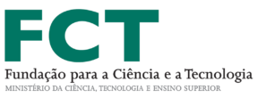
New chalcone analogues with potential bacterial efflux pump inhibitory effect
Joana Moreira ^{a, b}, Fernando Durães ^{a, b}, Joana Freitas-da-Silva ^{b, c}, Nikoletta Szemerédi ^{d}, Eugénia Pinto ^{b, e}, Paulo Costa ^{b, c}, Madalena Pinto ^{a, b}, Gabriella Spengler ^{d}, Emília Sousa ^{* a, b}, and Honorina Cidade^{* a, b}
a Laboratory of Organic and Pharmaceutical Chemistry, Faculty of Pharmacy, University of Porto, Portugal
b Interdisciplinary Centre of Marine and Environmental Research (CIIMAR), University of Porto, Portugal
c ICBAS – Institute of Biomedical Sciences Abel Salazar, University of Porto, Portugal
d Department of Medical Microbiology and Immunobiology, Faculty of Medicine, University of Szeged, Hungary
e Laboratory of Microbiology, Department of Biological Sciences, Faculty of Pharmacy, University of Porto, Portugal
* Corresponding author: hcidade@ff.up.pt, esousa@ff.up.pt

Slide 2
New chalcone analogues with potential bacterial efflux pump inhibitory effect
Synthesis of chalcone analogues
Antimicrobial activity evaluation
1. Screening for antibacterial potential
1 promising compound
(MIC = 32 µg/mL, S. aureus ATCC 29213)
2. Synergic effect evaluation
37 promising compounds
(decreased MIC of cefotaxime or vancomycin)
3. Efflux Pump Inhibition
9 promising compounds
(inhibited the efflux system of S. Typhimurium or S. aureus)

Slide 3
Abstract:
Chalcones comprise a class of natural products possessing two aromatic rings linked by an enone. These compounds show extensive biological activities, including antimicrobial activity in multidrug resistant bacteria [1].
Considering the potential of these compounds as antimicrobial agents, a library of chalcones and their analogues was synthesized, and the minimum inhibitory concentrations were determined by broth microdilution methods. Antibacterial activity was accessed for reference strains (Staphylococcus aureus ATCC 29213, Enterococcus faecalis ATCC 29212, Escherichia coli ATCC 25922, Pseudomonas aeruginosa ATCC 27853). Multidrug-resistant isolates, ESBL E. coli SA/2, MRSA S. aureus 66/1 and VRE E. faecalis B3/101, were used for the synergy assay with antibiotics, cefotaxime, oxacillin and vancomycin, respectively. Most of the compounds displayed promising results in combination with antibacterial drugs, while not displaying relevant antimicrobial activity. Further insights into the mechanisms through which these compounds could exert synergistic activity were pursued, and their potential to inhibit bacterial efflux pumps was investigated in Gram positive (S. aureus MRSA 272123) and Gram negative (a mutant strain of Salmonella enterica Typhimurium expressing the AcrAB-TolC efflux system with the acrA gene inactivated) bacteria. The assay is based on the intracellular accumulation of the efflux pump substrate ethidium bromide measuring the increase in fluorescence in the presence of a potential efflux pump inhibitor [2]. By this approach, some chalcone analogues displayed promising activity as bacterial efflux pump inhibitors.
Keywords: Chalcone analogues, Antibacterial activity, Synergic effetc, Efflux pump
[1] Singh, P. et al., Eur. J. Med. Chem., 2014. 85: p. 758-777; [2] Nové, M. et al., Microorganisms, 2020. 8(4): p. 566.

Slide 4
Introduction: Chalcone and chalcone analogues
Chemistry of natural and synthetic chalcone
Two aromatic rings
three carbon bridge
Enone linker
Chemistry of chalcone analogues: diarylpentanoids
Two aromatic rings
Five carbon bridge
Enone linker
Diarylpentanoids
C5-curcuminoids

Slide 5
Introduction: Chalcone and Chalcone analogues
Biological activities of chalcone and chalcone analogues
Antitubercular
Anti-inflammatory
Antioxidant
Antitumor
Anti-malarial
Antibacterial
Singh, P. et al., Eur. J. Med. Chem., 2014. 85: p. 758-777; Liang, G. et al., 2008, Chem. Pharm. Bull. 56(2): 162-167; Leão, M. et al., Life sciences, 2015. 142: p. 60-65: Aluwi, M. et al., Bioorg. Med. Chem. Lett, 2016. 26(10): p. 2531-2538.

Slide 6
Introduction: Antimicrobial Resistance Mechanisms
Bacteria can develop multiple mechanisms of antimicrobial resistance
This study will focus on the inhibition of bacterial efflux pumps
Duraes, D. et al., Curr. Med. Chem., 25 (2018) 6030-6069.

Slide 7
Results and Discussion: Synthesis
Scheme 1: Synthesis of diarylpentanoids. Reaction conditions: (i) NaOH, CH₃OH, 60 ºC.
A total of 46 derivatives were synthesized

Slide 8
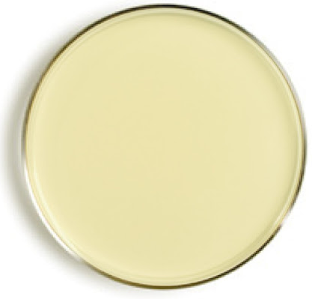
Results and Discussion: Antimicrobial activity
46 chalcone analogues were screened for their antibacterial potential
45 compounds did not display minimum inhibitory concentration (MIC) at the tested concentrations
Escherichia coli ATCC 25922
Staphylococcus aureus ATCC 29213
Pseudomonas aeruginosa ATCC 27853
Enterococcus faecalis ATCC 29212
Staphylococcus aureus MRSA 272123
Salmonella enterica serovar Typhimurium SL1344
One compound presented MIC = 32 µg/mL for S. aureus ATCC 29213

Slide 9
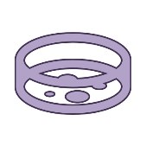
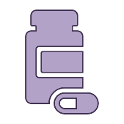
Results and Discussion: Synergy with antibiotics
Synergy Assay
Bacteria
Compound
Antibiotic
E. coli SA/2
E. faecalis B3/101
Cefotaxime
Vancomycin
+
+

Slide 10
Results and Discussion: Synergy with antibiotics
46 compounds tested
E. coli SA/2 + Cefotaxime
E. faecalis B3/101 + Vancomycin
MIC:
512 µg/ml
MIC:
1024 µg/ml
18 compounds decreased
MIC of cefotaxime
19 compounds decreased
MIC of vancomycin
2-fold
13 compounds
4-fold
4 compounds
8-fold
1 compound
2-fold
15 compounds
4-fold
3 compounds
16-fold
1 compound
Mechanism?

Slide 11
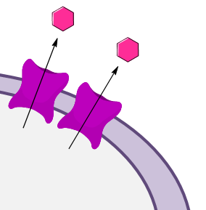
Results and Discussion: Efflux Pump Inhibition
29 compounds tested
Strains tested:
S. aureus MRSA 272123
S. Typhimurium SL1344
Ethidium bromide accumulation assay
(Positive control: reserpine)
Increased
fluorescence
1 compound inhibited the efflux system of S. Typhimurium
8 compounds inhibited the efflux system of S. aureus

Slide 12
Conclusions
46 chalcone analogues were synthesized
All compounds were screened for their antibacterial potential as well as their synergic effect:
One compound presented MIC = 32 µg/mL for S. aureus ATCC 29213
18 compounds decreased MIC of cefotaxime
19 compounds decreased MIC of vancomycin
The potential to inhibit bacterial efflux pumps of 29 chalcone analogues was investigated:
1 compound inhibited the efflux system of S. Typhimurium
8 compounds inhibited the efflux system of S. aureus

Slide 13
Acknowledgments
This research was partially supported by the Strategic Funding UIDB/04423/2020, UIDP/04423/2020 (Group of Natural Products and Medicinal Chemistry-CIIMAR) and under the project PTDC/SAU-PUB/28736/2017 (reference POCI-01-0145-FEDER-028736), co-financed by COMPETE 2020, Portugal 2020 and the European Union through the ERDF and by FCT through national funds. Fernando Durães and Joana Moreira acknowledge for their FCT grants (SFRH/BD/144681/2019 and SFRH/BD/135852/2018, respectively).
The authors thank Dr. Jessica Blair (Institute of Microbiology and Infection, College of Medical and Dental Sciences, University of Birmingham, Birmingham B15 2TT, UK) for providing the Salmonella strain.

