Slide 1
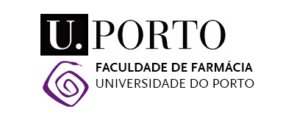








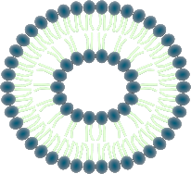

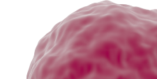
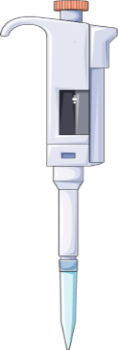
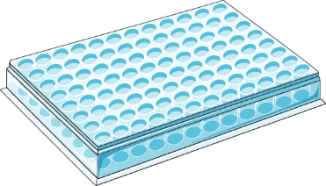
Insight into the protein tyrosine phosphatase 1B (PTP1B) inhibitory activity of pyrazoles
Sónia Rocha¹, Daniela Ribeiro¹, Vera L. M. Silva², Pedro M. O. Gomes², Artur M. S. Silva², Alberto N. Araújo¹, M. Luísa Corvo³, Eduarda Fernandes¹, Marisa Freitas¹
¹LAQV, REQUIMTE, Laboratory of Applied Chemistry, Department of Chemical Sciences, Faculty of Pharmacy, University of Porto, 4050-313 Porto, Portugal.
²LAQV-REQUIMTE, Department of Chemistry, University of Aveiro, Aveiro, Portugal.
³Research Institute for Medicines, Faculty of Pharmacy, University of Lisbon, 1649-003 Lisbon, Portugal.
Insulin
α
Introduction
α
Diabetes mellitus (DM) is a long-term chronic condition characterized by hyperglycemia, being one of the biggest global health emergencies of the 21st century. Type 2 DM is the most common form of DM, representing 90-95% of patients with DM. Insulin resistance is the earliest detectable abnormality and the characteristic feature in individuals with type 2 DM. Protein tyrosine phosphatase 1B (PTP1B) has been emerging as a promising drug target for the management of type 2 DM. Different causes disrupt a complex network of signaling cascades where insulin is involved, impairing its play role on glucose homeostasis. The insulin binding to the α subunit of its extracellular receptor (IR) (Fig. 1) unleashes the phosphorylation of the tyrosine residues of the β subunits, subsequent protein–protein interactions and the phosphorylation of insulin receptor substrates (IRS). Then, IRS proteins serve as docking for other signaling molecules, to onset protein kinase B (PKB) (also known as Akt) activation and translocation of glucose transporter 4 (GLUT4) storage vesicles to the plasma membrane for glucose uptake. PTP1B, as a negative regulator of insulin signaling pathway, acts by dephosphorylation of IR and IRS, leading to the attenuation of the insulin signal. PTP1B inhibitors amplify the level of phosphorylation of the IR and its substrates, rising the translocation of glucose transporters and glucose uptake in insulin-dependent cells, improving insulin sensitivity.
Main goal: Compare the inhibitory effect of a panel of new structurally related pyrazoles (Table 1) against human PTP1B activity, using a microanalysis screening system, and determine the mechanism of inhibition of the most active compounds, graphically by Lineweaver-Burk plots and by non-linear least squares regression using the SolverTM supplement of Excel Microsoft OfficeTM.
Insulin Receptor
PIP₂
β
β
P
P
P
P
PIP₃
P
IRS
P
P
PI3K
P
PDK-1
P
P
Akt
P
mTORC2
RGC
AS160
PTP1B
Glucose
GLUT4
P
GLUT4 vesicles
Endoplasmic reticulum
Methods
Fig. 1: Representation of insulin signaling pathway regulating glucose transport.
In vitro inhibitory assay for PTP1B activity
Pyrazoles
Positive control: ursolic acid
+
Human
PTP1B
2 min 37°C
pNPP
30 min 37°C
Abs = 405 nm
pNPP: p-nitrophenyl phosphate
Results
Table 1: Structures and in vitro PTP1B inhibition, expressed as % inhibition (at the highest tested concentration indicated in superscript) and IC₅₀ values (mean ± SEM) of the tested pyrazoles.
Most active pyrazoles
Compounds | R¹ | R² |  | R³ |  | R⁴ |  | R⁵ | PTP1B inhibitory activity
1 | - | H |  | - |  | - |  | - | <30% ^{100 μM}
2 | - | H |  | - |  | Cl |  | - | ≈100 μM ^{(a)}
3 | - | H |  | - |  | OCH₃ |  | - | <30% ^{100 μM}
4 | - | H |  | - |  | - |  | CF₃ | 35±2% ^{50 μM}
5 | - | (CH₂)₉CH₃ |  | - |  | - |  | - | <30% ^{50 μM}
6 | - | (CH₂)₁₁CH₃ |  | - |  | - |  | - | <30% ^{50 μM}
7 | - | (CH₂)₁₁CH₃ |  | - |  | Cl |  | - | <30% ^{50 μM}
8 | - | - |  | NO₂ |  | - |  | - | <30% ^{50 μM}
9 | OCH₃ | - |  | - |  | NO₂ |  | - | <30% ^{50 μM}
Compounds | R¹ |  | R² |  | R³ |  | PTP1B inhibitory activity
10 | OH |  | H |  | - |  | <30% ^{100 μM}
11 | OH |  | H |  | Cl |  | 41±6% ^{50 μM}
12 | OH |  | -Ph |  | OCH₃ |  | 46±6% ^{50 μM}
13 | OH |  | -Ts |  | OCH₃ |  | <30% ^{25 μM}
14 | -O-Ts |  | -Ts |  | - |  | <30% ^{25 μM}
15 | -O-Ts |  | -Ts |  | OCH₃ |  | <30% ^{25 μM}
Miscellaneous (16-22)
Compounds | Structure | PTP1B inhibitory activity
16 |  | <30% ^{50 μM}
17 |  | <30% ^{50 μM}
18 |  | <30% ^{50 μM}
19 |  | <30% ^{50 μM}
20 |  | 27±3 μM ^{(b)}
21 |  | 40±4 μM ^{(c)}
22 |  | 36±3 μM ^{(b,c)}
Pyrazole 20
Pyrazole 22
IC₅₀ = 27±3 μM
IC₅₀ = 36±3 μM
1-7
8-9
4-Styrylpyrazoles (1-9)
Non-competitive inhibition
Non-competitive inhibition
Fig. 2: Kinetic analysis of PTP1B inhibition by pyrazole 20.
Fig. 3: Kinetic analysis of PTP1B inhibition by pyrazole 22.
Positive control:
Ursolic acid
Non-competitive
inhibition
5-Styrylpyrazoles (10-15)
IC₅₀ = 7.4±0.4 μM
Fig. 4: Kinetic analysis of PTP1B inhibition by the positive control, ursolic acid.
Table 2: Type of inhibition (using Solver™ supplement) of pyrazoles 20 and 22, and the positive control, ursolic acid, and the respective kinetic constant values: V_{max}, K_{m}, K_{ic} and K_{iu} (mean ± SEM).
Compound | Type of inhibition | V_{max} (µM/min) | K_{m} (µM) | K_{ic} (µM) | K_{iu} (µM)
Pyrazole 20 | Non-competitive | 22.7±0.2 | 2208±38 | 18.0±0.2 | 18.0±0.2
Pyrazole 22 |  | 38.7±0.5 | 2435±71 | 16.2±0.3 | 16.2±0.3
Ursolic acid (positive control) |  | 38.7±1.7 | 2653±200 | 5.5±0.2 | 5.5±0.2
The IC₅₀ with different lowercase superscript letters are statistically different from each other (p<0.05).
Conclusions:
It was possible to conclude that the type of substituents in the pyrazole moiety influence the inhibitory activity of the compounds.
Pyrazole 20 and pyrazole 22 were the most promising compounds. The mechanism of inhibition was assessed using Lineweaver–Burk plots and non-linear least squares regression, since linear transformations are less exact. Both methods showed a non-competitive inhibition mechanism.
The presence of additional benzene rings seems to benefit the inhibitory activity against PTP1B in the pyrazole scaffold.
This study provides significant key considerations about the pyrazoles’ scaffold and their antidiabetic effects as PTP1B inhibitors.
Acknowledgements: The work was supported by UIDB/50006/2020 with funding from FCT/MCTES through national funds, and “Programa Operacional Competitividade e Internacionalização” (COMPETE) (POCI-01-0145-FEDER-029241). Sónia Rocha and Pedro Gomes acknowledge Fundação para a Ciência e Tecnologia (FCT) the financial support for the PhD grant (PD/BD/145169/2019), through the PhD Programme in Medicines and Pharmaceutical Innovation (i3DU) and a research grant through the project POCI-01-0145-FEDER-029241, respectively.

