Slide 1
Norhierridin B, a New Hierridin B-Based Hydroquinone with Improved Antitumor Activity
Joana Moreira ^{1,2,#}, Pedro Brandão ^{1,#}, Joana Almeida ³, Nair Nazareth ³, Ivo E. Sampaio-Dias ⁴, Vitor Vasconcelos ^{2,5}, Rosário Martins ^{2,6}, Pedro Leão ², Madalena Pinto ^{1,2}, Lucília Saraiva ^{3,*}, and Honorina Cidade ^{1,2,*}
1. Laboratory of Organic and Pharmaceutical Chemistry, Department of Chemical Sciences,
Faculty of Pharmacy, University of Porto, Rua de Jorge Viterbo Ferreira 228, 4050-313 Porto, Portugal;
2. CIIMAR/CIMAR, Interdisciplinary Centre of Marine and Environmental Research, University of Porto, Edifício do Terminal de Cruzeiros do Porto de Leixões, Avenida General Norton de Matos, S/N, 4450-208 Matosinhos, Portugal;
3. LAQV/REQUIMTE, Laboratory of Microbiology, Department of Biological Sciences, Faculty of Pharmacy, University of Porto, Rua Jorge Viterbo Ferreira, 228, 4050-313 Porto, Portugal;
4. LAQV/REQUIMTE, Department of Chemistry and Biochemistry, Faculty of Sciences, University of Porto, Rua do Campo Alegre 687, 4169-007 Porto, Portugal;
5. Department of Biology, Faculty of Sciences, University of Porto, Rua do Campo Alegre, Edifício FC4, 4169-007 Porto, Portugal;
6. Health and Environment Research Centre, School of Health, Polytechnic Institute of Porto, Rua Dr. António Bernardino de Almeida, 400,4200-072 Porto, Portugal.
# Authors contributed equally to this work.
* Corresponding author: lucilia.saraiva@ff.up.pt (L.S.); hcidade@ff.up.pt (H.C.)

Slide 2
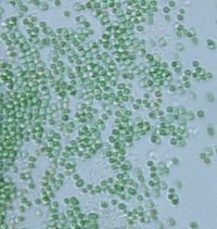
Norhierridin B, a New Hierridin B-Based Hydroquinone with Improved Antitumor Activity
Natural Product
GI₅₀ > 50 µM
In MDA-MB-231, SKBR3, MDA-MB-468,
A375, Huh-7, HCT116 cell lines
Cyanobium sp. LEGE 06113
Hierridin B
Synthetic Analogues
% of dead cells
p21 protein
Bax
1,4-benzoquinone
Norhierridin B
Bcl-2
GI₅₀ = 2.95-29.6 µM
GI₅₀ = 0.61-3.2 µM

Slide 3
Abstract:
Quinones/hydroquinones constitute a family of metabolites, widespread in nature, with a wide range of biological activities, including cytotoxicity to cancer cells [1]. Recently, hierridin B, a methylated hydroquinone derivative with a C15 aliphatic chain isolated from the marine picocyanobacterium Cyanobium sp. LEGE06,113 [2], was identified as moderate inhibitor of the growth of colon adenocarcinoma HT-29 cell line, with a GI₅₀ of 100.2 µM [2]. In order to obtain new structurally-related quinone/hydroquinone with improved antiproliferative activity in cancer cell lines, the demethylated hierridin B derivative, norhierridin, as well as structurally-related quinone, were synthesized and evaluated for their growth inhibitory effect in a panel of human tumor cell lines. Norhierridin B showed a great improvement of the antitumor activity when compared to hierridin and its structurally-related quinone with a potent growth inhibitory effect on all cancer cell lines, being the growth inhibitory effect on MDA-MB-231 cells associated with cell cycle arrest and apoptosis. Norhierridin B interfered with several p53 transcriptional targets, increasing p21, Bax, and MDM2, while decreasing Bcl-2 protein levels, which suggested the potential activation of a p53 pathway. Particularly, norhierridin B displayed a prominent growth inhibitory activity against TNBC cells, which are characterized by high therapeutic resistance.
Keywords: antiproliferative activity, hydroquinones, quinones
[1] Sunassee, N. and Davies-Coleman, T. Natural product reports, 2012. 29(5): p. 513-535. [2] Leão, P. et al. PLoS One, 2013. 8(7): p. e69562.

Slide 4
Introduction: Quinones and Hydroquinones
Quinones/ hydroquinones,
Family of metabolites widespread in Nature
wide range of biological activities
in vitro growth inhibitory effect against several human cancer cell lines
Natural quinones/hydroquinones with in vitro growth inhibitory effect against cancer cell lines:
GI₅₀ = 2.54- 11.32 µM
GI₅₀ = 2.21- 9.42 µM
GI₅₀ = 100.2 μM (HT-29 cell line)
isolated from Ardisia virens
isolated from Cyanobium sp. LEGE 06113, by CIIMAR research group
Chang, S. et al., Phytochemistry. 2009, 70, (17-18), 2064-2071.
Leão, P. et al., PLoS One. 2013, 8, (7), e69562.

Slide 5
Results and Discussion: Synthesis of quinones and hydroquinones with structure related with Hierridin B (3)
Scheme 1. Synthesis of norhierridin B (6). a) C₁₄H₂₉Br, Mg, Et₂O, 35 °C, 2 h; b) HCOOH, Pd/C, EtOH/H₂O, 80 °C, 4 h; c) O₂, salcomine, DMF, r. t., 24 h; d) Na₂S₂O₄, CHCl₃/H₂O, r. t., 10 min

Slide 6
Results and Discussion: Biological evaluation
Tumor cell growth inhibitory activity evaluation in Triple Negative Breast Cancer (TNBC) cell lines
Table 1. Effect of compounds 3-7 on the growth of human cancer cell lines.
 | GI₅₀ (μM)
Cell line/Compound | 3 | 4 | 5 | 6 | 7
MDA-MB-231 | >50 | 9.65±0.15 | 28.8±3.3 | 5.83±1.10 | 0.61±0.07
SKBR3 | >50 | 14.0±0.0 | >50 | 4.35±0.15 | 0.77±0.06
MDA-MB-468 | >50 | 7.85±2.15 | 31.00±7.00 | 6.65±0.90 | 0.68±0.13
A375 | >50 | 16.0±1.7 | 32.9±4.2 | 20.6±1.9 | 2.0±0.4
Huh-7 | >50 | 27.5±0.5 | >50 | 2.95±0.15 | 0.61±0.03
HCT116 | >50 | 26.5±0.5 | 26.0±3.2 | 29.6±0.5 | 3.2±0.6
Norhierridin B (7) showed to be the most effective against all cancer cell lines, exhibiting much lower GI₅₀ values than its methyl derivative hierridin B (3).

Slide 7
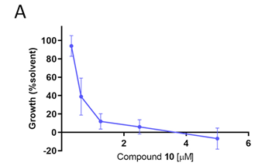
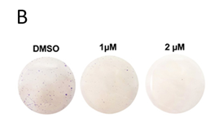
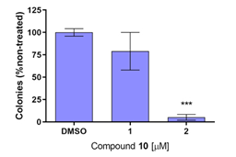
Results and Discussion: Biological evaluation
Tumor cell growth inhibitory activity evaluation
DMSO
1 µM
2 µM
Growth (% solvent)
Compound 7 [µM]
Colonies (%non-treated)
Compound 7 [µM]
Figure 2: Norhierridin B (7) inhibits the growth of breast adenocarcinoma MDA-MB-231 cells. (A) Dose-response curve for the growth of MDA-MB-231 cells treated with compound 7 for 48 h, determined by SRB assay; data are mean ± SEM of four independent experiments; growth obtained with vehicle was set as 100%. (B) Colony formation assay for MDA-MB-231 cells treated with compound 7 for nine days; images correspond to a representative experiment of two; graph represents mean ± SEM of two independent experiments; values significantly different from DMSO: *p < 0.05, unpaired Student’s t-test.

Slide 8
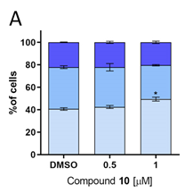
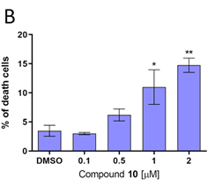
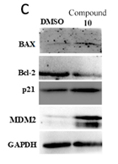
Results and Discussion: Biological evaluation
Tumor cell growth inhibitory activity evaluation
Compound
7
DMSO
BAX
% of cells
% of death cells
Bcl-2
p21
MDM2
Compound 7 [µM]
Compound 7 [µM]
GAPDH
Figure 3: Norhierridin B (7) induces cell cycle arrest and death and interferes with p53 transcriptional targets. (A) Cell cycle progression was analyzed after 48 h treatment with compound 7 in MDA-MB-231 cells; data are mean ± SEM of three independent experiments; values significantly different from DMSO: *p < 0.05, unpaired Student’s t-test. (B) Percentage of death cells determined by trypan blue assay for MDA-MB-231 cells treated with compound 7 for 48 h; data are mean ± SEM of three independent experiments; values significantly different from DMSO: *p < 0.05, **p < 0.001, unpaired Student’s t-test. (C) Protein expression levels of p53 targets in MDA-MB-231 cells was analysed by western blot after 48 h treatment with 2 µM compound 7. Immunoblots are representative of three independent experiments; GAPDH was used as loading control.

Slide 9
Conclusions
…was synthesized for the first time
…was the most effective in all cancer cell lines
…exhibiting much lower GI₅₀ values than its structural related quinone and hierridin B (3)
…the effects were associated with cell cycle arrest, increase of p21 and Bax and decrease of Bcl-2 protein expression levels
…could be an effective cytotoxic agent against TNBC cells, which deserve to be further explored in the future.

Slide 10
Acknowledgments
This research was partially supported by the Strategic Funding UIDB/04423/2020 and UIDP/04423/2020 (Group of Natural Products and Medicinal Chemistry, CIIMAR), and also UIDB/50006/2020 through national funds provided by the FCT—Foundation for Science and Technology and European Regional Development Fund (ERDF), within the framework of the program PT2020 and the project PTDC/SAU-PUB/28736/2017 (reference POCI-01-0145-FEDER-028736), co-financed by COMPETE 2020, Portugal 2020 and the European Union through the ERDF and by FCT through national funds. Joana Moreira and Joana Almeida acknowledge for their FCT grants (SFRH/BD/135852/2018 and 2020.05026.BD, respectively).

