Slide 1
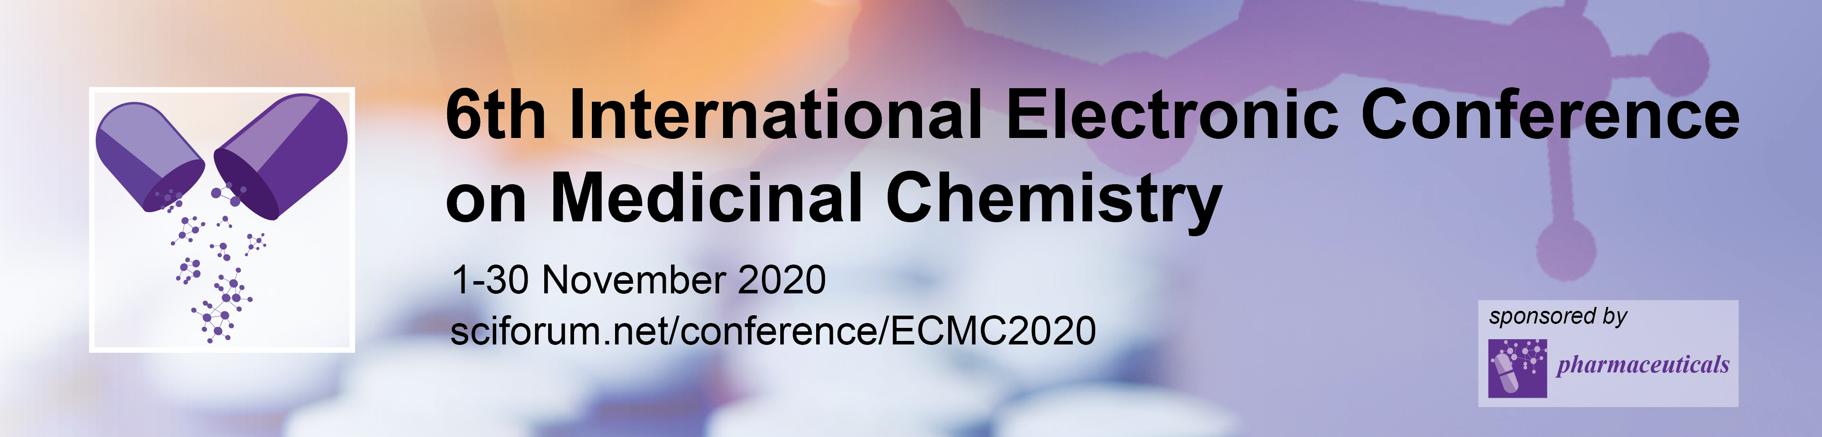

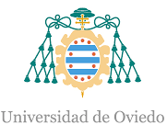
Synthesis and Biological Activity of C-Glycosyl
3-Vinylchromones: Toward Novel Antioxidant Drugs
Raquel G. Soengas ¹, Vera L. M. Silva ², and Artur M. S. Silva ^{2,*}
¹ Departamento de Química Orgánica e Inorgánica, Universidad de Oviedo, Julián Clavería 7, 33006 Oviedo, Spain;
² LAQV-REQUIMTE, Departamento de Química, Universidade de Aveiro, 3810-193 Aveiro, Portugal.
* Corresponding author: artur.silva@ua.pt

Slide 2
Synthesis and Biological Activity of C-Glycosyl
3-Vinylchromones: Toward Novel Antioxidant Drugs
Halochromones
+
Heck reaction
Sugar alkenes

Slide 3

Abstract
4H-Chromen-4-ones (chromones) are a well-known class of oxygenated heterocyclic derivatives widely distributed in Nature. Due to their impressive pharmacological potential, chromones have attracted much attention. The extensive search for chromone derivatives resulted in the discovery of 3-(2-phenyl-vinyl)chromones, a small family of naturally occurring chromones characterized by a potent antioxidant activity.
Naturally occurring chromones are usually glycosylated, which have a critical impact in their pharmacokinetics. Even though O-glycosyl chromones are more common, their C-glycosyl counterparts attracted much recent interest on account of their enhanced stability and bioactivity.
This study is aimed at the synthesis of a novel family of C-glycosyl 3-vinylchromones and the in vitro evaluation of their antioxidant activity.
Keywords: Chromones; Antioxidants, C-Glycosyl chromones.

Slide 4
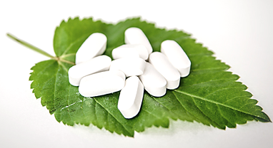
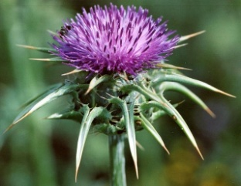
Introduction
The chromone structural unit
Interesting and broad biological activities:
Chromone core ubiquitous in natural products
Huge structural diversity
Antioxidant
Anti-inflammatory
Anticancer
Antifungal
Antiviral
Antimalarial
Hepatoprotective
Cardioprotective
Anti-allergic
…
Flavone
Privileged structural motifs in drug design
Chromone
Milk thistle
(Silybum marianum)
Impressive antioxidant and hepatoprotective activities
Isoflavone
Styrylchromone

Slide 5
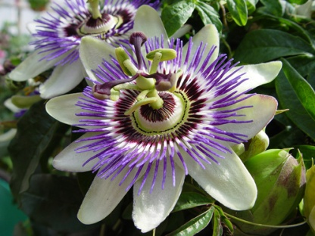
Introduction
C-glycosyl chromones
A pharmacological promising synergic effect…
Biological activities of phenolic compounds together with the high hydrophilic character of the sugar unit and the hydrolytic stability of the C-glycosidic bond
Passiflora incarnata
Enhanced stability towards enzymatic and chemical hydrolysis
Improved activity of the aglycones after their C-glycosylation

Slide 6
Results and Discussion
Synthetic Strategy
Palladium mediated C-C coupling strategy
Halochromones
+
Heck reaction
Sugar alkenes
3-(2-Glycosylvinyl)
chromone derivatives

Slide 7
Results and Discussion
Synthesis of Glycosylvinyl Chromones
48%
45%
(i) K₂CO₃, TBAB, Pd(OAc)₂, DMF, 100 °C, 12 h. (ii) TFA/H₂O (1:1), r.t., 12 h.

Slide 8
Results and Discussion
Synthesis of Glycosylvinyl Flavones
42%
(i) K₂CO₃, TBAB, Pd(OAc)₂, DMF, 100 °C, 12 h. (ii) TFA/H₂O (1:1), r.t., 12 h.

Slide 9
Results and Discussion
Synthesis of Glycosylvinyl Styrylchromones
41%
39%
(i) K₂CO₃, TBAB, Pd(OAc)₂, DMF, 100 °C, 12 h. (ii) TFA/H₂O (1:1), r.t., 12 h.

Slide 10
Results and Discussion
Synthetic Strategy
Wide scope Heck protocol!
New conjugates of chemical and biological interest containing unsaturated linking groups
By using the same methodology…
3-(2-Glycosylvinyl)chromones
3-(2-Glycosylvinyl)flavones
3-(2-Glycosylvinyl)-2-styrylchromones

Slide 11
Results and Discussion
Antioxidant activity
Structure | EC₅₀(µM) | Structure | EC₅₀(µM)
 | 16.9 ± 1.5 |  | >200
 | >200 |  | >200
 | >200 |  | >200

Slide 12
Results and Discussion
SAR for the antioxidant activity
No antioxidant activity
Strong antioxidant activity
Chromone unit
Catechol unit
Chromone unit
Catechol unit

Slide 13
Results and Discussion
Synthesis of a glycosylvinyl chromones with a catechol unit
(i) K₂CO₃, TBAB, Pd(OAc)₂, DMF, 100 °C, 12 h. (ii) HCl/TFA, r.t., 12 h.

Slide 14
Conclusions
The Heck cross-coupling reaction of halochromones with alkene sugars proved to be a straightforward synthetic C-glycosylation route;
The methodology is wide in scope as 3-(2-glycosylvinyl)flavones, chromones and 2-styryl-chromones were successfully synthesized;
The antioxidant activity of the C-glycosyl conjugates was evaluated;
Surprisingly, the obtained new conjugates were inactive;
On the study of the structure-activity relationship, we hypothesized that the lack of activity was related to the lack of a catechol unit;
A catechol-containing 3-(2-glycosylvinyl)flavone was then synthetized;
The next step would be the evaluation of the antioxidant potential of the obtained conjugates and the study of their structure-activity relationship.

Slide 15
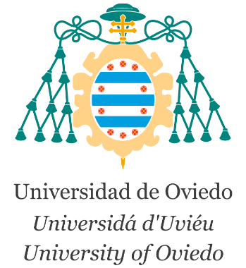
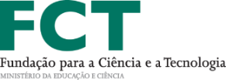


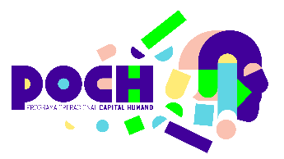

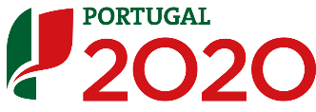
Acknowledgements

